Slide 1



Predicting Health Outcomes and Disease Risk Using Machine Learning
By Cheryl machingura

Slide 2
Data Sources & Key Features
primary dataset: "Heart Disease UCI dataset"
supplementary data: "National Center for Health Statistics (NCHS)"
Key Features: Age, cholesterol, blood pressure, etc.

Slide 3

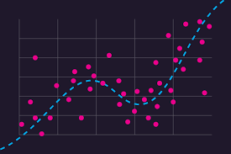
Models Used for Prediction
The first step was implementing a logistic regression model, serving as a baseline for comparison. Logistic regression is widely used in healthcare due to its interpretability, making it a valuable starting point for understanding the relationships between features and the likelihood of heart disease.

Slide 4
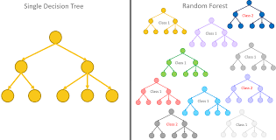
Models Used for Prediction
decision trees and neural networks were tested. Decision trees provided a transparent, rule-based approach, while neural networks aimed to capture more complex, non-linear interactions within the dataset. These models introduced a level of flexibility that logistic regression could not offer.

Slide 5
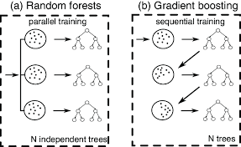
Models Used for Prediction
To further enhance predictive accuracy, ensemble methods such as Random Forest and Gradient Boosting were implemented. These models leverage multiple decision trees to create more robust predictions by aggregating insights from different weak learners. Random Forest proved to be highly effective in reducing overfitting while maintaining interpretability.

Slide 6
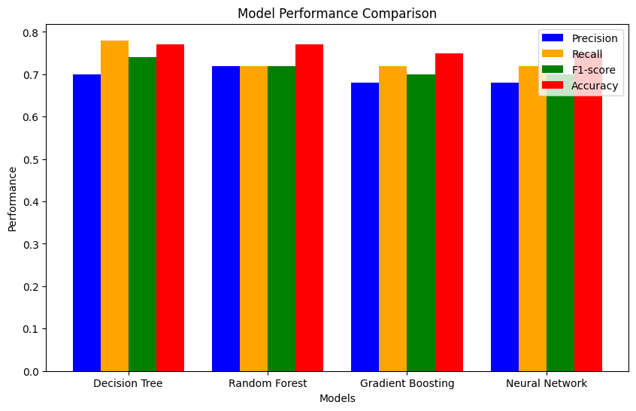
Model Performance Comparison
Comparison Table
Visual-Bar chart:
Model | Precision (Class 1) | Recall (Class 1) | F1-Score (Class 1 | Accuracy
Decision Tree | 0.70 | 0.78 | 0.74 | 77%
Random Forest | 0.72 | 0.72 | 0.72 | 77%
Gradient Boosting | 0.68 | 0.72 | 0.70 | 75%
Neural Network | 0.68 | 0.72 | 0.70 | 75%

Slide 7
Conclusion & Recommendations
Random Forest was the most effective model for predicting heart disease risk. I recommend using Random Forest for deployment in real-world healthcare applications because of its high performance and interpretability. Moving forward, we can further improve the model through hyperparameter tuning and bias mitigation to ensure fair predictions across different demographic groups. Additionally, external validation on larger, diverse datasets would help improve the model's generalizability.

Slide 8

Ethical Considerations
The potential for bias in the data, particularly with respect to gender and age distributions, must be carefully considered. Subgroup analyses will be used to ensure that the model does not unfairly favor one demographic over another, ensuring that the predictions are fair and equitable across all groups. Additionally, privacy compliance is critical, and data anonymization will ensure that the analysis adheres to HIPAA guidelines (HHS, 1996).
Model transparency Given the high stakes involved in predicting health outcomes, it is essential that the model's decisions are explainable to healthcare providers. Techniques such as SHAP (Lundberg & Lee, 2017) will be used to provide insights into how the model arrives at its predictions, building trust in the results and ensuring that healthcare professionals can confidently use the model to inform their decisions.

