Slide 1
Economic overview
As the world population and the demand for food continue to grow, global food security characterized by the accessibility, usability, and availability of food is becoming increasingly threatened by an array of factors, including the worldwide expansion and changing dietary preferences of the middle class, urbanization, diminishing natural resources, food price volatility, and inefficient labor and land use (WHO n.d.). Despite these challenges, the Food and Agriculture Organization of the United Nations ascertains that our planet has the capacity to sustain the expanding global population. Many farmers incur losses during postharvest .Many places where drought is prominent people are affected by Malnutrition diseases.
Primary data on the stressors was collected from detailed interviews with 30 farmers, vendors, from various parts of Kenya. Understanding which models are the most resilient to the various stressors would allow entrepreneurs to compare models and make more informed decisions about which models are most appropriate for their technologies. Most of these vegetables sold in open markets appeared fresh but were sold from poor environmental conditions. At times because of poor handling, their qualities were perceived to be poor, an issue that discouraged many potential buyers from consuming these products. The most commonly sold traditional leafy vegetables in Nairobi were Jute (‘mrenda’), Crotalaria (‘mito’), Solanum (‘osuga’/’managu’), Spider plant (‘saget’), Amaranth, pumpkin leaves, and African kale. The survey was conducted during the hot months (February/March) and therefore most of the vegetables were not available in large quantities.
Lastly, this technology being cheap and effective should be transferred to the local communities and women groups for preservation of seasonal vegetables like cowpeas. Together with it, the promotion for increased acceptability and consumption of the fermented and dehydrated vegetables should be done among the rural communities, where the deficiency of vitamin A and iron is likely to be rampant during the drought The most applicable method of drying includes freeze, vacuum, osmotic, cabinet or tray, ﬂuidized bed, spouted bed, Ohmic, microwave and combination thereof except for freeze drying, applying heat during drying through conduction, convection and radiation are the basic techniques used to force water to vaporize, while forced air is applied to encourage the removal of vapor. A large number of food and biomaterials are dehydrated in a variety of units with diverse processing conditions. The choice of drying method depends on various factors such as the type of product, availability of dryer, cost of dehydration and ﬁnal quality of desiccated product. Energy consumption and quality of dried products are other

Slide 2
critical parameters in the selection of a drying process. To reduce the use of fossil fuel, electrical energy is an alternate source of energy for drying applications especially where electricity is generated by a renewable energy source such as hydro power or wind power. Keeping these in view, the present review is focusing on recent developments in drying and dehydration and future scope for better drying. Malnutrition due to nutritionally inadequate diets is one of the major concerns in Kenya and many other developing countries. The vegetables are rich in vitamins especially A, B, and C, and minerals such as iron, zinc, calcium and phosphorus, thus helping curb malnutrition mostly in hunger stricken areas.

Slide 3
PRODUCT
Being in a country that has one of its major concerns as fighting malnutrition mostly in hunger stricken areas because the relief food from the government doesn’t contain all the nutrients required by the body, we decided to come up with a solution to the problem that we validated from the research we did by interviewing farmers and also vegetable vendors, which is building a hardware product that will be used to dry surplus vegetables from farmers to reduce post-harvest losses of their vegetables. After drying these vegetables we plan to package them in 500g plastic bags then deliver/sell them to NGOs so that they can be distributed to the hunger-stricken areas with the aim of providing a balanced diet to curb malnutrition. Our product will be able to meet different needs at the same time as our customers requested which is:-drying more than one farm produce at the same time with regulated temperatures, which after drying the farm produce will retain the same percentage of nutrients as fresh produce from the farm.
The hardware machine will be powered by solar. Using a solar panel, the power will be then transferred to batteries that have an adapter to convert energy. The power will be supplied to Arduino, then the Arduino transfers power to the fan. The hardware machine will also have temperature humidity sensor that measures the temperature to remain moderate for vegetable drying. This ensures that the temperature remains 150F - 180F.When the temperatures are higher than the maximum the fan is automatically turned on. This is to allow the temperatures to remain moderate to ensure that the vegetables don’t lose their nutrients
The vegetables will be picked from the farmers and packed carefully in crates neither too tight nor too loose in two bunches stalks facing different sides. The vegetables will then be weighed, loaded to our trucks then transported to our warehouse. After vegetables from different farmers arrive at the warehouse they will be offloaded then weighed again just to confirm that the weight given at the farm level is still intact. The vegetables will then be sorted and graded then weighed again according to their different grades, After which we will now engage in washing them clean and putting them in the machine for drying. After drying we will package the vegetables in 500g plastic bags then according to orders we deliver the vegetables to the respective NGOs

Slide 4
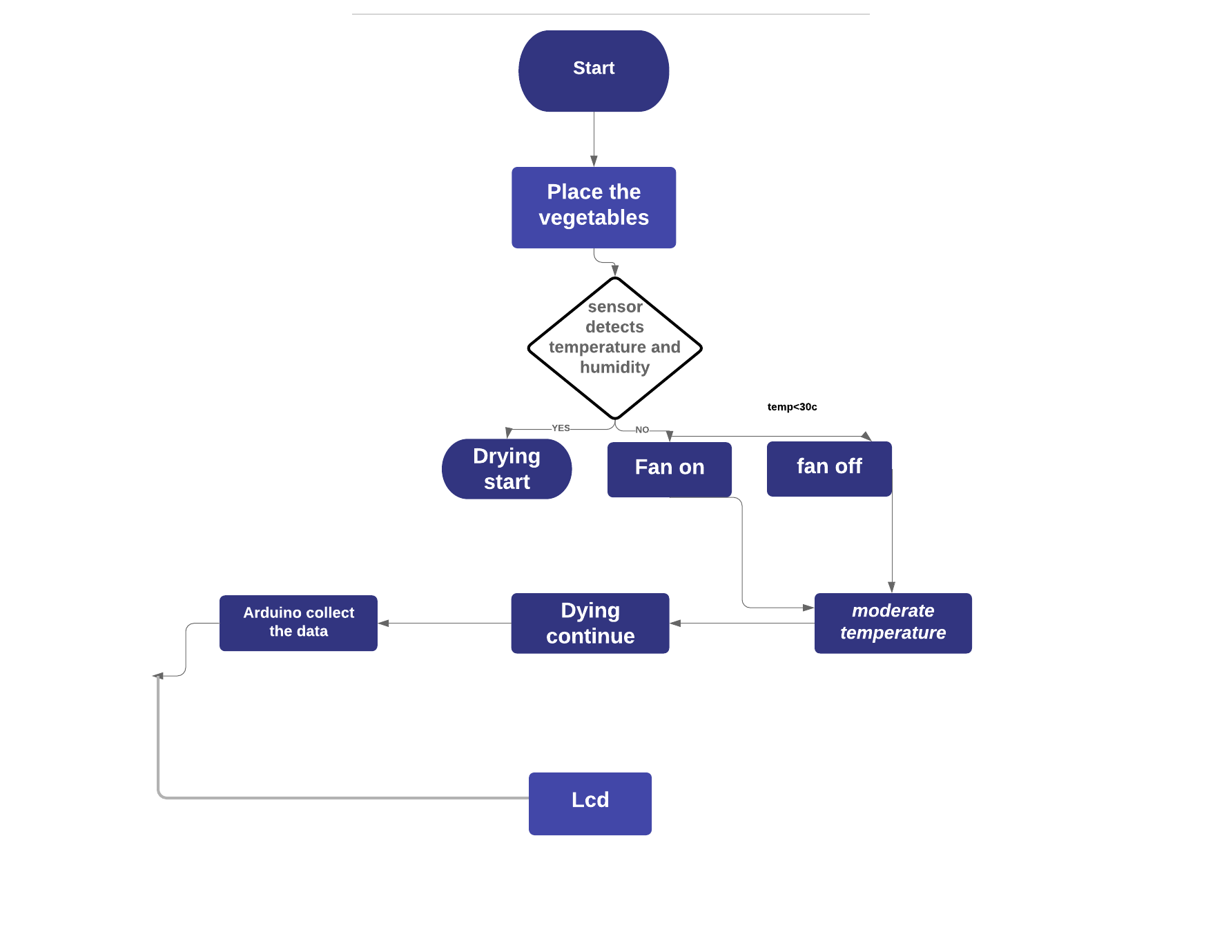
Product process

Slide 5

Product features

Slide 6
MARKETING RESEARCH
To have a better understanding of our customer we developed a persona. Our personas’ name is Helen. Hellene is a 43 years old woman located in Kahuho area and owns a 3 acre land that she plants vegetables and sells them to vegetable vendors for income because being a single mother, she has to provide for her kids. During vegetable surplus season Hellene gets so many vegetables That some end up becoming cows food. Helen also leaves her vegetables to rot in her farmer in times of surplus.
We have one confirmed NGO customer, Akothee foundations. We made a call at Akothee office and she confirmed that they really need vegetables in large quantities to supply in Turkana as it has been the company’s’ goal to provide food that not only makes the people full but also a meal that contains all the nutrients needed by the body.
Our customer number will grow by us marketing ourselves and also making sure that we deliver exactly what we promise to deliver or even better. This will b so if we the right procedure of drying our vegetables and making sure we do not exploit our customers.
We have several companies that are trying to solve the same problem we are solving but we have decided to settle with JKUAT as our competitors because they make the drying machine they use and they sell it to the farmers for drying the vegetable which is our future plan. They also dry vegetables on their own but the problem is they cannot dry small quantities because their machine is the size of a greenhouse thus making it expensive for farmers to purchase. JKUAT sells one machine at 180 million Kenyan shillings. Their machine is also not convenient because it requires to be operated manually. The advantage they have is that the machine uses solar meaning electricity cannot inconvenience the farmers while drying and also the machine is huge thus drying a large number of vegetables and saving time.

Slide 7
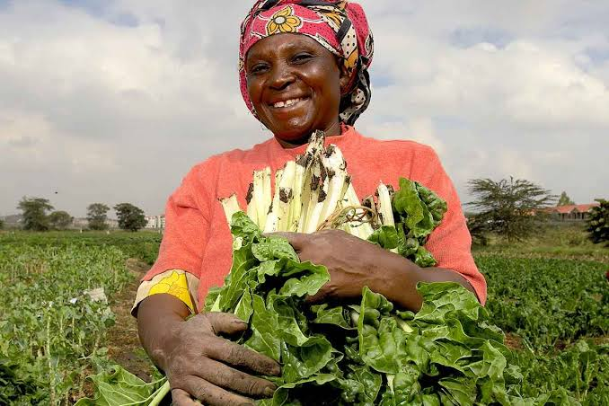
Market research & analysis
Name: Hellene Jana,
Age: 43,
Occupation: Full-time farmer,
Location: Kahuho,
No. of Employees: 2­­­­­ ,
Income: KSH 50,000,
Farm size:3 acres,
Type of farming: Mono-crop farming
Children:4
No of cows:2
Annual Expenditure on the farm: 400,000
Goal: "To provide for her family and ensure they are well educated”

Slide 8
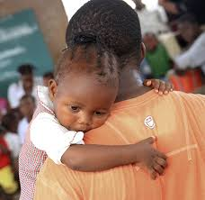
Business Model Canvas -
Name: Akothee Foundations ,
Location: Nairobi,
No. of Employees: 2,
Existence:3 years,
Goal: "lets make a difference in people's lives.”

Slide 9
Marketing Plan
Overall marketing strategy and main marketing channels
The mission of the company is to control the vegetable losses that farmers face. As a result, product life cycles may be quite short. Single-sourcing can be detrimental or even fatal to a company if the buyer supplier relationship is damaged or if the supplying company has financial difficulty. Competition from traditional paper calendars and other promotional items is strong.
Matching strengths to opportunities/ Converting weaknesses and threats.
Marketing Channels
1.Advertising through promotional items relies on gadgetry and ideas that are new and different.
2.Use of flyers to advertise the product.
3.Creating a website and enabling a Google Analytic plugin.
-This is to track the amount of people that login to the site and view its content.
4.A blog that will explain more about the product.
5.Partnering with the companies that do the same thing to help advertise the product to the market.
6.Having social media adds that enhance traffic to our sites.
7.Use Facebook click.
8.The use of social media influencers like chefs that advertise the value of the product.
9.Launching videos that give the explanation of a product and how it works and the nutritional value.
10.Pay for sections in supermarkets to be on top shelves.
-Hire a person to advertise for the product and give a price comparison with the competitors.

Slide 10
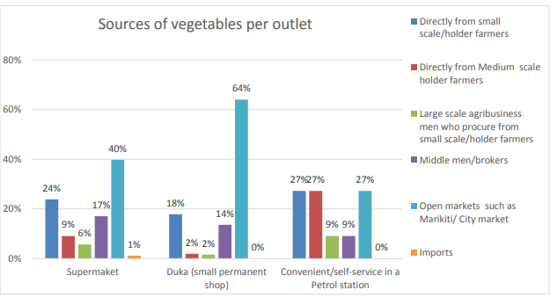
Previous successful marketing strategies
1.The use of social media influencers like chefs that advertise the value of the product.
2.Launching videos that give the explanation of a product and how it works and the nutritional value. 3.Partnering with the companies that do the same thing to help advertise the product to the market.
-The product will be able to reach the customers by attending summits that allows them to test the products and give offers to the customers.
4.Pay for sections in supermarket to be on top shelves and hire a person to Advertise for the product and give a price comparison with the competitors.
Pricing
By determining the sales of our competitors e.g.: Sundried sell indigenous vegetables at ksh.350 per 100g.
When the surplus is bulky, approximately buying vegetables worth ksh.50 will result in 2kg of these vegetables.
Sales statistics

Slide 11
Advertising and promotion
The company will use Informative advertising to give people the basic in formation about the product what it does and demonstration showing different ways in which the product is used .This will enable to capture interest, raise awareness, leave a positive impression, and motivate people to take the next step, like making a purchase or requesting more information about the product.
Creating segmentation on the market that enable user and customers to have bonus When buying or producing different quantity of vegetables. This will motivate the customers to produce more product an maintain growth. Paying a influencer to influence people to change brands, or motivate people to make a purchase. This might show the benefits a product offers or compare key features against a leading competitor.
Having a reminder to reassures people who already know and potentially like a brand, with a goal of keeping the product or service top-of-mind for future purchases. It reinforces messages from other ads, and may include customer testimonials.

Slide 12
Operating Hours
Veg dryer intends to operate Monday thru Friday from 9 am to 5 pm. The Company will be operational year round.
and Mrs. Marcy will be the sole employees of Veg dryer for the first two years of operation. When additional human resources are needed, Veg dryer has identified the persons qualified and able to assist on a contract basis for the same rate as the owner. They include:
Mr. Wes Aaron, and environmental engineering technician will be sub-contracted to complete work as needed. It is estimated that Mrs. Marcy will eventually be hired full time by Veg dryer once demand warrants growth.
Mrs. Hellen masai holds a Masters in medical Health Engineering and will also be sub-contracted to perform work for the company. Eventually, Veg dryer intends to hire Mrs. White full time.
Mr. marc Pearson holds a Bachelors of Science Degree in Agricultural Engineering and has a vast technical experience base in the environmental assessment area and will be retained when needed.
Once the business reaches 60% of its operational capacity this will represent 1300 hours, Veg dryer will offer the above environmental professionals full time positions. Also at this time, an administrative assistant will be sought.
Office Requirements and Asset Acquisitions
Computer
Office
3D
2 Table
8Seats
Machine for creating the Electronics code signing the product
Software's ,Fusion 360,Adobe illustrator ,adobe Photoshop,xd
Electronic components

Slide 13
Operation Plan
Searching business name | KSh 50
Registering a business | Ksh 2,500
licence | Ksh 10,000
Place of incubation | Ksh 90,000
Total Capital Costs The above noted capital purchases will increase work effectiveness, enhance professionalism and will prepare the business for the forecasted demand for services. Further, the equipment may be leased out to partner associates during times of low activity.

Slide 14
Operational Workflow
As with any vegetable drying companies, the operational workflow for the business is quite uniform and simple to follow. The following is a step by step outline of how process flows in a regular basis:
Step 1 Veg Dryer will respond to a request for proposal (RFP) with a professionally prepared proposal for service;
Step 2
Step 3
It is estimated that the length and terms of payments are net 30 for all clients. This will allow the business to avoid cash flow problems. Late payment charges are 2% of the products outstanding balance.

Slide 16
Operation Plan
Packaging
Buying vegetable
Purchase material
Marketing and selling
Sell product
Create the product
(Product)
Drying

Slide 17
Health insurance
General Liability and Property Insurance
Compensation Insurance
Liability Insurance
Business Income Insurance helps replace lost income if you must temporarily shut down your business because of a covered incident.
Employment contracts are not only a legal necessity, they can also help set the tone of your business. They are a great way to set out clear expectations for the employer and employee, laying the foundations for a mutually rewarding relationship. An employment contract should cover key areas such as pay, benefits, hours, holiday, sickness and termination.
Confidentiality agreement (Non-Disclosure Agreement)
An NDA is the first step to protecting your ideas and intellectual property when sharing confidential information with other individuals or businesses. It is the easiest and most common way of ensuring that this information is not made public or exploited in any way. It also means that in the eventuality of any breach of contract, you can take legal action to implement any solution needed to rectify or prevent further breaches and recover damages.
Partnership agreement
Avoid potential conflict when you enter into a partnership by having in place a detailed and complete partnership agreement of what is expected from each of the partners and how the business will be run under the new partnership. This document should cover who the partners are, their rights and responsibilities, and what will happen if and when they decide to leave the partnership.

Slide 18
Employment contracts are not only a legal necessity, they can also help set the tone of your business. They are a great way to set out clear expectations for the employer and employee, laying the foundations for a mutually rewarding relationship. An employment contract should cover key areas such as pay, benefits, hours, holiday, sickness and termination.
•Confidentiality agreement (Non-Disclosure Agreement
•An NDA is the first step to protecting your ideas and intellectual property when sharing confidential information with other individuals or businesses. It is the easiest and most common way of ensuring that this information is not made public or exploited in any way. It also means that in the eventuality of any breach of contract, you can take legal action to implement any solution needed to rectify or prevent further breaches and recover damages.
•Partnership agreement
•Avoid potential conflict when you enter into a partnership by having in place a detailed and complete partnership agreement of what is expected from each of the partners and how the business will be run under the new partnership. This document should cover who the partners are, their rights and responsibilities, and what will happen if and when they decide to leave the partnership.

Slide 19
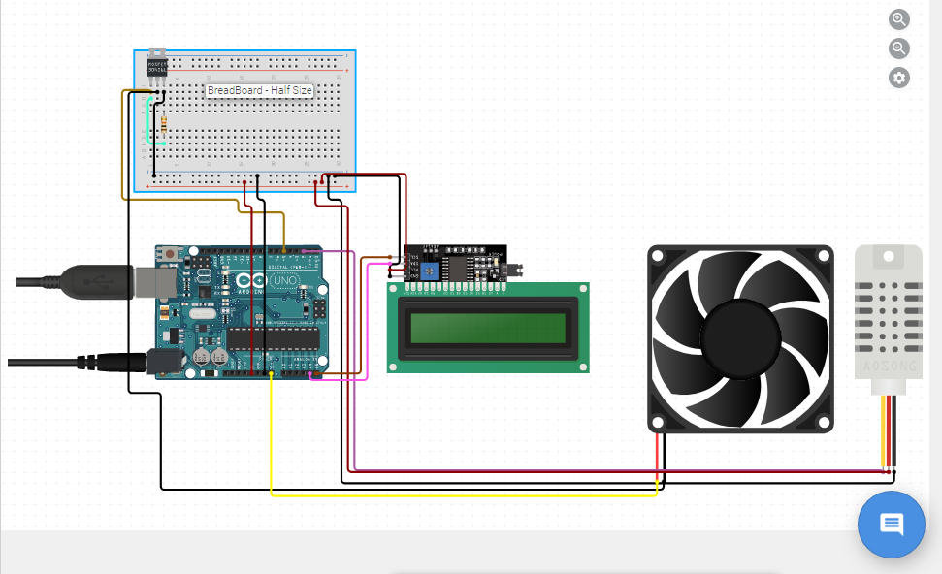

Slide 20
The process of identifying the problem and possible solution. Creating a suitable solution to the problem. By identifying the problem and coming up with different solution .The process of creating the solution started with research ,Where we interview different farmers who where the main source of validating that there is need of solving the problem in the market. We decided to come up with a solution of creating a solar dryer that will enable farmer to dry there vegetable in the right condition and temperature. The product started with creating a flowchart of component. Link to the component flow.
https://docs.google.com/document/d/18sloYI21L3dBR4tekCklNeGP-nKL81_HxwjiPRM9JkQ/edit?usp=sharing
Designing and placing of component .The product will be using DHT22sensor to sense Humidity and temperature to ensure the Condition are maintain for proper and healthy drying.
Fan will be used to regulate the temperature. When the temperature are high the fun will automatically be turned on ,this will allow the supply of air to regulate the temperature to ensure the nutrient are retained during drying maintain healthy .

