Slide 1
CHECK YOUR CITY

Slide 2
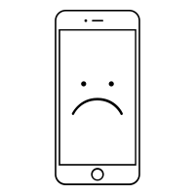

PROBLEM
COVID-19 CONTINUES TO BE A GLOBAL PROBLEM EVEN THOUGH VACCINATION EFFORTS ARE UNDERWAY TO CONTROL ITS PROPAGATION

Slide 3
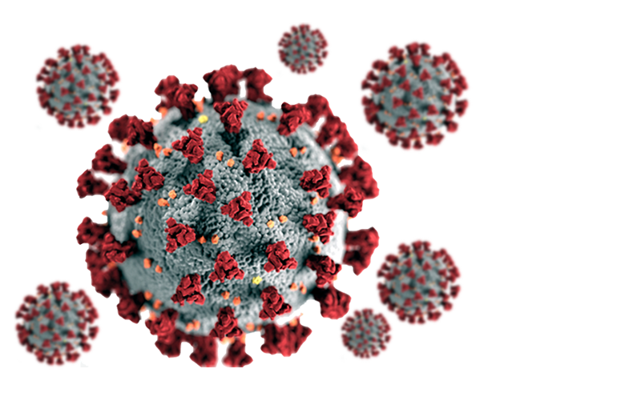
STATEMENT
BUILD A SMARTPHONE APPLICATION THAT PROVIDES INDIVIDUALIZED, GEOLOCATED, COVID-19 RISK WARNINGS TO GUIDE SOCIAL AWARENESS, RESPONSE, AND HEALTH SECURITY
Notes:
TO USE ENVIRONMENTAL DATA AND OTHER INFORMATION (SUCH AS EPIDEMIOLOGICAL, SOCIAL, POLICY, AND ECONOMIC DATA) TO BUILD A SMARTPHONE APPLICATION THAT PROVIDES INDIVIDUALIZED, GEOLOCATED, COVID-19 RISK WARNINGS TO GUIDE SOCIAL AWARENESS, RESPONSE, AND HEALTH SECURITY

Slide 4
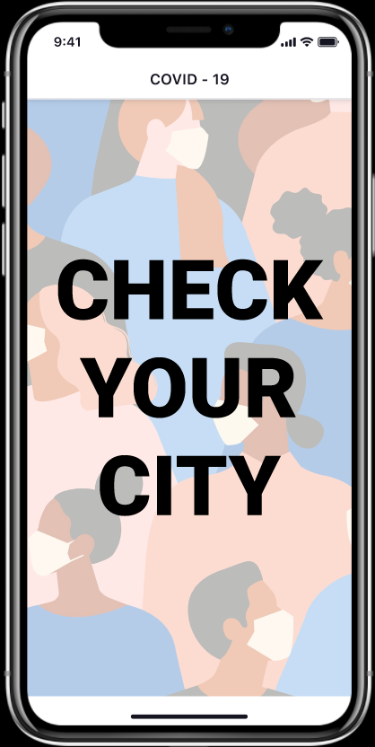
SOLUTION
WE CREATED A SIMPLE WEB APPLICATION WITH A MOBILE VIEW FOR EASY CHECK HEALTH WARNINGS IN YOUR AREA VIA PYTHON, FLASK FRAMEWORK, AND GEONAMESCACHE LIBRARY TECHNOLOGIES FOR OUR PROJECT

Slide 5
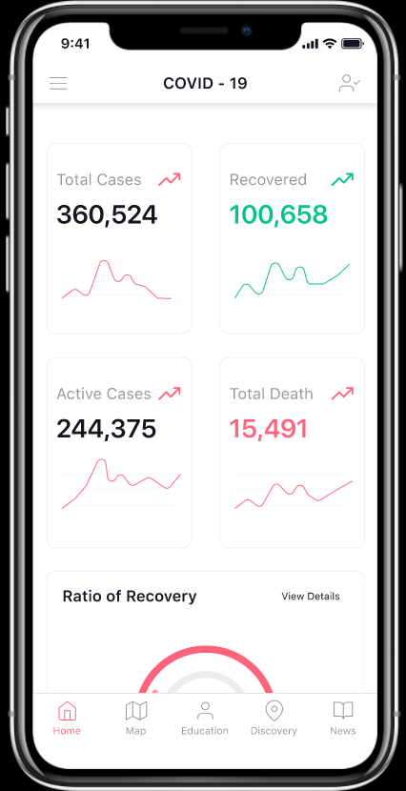
SPACE TO GROW
ADD NEW FUNCTIONALITY
TEACH HOW EVERYTHING WORKS (SUCH WHAT IS ACTIVE CASES, WHAT IS COVID-19…)
ADD ABILITY TO SEE GLOBAL STATISTICS

Slide 6
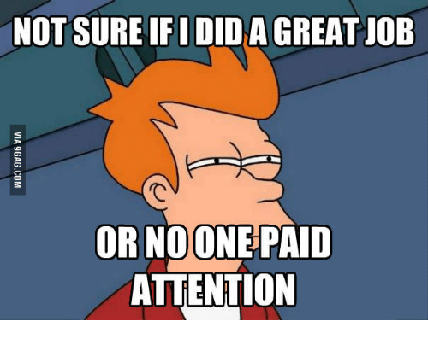

THANKS FOR ATTENTION

