Slide 1
Socket Programming Project: IP Network Emulation
Jaehoon (Paul) Jeong
pauljeong@skku.edu

Slide 2
Project Objectives
To Understand the IP Networking
IP Addressing
IP Address Classification
IP Subnetting by Network Masking
IP Routing Protocol
Distance Vector Routing Protocol (e.g., RIP)
IP Packet Forwarding
Address Resolution Protocol (ARP)
Domain Name Service (DNS)

Slide 3
IP Packet Routing
IP Packet
IP Packet
The shortest path between Host 1 and Host 2: <Host 1, Router 1, Router 2, Router 3, Host 2>

Slide 4
Packet Formation in the Protocol Stacks
Simplified Protocol Stacks
Application Layer
Encapsulation
Application Data
IP Layer
IP Header
Application Data
Ethernet Layer
Ethernet Header
IP Header
Application Data
Decapsulation

Slide 5
Packet Transmission Procedure in the IP Host
DNS Resolution
Resolve the host DNS name into the corresponding IP address by DNS Resolver.
Decision of Next Hop
If the destination IP address has the same network address as its own one, then
Decide the MAC address of the destination host by ARP.
Otherwise,
Decide the MAC address of the default router by ARP.
Transmission of the Ethernet Frame
Send the Ethernet Frame including IP Packet.

Slide 6
Routing Decision in the IP Router
Receiving an IP Packet
If the IP Packet is the routing info, then
Update the routing table and forwarding table.
Send the updated routing information to its neighbors
Otherwise,
Forward the IP Packet to the appropriate next hop with its forwarding table.
The appropriate MAC address of the next hop is determined by ARP.

Slide 7
Distance Vector Routing Protocol (DV)
DV is based on Bellman and Ford’s shortest path algorithm.
The difference
Bellman and Ford’s algorithm is performed with the complete network topology.
DV is performed with the partial network topology and is continuously updated with the neighbors’ routing information.

Slide 8
Template Codes
Files
README explains the files and how to compile and run the programs
host.c contains source code of host program
hub.c contains source code of hub program
router.c contains source code of router program
utils.c utilities used by all the programs
common.h common macros and function prototypes
dist-vec.h header file for distance vector routing protocol
dist-vec.c functions for handling distance vector routing protocol
Makefile.template template file for generating a Makefile with 'Configure' shell script according to the operating system, such as Linux and SunOS
host host executable in Linux
hub hub executable in Linux
router router executable in Linux
ip-addr.conf configuration file for the IP address assignment for hubs, routers, and hosts
mac-addr.conf configuration file for the MAC address assignment for routers and hosts
gateway.conf configuration file for configuring default gateway at hosts

Slide 9
Network Topology constructed by the configuration files

Slide 10
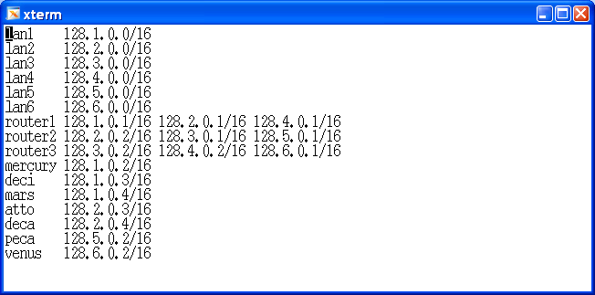
ip-addr.conf

Slide 11
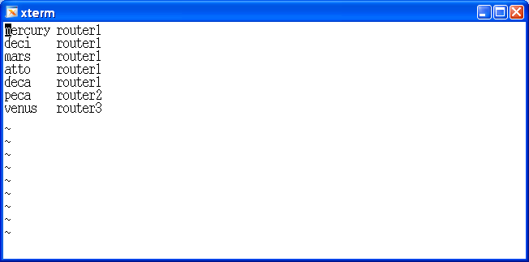
gateway.conf

Slide 12
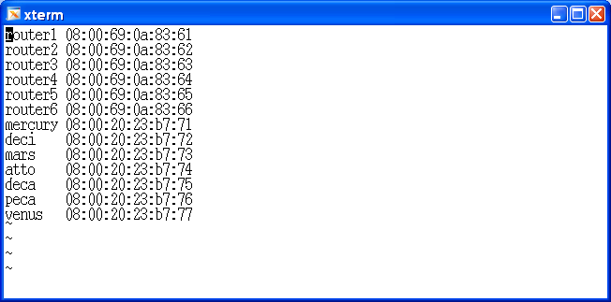
mac-addr.conf

Slide 13
Testing Scenarios
Single LAN Scenario
Two LANs Scenario
Multiple LANs Scenario

Slide 14
Single LAN Scenario

Slide 15
Two LANs Scenario

Slide 16
Multiple LANs Scenario (1/2)

Slide 17
Multiple LANs Scenario (2/2)

Slide 18
Grading Policy
1. Design document (20%)
2. Routing table exchange through DV routing protocol (20%)
3. Establishment of a routing table in each router (10%)
4. Establishment of a forwarding table in each router (10%)
5. Routing of IP packet from a source host to a destination host (10%)
6. Dynamic update of routing tables in routers by the router insertion and deletion (15%)
7. Detection and advertisement of link breakage (15%)

