Slide 1
RAAH DARSHINI
A CO-PILOT TO NAVIGATE VISUALLY IMPAIRED PEOPLE

Slide 2
INSPIRATION
Computer Vision has been used to make our life easy, but can also be used to help people who are visually impaired or blind.
“Obstacle detectors for visually impaired people” a paper published in the 2014 OPTIM Conference of IEEE served as an inspiration for this project.
Moreover with the current scenario of high traffic and use of physical navigation, great advancements were necessary.

Slide 3
IDEA
The main idea behind the project is to help blind people. We’ve observed that they are always dependent on other people to help them find their way. With Raah Darshini, we aim to help these people become independent. Raah Darshini can detect obstacles in the person’s way and hence guide them accordingly.
We use audio cues to guide the person to the correct or obstacle free path. In further development we intend to use a physical device that would correct the path in certain circumstances.

Slide 4
IMPLEMENTATION
We detect the obstacle and after detecting the object, navigation path are given to the user. For being economical we use a camera feature instead of relying on acquired help like guide dogs.
We’ve used the Single Shot Detector (SSD) which provides a good balance between speed and accuracy since the project would work on real-time implementation. The COCO dataset is used for the objects.
Currently the application works on audio cues.

Slide 5
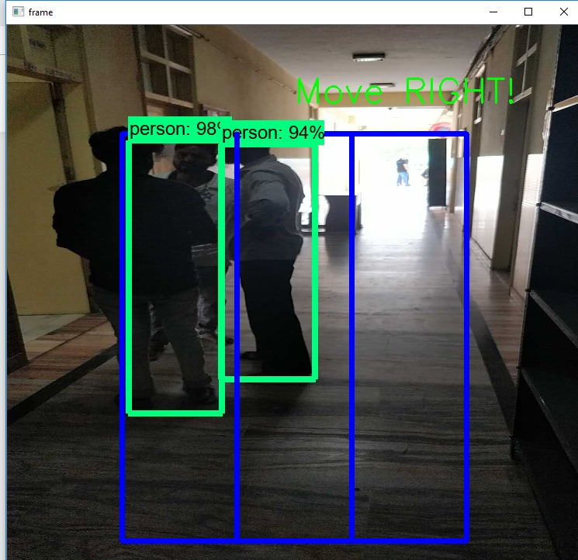
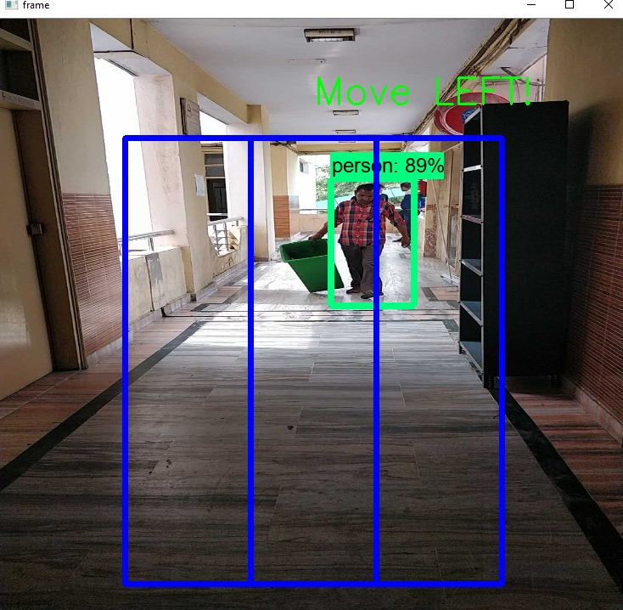
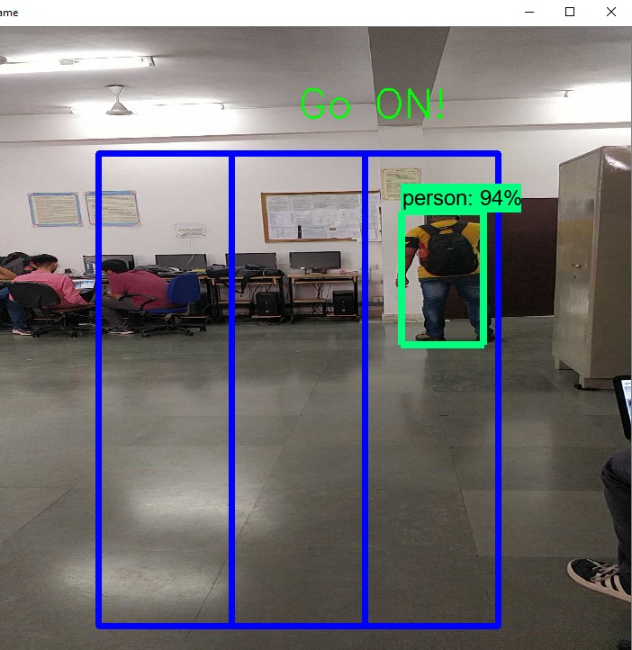
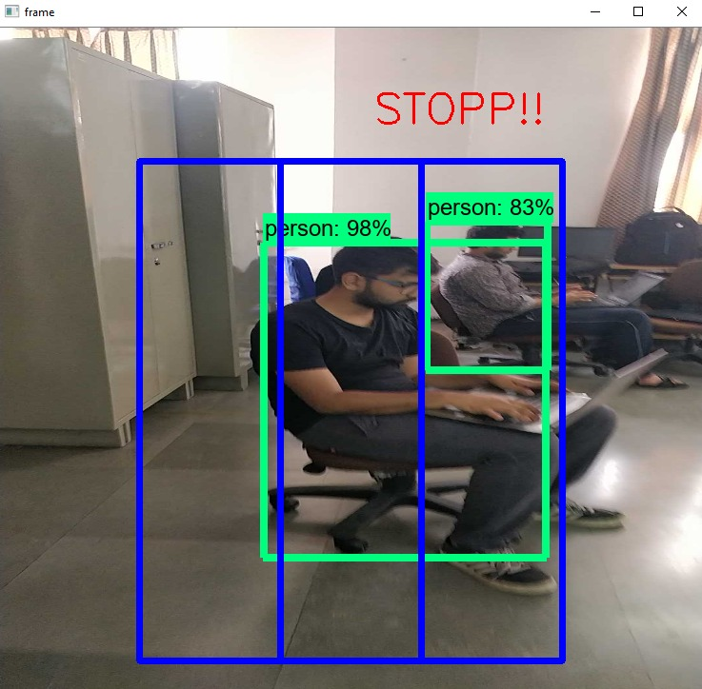

Slide 6
BUSINESS PROSPECTS
Of the 37 million people across the globe who are blind, over 15 million are from India.
Our developing country is not yet prepared to handle such situations that require sociological and economical expenditure.
With our product, we aim to organize with various NGOs as well as communities to provide an economical solution which can be implemented with ease.

Slide 7
BUSINESS STRATEGY
Initially we’ll launch a mobile application that would inquire no cost. This would provide an early assessment of our target audience and the scope of the application.
Our main product highlights would be the highly economical use of devices which altogether reduces the cost as compared to when being made by analog devices which would require high maintenance.
After an initial assessment and market research we would launch our second and third products into the market which would be “Immersive Glasses” and a highly productive walking stick.
Our main product assessment and recognition would be by these devices whose services would be billed quarterly.

Slide 8
INITIAL STAGE MOBILE APP
Market Research
ANALYSE MARKET
After 6-8 month of market research
IMMERSIVE GLASSES
INTERACTIVE STICK
FEEDBACK AND IMPROVEMENTS
TESTING FEEDBACK IMPLEMENTATION
RESEARCH & ENHANCEMENTS

Slide 9
REVENUE MODEL
Our major source of income comes through the software updates, patches and renewal of subscriptions.
The price of the equipment is determined taking in effect numerous factors such as the cost of hardware, material used, usability, target audience and profit.
We have thought that our idea would be in collaboration with certain NGO’s which would provide a part of subsidiary to people.

Slide 10
THANK YOU

