Slide 2
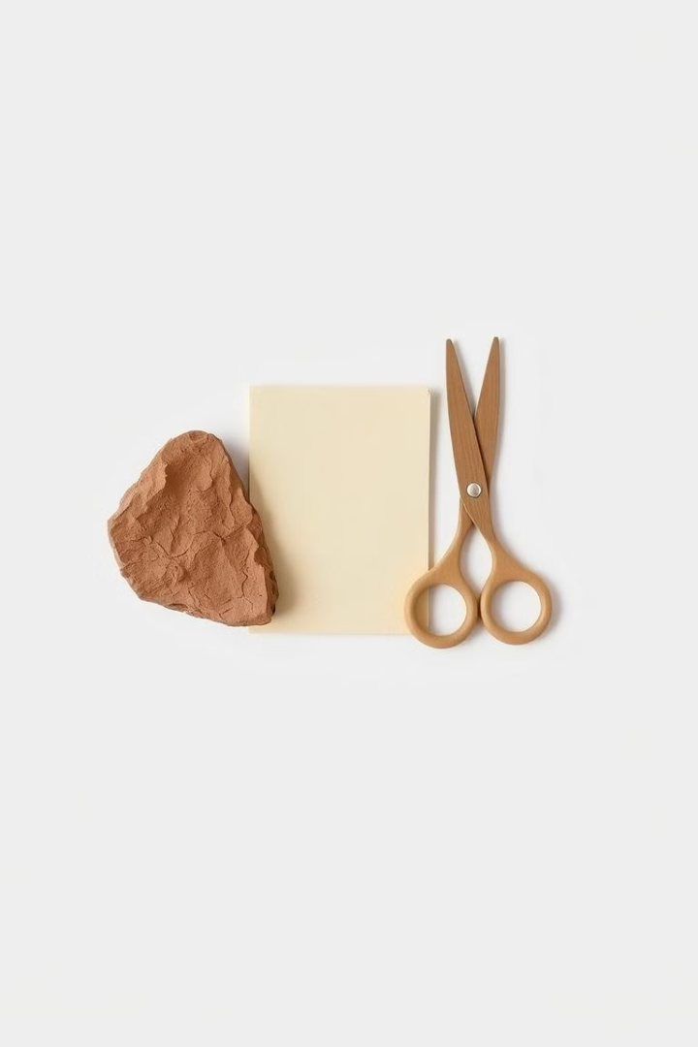
Rock Paper Scissors Game using Frontend Technologies
Develop an interactive "Rock Paper Scissors" game using HTML, CSS, and JavaScript.

Slide 3
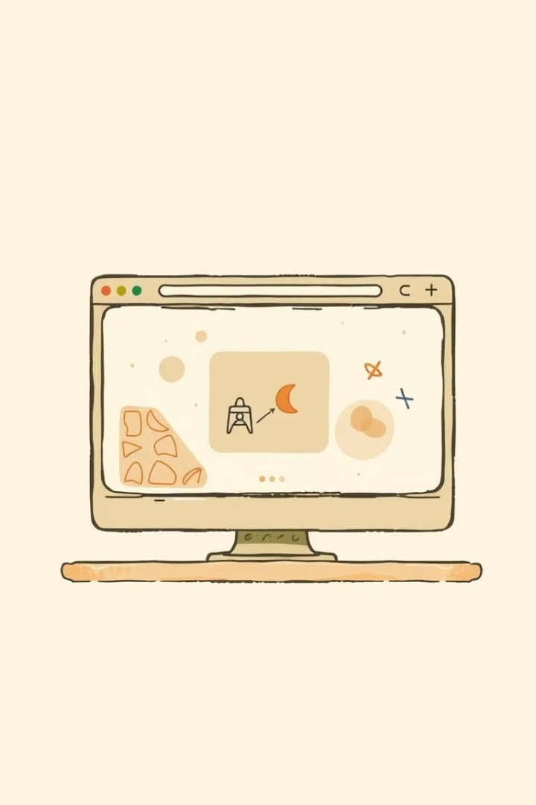
Project Overview
1
Browser-based Game
Create a simple "Rock Paper Scissors" game for web browsers.
2
Frontend Concepts
Utilize HTML, CSS, and JavaScript to demonstrate key frontend skills.
3
Engaging Experience
Provide an interactive and visually appealing user experience.

Slide 4

Scope of the Project
Interactive Game
User vs. Computer
Responsive Design
Playable "Rock Paper Scissors" game on web browsers.
Allow users to play against a computer opponent.
Maintain a user-friendly experience on desktop and mobile.

Slide 5

Project Objectives
1
Demonstrate Frontend Skills
Create a fun and interactive game to showcase abilities.
2
Design Clean UI
Practice designing a simple and visually appealing interface.
3
Implement Game Logic
Use JavaScript to determine the outcomes of the game.
4
Provide Responsiveness
Ensure a user-friendly experience across different devices.

Slide 6
Programming Languages
HTML
CSS
JavaScript
Structure the game interface layout.
Design the visual appearance and styling.
Implement the game logic and functionality.
Create buttons, titles, and result display.
Implement responsive layout and animations.
Handle user input and determine outcomes.

Slide 7




User Interface Design
HTML Layout
CSS Styling
JavaScript Interactivity
Buttons for user choices, result area.
Aesthetics, button effects, responsive layout.
Handle user actions, determine game results.

Slide 8

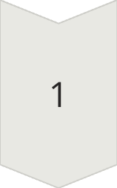
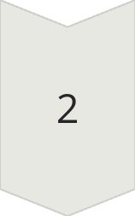
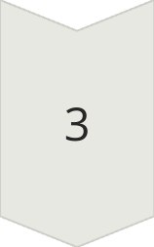
Implementation Steps
HTML Structure
Create game elements like buttons and result display.
CSS Styling
Enhance aesthetics and make it mobile-friendly.
JavaScript Logic
Implement functions to handle user actions and outcomes.

Slide 9
Code Snippets
HTML Example
JavaScript Example
<h1>Rock Paper Scissors</h1> <button>Rock</button> <button>Paper</button> <button>Scissors</button> <div id="result"></div>
function play(playerChoice) { const choices = ['rock', 'paper', 'scissors']; const computerChoice = choices[Math.floor(Math.random() * choices.length)]; let result = determineWinner(playerChoice, computerChoice); document.getElementById('result').innerText = `You chose ${playerChoice}, Computer chose ${computerChoice}. ${result}`; } function determineWinner(player, computer) { // Game logic to determine the winner }

Slide 10

Testing and Debugging
Testing
Verify button functionality, cross-browser compatibility, and responsiveness.
Debugging Tools
Use browser developer tools and console.log for troubleshooting.

Slide 11
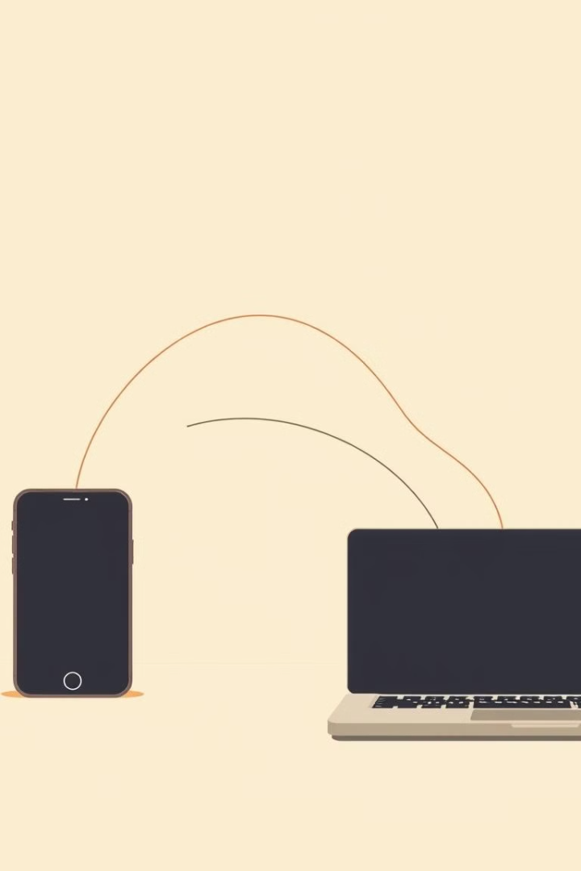
Deployment and Feedback
1
Deployment
Host the game on GitHub Pages or other free services.
2
User Feedback
Collect feedback from users and consider improvements.

