Slide 1
Computer Vision project Solve sudoku from AN image
Asatryan Sona

Slide 2
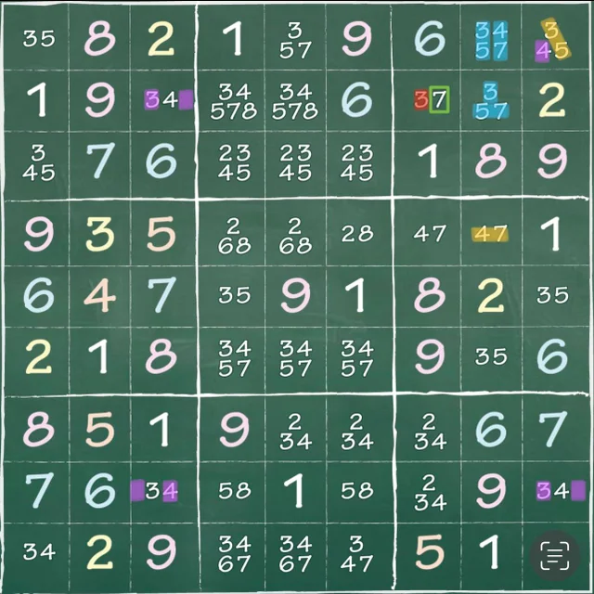
Agenda
Problem definition
Digit classification
Obtain Sudoku matrix from an image
Solve Sudoku puzzle
Q&A

Slide 3
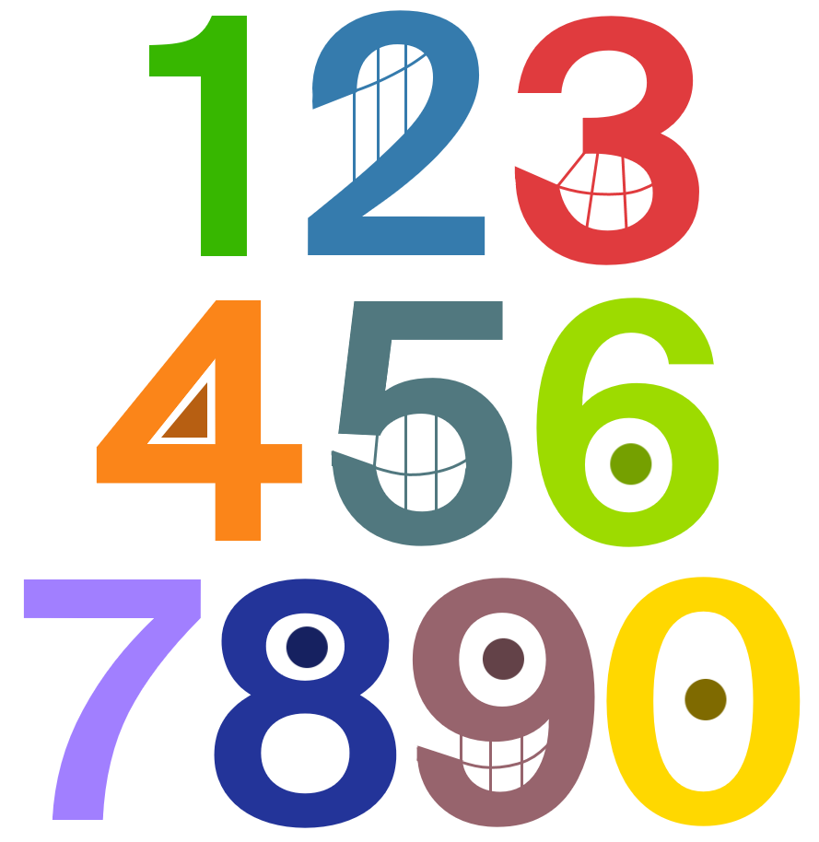
Problem Definition
Solve a sudoku from an image
Project has 3 parts:
Digit Classification
Detecting And Reading The Sudoku From An Image
Solving The Puzzle
Used Chars74K dataset for digits classification model
Classify the digits from an image
Getting the values of the cells in the sudoku and convert it to matrix
Solve sudoku puzzle using recursion

Slide 4
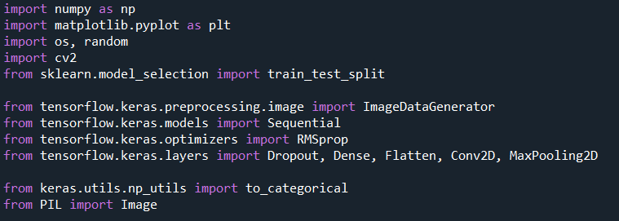
Used Libraries

Slide 5
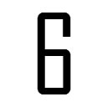
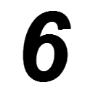
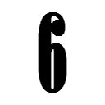
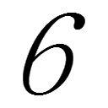
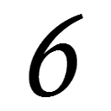
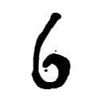
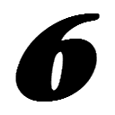
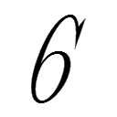
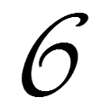
Digit classification
Loading Data
Converting images into arrays (32x32)
Labeling the data
Splitting The Test Train And Validation Sets
Train/Test split size is taken 0.05
Validation split size is taken 0.2
Training Set Shape = (7721, 32, 32, 3)
Validation Set Shape = (1931, 32, 32, 3)
Test Set Shape = (508, 32, 32, 3)
Preprocessing The Data
Convert image to grayscale
Histogram equalization to enhance contrast (cv2.equalizeHist)
Normalizing (img/255)
Data Augmentation using Keras ImageDataGenerator
width_shift_range=0.1
height_shift_range=0.1
zoom_range=0.2
shear_range=0.1
rotation_range=10
One-Hot encoding of the labels
Examples from digits dataset

Slide 6
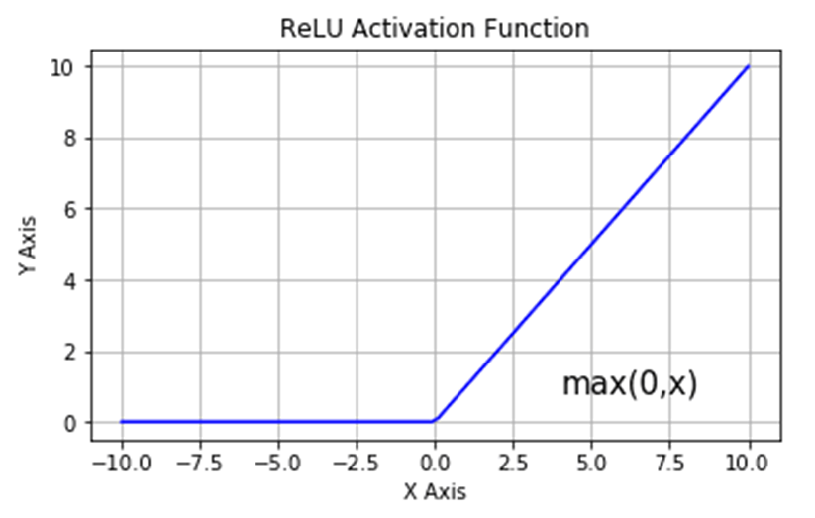
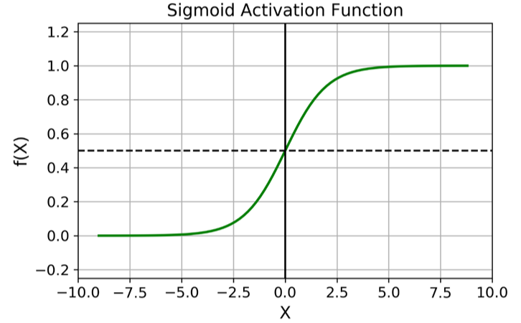
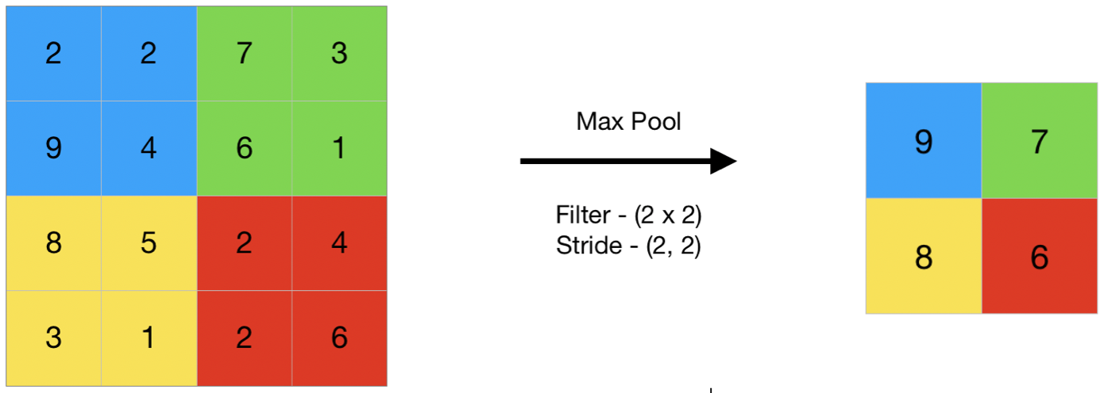
Digit classification. Model Building
We will use CNN (Convolutional Neural Network or ConvNet)
Initializing the CNN
Adding hidden layers
Conv2D, with ReLU activation function
Conv2D, with Sigmoid activation function
MaxPooling layer
2x2
Conv2D, with ReLU activation function
MaxPooling layer
2x2
Dropout
Rate = 0.5
Dense layer with Softmax activation function
Flatten
Dense layer with Sigmoid activation function
Dropout
Rate = 0.5

Slide 7
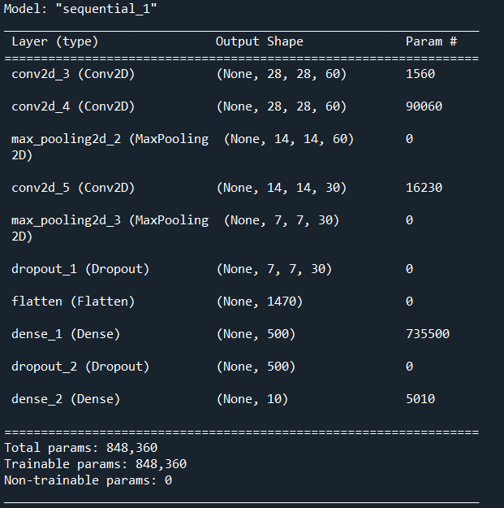
Digit classification. Model Building
Model summary
Compiling the CNN model
Optimizer: RMSprop (Root Mean Squared Propagation)
Learning rate: 0.001
Loss: categorical cross-entropy
Metrics: accuracy
Train the CNN model
Epochs: 30
Test Accuracy = 0.998031497001648
Train Accuracy = 0.9966325759887695
No overfitting!

Slide 8
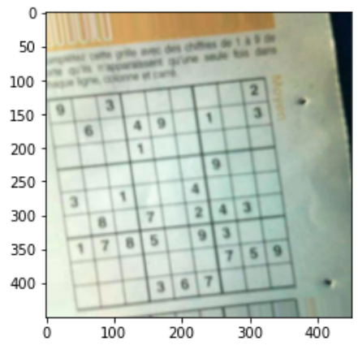
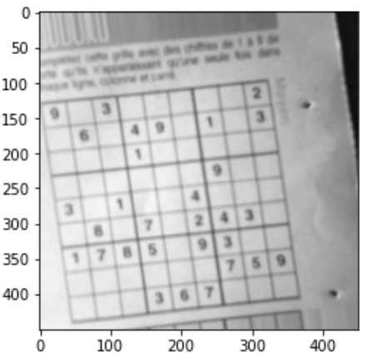
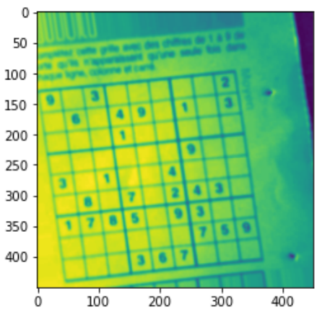
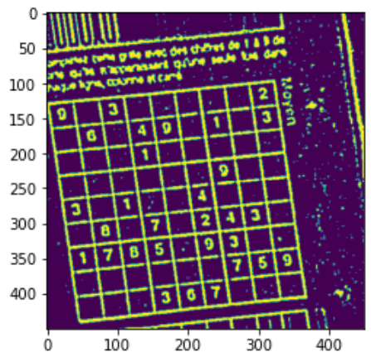
Obtain Sudoku matrix from an image
Read a random image from dataset and preprocess to detect the biggest contour
Grayscale
Gaussian Blur
Threshold
Pick a random image
Used modules:
cv2.cvtColor(sudoku_img, cv2.COLOR_BGR2GRAY)
cv2.GaussianBlur()
cv2.adaptiveThreshold()

Slide 9
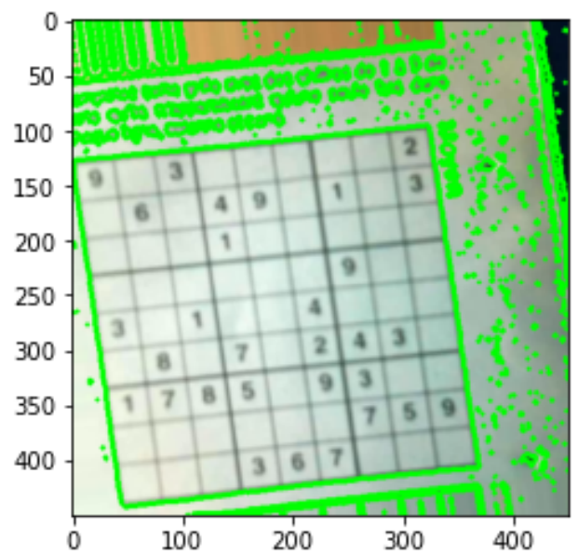
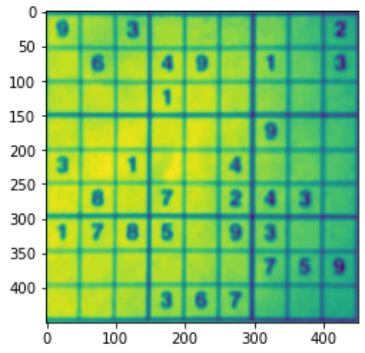
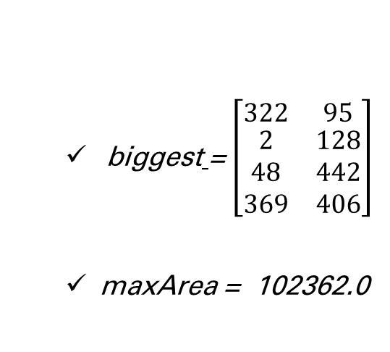
Obtain Sudoku matrix from an image
Detect the biggest contour of the image and reshape the outline
biggest = $\left[\begin{matrix}322 & 95 \\ \begin{aligned}2 \\ 48 \\ 369\end{aligned} & \begin{aligned}128 \\ 442 \\ 406\end{aligned}\end{matrix}\right]$
maxArea = 102362.0
Used modules:
cv2. findContours(image, cv2.RETR_EXTERNAL, cv2.CHAIN_APPROX_SIMPLE)
cv2.getPerspectiveTransform(pts1,pts2)
cv2.warpPerspective(sudoku_img,matrix,(450,450))
cv2.cvtColor(imagewrap, cv2.COLOR_BGR2GRAY)

Slide 10
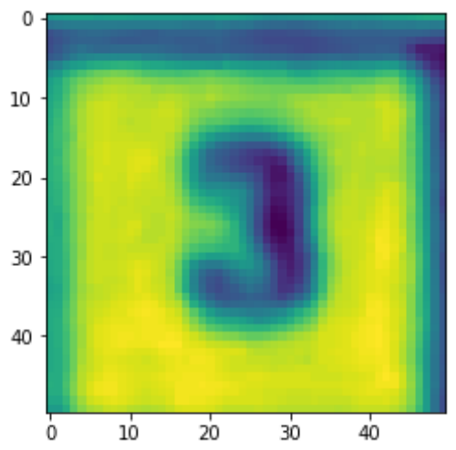
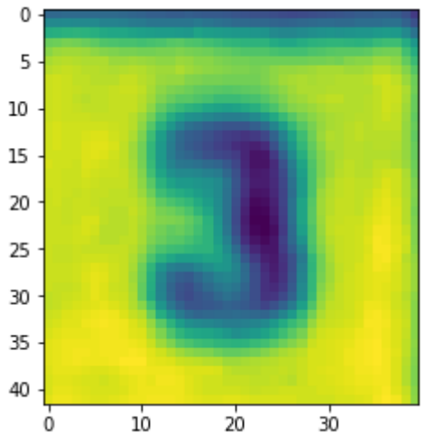


Obtain Sudoku matrix from an image
Splitting the sudoku box into 81 cells and cropping them
For splitting cells used vsplit and hsplit from numpy package
Removed 3 pixels from each side for every cell. This is useful for a better digit classification.
Before image crop
After image crop

Slide 11
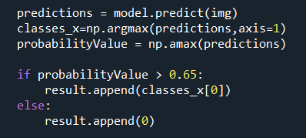
Obtain Sudoku matrix from an image
Using the model to classify the digits in the cells and form an array of 81 digits
Pass each cell through CNN model
Make predictions
Classify the digit with label, which probability is more than 0.65
result = [[9 1 3 0 0 0 0 0 2]
[0 6 0 4 9 0 1 0 3]
[0 0 0 1 0 0 0 0 0]
[0 0 0 0 0 1 9 0 0]
[3 0 1 0 0 4 0 0 0]
[0 8 0 7 0 2 4 3 0]
[1 7 8 5 0 9 3 0 0]
[0 0 0 0 0 0 7 5 9]
[0 0 0 3 6 7 0 0 0]]

Slide 12
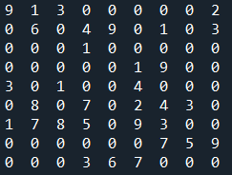
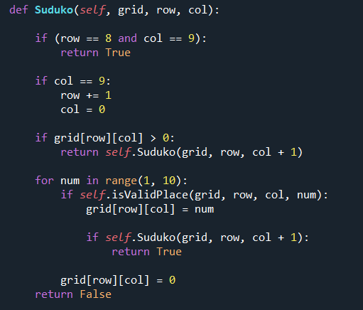

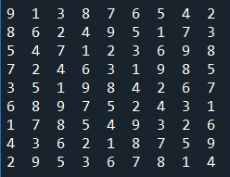
Solve Sudoku puzzle
Reshaping the array into a 9 x 9 matrix
Solving the matrix using recursion

Slide 13

Q&A

