Slide 1
“HYPER ACCEL”
Game Project Presentation- Gameloft intern team
Thinh,Quang
March 2023

Slide 2
Presentation Structure
Project Introduction
Team Introduction & Credits
Game Analysis & Demo
Advantages/
Disadvantages
Q&A
Overview of our project
Introduction of our team and crediting
Detailed rundowns of our game’s mechanics and game demo
Advances and drawbacks in the development flow
Questions and Answers
Further developments
Ideas for further development
Notes:
We are near the end of this event, so I will cover how you might transition the idea you have developed here into a full project.
This might sound boring and not very 'hack-ish', but these are just tips to enable your project to be more flexible in the long run.
Following these tips early on could be the difference between a successful and unworkable project.

Slide 3
Team Two Introduction
About us
Notes:
First, a little bit about us and why we choose to develop using Unity 3D

Slide 4
Members
Team Introduction
Dao Duc Thinh (Lead, UI, Engine, Physics)
Tran Quang Minh (Graphics, Sound & Engine)

Slide 5
Project Introduction
Name: “Hyper Accel”
Genre: Platformer
Inspirations: rawn from many famous games like Space Panic, zombie tsunami, mario,,… etc
Language: C++ and GLSL.
Resources: Royalty-free assets from the net.
API: OpenGL ES 2.0; Box2D; SFML 2.5.1; Pugixml 1.9; Freetype1 .

Slide 6
Game Development Process
Game Planning
Duration: 2 days
Framework Building
Duration: 1 week
Core development
Duration: 3 weeks
Testing
Duration: throughout
Presentation!
Team members discuss game ideas as well as intended features to include in the final game and personal responsibilities
Basic engine structure creation by integrating from previous project(s) in the internship.
Main development process, including assets gathering, project modulization and modular mergings.
Testing and debugging as part of programming
Showing our work to audience in Apollo room
Notes:
We are near the end of this event, so I will cover how you might transition the idea you have developed here into a full project.
This might sound boring and not very 'hack-ish', but these are just tips to enable your project to be more flexible in the long run.
Following these tips early on could be the difference between a successful and unworkable project.

Slide 7
Game Showcase & Demo
Rundowns of our game
Notes:
First, a little bit about us and why we choose to develop using Unity 3D

Slide 8
Game Showcase & Demo
General Script Structure
Init()
Input()
Update()
Render()
CleanUp()
Notes:
Before we dive into the demo, I’m going to first introduce the basic functions that are used in game development
Awake is the function that first gets called in any MonoBehaviour script. It has more uses as project become more advanced, but just know that it runs before Start.
Start is where the script is set up before update runs for the first time. In many cases it is just important to make sure any necessary connections to other scripts are made before update tries to use them. This can also be use to throw debug errors in case a script can’t find all the resources it needs to run effectively.
Update is run every frame to update the visual components of an object before the next scene is rendered. The goal is for this to run more than 60 times a second, so keep the logic in here as efficient as possible. The timestep for each frame can vary wildly, so this is not a wise place to update an objects position.
FixedUpdate is run every physics frame. This timestep is always the same, making it the ideal place to run collision checks and update an objects position.
In science and engineering inspired games like ours at Tau Ceti Labs, FixedUpdate often gets more CPU time than Update due to all the physics updates we are running. This is not the norm…

Slide 9
Game Structure Overview
Game Showcase & Demo
Intro
Main menu
Setting
High score
About
Game play (endless mode)
Quit

Slide 10

Game flow chart
Game Analysis & Demo
Intro
Quit
Main menu
Game play
GameOver
Setting
About
High score

Slide 11
Main game mechanics
Game Showcase & Demo
The player moves the character up and down, left and right with the "W, S, A, D" keys and shoots the incoming enemies with the spacebar.
The game ends if the player's character gets hit or collides with a monster.

Slide 12
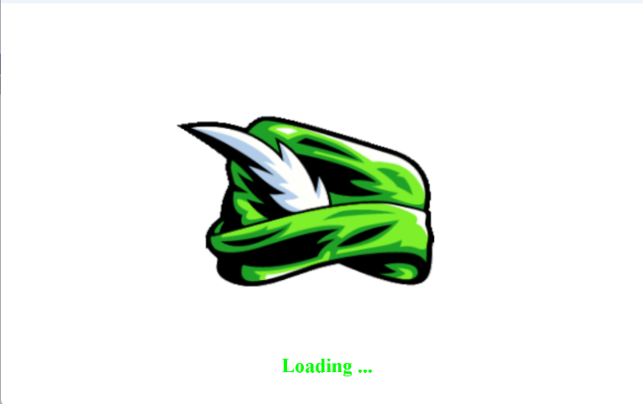
Intro screen
Game Showcase & Demo

Slide 13
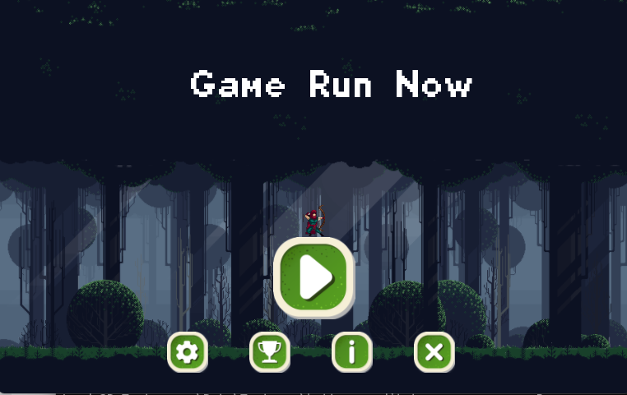
Main menu screen
Game Showcase & Demo

Slide 14
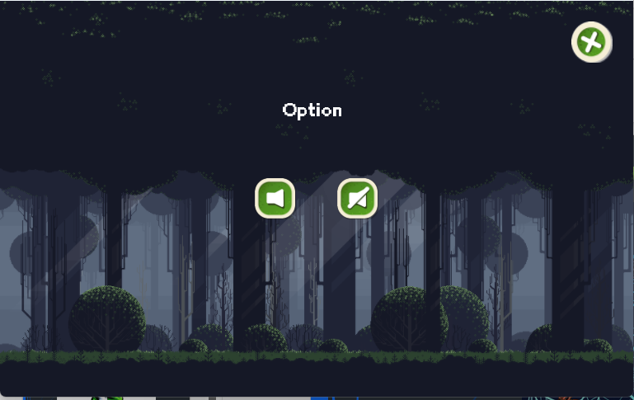
Setting screen
Game Showcase & Demo

Slide 15
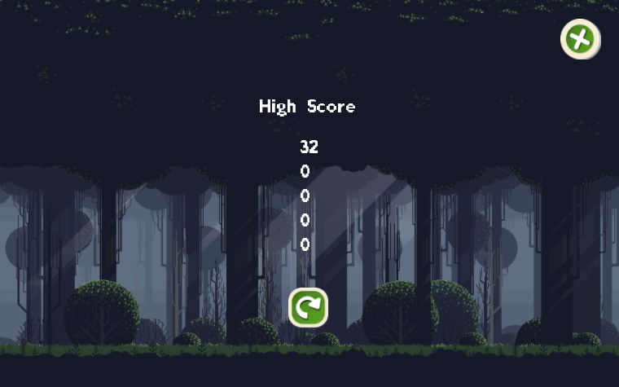
High score screen
Game Showcase & Demo

Slide 16
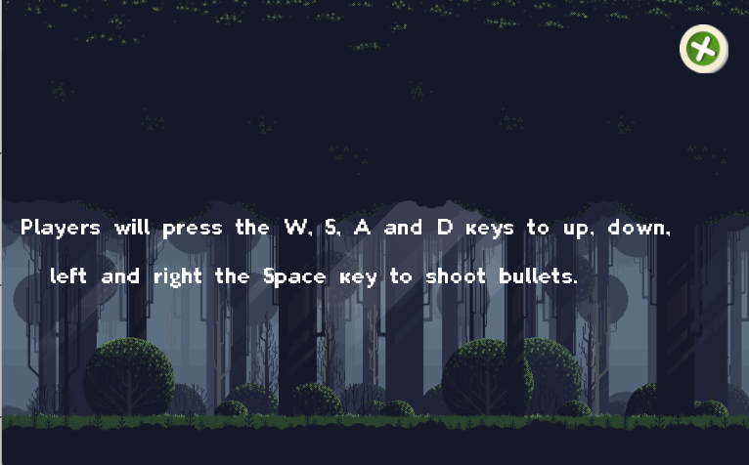
About screen
Game Showcase & Demo

Slide 17
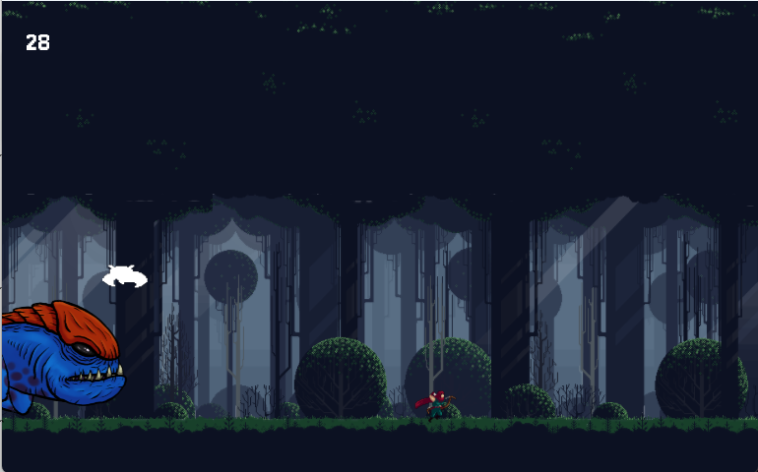
Gameplay interface
Game Analysis & Demo
Score

Slide 18
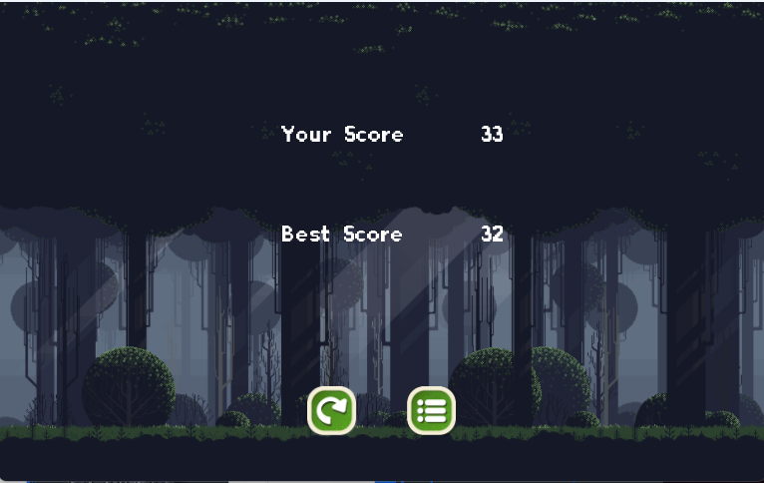
Gameover screen
Game Analysis & Demo
Game Assets

Slide 19
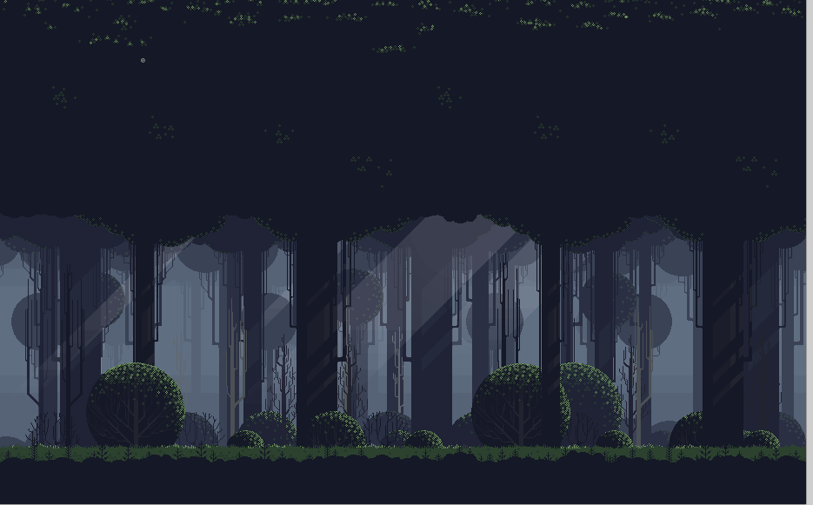
Background sprite
Game Analysis & Demo

Slide 20

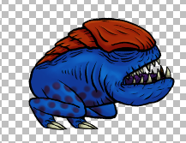


Boss
Game Analysis & Demo
Player

Slide 21
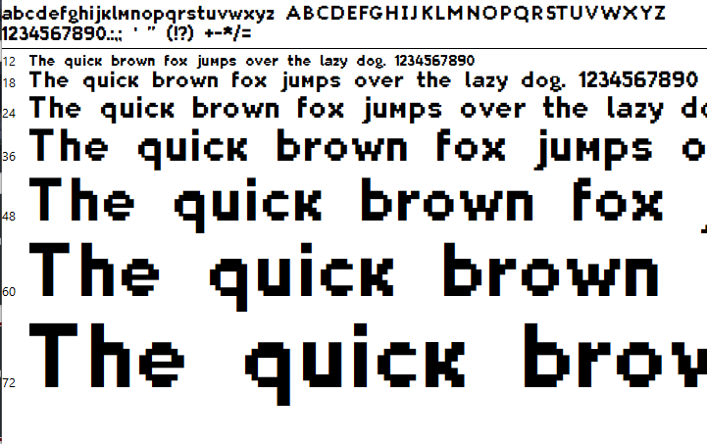
Boss
Game Analysis & Demo
Font : Planes_ValMore

Slide 22
Advantages & Disadvantages
Ups and downs

Slide 23
Advantages
Advantages & Disadvantages
Great working environments: Office and people
Good supports from trainers
Helpful internship resources
Notes:
The more programs used, the more dependencies and more potential incompatibilities. Unless it plugs into just the base of the software, it isn’t considered in our studio.
We chose programs wisely (including Unity) as the tools need to cover broad swaths of game development requirements
If you are wondering, we switched from Blender to Maya for its broader feature set
Our most important software thus far has been Unity 3D
It is easy to approach while being flexible for advanced users
Its active development and broad base makes it a stable platform
We feel confident in our use of it

Slide 24
Disadvantages
Advantages & Disadvantages
New knowledges needing acquired
Unfamiliar APIs and their intergrations
Inadequate experience
Non-optimized team communications
Notes:
The more programs used, the more dependencies and more potential incompatibilities. Unless it plugs into just the base of the software, it isn’t considered in our studio.
We chose programs wisely (including Unity) as the tools need to cover broad swaths of game development requirements
If you are wondering, we switched from Blender to Maya for its broader feature set
Our most important software thus far has been Unity 3D
It is easy to approach while being flexible for advanced users
Its active development and broad base makes it a stable platform
We feel confident in our use of it

Slide 25
Further Developments
What’s next for the project
Notes:
Its is useful to get familiar with the general interface

Slide 26
Further Developments
Add an in-game currency system where players can generate income based on points earned after each play.
More shops to buy characters, costumes, weapons.
Add new map.
More content (graphics, mechanics, ..etc.).
Notes:
The more programs used, the more dependencies and more potential incompatibilities. Unless it plugs into just the base of the software, it isn’t considered in our studio.
We chose programs wisely (including Unity) as the tools need to cover broad swaths of game development requirements
If you are wondering, we switched from Blender to Maya for its broader feature set
Our most important software thus far has been Unity 3D
It is easy to approach while being flexible for advanced users
Its active development and broad base makes it a stable platform
We feel confident in our use of it

Slide 27
Questions & Answers
Please ask away!

Slide 28
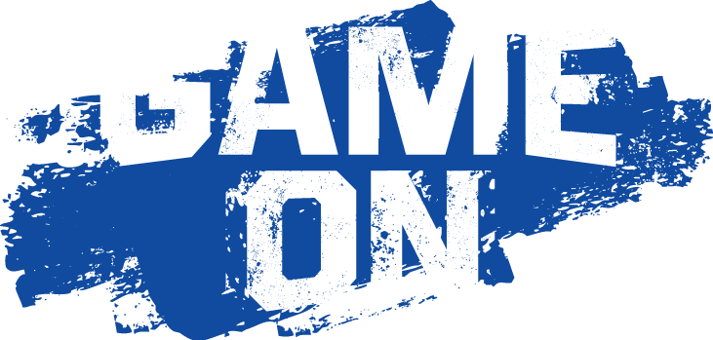
Thanks for listening to our presentation!
And happy gaming!
Notes:
Pause/play and move/rotate tools
There is also the collaborate drop-down, which is the built in version control

