Slide 1
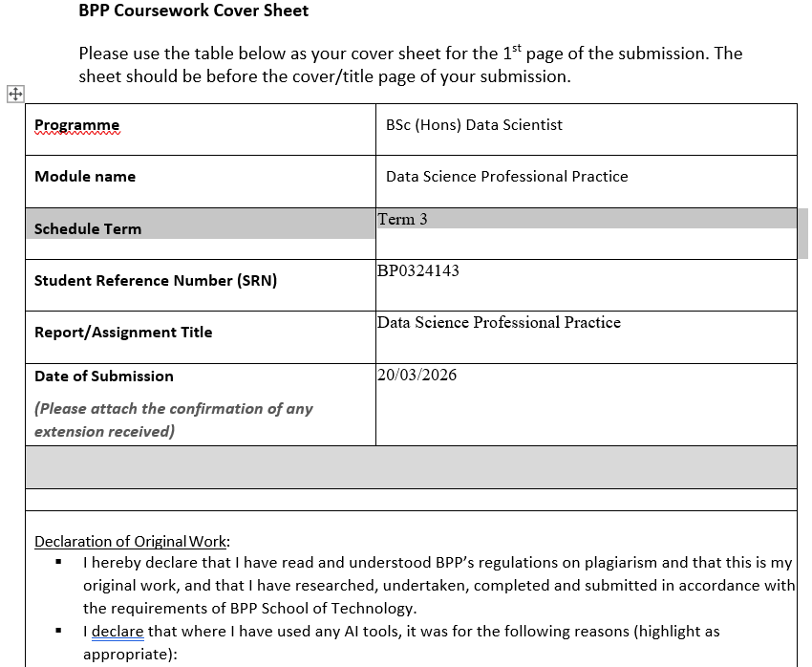

Slide 2
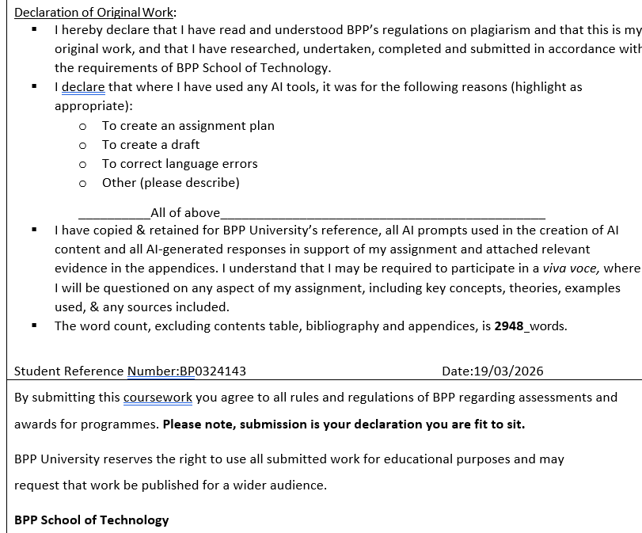

Slide 3
Executive Summary
US Homicide Time Series Analysis
This analysis applies ARIMA time series modelling to US homicide data spanning 1980 to 2014, sourced from a Kaggle dataset of 638,454 records. The central hypothesis (H1) is that the decline follows a statistically predictable autoregressive structure, measurable and forecastable using ARIMA modelling.
An Augmented Dickey-Fuller test confirmed non-stationarity (p=0.50), justifying ARIMA over ARMA. ACF and PACF plots identified ARIMA(1,1,1) as optimal model order. Trained on 1980–2000 data and evaluated against 2001–2014 actuals, the model achieved a Mean Absolute Error of 7.2% — strong predictive performance given 21 training observations. ARIMA was selected over Prophet and simple linear regression due to transparency and alignment with established literature (Box and Jenkins, 1976).
EDA revealed a national peak of 24,335 homicides in 1993, sharp decline to ~14,000 by 2000 and stabilization thereafter. Convergent trends across White and Black victim groups and male and female victims suggest macro structural forces drove the decline. Counts were normalized against US population data revealing the true scale of decline.
Ethical considerations include responsible presentation of race disaggregated data, administrative racial classification bias, intersectionality as a structural limitation and data privacy — the dataset is fully anonymized under Kaggle's open license.
Methodology transfers directly to commercial forecasting as demonstrated in Part 2.

Slide 4
Data Infrastructure and Tools
Data Ecosystem:
Excel — CSV downloaded from Kaggle. Familiar and accessible. Limitation: not scalable, manual processes.
Python/Jupyter Notebook — Open source, reproducible, rich statistical libraries. Limitation: requires coding expertise
Power BI — interactive dashboards, accessible to nontechnical stakeholders. Limitation: limited statistical modelling capability
GitHub Pages — version control, reproducible open access notebook hosting. Limitation: static, no live data integration
How Tools Connect:
Excel stores raw data → Power BI enables interactive exploration with time charts and demographic slicers to identify patterns → Python performs deeper statistical modelling and ARIMA analysis → GitHub Pages hosts reproducible notebook output
A basic report was built in Power BI first — including time series trend chart sliceable by race, gender and state — to identify patterns before committing to Python implementation
This workflow reflects separation of operational and analytical environments (Inmon, 2005)
Emerging Trends in Data Infrastructure:
Cloud platforms — Azure, AWS, Databricks replacing local Python environments for scalability
Automated DataOps pipelines replacing manual Excel and CSV workflows

Slide 5
Data Engineering
Dataset Quality:
Kaggle usability score 8.6/10 — relatively clean and well structured
638,454 records spanning 35 years — sufficient volume for time series analysis
Key columns selected: Year, Month, Victim Race, Victim Sex, Record ID — selection justified by research question focus on temporal and demographic trends
DAMA DMBOK Quality Assessment (DAMA International, 2017):
Completeness — “Unknown” race and sex categories identified, likely Missing not at Random (MNAR) suggesting systemic rather than random recording gaps (Rubin 1976).
Timeliness — all records fall within 1980–2014 period
Validity — Month stored as text, transformed to numeric for time series compatibility
Uniqueness — Record ID confirmed no duplicate entries
Data Transformation Decisions:
Annual aggregation chosen over monthly — sufficient granularity for structural trend analysis while reducing noise
Population normalization applied (* this will be done for summative) — raw counts misleading across growing population, rates per 100,000 reveal true decline (Blumstein, 2000)
“Unknown” race category retained but documented — removal would introduce systematic bias
ETL approach follows clean separation between raw sourced data and analytical dataset (Kimball and Caserta, 2011)
Feature Engineering:
Train/test split at year 2000 — reflects structural stabilization observed in EDA, prevents data leakage
Preprocessing documented in Jupyter notebook ensuring full reproducibility

Slide 6
Data Visualization and Dashboards
Target Audience:
Academic and portfolio context — emphasis on statistical transparency over executive dashboard style
Designed for data science practitioners and academic reviewers — not general stakeholder reporting
Visualization Rationale and Design:
Visualizations follow overview to detail principle — national trend established before demographic disaggregation (Few, 2013)
Colour, labelling and reference lines chosen to minimize cognitive load and maximize interpretability (Knaflic, 2015)
Figure 1 — White and Black Homicide Counts 1980-2014:
Line chart selected — optimal for displaying continuous time series trends across two groups simultaneously
Convergent shapes across White and Black victim groups visually confirm macro structural forces drove the decline
Reference lines added at 1993 peak and 2000 stabilization point — guides reader interpretation
Figure 2 — ACF and PACF Plots:
Generated via statsmodels graphics library (Seabold and Perktold, 2010)
Technical diagnostic charts — intended for expert audience only, not general stakeholder reporting
Significant lag 1 spike in both plots empirically confirmed ARIMA(1,1,1) order selection (Box and Jenkins, 1976)
Included as evidence of rigorous experimental design rather than communication tool
Figure 3 — ARIMA Forecast vs Actual 1980-2014:
Line chart with train/test split reference line — clearly distinguishes modelled from forecast period
Blue forecast line vs green actual line — visual comparison of model performance
Forecast stabilization at 14,500-14,700 closely matching actual 14,000-15,000 visually confirms MAE of 7.2%
Maximum homicide count 1993 and stabilization post 2000 clearly visible

Slide 7
Data Analytics
Hypothesis:
H1: The decline in US homicides 1980–2014 follows a statistically predictable autoregressive structure, measurable and forecastable using ARIMA modelling
H0: The series follows no predictable structure and cannot be forecast beyond random walk
Methodology — ARIMA(1,1,1):
Augmented Dickie Fuller test confirmed non-stationarity (p=0.50) — formally justifying ARIMA over ARMA (Dickey and Fuller, 1979)
First differencing (I=1) applied — transforms declining series to stationary, enabling ARMA components to model residual patterns
ACF suggested MA(1), PACF suggested AR(1) — model order selection follows Box and Jenkins (1976)
Alternative approaches considered and rejected — Prophet (less transparent), simple linear regression (ignores autocorrelation), ARMA (requires stationarity)
Methodology conforms to CRISP-DM (Chapman et al., 2000): structured experimental design framework
Results and Evaluation:
Mean Absolute Error 1,137 homicides — 7.2% of mean actual value — strong predictive performance
Model correctly forecast stabilization post 2000 rather than continued decline
Structural break identified — pre-2000 momentum not sustained, consistent with social equilibrium
Technical finding transferable to commercial forecasting — directly applied to VMO2 CPP in Part 2
Ethics, Bias and Privacy:
Race disaggregated data presented responsibly — raw counts without population adjustment risk misrepresenting racial disparities
Administrative racial classification introduces bias — categories assigned not self identified
Intersectionality acknowledged as structural limitation (Crenshaw, 1989)
Dataset fully anonymized — no personal data, used under Kaggle open license

Slide 8
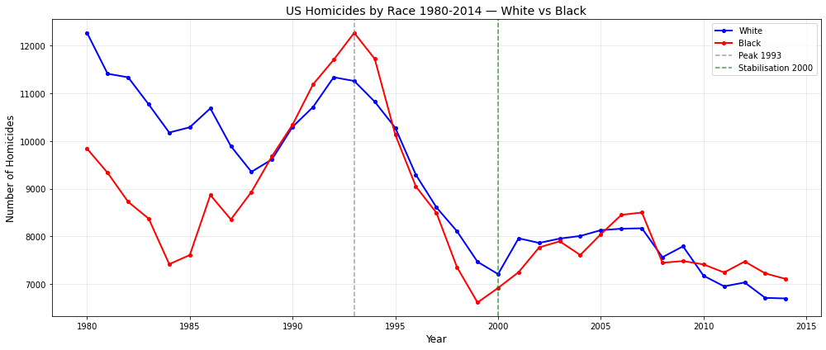
Figure 1: Annual US homicide counts 1980–2014 by race. White and Black victim trends exhibit convergent shapes — peak 1993, sharp decline to 2000, stabilisation post 2000 — suggesting macro structural forces drove the national decline independent of demographic characteristics. Source: Kaggle US Homicides Dataset (2016).

Slide 9
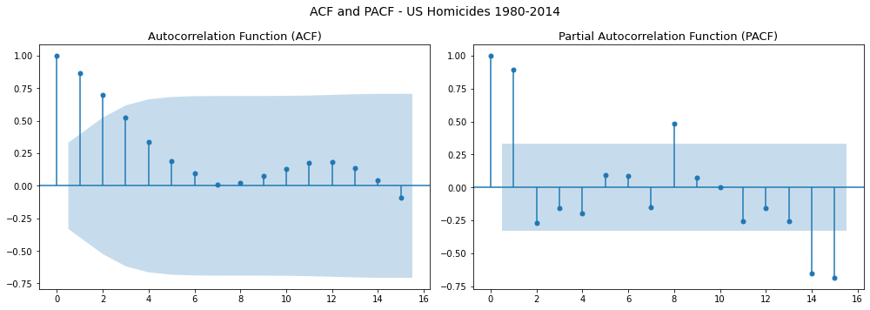
Figure 2: Autocorrelation Function (ACF) and Partial Autocorrelation Function (PACF) for annual US homicide counts 1980–2014. ACF decay pattern confirms non-stationarity. Significant spike at lag 1 in both plots informed selection of ARIMA(1,1,1) model order, consistent with Box and Jenkins (1976) methodology.

Slide 10
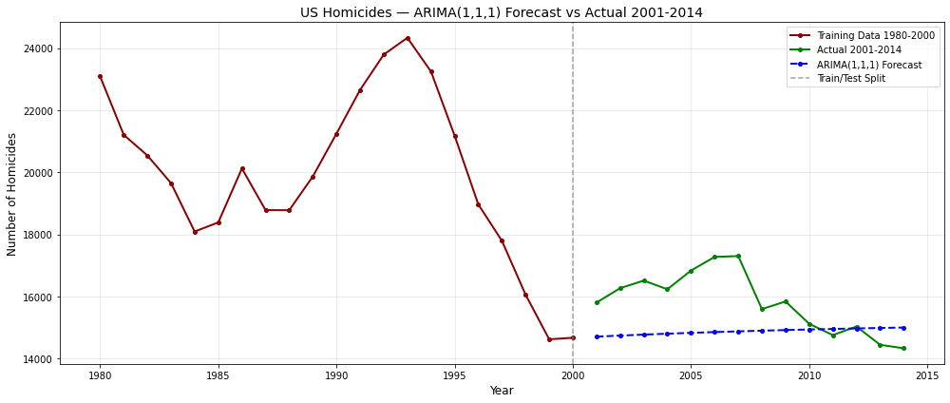
Figure 3: ARIMA(1,1,1) forecast (2001–2014) against actual homicide counts. Model trained on 1980–2000 data correctly forecast stabilisation at approximately 14,500–14,700 annually. Mean Absolute Error of 1,137 homicides (7.2% of mean actual) indicates strong predictive performance. Structural break evident post 2000 — pre-2000 declining momentum was not sustained, consistent with social equilibrium hypothesis.

Slide 11
Impact Evaluation
Executive Summary Part 2: Average cost Per Premise Time Series Analysis — Virgin Media O2 This analysis applies ARIMA time series modelling to Virgin Media O2 Cost Per Premise (CPP) data spanning January 2022 to February 2026. CPP represents the average cost of “construction problem” broadband installations where a billable cost exists. The central hypothesis is that CPP follows a statistically predictable upward trend, forecastable using ARIMA — directly paralleling Part 1 but applied to a rising rather than declining series.
CPP rose from approximately £710 in January 2022 to £950 by mid 2024 — a nominal increase of approximately 34%. ADF stationarity testing confirmed non stationarity, with ACF/PACF plots informing model order selection. Three forecasting models were applied — ARIMA predicts stabilization at approximately £945, ETS Holt predicts continued rise toward £1,000+, and Prophet forecasts upward trajectory with volatility. Model divergence provides scenario planning range for budget and contract management decisions.
Business impact includes early identification of cost overruns, improved PO budget forecasting and data driven contract negotiation support. Power BI automation saves an estimated 25 analyst days annually versus previous manual Excel monitoring. Monitoring CPP as a structured time series transforms it from a retrospective reporting figure into a forward-looking management tool — demonstrating direct transferability of analytical techniques from Part 1.

Slide 12
Project Background
Company Context:
Virgin Media O2 broadband problem installations assign properties with construction challenges — such as de-silting and blockages — to external civil engineering partners
Construction programme represents several million pounds of annual expenditure — making accurate cost monitoring essential for financial governance
The Business Problem:
Prior to this analysis CPP monitoring was performed manually in Excel — producing irregular and inconclusive updates with no forward-looking forecast capability
Rising CPP since January 2022 raised commercially significant questions about contract valuations and budget requirements — motivating a structured time series approach
Average Cost Per Premise Metric:
CPP is an average cost metric — total construction costs across all completed properties divided by the number of properties, giving the mean cost per individual premise
Properties with zero cost excluded from both numerator and denominator — ensuring the average reflects only genuinely billable construction activity
Stakeholders:
Key stakeholders include operations managers responsible for partner performance and contract decisions, and finance teams overseeing PO budget allocation and governance

Slide 13
Approach and Analysis
Data Preparation:
CPP data extracted from VMO2 finance systems and cleaned — removing records prior to January 2022, blank work order IDs and duplicate entries to ensure analytical integrity
Monthly granularity selected from timestamped property level data — providing 50 observations January 2022 to February 2026 as the analytical dataset
Exploratory Analysis — Power BI:
Power BI exploratory analysis confirmed consistent upward CPP trajectory from £710 (2022) to £950 (mid 2024) — rolling average revealed underlying structural trend and scatter plot confirmed billing discipline across approximately 10 partners since 2022
Time Series Methodology — Python:
ADF stationarity test confirmed non stationarity — formally justifying ARIMA over ARMA (Dickey and Fuller, 1979), ACF/PACF plots informed model order selection resulting in ARIMA(1,1,1) and ARIMA(0,1,1)
Three models applied for comparative analysis — ARIMA selected for transparency and alignment with established literature (Box and Jenkins, 1976), ETS Holt and Prophet applied as alternatives
Model divergence to be evaluated via formal train/test split for summative — producing MAE and RMSE per model to objectively identify best performer

Slide 14
Results and Impact
CPP Trend Findings:
CPP rose from approximately £710 in January 2022 to £950 by mid 2024 — nominal increase of approximately 34%
Against UK CPI of approximately 15-20% over the same period a real terms increase of 14-19% is indicated — formal monthly inflation adjustment to be completed for summative to confirm this finding
Forecast Model Results:
ARIMA(1,1,1) and ARIMA(0,1,1) — predict stabilization at approximately £945 — Figure 5
ETS Holt — predicts continued rise toward £1,000+ by 2027
Prophet — predicts upward trajectory with significant volatility
Quantified Business Value:
Power BI automation estimated to save minimum 25 analyst days annually — replacing manual Excel monitoring across 10,000+ rows of construction data, enabling consistent weekly refresh versus previous irregular inconclusive updates
Four time series models — ARIMA, ARIMA(0,1,1), ETS Holt and Prophet — applied to 50 monthly observations, producing forecast range of £945 stabilization to £1,000+ continued rise by 2027, directly informing PO budget planning across a multi million-pound construction programme
Stakeholder Impact:
Structured CPP forecasting delivers early warning of cost trajectory to operations managers, improved PO budget planning for finance based on upper confidence interval of £1,060, and evidence-based partner performance data for procurement contract renewal decisions — transforming a manual reporting process into a forward-looking governance tool

Slide 15
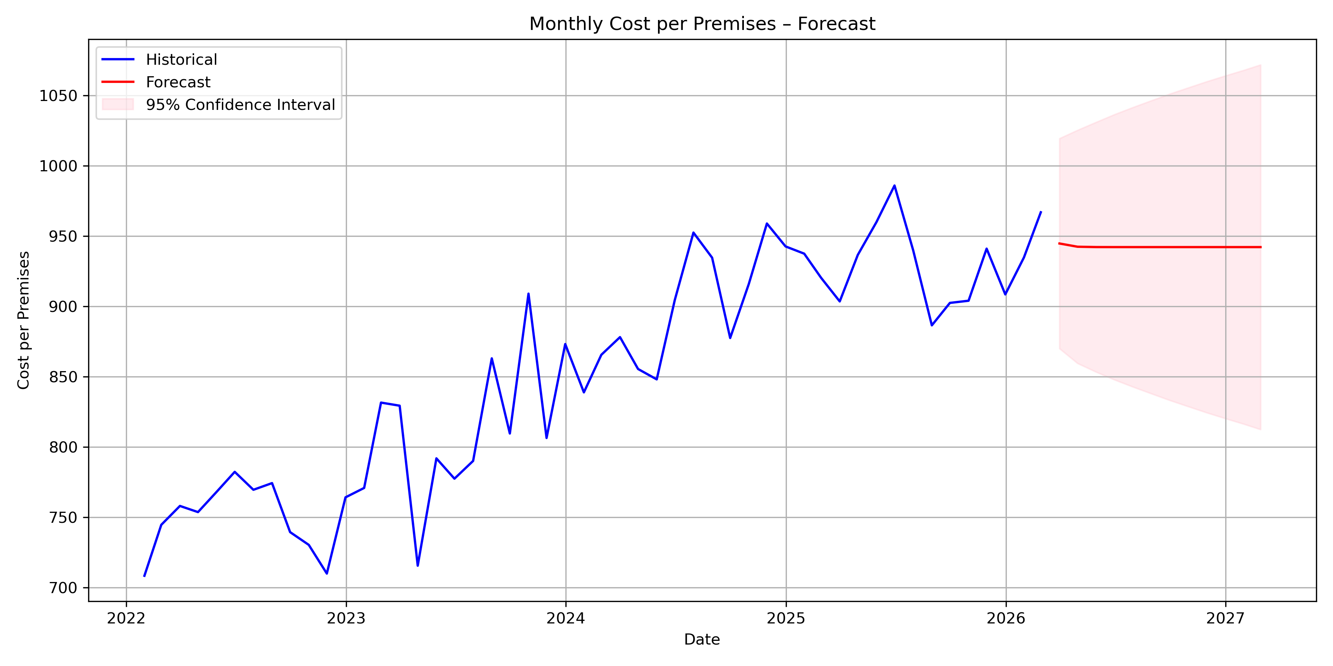
Figure 4: ARIMA(1,1,1) monthly CPP forecast January 2022 to February 2026 with 95% confidence interval. Central forecast predicts stabilisation at approximately £945. Confidence interval widens to £850–£1,060 by mid 2027 — prudent budget planning should reference upper bound rather than central forecast alone.

Slide 16
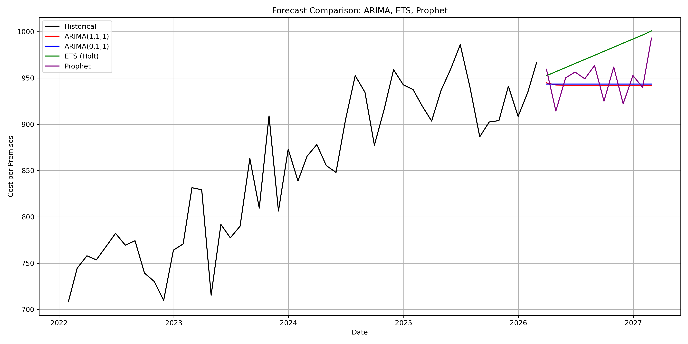
Figure 5: Forecast comparison across ARIMA(1,1,1), ARIMA(0,1,1), ETS Holt and Prophet models. ARIMA variants predict stabilisation at approximately £940–£950, ETS Holt predicts continued rise toward £1,000+, Prophet forecasts upward trajectory with volatility. Model divergence provides scenario planning range for contract and budget management decisions.

Slide 17
Recommendations
Immediate:
Complete inflation adjustment using ONS CPI Index — real terms CPP increase of 14-19% already indicated, formal monthly adjustment to confirm (ONS, 2026)
Present forecast scenario range to senior stakeholders — ARIMA stabilization vs ETS Holt continued rise vs Prophet volatility provides planning options
Modelling Improvements:
Train/test split to be implemented for summative — replicating homicide methodology to produce MAE metric across all four models, enabling objective model comparison equivalent to the 7.2% MAE achieved in Part 1
Partner breakdown — running separate forecasts for each individual partner would reveal which specific partners are driving the overall cost increase — turning an aggregate finding into an actionable insight for contract and procurement decisions
Data Infrastructure:
Automate CPP data extraction via Azure Data Factory or similar — replacing manual CSV exports, eliminating human error risk and aligning with emerging DataOps best practice (Gartner, 2024)
Strategic:
Establish CPP as a formally governed strategic KPI — when combined with inflation adjustment and partner level decomposition it provides an objective evidence base for identifying which partners are pricing above real terms expectations, directly informing contract renegotiation and procurement decisions across a multi million-pound construction programme

Slide 18
References
Technical and Methodological:
Box, G.E.P. and Jenkins, G.M. (1976) Time Series Analysis: Forecasting and Control. San Francisco: Holden-Day.
Chapman, P., Clinton, J., Kerber, R., Khabaza, T., Reinartz, T., Shearer, C. and Wirth, R. (2000) CRISP-DM 1.0: Step-by-Step Data Mining Guide. SPSS Inc. Available at: https://www.the-modeling-agency.com/crisp-dm.pdf (Accessed: 14 March 2026).
Dickey, D.A. and Fuller, W.A. (1979) 'Distribution of the estimators for autoregressive time series with a unit root', Journal of the American Statistical Association, 74(366), pp. 427–431.
Hyndman, R.J. and Athanasopoulos, G. (2021) Forecasting: Principles and Practice. 3rd edn. Melbourne: OTexts. Available at: https://otexts.com/fpp3 (Accessed: 14 March 2026).
Rubin, D.B. (1976) 'Inference and missing data', Biometrika, 63(3), pp. 581–592.
Seabold, S. and Perktold, J. (2010) 'Statsmodels: Econometric and statistical modeling with Python', Proceedings of the 9th Python in Science Conference, pp. 92–96.
Data Visualisation:
Few, S. (2013) Information Dashboard Design: Displaying Data for At-a-Glance Monitoring. 2nd edn. Burlingame: Analytics Press.
Knaflic, C.N. (2015) Storytelling with Data: A Data Visualization Guide for Business Professionals. Hoboken: Wiley.
Sociological and Criminological:
Blumstein, A. (2000) 'Disaggregating the violence trends', in Blumstein, A. and Wallman, J. (eds.) The Crime Drop in America. Cambridge: Cambridge University Press, pp. 13–44.
Donohue, J.J. and Levitt, S.D. (2001) 'The impact of legalised abortion on crime', Quarterly Journal of Economics, 116(2), pp. 379–420.
Nevin, R. (2007) 'Understanding international crime trends: The legacy of preschool lead exposure', Environmental Research, 104(3), pp. 315–336.
Sharkey, P. (2017) Uneasy Peace: The Great Crime Decline, the Renewal of City Life, and the Next War on Violence. New York: Norton.
Ethical Framework:
Crenshaw, K. (1989) 'Demarginalizing the intersection of race and sex', University of Chicago Legal Forum, 1989(1), pp. 139–167.
European Commission (2019) Ethics Guidelines for Trustworthy AI. Brussels: European Commission. Available at: https://ec.europa.eu/digital-single-market/en/news/ethics-guidelines-trustworthy-ai (Accessed: 14 March 2026).
Data Governance:
DAMA International (2017) DAMA-DMBOK: Data Management Body of Knowledge. 2nd edn. Basking Ridge: Technics Publications.
Inmon, W.H. (2005) Building the Data Warehouse. 4th edn. Indianapolis: Wiley.
Kimball, R. and Caserta, J. (2011) The Data Warehouse ETL Toolkit. Indianapolis: Wiley.
Business Intelligence:
Davenport, T.H. and Harris, J.G. (2007) Competing on Analytics: The New Science of Winning. Boston: Harvard Business School Press.
Sharda, R., Delen, D. and Turban, E. (2020) Analytics, Data Science and Artificial Intelligence: Systems for Decision Support. 11th edn. Harlow: Pearson.
Emerging Trends:
Gartner (2024) Top Trends in Data and Analytics. Stamford: Gartner Research. Available at: https://www.gartner.com (Accessed: 14 March 2026).
Datasets and Data Sources:
Kaggle (2016) US Homicides 1980–2014 [Dataset]. Available at: https://www.kaggle.com/datasets/murderaccountability/homicide-reports (Accessed: 14 March 2026).
Office for National Statistics (2026) Consumer Price Index (CPI) — Monthly Data. Available at: https://www.ons.gov.uk/economy/inflationandpriceindices (Accessed: 14 March 2026).
World Bank (2024) Population, Total — United States [Dataset]. Available at: https://data.worldbank.org/indicator/SP.POP.TOTL?locations=US (Accessed: 14 March 2026).

Slide 19
AI Usage Statement
Tool Used:
Claude (Anthropic, 2026) — Claude Sonnet, accessed via claude.ai
How AI Was Used in This Project:
Conceptual explanation — ARIMA, ADF stationarity testing, ACF/PACF interpretation and autocorrelation explained conversationally to build genuine understanding before implementation
Code assistance — Python code for groupby aggregation, ADF test, ACF/PACF plots, ARIMA fitting, forecast visualisation and MAE/RMSE evaluation written collaboratively with errors debugged iteratively
Executive summary and slide content — drafted by AI based on analytical findings and results provided by the student
Reference list — Harvard formatted references compiled with student verification
Sociological contextualisation — Durkheim, intersectionality, race convergence findings and criminological literature connected to analytical observations made independently by the student
What Was NOT Done by AI:
All data exploration and pattern identification in PowerBI — conducted independently
Key analytical observations — 114 homicide difference, southern states finding, race convergence, seasonal pattern — identified before AI involvement
Critical evaluation of results and findings — directed all interpretive decisions
Final judgement on methodology, structure and content — student throughout
Reference: Anthropic (2026) Claude Sonnet [Large language model]. Available at: https://claude.ai (Accessed: 13 March 2026).

Slide 20
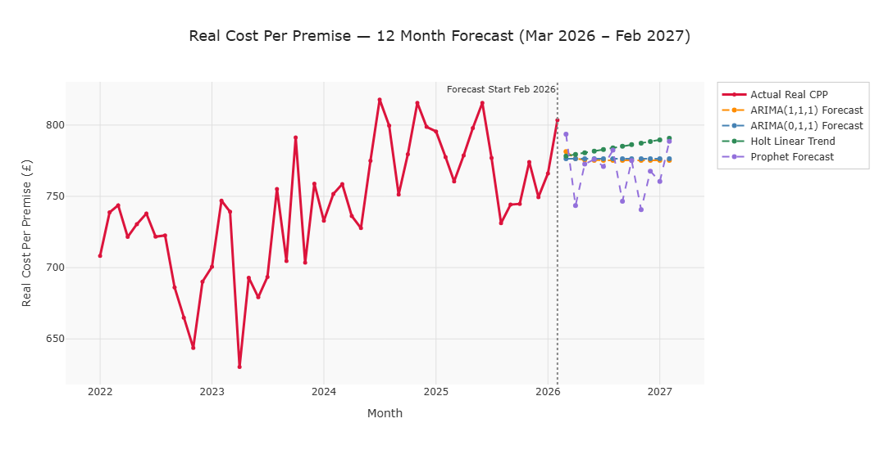
Strengths
Strong and well-executed analysis, clear use of ARIMA modelling with appropriate statistical tests (ADF, ACF/PACF) and solid justification of model choice.
Excellent communication of results ; metrics like MAE are clearly presented and interpreted, making the model performance easy to understand.
Very strong impact evaluation, clear business value (e.g. 25 analyst days saved, improved forecasting for budgets) and strong linkage to decision-making.
Areas of improvement
Simplify some explanations — parts are quite dense and academic; slightly clearer wording would improve accessibility for a broader audience.
Balance technical vs business focus — very strong technically, but could emphasise business implications slightly earlier in sections.
Add a bit more on data limitations, briefly outline any constraints in the dataset (e.g. aggregation choices, missing data impact).
Overall comments
This is a very strong formative with excellent technical execution and clear real-world application. The modelling is well justified, and the impact evaluation demonstrates strong business awareness and value. Brilliant work.

