Slide 1
1
Paying for Centrality
Transit Job Access, Rent and the Interborough Express in New York City
Independent research project, 2026 · rebuilt from my 2025 course project
Python (GeoPandas, r5py, PySAL, mgwr) · D3 web atlas
3 Study Design
PUBLIC DATA
MTA GTFS, subway + bus
OpenStreetMap
LEHD LODES 2023 jobs
ACS 2020–24, 5-year
PLUTO 26v2
DCP 2020 tracts
1 Introduction
New York's subway and bus network puts 50% of the city's 8.5 million residents within 45 minutes of a million jobs. Planners often assume that access is priced into rent, which turns every transit improvement into a question about who benefits. My 2025 version of this project correlated a stop-density index with rent across about 165 neighborhoods. This version rebuilds it at the census-tract level with schedule-based job accessibility, spatial econometrics and a scenario test of the proposed Interborough Express (IBX).
TRACT MEASURES · 2,325 TRACTS
Job accessibility
R5 routing, 7–8 AM, 45 min
Rent and housing stock
ACS rent, PLUTO controls
Renter vulnerability
Burden, poverty, renter share
RQ1 Capitalization
Is access priced into rent?
RQ2 Spatial equity
Where do access and rent diverge?
RQ3 IBX scenario
Who would gain?
2 Research Questions
RQ1
Is transit job access priced into rent once housing stock and location are held constant?
Hedonic OLS
Rent ~ access + stock + borough
Bivariate LISA
Access vs. neighbors' rent, FDR
Scenario network
18 stations, synthetic GTFS
RQ2
Where do access and rent diverge, and which renters live there?
Spatial models
LM tests; lag, error, SAC
Planning typology
Access × rent × vulnerability
Re-route
Change in jobs within 45 min
RQ3
Who would gain access from the IBX, and where could gains turn into rent pressure?
What changed from the 2025 version
Centrality decomposition
Location vs. excess access
vulnerability, type
Who gains
By vulnerability and type
 | 2025 | 2026
Unit | ~165 NTAs | 2,325 census tracts, EPSG:2263
Access | Stop density, 400 m buffers | Jobs within 45 min by transit (R5, GTFS, LODES)
Model | Bivariate OLS | Hedonic OLS, spatial lag / error / SAC, MGWR
Equity | — | Bivariate LISA, renter-vulnerability typology
Scenario | — | IBX GTFS scenario, rent-pressure screen
MGWR
Local access premium
capitalization rates
Rent-pressure screen
Bracketed by RQ1 rates

Slide 2
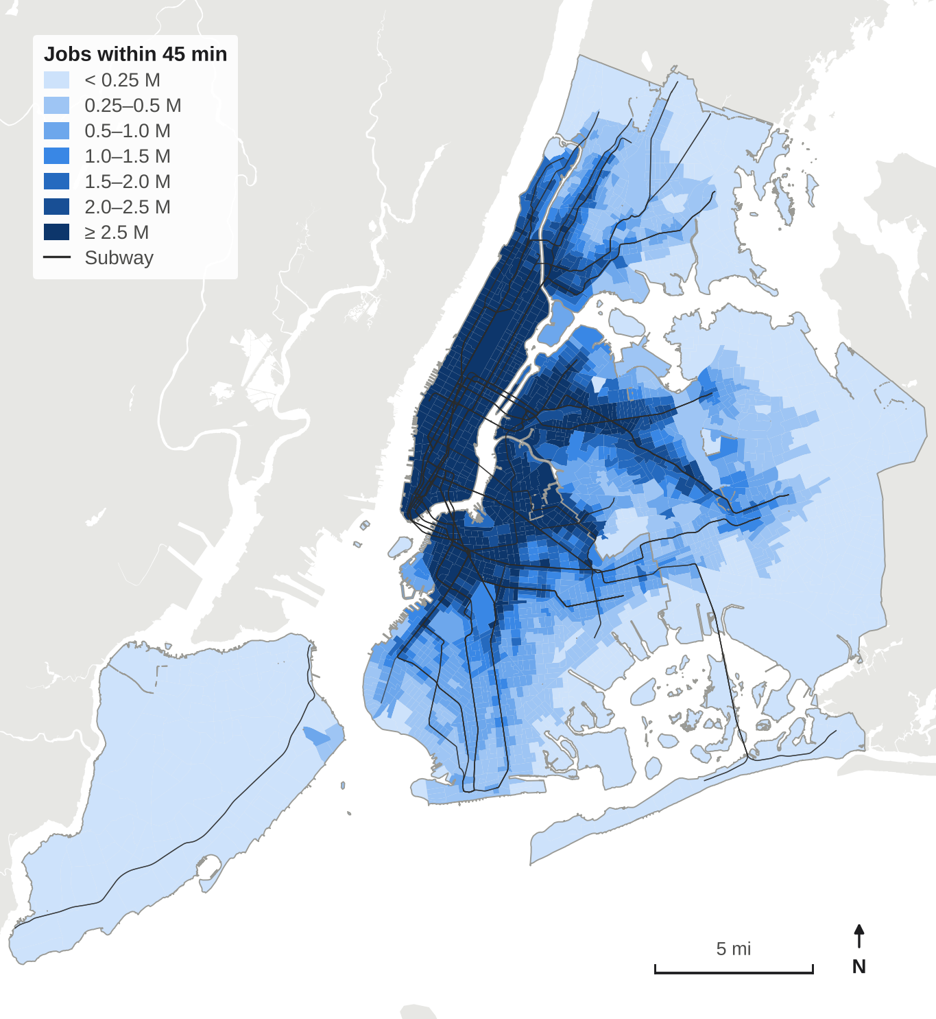
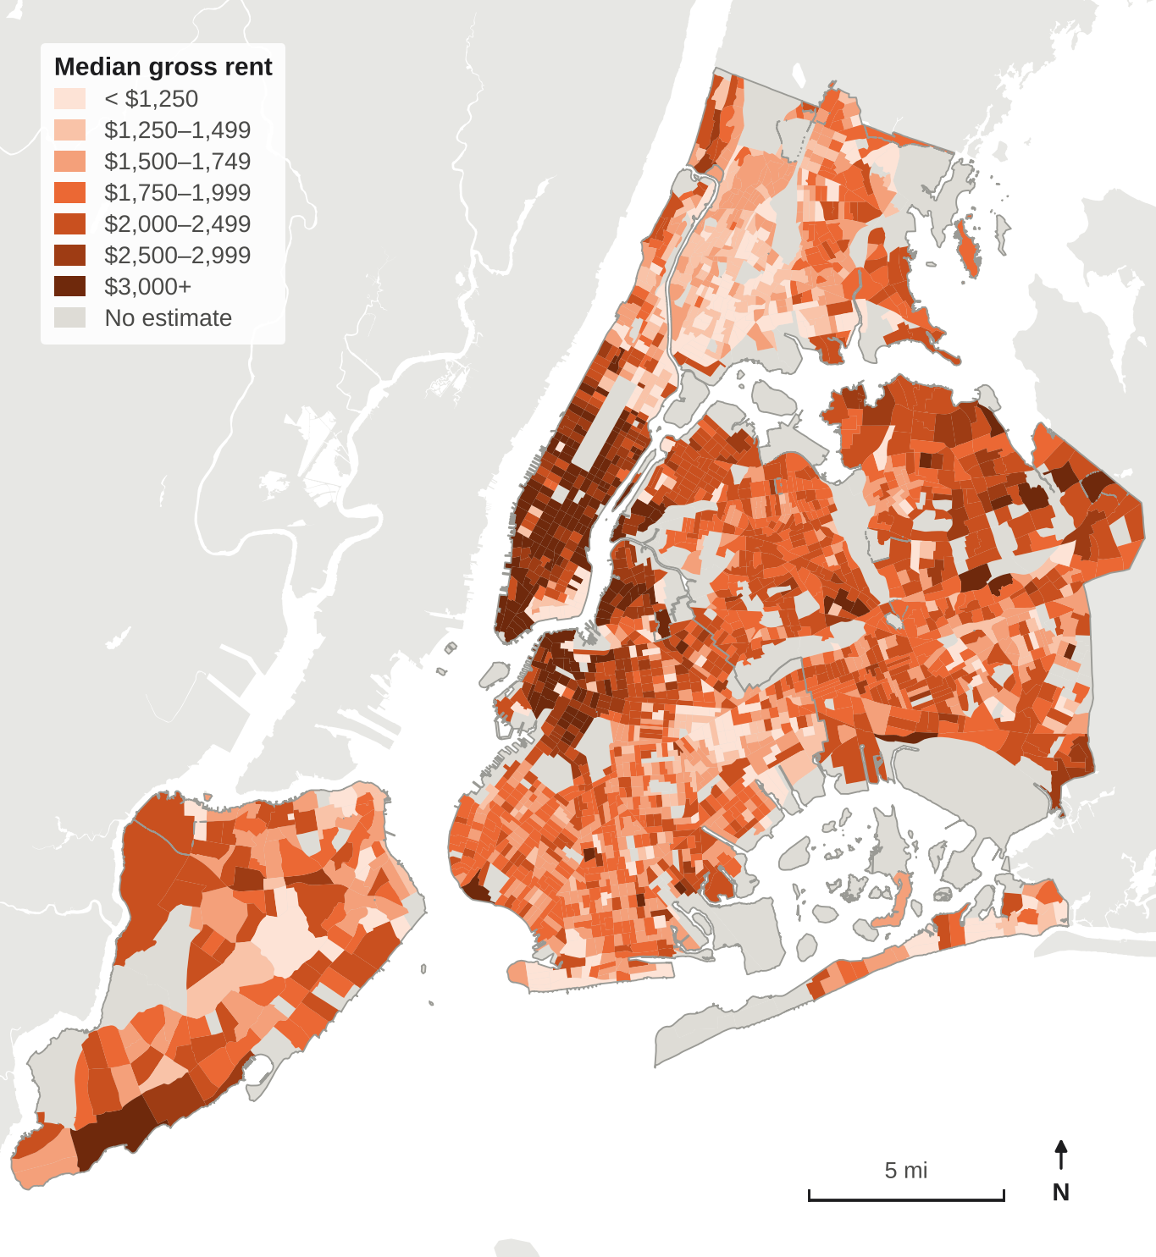
4 Transit Job Accessibility
5 Rent
Accessibility counts the jobs a resident can reach by subway, bus and walking within 45 minutes. Trips were routed with Conveyal R5 on MTA's October 2026 schedules and an OpenStreetMap walking network, departing every minute from 7 to 8 AM on a weekday; the median of the 60 departures is used. Origins are weighted by homes (PLUTO), destinations by LEHD LODES 2023 jobs.
Median gross rent (rent plus utilities) comes from the ACS 2020–24 five-year estimates for the 2,164 tracts with at least 50 renter households. Rents peak below 96th Street and in brownstone Brooklyn, but northeastern and western Queens also top $2,000. The lowest rents sit in public-housing tracts, where rent is set by income.
1.40M
jobs within 45 min for the average resident
$1,862
median gross rent across sample tracts
50%
of residents reach at least a million jobs
2,164
tracts in the rent models
Median tract
Manhattan 3.01M
Brooklyn 885k
Queens 492k
Bronx 422k
Staten Island 52k
90
rents top-coded at $3,500+; handled with a Tobit check

Slide 3
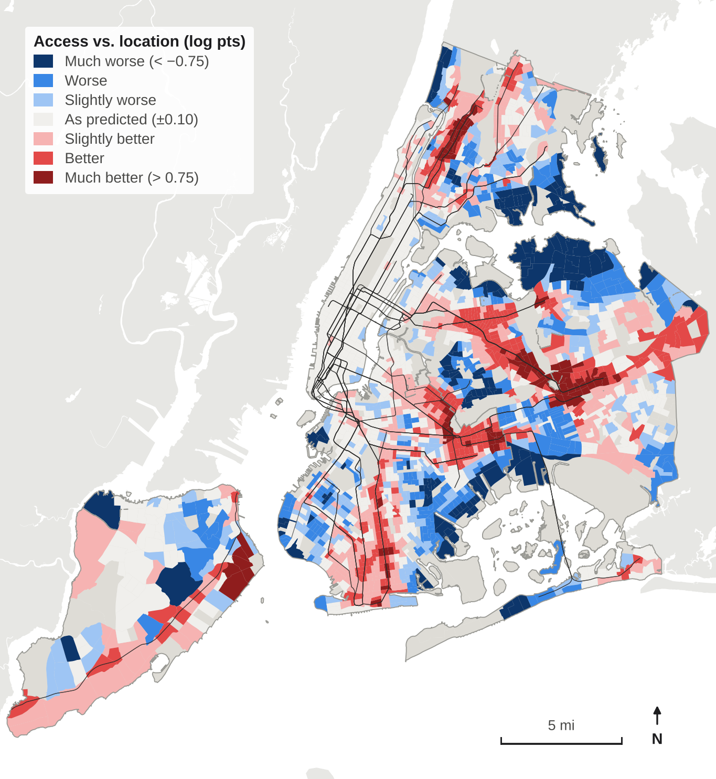
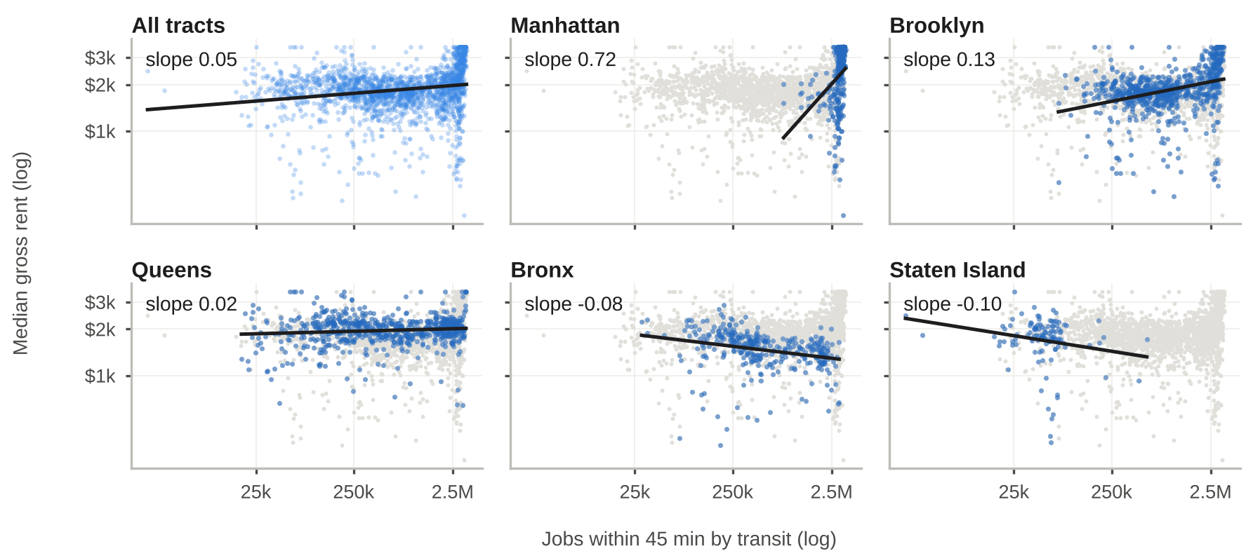
6 Is Access Priced into Rent?
7 Centrality or Transit?
A hedonic model regresses log rent on log 45-minute job access, controlling for renter-stock age, rooms, the pre-1974 rent-stabilized share, NYCHA share and borough. OLS residuals cluster (Moran's I = 0.34) and both robust LM tests are significant, so the preferred model combines a spatial lag and a spatial error (SAC). Doubling access goes with about 3% higher rent in the tract itself, 7% including spillovers.
Access and centrality are nearly the same variable: a within-borough spline in distance to the nearest CBD explains 86% of the variation in access. Splitting access into the part location predicts and the remainder (excess access) shows where the premium sits. Red tracts get more transit than their location delivers, at little or no extra rent: Jamaica, the West Bronx and the Queens Boulevard corridor.
Model | Access elasticity (SE) | R² | Residual Moran's I
OLS, access only | 0.051 (0.006) | 0.04 | 0.40
OLS + housing stock + borough | 0.072 (0.006) | 0.50 | 0.34
Spatial lag (ML) | 0.043 (0.005) | 0.65 | 0.00
Spatial error (ML) | 0.045 (0.011) | 0.49 | −0.03
SAC (GMM), direct effect | 0.047 (0.007) | – | –
SAC (GMM), total effect | 0.095 (0.017) | – | –
86%
of the variation in access explained by location
0.084
rent elasticity of location-predicted access
n = 2,164 tracts. R² is pseudo-R² for the ML models; SAC ρ = 0.52. Bold: preferred model.
One citywide slope, five borough slopes: access is priced in Manhattan and Brooklyn
0.022
of access beyond location (p = 0.05; −0.001 to 0.031 across four location models)

Slide 4
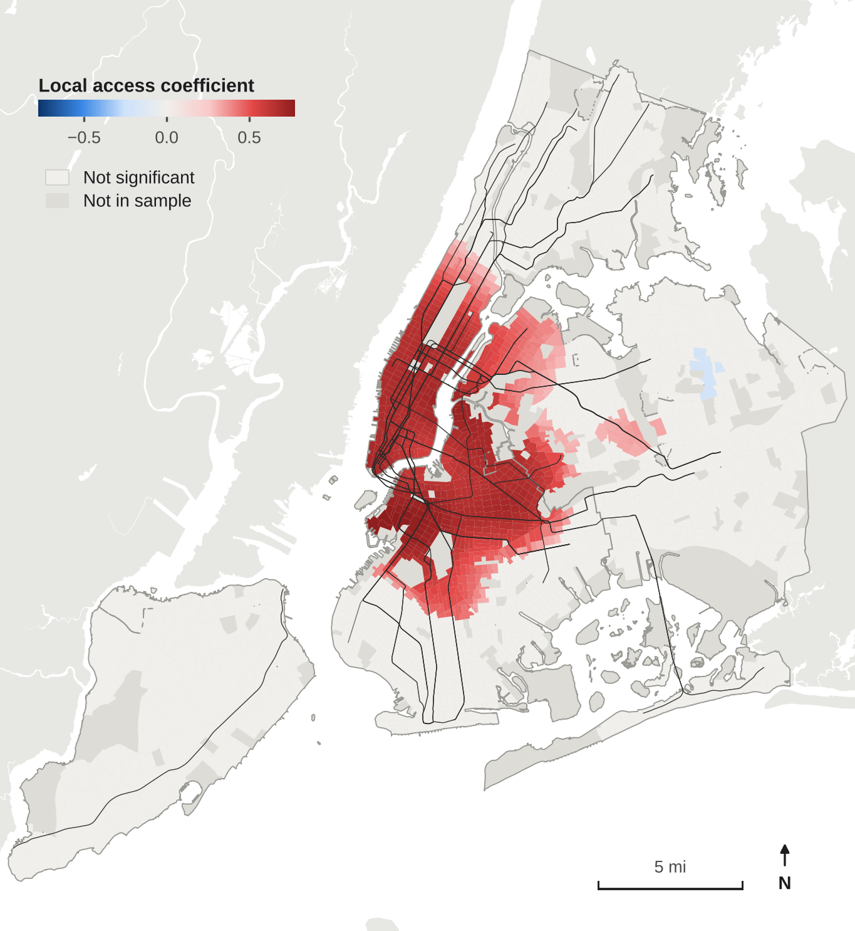
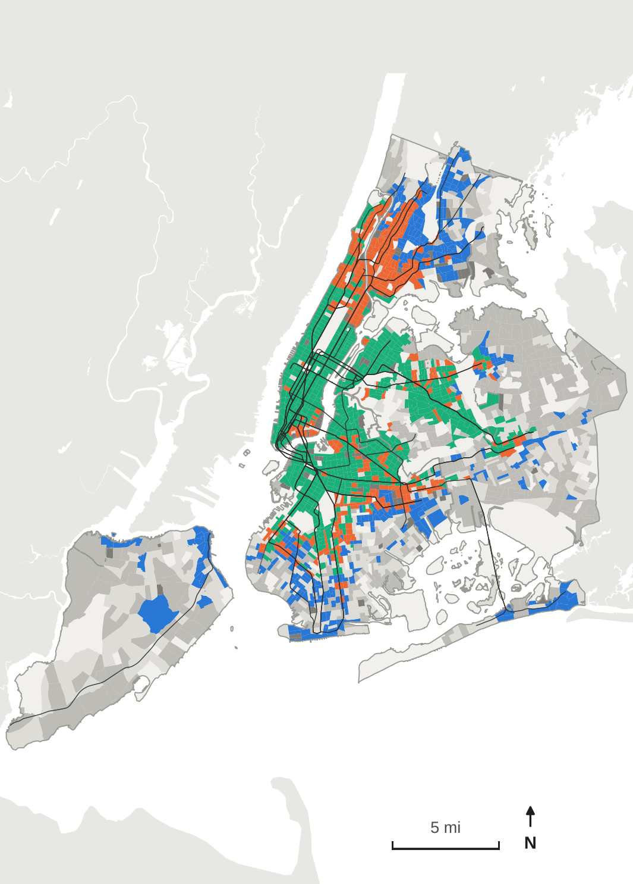
8 Where Is Access Priced?
9 Equity Typology
A multiscale geographically weighted regression (MGWR) lets each coefficient vary over its own bandwidth. The access coefficient varies over about 177 neighboring tracts, roughly 4–5 community districts, so it compares places that share a broad location. Access carries a local premium in Manhattan and much of Brooklyn, and none in the Bronx or on Staten Island.
Crossing access and rent at their citywide medians with a renter-vulnerability index (severe rent burden, poverty, renter share) gives six planning types. Displacement watch: high access, low rent, high vulnerability. Service priority: low access, low rent, high vulnerability. A bivariate LISA (FDR-adjusted) finds 92 significant high-access, low-rent tracts.
Tracts with a significant positive premium
Displacement watch
339 tracts · 531k renter HH
median rent $1,542, 28% poverty
Manhattan
Service priority
319 tracts · 344k renter HH
38% severely rent-burdened
81%
Brooklyn
48%
Queens
Established access premium
636 tracts · 831k renter HH
high access, high rent
24%
Bronx
Public housing (NYCHA ≥ 50%)
60 tracts · 101k renter HH
rent set by income
0%
Staten Island
0%
Car-oriented / amenity
445 tracts · 204k renter HH
low access, high rent
0.71
MGWR R² (OLS: 0.50)
Middle
365 tracts · 210k renter HH
near the medians
No residents, or not in the rent sample

Slide 5
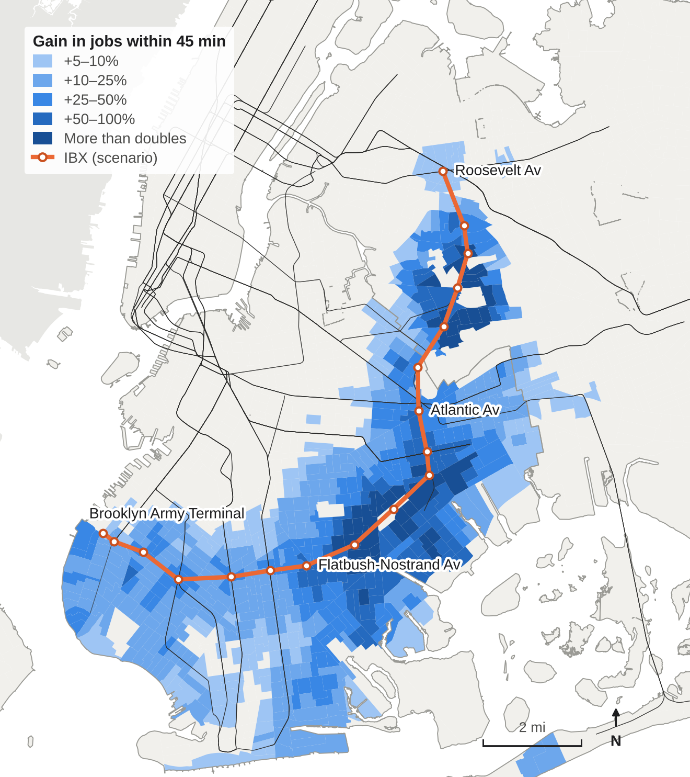
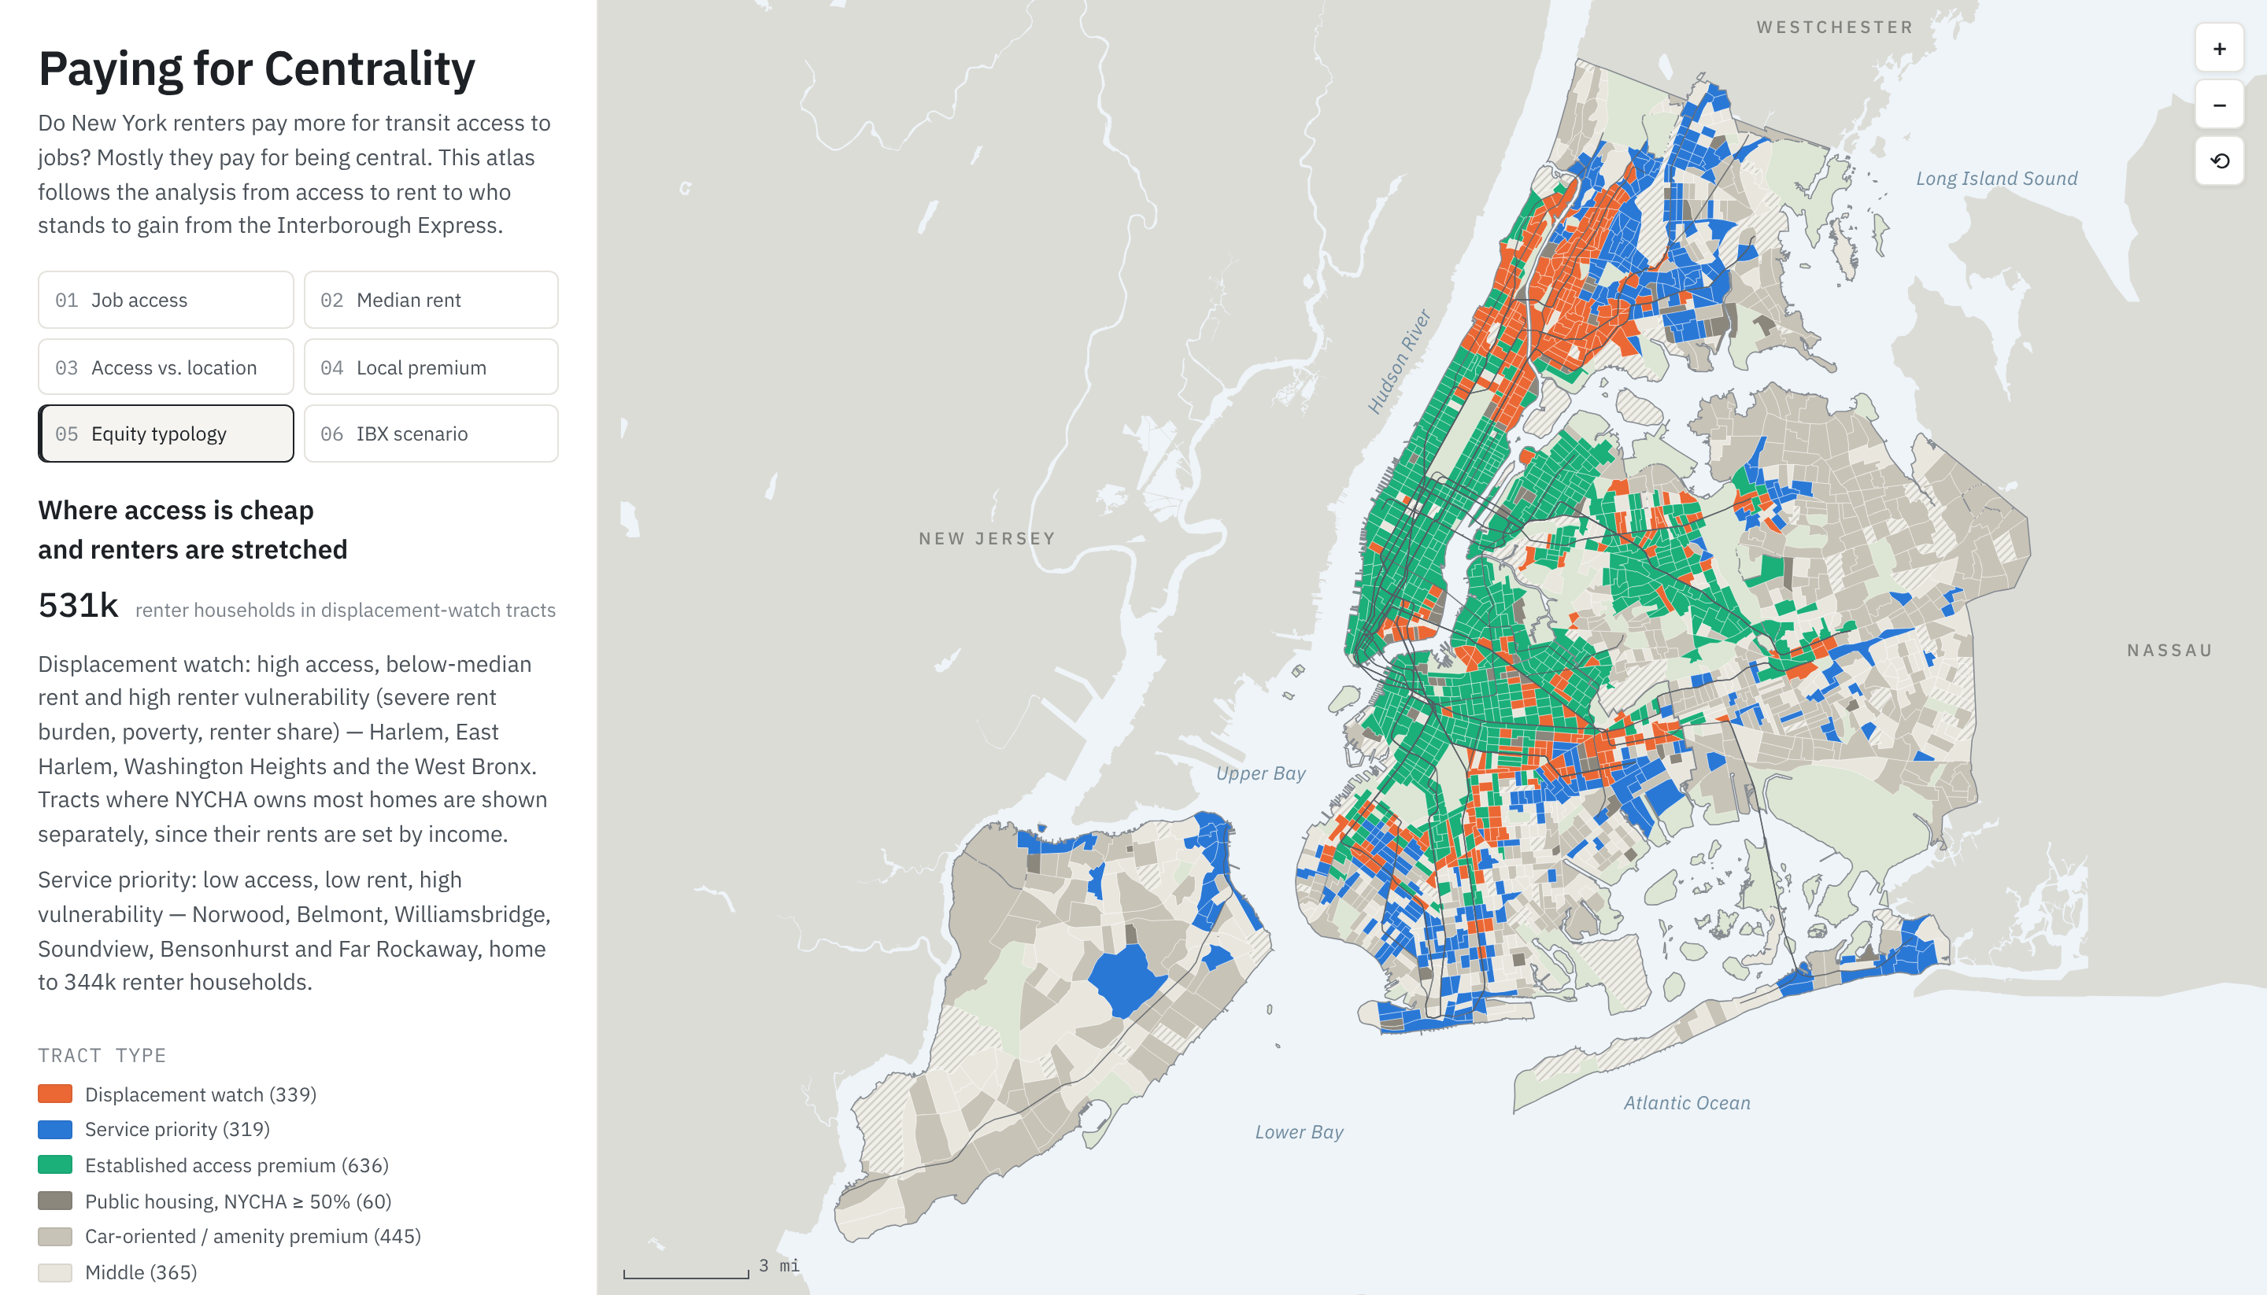
10 Interborough Express Scenario
11 Planning Implications
The IBX would run about 14 miles on the Bay Ridge Branch and Fremont Secondary, from Sunset Park to Jackson Heights. I sited its 18 stations on the right-of-way in OpenStreetMap, wrote a synthetic GTFS feed with MTA's public parameters (32 minutes end to end, trains every 5 minutes) and re-routed every tract with the baseline settings.
Monitor before opening day where gains meet priced markets: tenant services and rent-regulated preservation in Ocean Hill, Bushwick, East Flatbush, Flatbush and Ridgewood.
Protect transit-rich, low-rent neighborhoods such as Upper Manhattan and the West Bronx; rezonings there need firm affordability requirements.
Target bus priority and frequency at service-priority tracts such as Norwood, Soundview, Bensonhurst and Far Rockaway.
Report accessibility gains by renter vulnerability alongside riders and travel-time savings in project evaluations.
1.89M
residents in 624 tracts gain ≥ 5% access
+20%
median gain in gaining tracts (13% at 60 min)
Interactive atlas chesterchen2003.github.io/paying-for-centrality
Code and data github.com/ChesterChen2003/paying-for-centrality
70%
of their renters are in the two most vulnerable quartiles (62% citywide)
0.4–1.7%
illustrative rent pressure, median (2.1% where access is already priced)
113 tracts
123k renter HH flagged by the precautionary screen

