Slide 1
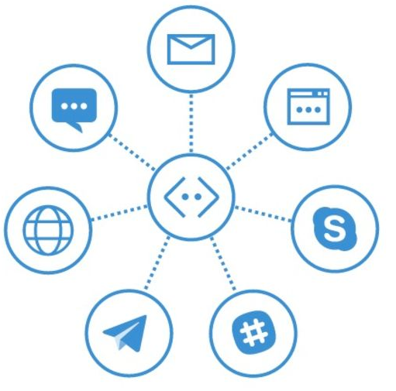

Logging Chat Conversations with Bot Framework
Mithun Prasad, PhD Applied Data Scientist
Artificial Intelligence Group

Slide 2
Agenda
Why Log?
Intercept Messages
Code Highlights

Slide 3
Why Log: Privacy Implications
Bot Framework does not automatically save conversation
Capturing conversational details can potentially capture private information
Bots and users may not wish to share with outside parties

Slide 4
Why Log: Chat History
Learning to chat
Question-answering
Personality for Your Chatbot
Retrieval-based models
Lookup (with various degrees of sophistication) from a predefined set of answers

Slide 5
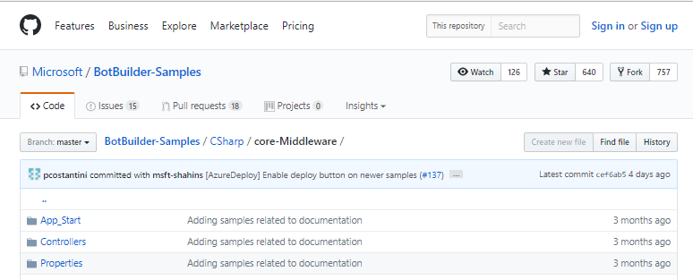
Intercept Messages
Middleware functionality enables your bot to intercept all messages that are exchanged between user and bot
For each message that is intercepted
Save the message to data store
Create a conversation log
https://github.com/Microsoft/BotBuilder-Samples/tree/master/CSharp/core-Middleware

Slide 6
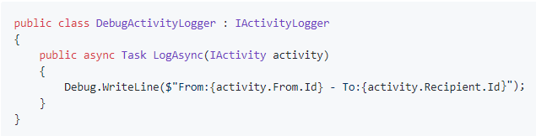
Code Highlights
Implementation of the IActivityLogger
Microsoft.Bot.Builder.History namespace provides interfaces and classes for performing intercepts
IActivityLogger: Contains the definition of the functionality that a class needs to implement to log message activities
Log what you want in the LogAsync method

Slide 7
Life Cycle Events
Application life cycle
Application raises events that you can handle and calls particular methods that you can override
To handle application events, you can create a file named Global.asax in the root directory of your application
Application_Start Event
Application_Start method is called only one time during the life cycle of an application
Perform startup tasks
Application_End Event
Called once per lifetime of the application before the application is unloaded

Slide 8
Conclusion
Chat history can be useful for advanced analytics and monitoring
IActivityLogger interface to log
Life Cycle Events in Global.asax
Store logs anywhere

Slide 9

LAB: BotsLoggingLab

