Slide 1
If you are buying a Kit - Aero Open Hand
Things you Might need :
Proto Board - 4PCS Breadboards Kit Include 2PCS 830 Point 2PCS 400 Point Solderless Breadboards for Proto Shield Distribution Connecting Blocks: Amazon.com: Industrial & Scientific
DC Power Supply - Amazon.com: inShareplus 6V Low Voltage Power Supply, Transformer, Power Adapter, 10A 60 Watt Max, AC 100-240V to DC 6V, with 5.5/2.1 DC Female Barrel Connector : Electronics
Seeed Studio ESP32S3 - Amazon.com: Seeed Studio XIAO ESP32S3-2.4GHz Wi-Fi, BLE 5.0, Dual-core, Battery Charge Supported, Power Efficiency and Rich Interface, Ideal for Smart Homes, IoT, Wearable Devices, Robotics … : Electronics
Pin Headers - HiLetgo 20pcs 40P 2.54mm Pitch Single Row Pin Header Strip 40Pin 2.54mm Pitch: Amazon.com: Industrial & Scientific
3 Jumper Wires Pin - Pin (Male to Male) - Antrader Multicolored Breadboard Jumper Wires 40 Pin 10CM Male to Male Ribbon Cables: Amazon.com: Industrial & Scientific
Soldering Material

Slide 2
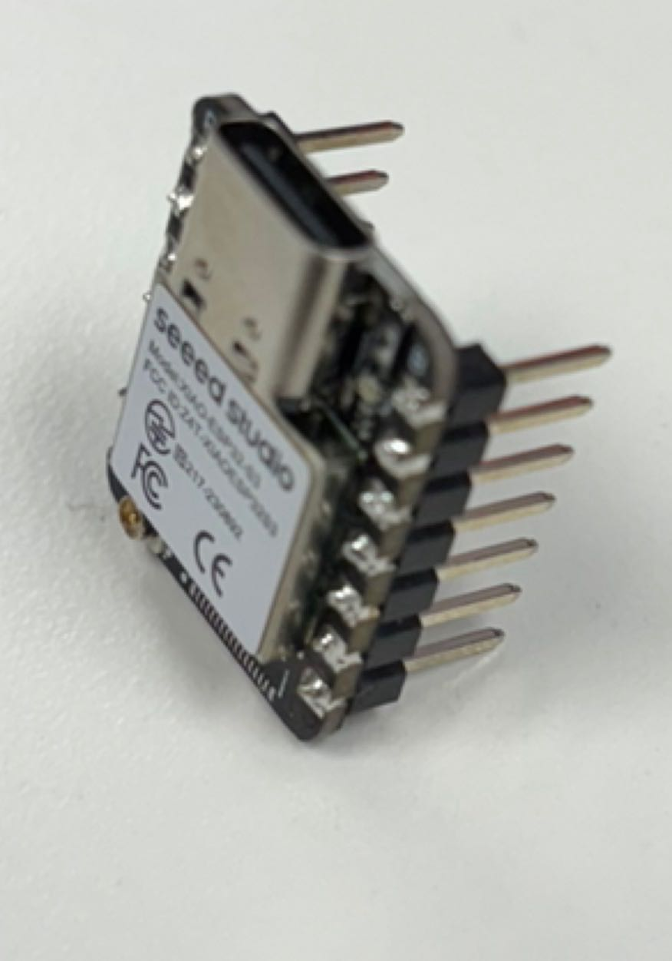
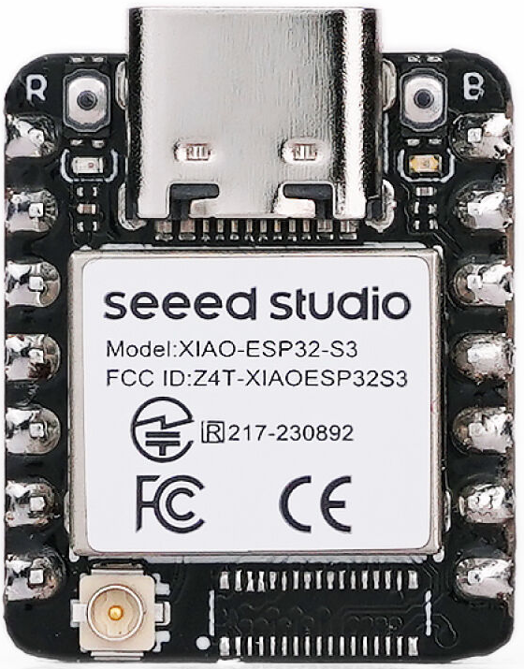
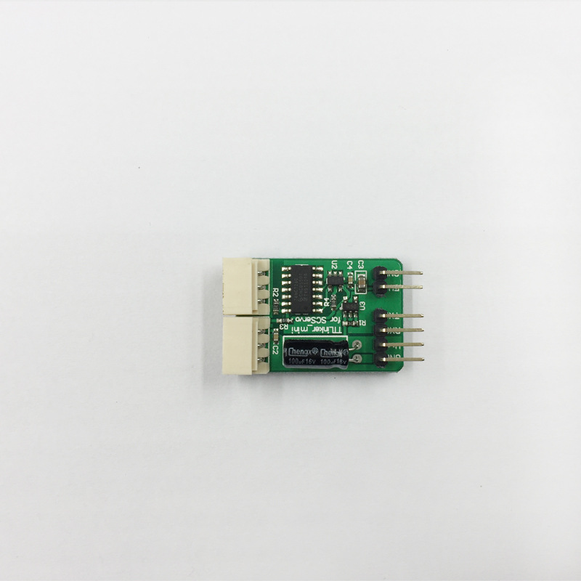
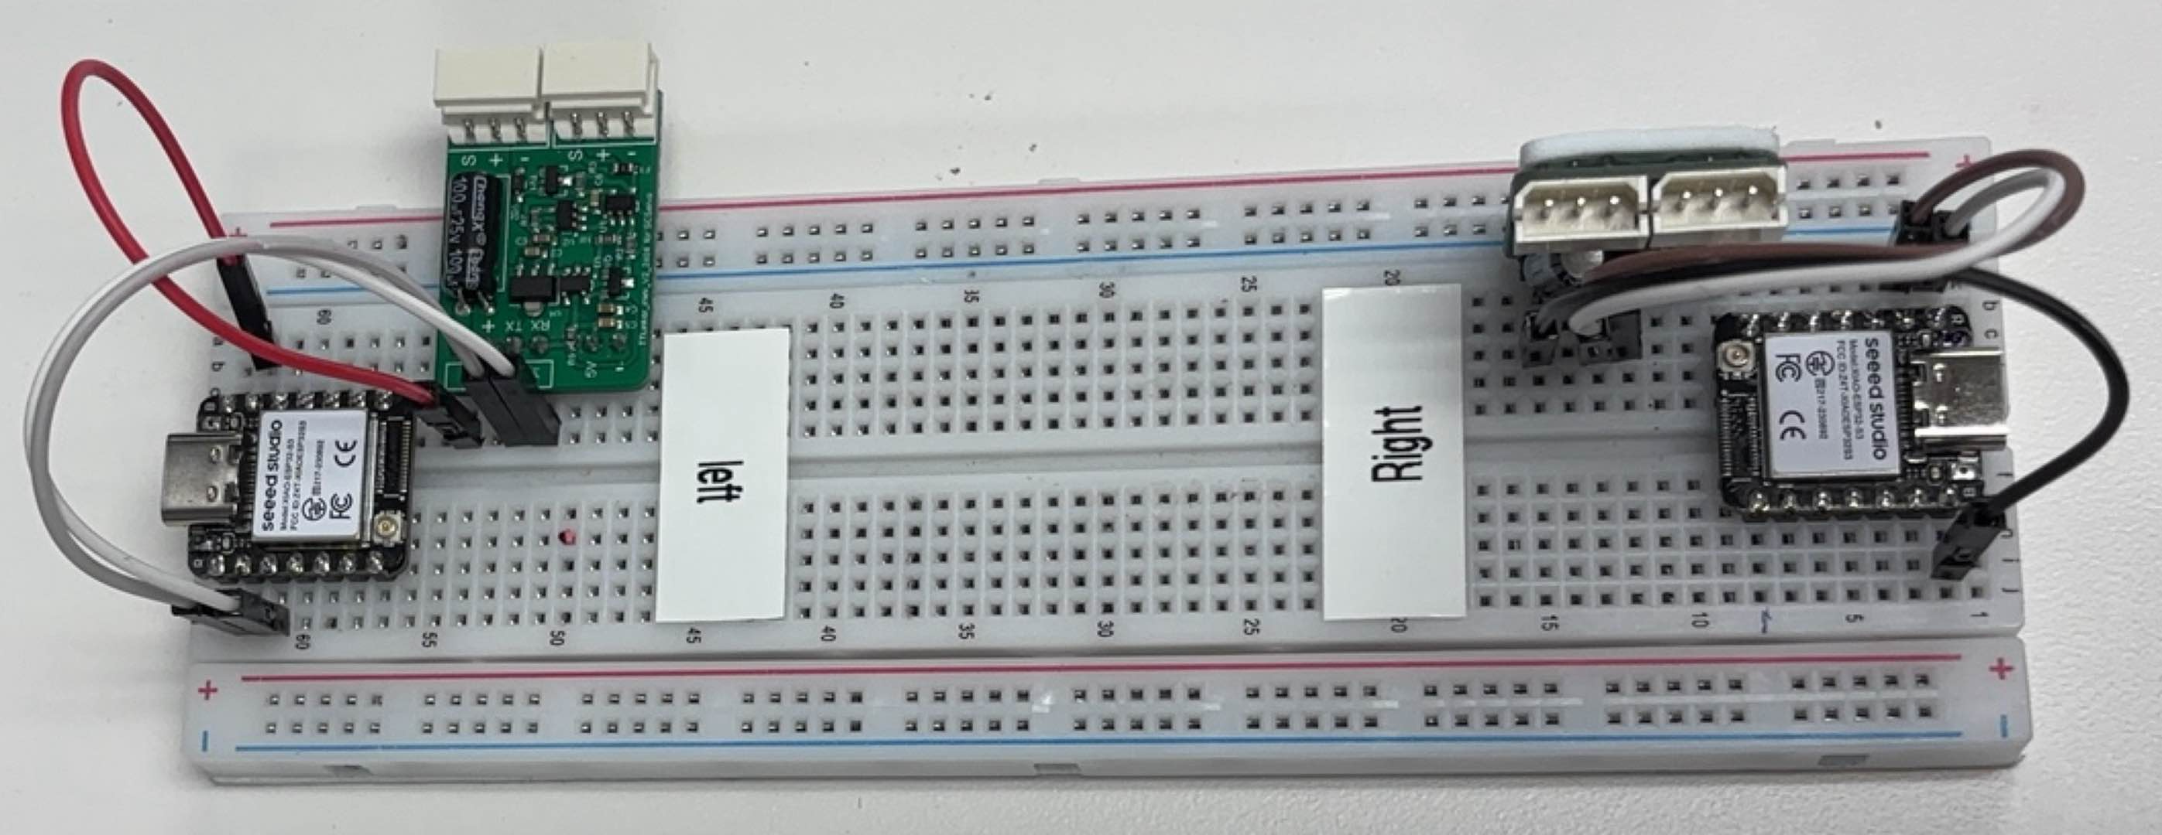
Next Step: Solder Pin Headers to your ESP32 S3
Take out 3 Pin to Pin headers and the TTLinker Mini Servo Board.
Do the Connections on Protoboard
ESP TX TX
ESP RX RX
GND GND
Once ESP is Soldered, Try to use Multimeter to check
if any connections are not shorted Together.
GND
ESP TX
ESP RX
Once Setup is Done,
It should look like this.
Note: This setup is do to control 2 hands , Left to Control Left hand.
Right Indicates the same setup to control right hand.
It contains the same TTLinker mini board, Just at different angles.

Slide 3
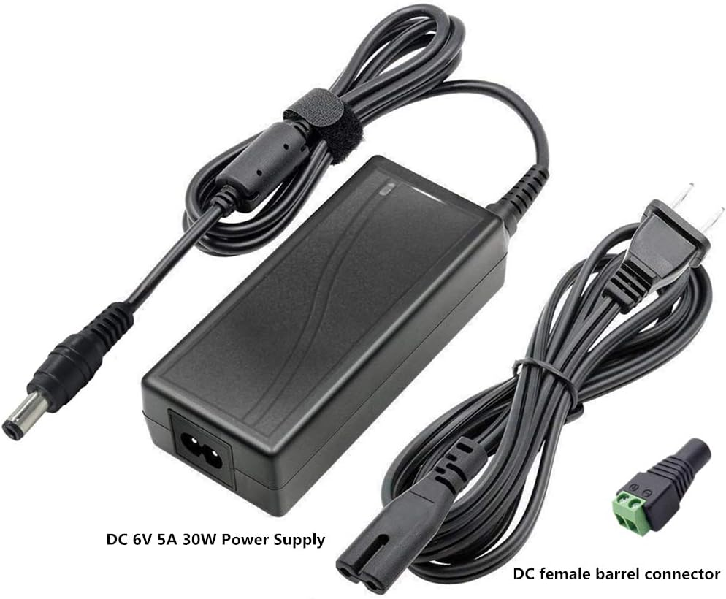
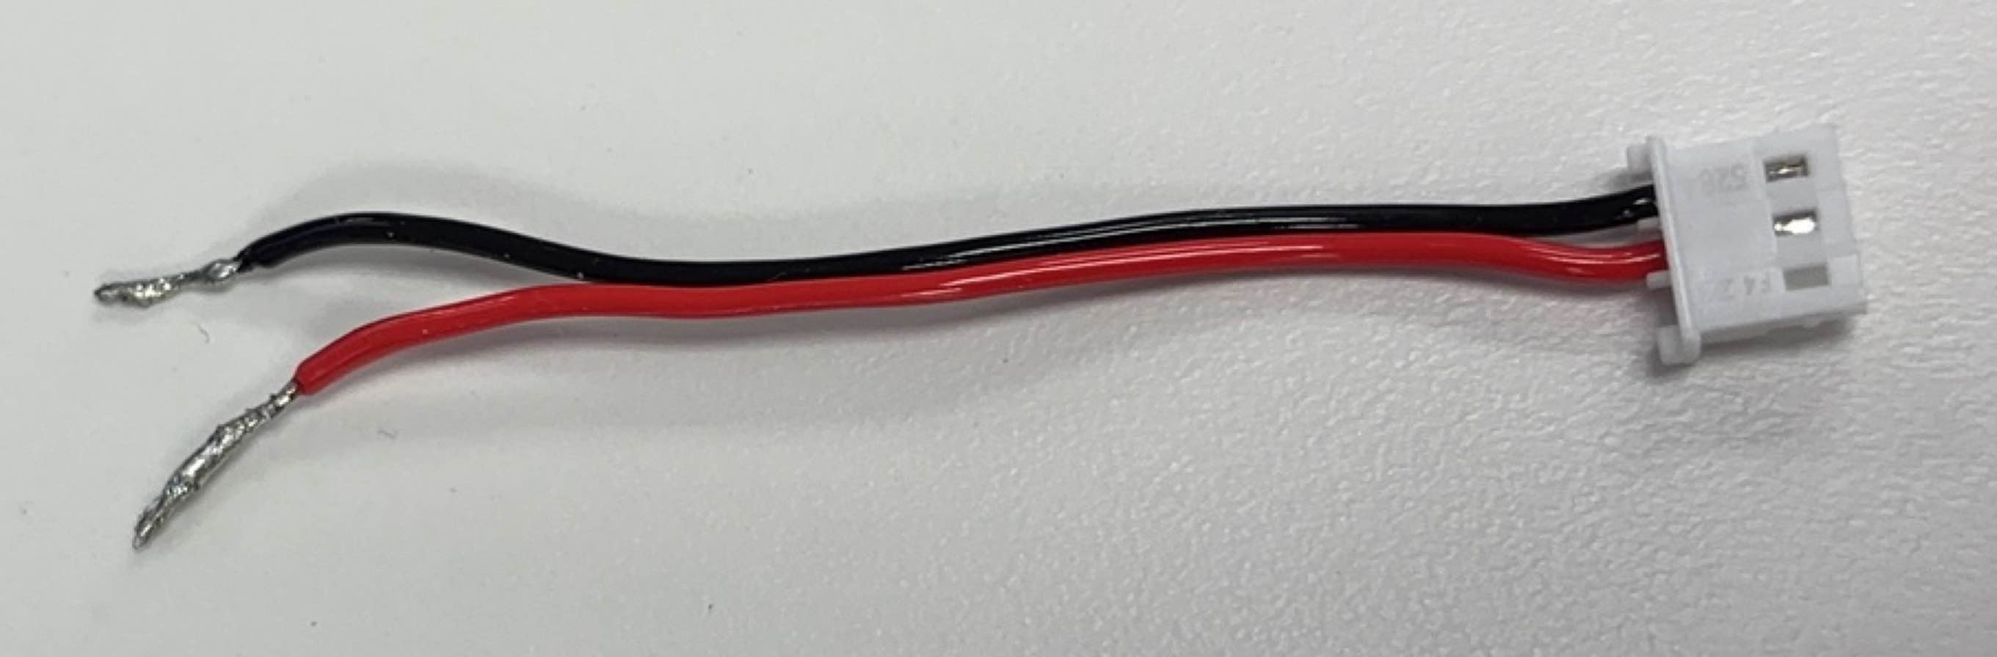
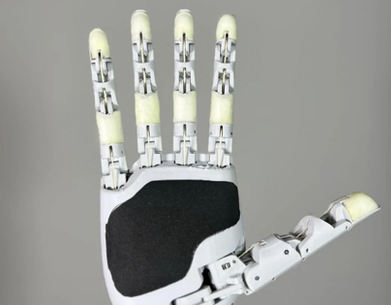
Once Protoboard is Setup,
You need stable 6V 10A supply and a 3P Molex Connector and all set , Ready to go.
Connect to one of the
2 plugs of the TTL Linker Mini
Power
6V 10A
Servo Cable of Hand

Slide 4
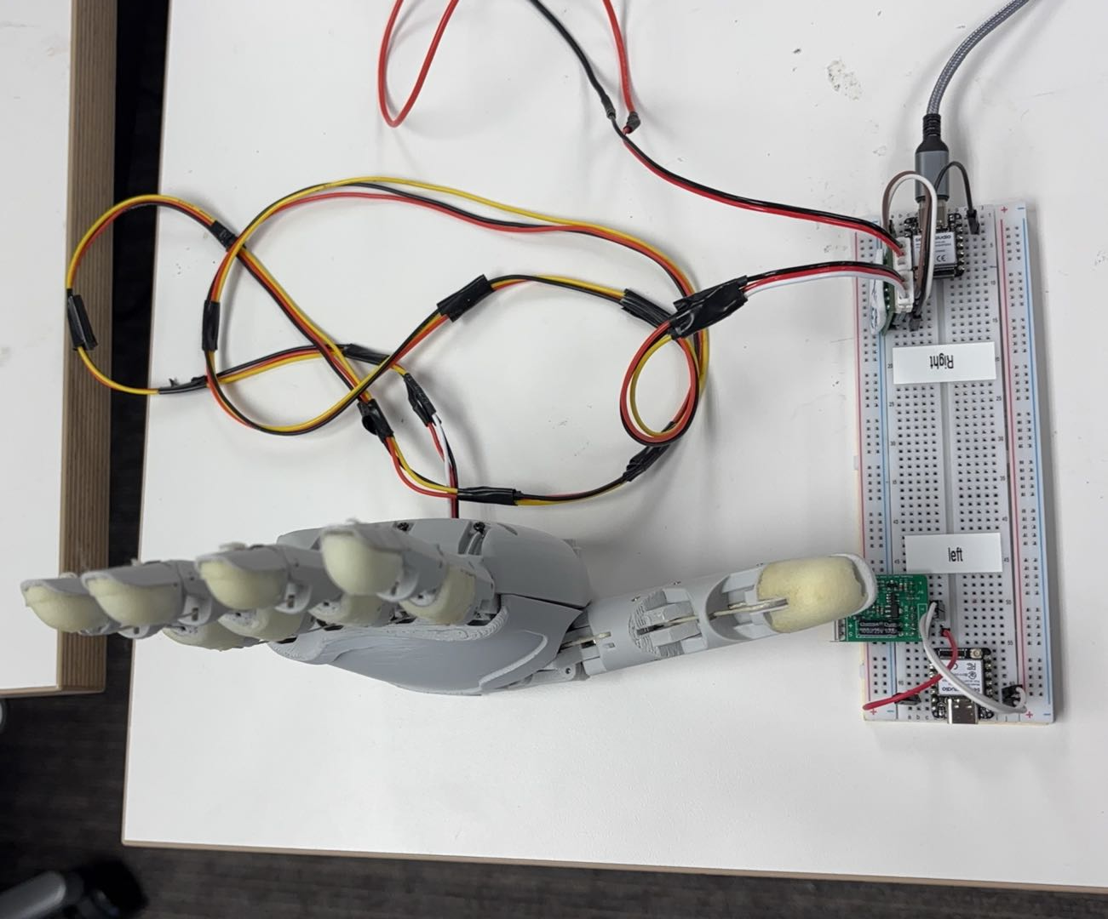
DC Power Supply 6V 10A
USB C to PC
Right Hand
Not Sure, What to do Next ?
Dig into our SDK - aero-hand-open/sdk at main · TetherIA/aero-hand-open
Documentation - Aero Hand Open | Aero Hand

Slide 5
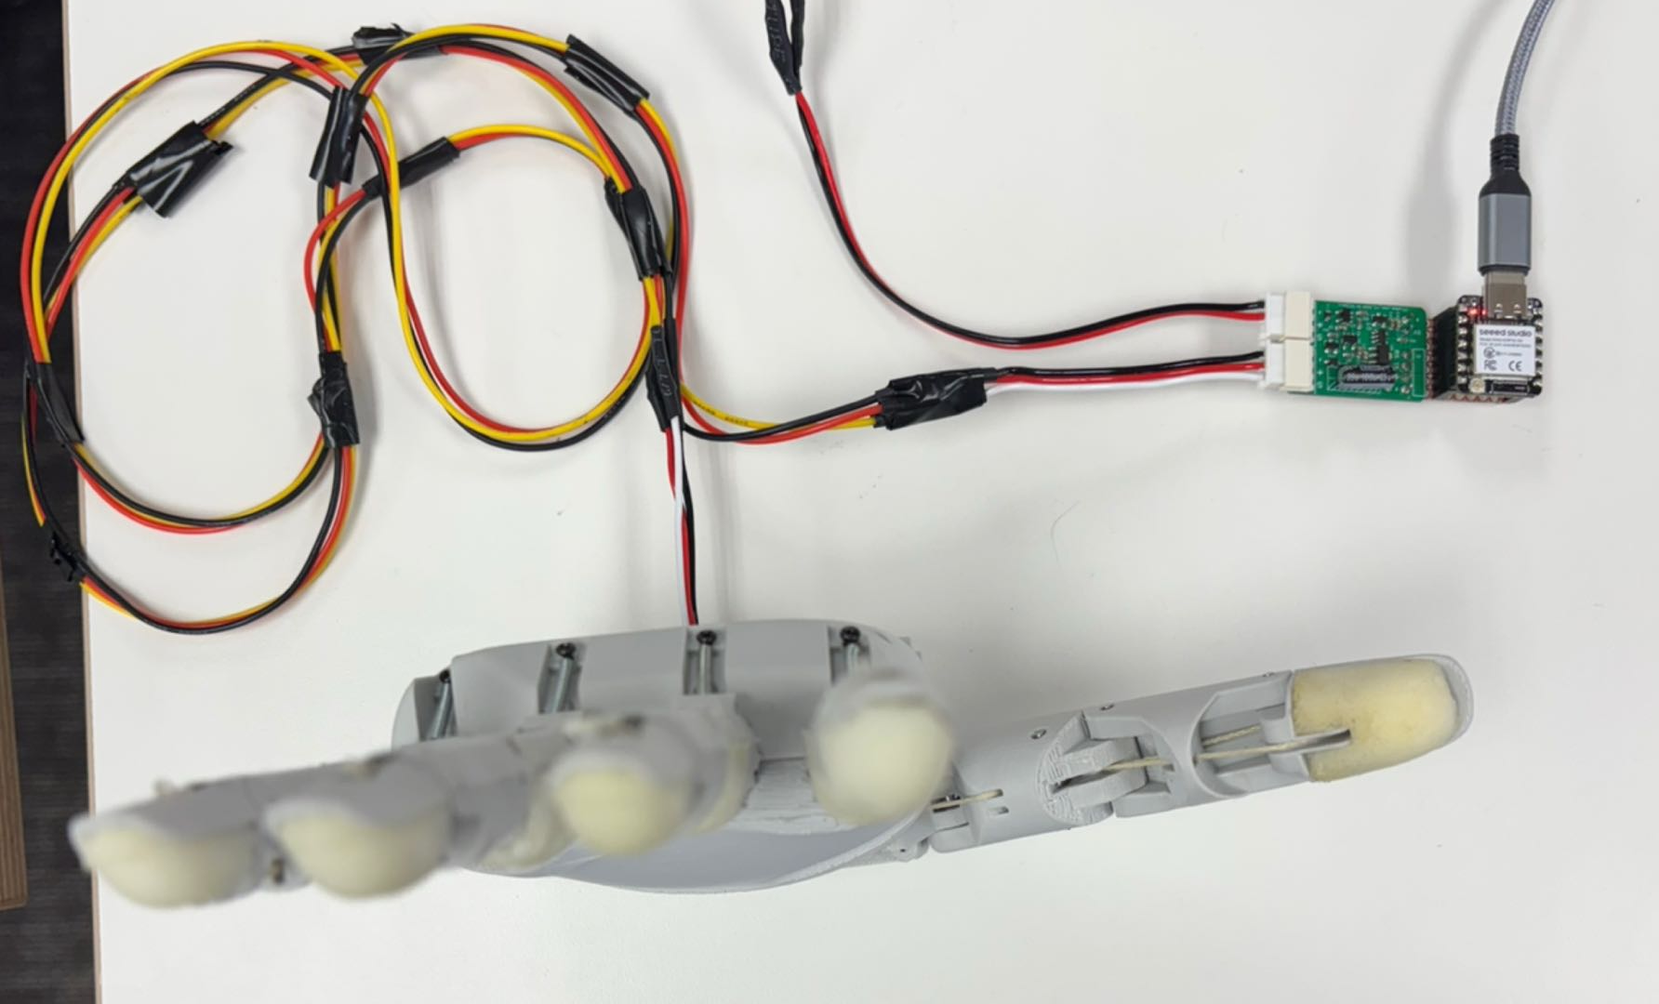
DC Power Supply Stable 6V 10A
USB C to PC
Right Hand

