Slide 1

Realtime Earthquake Prediction
RUPINDER SINGH RANA
(102117128)
CHETAN AGGARWAL
(102117133)

Slide 2
Overview
* Countless dollars and entire scientific careers have been dedicated to predicting where and when the next big earthquake will strike.
* This project aims a simple solution to above problem by predicting or forecasting likely places to have earthquake in next 7 days.
* For user-friendly part, this project we have taken data which is updated every minute provided by USGS.gov and predicts next likely place world wide to get hit by an earthquake, hence a realtime solution is provided.

Slide 3
Our Approach
* The goal of this project is to predict where likely in the world and on what dates the earthquake will happen
* Given geological locations, magnitude and other factors in dataset from https://earthquake.usgs.gov/earthquakes/feed/v1.0/csv.php for 30 days past which is updated every minute, we predict or forecast 7 days time in future that is yet to come, the places where quake would likely happen.
*The model will be trained with Adaboost classifier (RandomForestClassifier and DecisionTreeClassifier) and compared with XGBoost based on AUC ROC score and recall score due to the nature of problem (i.e binary classification).

Slide 4

Dataset
Real time data that updates every minute on https://earthquake.usgs.gov/earthquakes/feed/v1.0/csv.php for past 30 days. Below is the feature description of the dataset with 22 features and 11623 samples at the time of training.

Slide 5
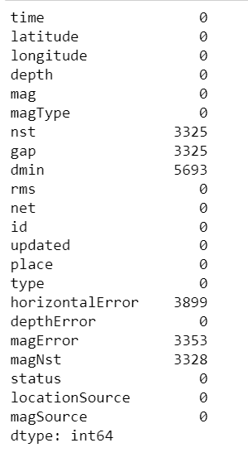
Exploratory Data Analysis and Data preprocessing
Data Info:-
Here shows the null value counts for some features and what to do with that.

Slide 6
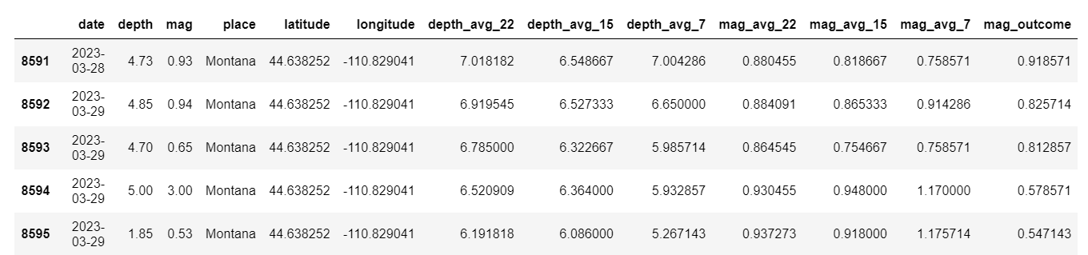
We can see lots of null values of certain features, but as part of prediction most of the features that address 'error' in measurement have missing values, thus for feature selection we consider only certain features in final dataframe, hence I choose simply drop or ignore the null values.
I have done some feature Engineering based on some considerations on my model as follows:
Set rolling window size for future prediction based on past values with fixed window size in past
I have created 6 new features based on rolling window size on average depth and average magnitude.
A final outcome 'mag_outcome' has been defined as target values and the output is considered as shifted values from set rolling window of past days eg: '7'. New features include : avg_depth, magnitude_avg for 22,15,7 days rolling window period for training.

Slide 7
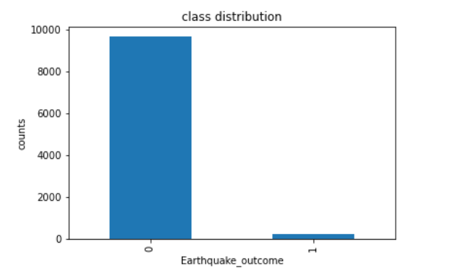
After feature engineering and dealing with null values, the model has imbalance class distribution
For the project I have considered the metrics for treating this imbalance nature with-
Confusion Matrix: A breakdown of predictions into a table showing correct predictions (the diagonal) and the types of incorrect predictions made (what classes incorrect predictions were assigned).
Recall: A measure of a classifiers completeness
ROC Curves: Like precision and recall, accuracy is divided into sensitivity and specificity and models can be chosen based on the balance thresholds of these values.
Moreover the reason for choosing this metrics not only helps me improve class imbalance confirmation bias but also due to my nature of problem to be solved of earthquake prediction False negative must be penalized more.

Slide 8
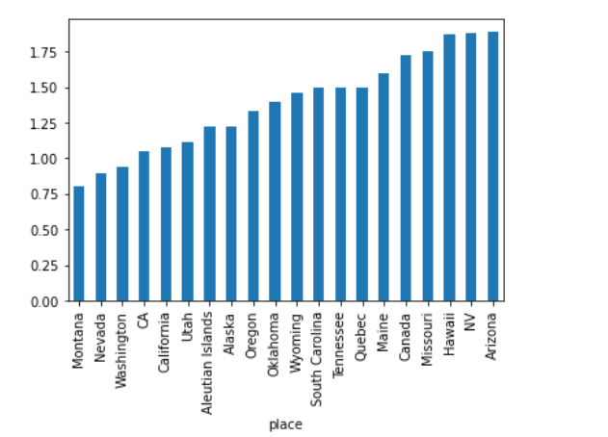
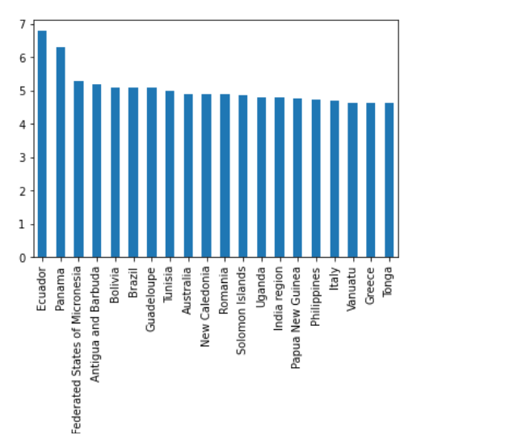
Lets analyze places with top 20 higher & lower number of magnitude mean
Top 20 places where lowest magnitude mean quake experienced in past 30 days.
Top 20 places where highest magnitude mean quake experienced in past 30 days.

Slide 9
Model implementation and methodology
After preprocessing with removing null values, and feature engineering as discussed above, I performed Boosting algorithms for classification problem.
1. classifier with estimator as DecisionTreeClassifier
2. classifier with estimator as RandomForestClassifier
3. Finally we tried Xgboost algorithm.

Slide 10
Improvement and evaluation
We have used gridsearch CV for improving model and hyperparameter tunning on classifier with base estimators as DecisionTreeClassifier and RandomForestClassifier.
Using the same hyper parameters We trained XGBoost. As mentioned above, metrics for evaluation is roc_auc score and recall.

Slide 11
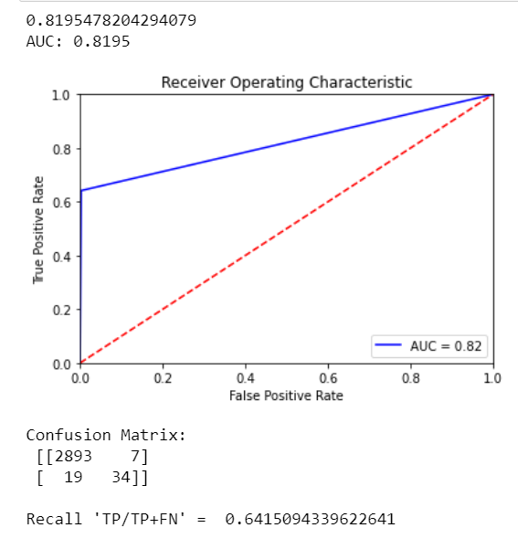
DecisionTreeClassifier adaboost
With adaboost decision tree classifier and hyper parameter tunning, we get area under curve (score) = 0.8195
higher the auc score, better is the model since it is better at distinguishing postive and negative classes.
Make a note here that we get from confusion matrix, False negative = 34 and Recall score =0.6415. We need this value apart from auc score that we will analyze later when we have tested with diffferent models below
I got Best estimator with max_depth = 6 and for n_estimators = 500 after running gridSearchcv.
model selection is based on metrics score after comaparing all the algorithm score

Slide 12
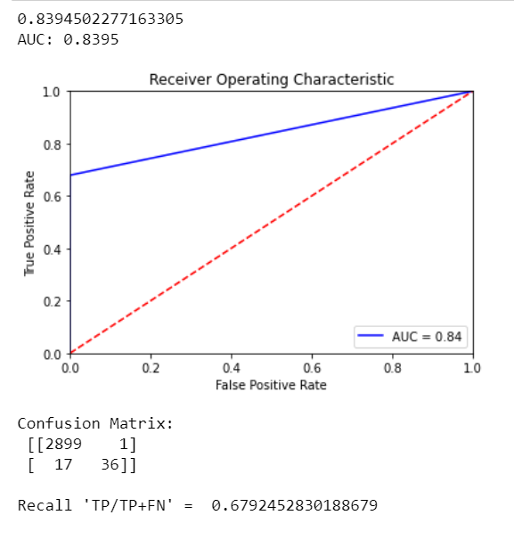
RandomForestClassifier adaboost
Below is the auc score for adaboost RandomForest classifier with 0.8395 which is slightly higher than Decision tree classifier
Moreover when we look at confusion matrix, False Negative=36 and `Recall score = 0.67924' can be observed which is slightly higher than recall score of decision tree. Thus performs better than decision tree adabooost
Random forest gets best estimator with max_depth = 7 and max_feature = sqrt(features)
Model selection is based on metrics score after comaparing all the algorithm score

Slide 13
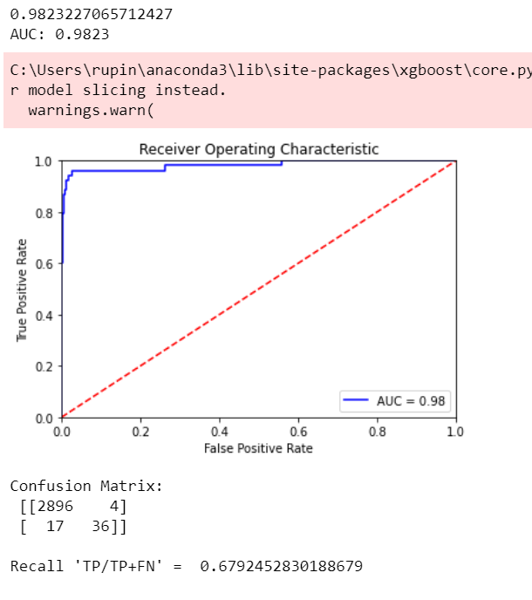
XGBoost model
I have also tested with xgboost model below with similar parameters as I got above, since grid search CV was taking lot of time for xgboost.
With Estimators = 500 , and learning rate =0.03 as we can see this significantly gives higher AUC score of almost 0.98 and also False negative = 36 which is similar Random Forest adaboost but xgboost has higher True positive and less False Positve compared to Random forest adaboost. i.e Recall score = 0.6924 which is similar adaboost Random Forrest tree. But XGboost is really good at classifying positive and negative classes and also better aur_roc_score = 0.9823. We can see above that xgboost algorithm has higher auc score (0.9823) than adaboost decision tree and random forest, as it is evident from the ROC curve.
Since Xgboost model having higher recall & auc_score than other alorithms, it can be considered more robust as it has ability to handle class imbalance with recall score, and deal good with False negative values and penalize it which is important for our task. i.e reduce False Negative values. Hence we consider xgboost for prediction of live data and deployment in the application.

Slide 14
Improvement and conclusion
Though XGboost model has given Higher roc_auc and better recall, I believe any work given always has some scope for improvement and in here we could also use RNN or LSTM for time series or rather event series forecasting. LSTMs have hidden memory cells that help in remembering and handeling time series or event series data well. Moreover for xgboost I have just used hyper parameters from already tuned Adaboost models, but we can also tune xgboost hyper parameter and find best parameters using GridSearchCV or RandomSearch.
Some final thoughts:
So far the model looks good with xgboost as chosen model for predictions in web app haveing higher auc score and higher recall_score as I have explained under XGBoost result section why auc and recall score are chosen.
Our main Aim is to predict wether earthquake will happen or not at a given day and place. So we definitely would not like the model with higher False Neagtive values , since its more dangerous to predict as no earthquake while in reality earthquake happend than predicting earthquake will happen given in reality it did not. We can allow False positive more than False negative
After seeing these comparision on auc_roc score, confusion matrix, and recall score, since all the above algorithm have given similar result with slightly different recall scores, Xgboost with FN=36 but with higher auc_score 0f 0.98 performs over-all better. Hence for webapplication deployment, I have chosen Xgboost as it also faster than adaboost.

Slide 15
THANK YOU…………………

