Slide 1
DEVOPS ENGINEERING • PROJECT REVIEW
Smart Irrigation
Alert Dashboard
PROJECT SNAPSHOT
5
Problem statement, implementation and Ubuntu demo readiness
seeded farm zones
Java 21 • Spring Boot
Dockerfile • Jenkinsfile
Ansible playbook
Chetan Katkar
Roll No. 23102A0024 • BE CMPN-A
PROTOTYPE
Tasks 1–15 consolidated review | 29 October 2026
Notes:
Sources: CMPN-A.xlsx, BE CMPN A row for 23102A0024; repository source and Tasks 1–15 folders..
Presenter note: Set expectations: this is a prototype and evidence review. Distinguish source implementation from successful execution evidence.

Slide 2
PROBLEM STATEMENT
The problem: irrigation decisions arrive too late
Calendar-based watering and manual field checks make it hard to see which zone needs attention.
WATER WASTE
DELAYED RESPONSE
LOW VISIBILITY
Routine schedules
Manual inspection
Scattered readings
Water may be applied when soil already has enough moisture.
A dry zone can remain unnoticed between field checks.
Operators need a shared view of zones, current readings and alerts.
Scope note: the repository prototype simulates sensor readings; no field hardware or measured water savings are evidenced.
CHETAN KATKAR • 23102A0024
02 / 14
Notes:
Sources: Task-01/Problem_Statement.pdf; Task-03 requirements documents; current source code..
Presenter note: The assignment documents set alert and reliability targets, but no measurements establishing those targets were found.

Slide 3
PROPOSED SOLUTION
A small dashboard turns readings into action
The MVP makes the latest sensor state visible and supports a simulated response.
01
02
03
04
05
Five zones
Status at a glance
Critical alerts
Find and filter
Simulate & irrigate
Seeded sample data for a small farm.
Moisture, temperature and status per zone.
Highlights readings below 30% moisture.
Search by zone or crop; filter statuses.
Update readings or set moisture to 75%.
SIMULATED SENSOR DATA
CHETAN KATKAR • 23102A0024
03 / 14
Notes:
Sources: src/main/java/com/irrigation/SmartIrrigationApplication.java; SensorApiController.java; src/main/resources/static/index.html..

Slide 4
ARCHITECTURE
How the prototype is wired
Current implementation path
WEB UI
REST API
DATA LAYER
DATABASE
HTML / CSS / JS
→
Spring Boot
→
Spring Data JPA
→
H2 in-memory
Zone dashboard
SensorApiController
SensorRepository
Resets on restart
RUNTIME
Java 21 • Maven 3.9.12 • Spring Boot 3.2.5 • App listens on port 8085
CHETAN KATKAR • 23102A0024
04 / 14
Notes:
Sources: pom.xml; src/main/resources/application.properties; source packages controller, model and repository..
Presenter note: The architecture diagram in older project docs includes a separate alert engine/service, which is not present as a separate component in current code.

Slide 5
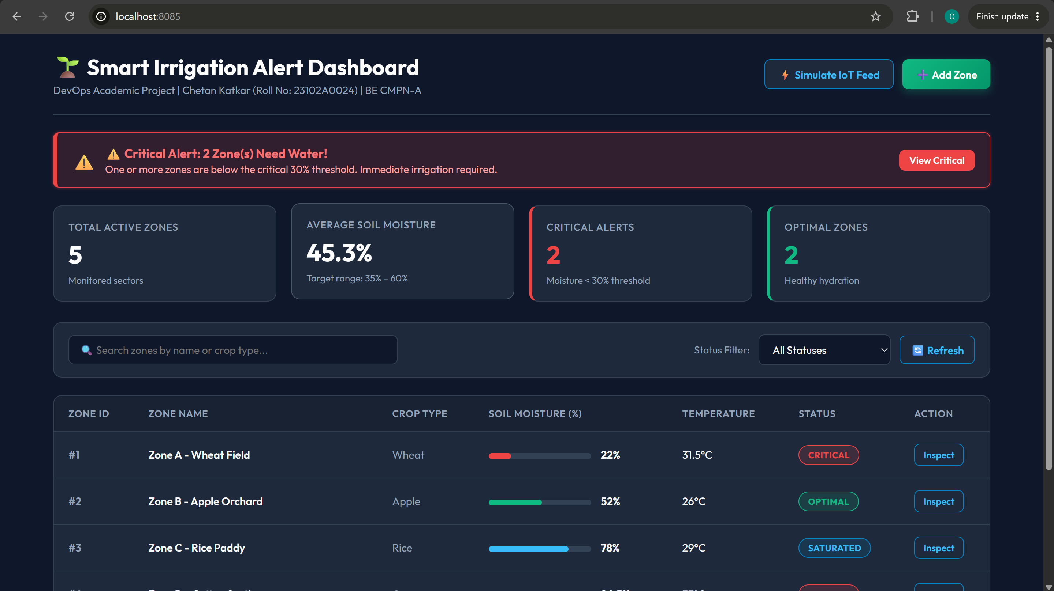
APPLICATION WALKTHROUGH
The dashboard shown in the project evidence
CAPTURED 11 OCT 2026
5 zones
2 critical alerts
45.3% average moisture
This is historical evidence from Windows at localhost:8085. The Ubuntu runtime has not yet been verified in this session.
CHETAN KATKAR • 23102A0024
05 / 14
Notes:
Sources: Task-06/Screenshot 2026-10-11 155327.png; Task-06 implementation notes..
Presenter note: Call out that the screenshot proves a prior UI state only. It is not a live Ubuntu demo.

Slide 6
APPLICATION BEHAVIOR
Business rules in the current code
Moisture status bands
< 30%
30–60%
> 60%
CRITICAL
OPTIMAL
SATURATED
SIMULATION
IRRIGATION
Bounded fluctuations
Set to 75%
Moisture shifts by ±5 points (clamped 5–95); temperature changes by ±1°C (clamped 15–45°C).
The simulated irrigation endpoint sets the zone moisture to 75% and refreshes its status and timestamp.
CHETAN KATKAR • 23102A0024
06 / 14
Notes:
Sources: src/main/java/com/irrigation/model/SensorZone.java; src/main/java/com/irrigation/controller/SensorApiController.java..

Slide 7
APPLICATION BEHAVIOR
API surface available in the source
All routes use the /api prefix.
GET
/sensors
List zones
POST
/sensors
Create zone (zone name required)
GET
/alerts
List zones below 30% moisture
GET
/summary
Counts and average moisture
POST
/simulate
Simulate updates for all zones
POST
/sensors/{id}/irrigate
Set selected zone to 75% moisture
Basic create validation checks for a non-empty zone name; broader numeric input validation is not present.
CHETAN KATKAR • 23102A0024
07 / 14
Notes:
Sources: src/main/java/com/irrigation/controller/SensorApiController.java..

Slide 8
SOURCE CONTROL
Git history records a structured workflow
PLAN
BRANCH
REVIEW
MERGE
RELEASE
Task list & stories
›
feature/sensor-dashboard
›
PR #4 recorded
›
Merge commit in local history
›
v1.0 tag present
LOCAL REPO STATE
main is one commit ahead of origin/main
The self-building Dockerfile commit has not been pushed. A repository screenshot shows PR #4 before merge; local Git history contains a later merge commit.
PUSH PENDING
CHETAN KATKAR • 23102A0024
08 / 14
Notes:
Sources: .git refs and commit log; Task-04 and Task-05 screenshots; repository remote configuration..
Presenter note: The current remote is HTTPS. GitHub no longer accepts an account password for Git pushes; use SSH or a personal access token kept private.

Slide 9
CI/CD
Jenkinsfile defines a pipeline; deployment is unfinished
01
02
03
04
05
CHECKOUT
→
COMPILE
→
TEST
→
PACKAGE
→
DEPLOY
Git source
Maven package
Maven tests
Build output
Echo only
CONFIGURATION EVIDENCE
CURRENT JENKINSFILE
Jenkins job screenshot
Linux shell steps
Shows a job config for branch develop, but the dashboard screenshot has no jobs and an offline built-in node.
The deploy stage only prints a message; no Docker publish or live health check is configured.
No current successful pipeline run or archived test report was found.
CHETAN KATKAR • 23102A0024
09 / 14
Notes:
Sources: Jenkinsfile; Task-07_Jenkins-CI screenshots; Task-08 pipeline docs..

Slide 10
VALIDATION
What is covered—and what remains unproven
SOURCE TESTS
EVIDENCE GAPS
5
•
No Selenium/WebDriver test class found
•
Maven dependency fetch was blocked by DNS in this session
MockMvc integration tests
They exercise API behavior in the Spring test context.
•
No Jenkins test report or current pass log found
Do not claim the assignment’s Selenium or timing targets as achieved without a fresh run and captured results.
CHETAN KATKAR • 23102A0024
10 / 14
Notes:
Sources: src/test/java/com/irrigation; pom.xml; current Maven command output; Task-01 acceptance targets..
Presenter note: In this execution environment Maven could not resolve dependencies from Maven Central. That is a session restriction, not proof the user laptop cannot build.

Slide 11
CONTAINERS
Docker image definition is ready to build
Current Dockerfile design
BUILD STAGE
RUNTIME STAGE
NETWORK
Maven 3.9.9 + Temurin 21
Temurin 21 JRE Alpine
Container port 8085
Compiles the project inside the image
Runs as non-root UID/GID 10001
Guide maps host 8086 → container 8085
Current Ubuntu session check
Docker CLI could not reach a daemon socket here. Image build and container state remain unverified.
CHETAN KATKAR • 23102A0024
11 / 14
Notes:
Sources: Dockerfile; docker_commands.md; current docker context/ps command output..
Presenter note: On the laptop, first confirm Docker Engine is active and your user can access it; then build and run the image.

Slide 12
DEPLOYMENT
Ansible automation exists; repeatability needs repair
PLAYBOOK ACTIONS
GAPS TO ADDRESS
Create directories → stop/remove container → run new image → poll API
•
Stops and recreates on every run, so not idempotent
The current playbook contains the intended deployment sequence.
•
Docker service task ignores errors
•
No Docker package/user provisioning
•
No demonstrated rollback or healthy-response log
ANSIBLE NOT INSTALLED IN CURRENT SESSION
Run it only after Docker access and target host settings are configured.
CHETAN KATKAR • 23102A0024
12 / 14
Notes:
Sources: Task-13 and Task-14 Ansible playbooks and docs; current command availability check..

Slide 13
DEMO CHECKLIST
Ubuntu demo runbook: bring the app up first
TERMINAL
OPEN THESE
$ cd ~/Desktop/DevOps-Project/DevOPs-Project
App
http://localhost:8086
$ git status -sb
$ java -version && mvn -version
Jenkins
http://localhost:8080
$ mvn test
$ docker build -t smart-irrigation:local .
$ docker run --rm -p 8086:8085 smart-irrigation:local
Docker dashboard
Open Docker Desktop or your installed UI
The Jenkins URL assumes a local Jenkins service is installed and running.
CHETAN KATKAR • 23102A0024
13 / 14
Notes:
Sources: README.md; docker_commands.md; application.properties; current Ubuntu environment inspection..
Presenter note: Verify localhost app and Jenkins endpoints from the laptop. If Docker is CLI-only, use `docker ps -a` and `docker images` for the terminal demo.

Slide 14
NEXT STEPS
Before the live demo: close these evidence gaps
1
Authenticate Git
Use SSH or a PAT; push the local commit.
2
Prove the build
Run mvn test after dependencies resolve.
3
Run CI
Start Jenkins; configure Git/credentials; capture a passing build.
4
Run Docker
Build image, start container, verify app on :8086.
5
Complete automation
Add Selenium checks; make Ansible repeatable; add health and rollback evidence.
The project UI is demonstrable from historical evidence. Live Ubuntu readiness depends on completing and capturing the checks above.
CHETAN KATKAR • 23102A0024
14 / 14
Notes:
Sources: Synthesis of repository audit, current Ubuntu checks, and Task-01 acceptance criteria..

