Slide 1

SMART FARMING

Slide 2
COMPONENT REQUIRED
1.SOIL MOISTURE SENSOR
2.TEMPERATURE SENSOR
3.MICROCONTROLER
4.PUMP
5.BATTERTY

Slide 3
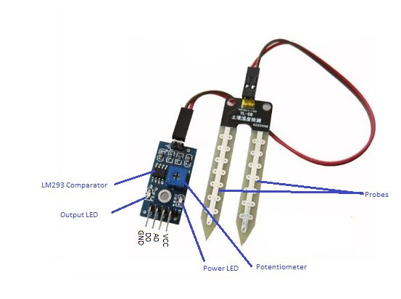
SOIL MOISTURE SENSOR
SPECIFICATIONS
Input Voltage | 3.3 – 5V
Output Voltage | 0 – 4.2V
Input Current | 35mA
Output Signal | Both Analog and Digital
SOIL MOISTURE SENSOR(FC-28)

Slide 4
WORKING OF SENSOR
The soil moisture sensor consists of two probes which are used to measure the volumetric content of water. The two probes allow the current to pass through the soil and then it gets the resistance value to measure the moisture value.
When there is more water, the soil will conduct more electricity which means that there will be less resistance. Therefore, the moisture level will be higher. Dry soil conducts electricity poorly, so when there will be less water, then the soil will conduct less electricity which means that there will be more resistance. Therefore, the moisture level will be lower.

Slide 5
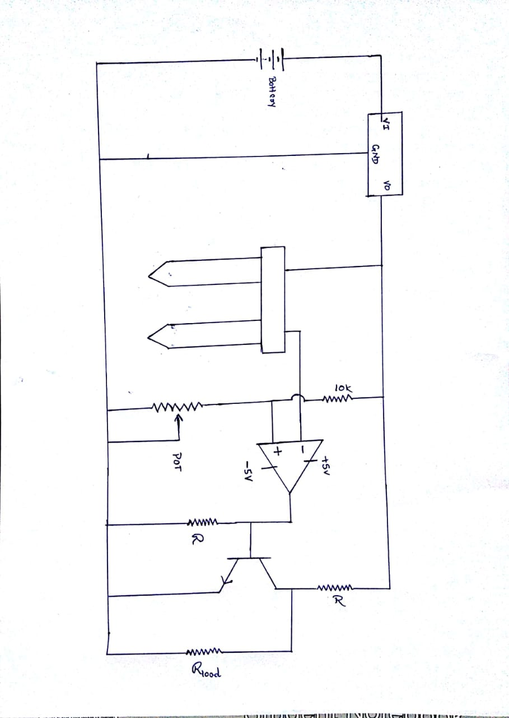
INTERNAL CIRCUIT WORKING

Slide 6
INTERNAL WORKING OF SENSOR
To connect the soil moisture sensor FC-28 in the digital mode, we will connect the digital output of the sensor to the digital pin of the Arduino. The Sensor module contains a potentiometer with it, which is used to set the threshold value. This threshold value is then compared with the sensor output value using the LM393 comparator which is placed on the sensor module.
The LM393 comparator will compare the sensor output value and the threshold value and then gives us the output through the digital pin. When the sensor value will be greater than the threshold value, then the digital pin will give us 5V and the LED on the sensor will light up and when the sensor value will be less than this threshold value, then the digital pin will give us 0V and the light will go down.

Slide 7
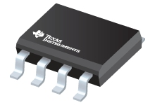
TEMPERATURE SENSOR
SPECIFICATIONS
Power Supply | 2.7-10v
Max current | 230uA
Vref | 1.250v
Hysterisis | 5v
Internal temp sensor output voltage | (6.2mV/c *T)+395mV
LM56

Slide 8
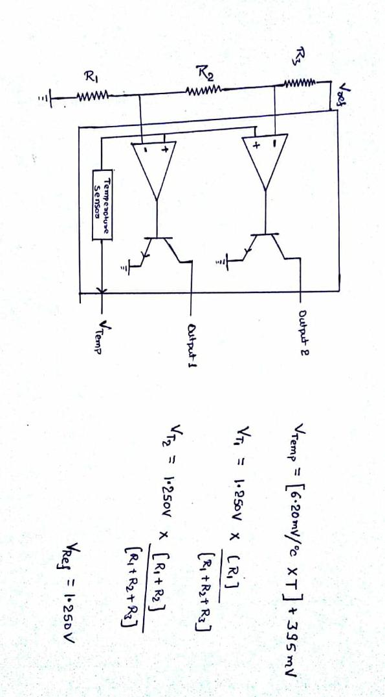
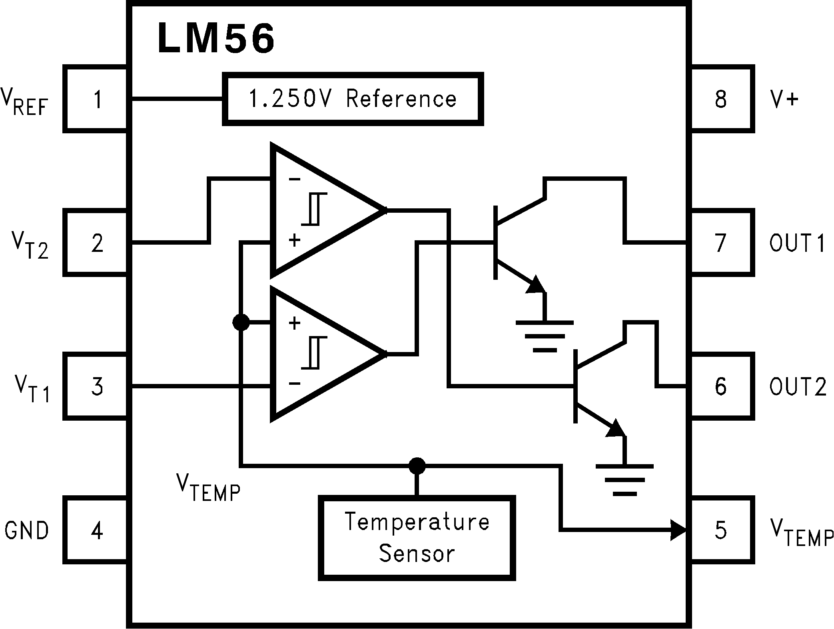
INTERNAL CIRCUIT DIAGRAM

Slide 9
WORKING OF LM56
A temperature sensor produces an analogue or digital output whose strength depends on the temperature of the sensor. Heat is conducted to the sensing element through the sensor’s package and its metal leads.
OUT1 goes LOW when the temperature exceeds T1 and goes HIGH when the the temperature goes below (T1–THYST). Similarly, OUT2 goes LOW when the temperature exceeds T2 and goes HIGH when the temperature goes below (T2–THYST). THYST is an internally set 5°C typical hysteresis.

Slide 10
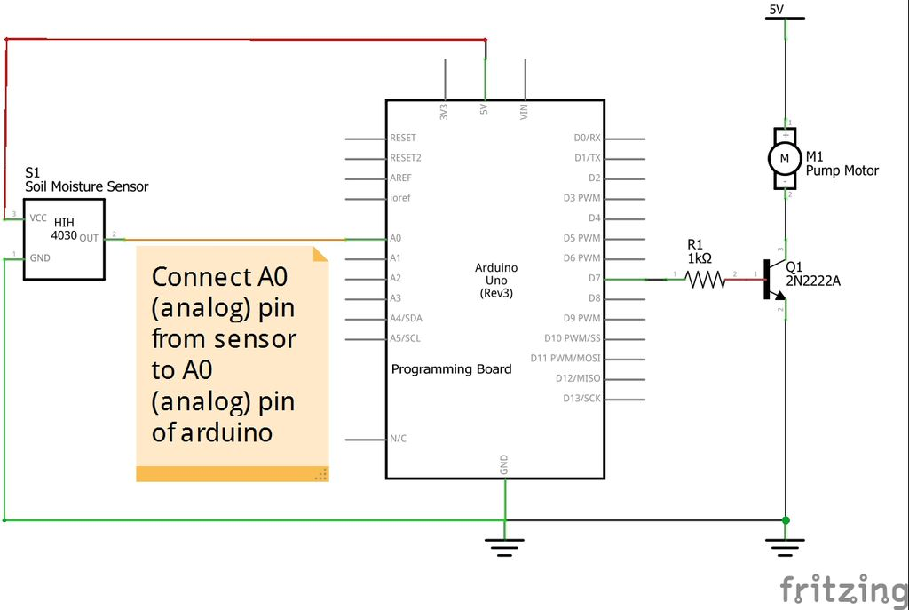
HOW TO MAKE A AUTOMATIC MOTOR USING SOIL MOISTURE SENSOR

Slide 11
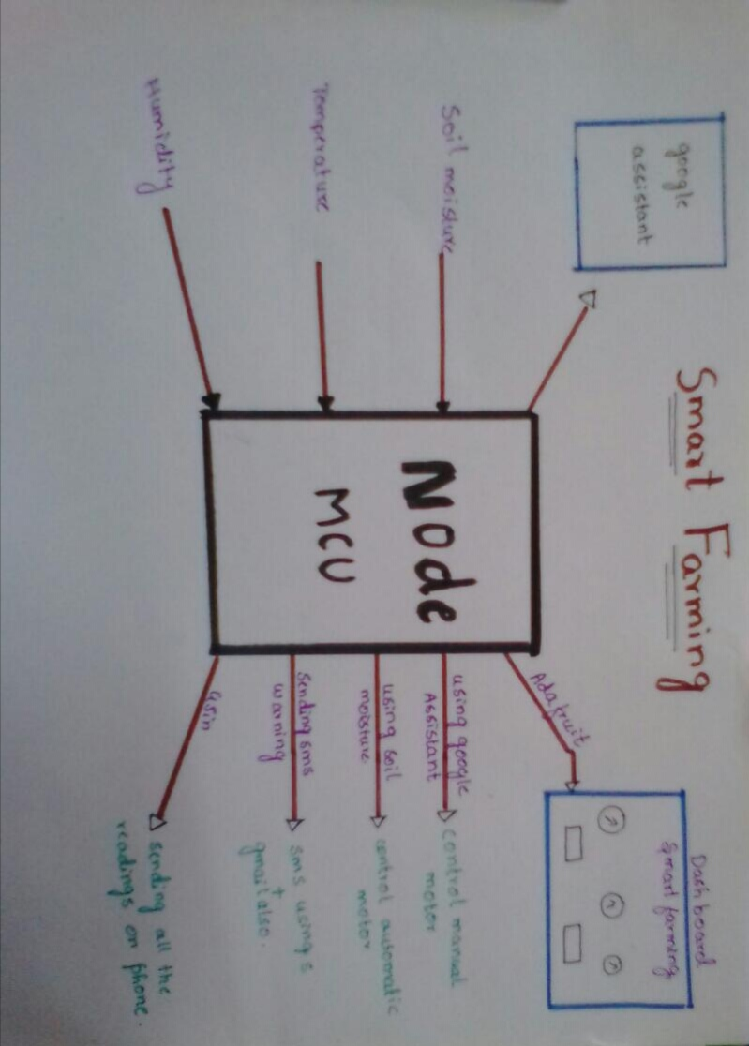
REAL LIFE APPLIC-ATION

Slide 12
THANK U
TEAM:-
SHAKSHAM SINHA
ANUSHANT BHUSHAN
ANURAG GOSWAMI

