Slide 1
DESCENT-STATIC WINGLET

Slide 2
Header
Analyst | GADDALA CHETAN
Date | 1/21/2025 06:48 PM
Table of contents

Slide 3
Table of Contents
System Information
Geometry and Mesh
Mesh Size
Mesh Quality
Orthogonal Quality
Simulation Setup
Physics
Models
Material Properties
Cell Zone Conditions
Boundary Conditions
Reference Values
Solver Settings
Run Information
Solution Status
Report Definitions
Plots
Residuals
Report Plots

Slide 4
System Information
Application | Fluent
Settings | 3d, double precision, pressure-based, SST k-omega
Version | 24.1.0-10184
Source Revision | 5b3f9fb3c8
Build Time | Nov 22 2023 10:32:41 EST
CPU | 12th Gen Intel(R) Core(TM) i5-12450H
OS | Windows
System Information
Table of contents

Slide 5
Geometry and Mesh
Geometry and Mesh
Table of contents

Slide 6
Mesh Size
Cells | Faces | Nodes
31080 | 198609 | 162431
Geometry and Mesh / Mesh Size
Table of contents

Slide 7
Mesh Quality
Name | Type | Min Orthogonal Quality | Max Aspect Ratio
solid | Poly Cell | 0.2175526 | 21.542509
Geometry and Mesh / Mesh Quality
Table of contents

Slide 8
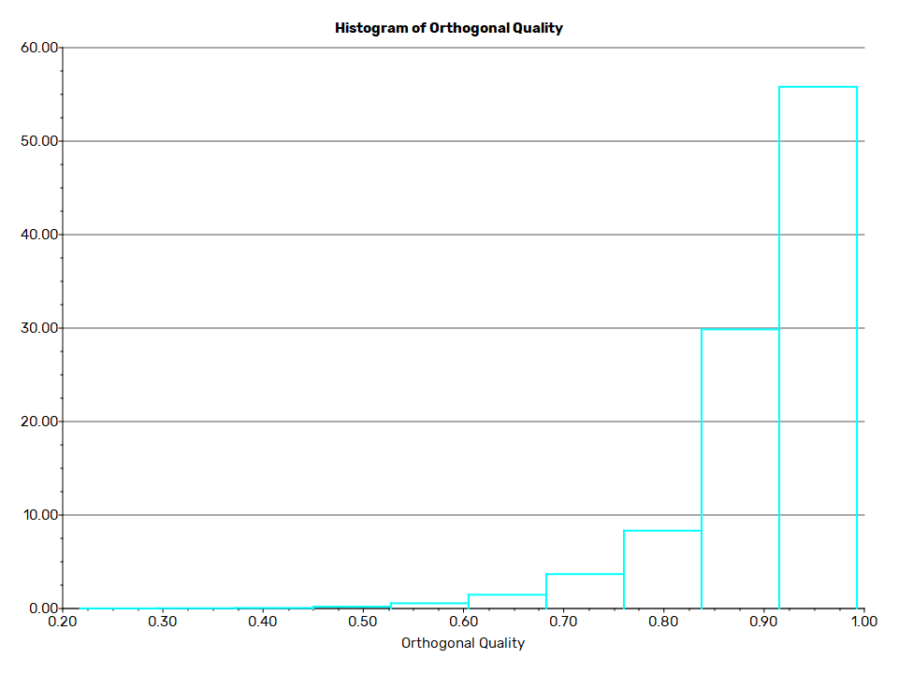
Orthogonal Quality
Geometry and Mesh / Orthogonal Quality
Table of contents

Slide 9
Simulation Setup
Simulation Setup
Table of contents

Slide 10
Physics
Simulation Setup / Physics
Table of contents

Slide 11
Models
Model | Settings
Space | 3D
Time | Steady
Viscous | SST k-omega turbulence model
Simulation Setup / Physics / Models
Table of contents

Slide 12
Material Properties
- Fluid
- air
Density | 1.225 kg/m^3
Cp (Specific Heat) | 1006.43 J/(kg K)
Thermal Conductivity | 0.0242 W/(m K)
Viscosity | 1.7894e-05 kg/(m s)
Molecular Weight | 28.966 kg/kmol
- Solid
- aluminum
Density | 2719 kg/m^3
Cp (Specific Heat) | 871 J/(kg K)
Thermal Conductivity | 202.4 W/(m K)
Simulation Setup / Physics / Material Properties
Table of contents

Slide 13
Cell Zone Conditions
- Fluid
- solid
Material Name | air
Specify source terms? | no
Specify fixed values? | no
Frame Motion? | no
Laminar zone? | no
Porous zone? | no
3D Fan Zone? | no
Simulation Setup / Physics / Cell Zone Conditions
Table of contents

Slide 14
Boundary Conditions
- Inlet
- inlet
Velocity Specification Method | Magnitude, Normal to Boundary
Reference Frame | Absolute
Velocity Magnitude [m/s] | 170.145
Supersonic/Initial Gauge Pressure [Pa] | 0
Turbulent Specification Method | Intensity and Viscosity Ratio
Turbulent Intensity [%] | 5
Turbulent Viscosity Ratio | 10
- Outlet
- outlet
Backflow Reference Frame | Absolute
Gauge Pressure [Pa] | 0
Simulation Setup / Physics / Boundary Conditions (1 of 3)
Table of contents

Slide 15
Boundary Conditions
Pressure Profile Multiplier | 1
Backflow Direction Specification Method | Normal to Boundary
Turbulent Specification Method | Intensity and Viscosity Ratio
Backflow Turbulent Intensity [%] | 5
Backflow Turbulent Viscosity Ratio | 10
Backflow Pressure Specification | Total Pressure
Build artificial walls to prevent reverse flow? | no
Radial Equilibrium Pressure Distribution | no
Average Pressure Specification? | no
Specify targeted mass flow rate | no
- Wall
- walls
Wall Motion | Stationary Wall
Simulation Setup / Physics / Boundary Conditions (2 of 3)
Table of contents

Slide 16
Boundary Conditions
Shear Boundary Condition | No Slip
Wall Surface Roughness | rough bc standard
Wall Roughness Height [m] | 0
Wall Roughness Constant | 0.5
- wing
Wall Motion | Stationary Wall
Shear Boundary Condition | No Slip
Wall Surface Roughness | rough bc standard
Wall Roughness Height [m] | 0
Wall Roughness Constant | 0.5
Simulation Setup / Physics / Boundary Conditions (3 of 3)
Table of contents

Slide 17
Reference Values
Area | 1 m^2
Density | 1.225 kg/m^3
Enthalpy | 0 J/kg
Length | 1 m
Pressure | 0 Pa
Temperature | 288.16 K
Velocity | 1 m/s
Viscosity | 1.7894e-05 kg/(m s)
Ratio of Specific Heats | 1.4
Yplus for Heat Tran. Coef. | 300
Reference Zone | solid
Simulation Setup / Physics / Reference Values
Table of contents

Slide 18
Solver Settings
- Equations
Flow | True
Turbulence | True
- Numerics
Absolute Velocity Formulation | True
- Pseudo Time Explicit Relaxation Factors
Density | 1
Body Forces | 1
Turbulent Kinetic Energy | 0.75
Specific Dissipation Rate | 0.75
Turbulent Viscosity | 1
Explicit Momentum | 0.5
Explicit Pressure | 0.5
Simulation Setup / Solver Settings (1 of 3)
Table of contents

Slide 19
Solver Settings
- Pressure-Velocity Coupling
Type | Coupled
Pseudo Time Method (Global Time Step) | True
- Discretization Scheme
Pressure | Second Order
Momentum | Second Order Upwind
Turbulent Kinetic Energy | Second Order Upwind
Specific Dissipation Rate | Second Order Upwind
- Solution Limits
Minimum Absolute Pressure [Pa] | 1
Maximum Absolute Pressure [Pa] | 5e+10
Minimum Static Temperature [K] | 1
Maximum Static Temperature [K] | 5000
Simulation Setup / Solver Settings (2 of 3)
Table of contents

Slide 20
Solver Settings
Minimum Turb. Kinetic Energy [m^2/s^2] | 1e-14
Minimum Spec. Dissipation Rate [s^-1] | 1e-20
Maximum Turb. Viscosity Ratio | 100000
Simulation Setup / Solver Settings (3 of 3)
Table of contents

Slide 21
Run Information
Number of Machines | 1
Number of Cores | 12
Case Read | 16.395 seconds
Iteration | 9.669 seconds
AMG | 5.11 seconds
Virtual Current Memory | 2.56313 GB
Virtual Peak Memory | 2.97367 GB
Memory Per M Cell | 62.5635
Run Information
Table of contents

Slide 22
Solution Status
Iterations: 57
 | Value | Absolute Criteria | Convergence Status
continuity | 0.0009888716 | 0.001 | Converged
x-velocity | 1.387934e-08 | 0.001 | Converged
y-velocity | 1.25883e-09 | 0.001 | Converged
z-velocity | 1.270612e-09 | 0.001 | Converged
k | 0.0001398444 | 0.001 | Converged
omega | 1.116332e-05 | 0.001 | Converged
Solution Status
Table of contents

Slide 23
Report Definitions
lift_force | 20609.82 | N
drag_force | 1833.976 | N
Report Definitions
Table of contents

Slide 24
Plots
Plots
Table of contents

Slide 25
Residuals
Plots / Residuals
Table of contents

Slide 26
Report Plots
Plots / Report Plots
Table of contents

Slide 27
drag_force-rplot
Plots / Report Plots / report plots
Table of contents

Slide 28
lift_force-rplot
Plots / Report Plots / report plots
Table of contents

