Slide 1

Website Using Front End
Submitted by: Chetan Lunthi
Student ID: 210111510
Roll NO: 16

Slide 2
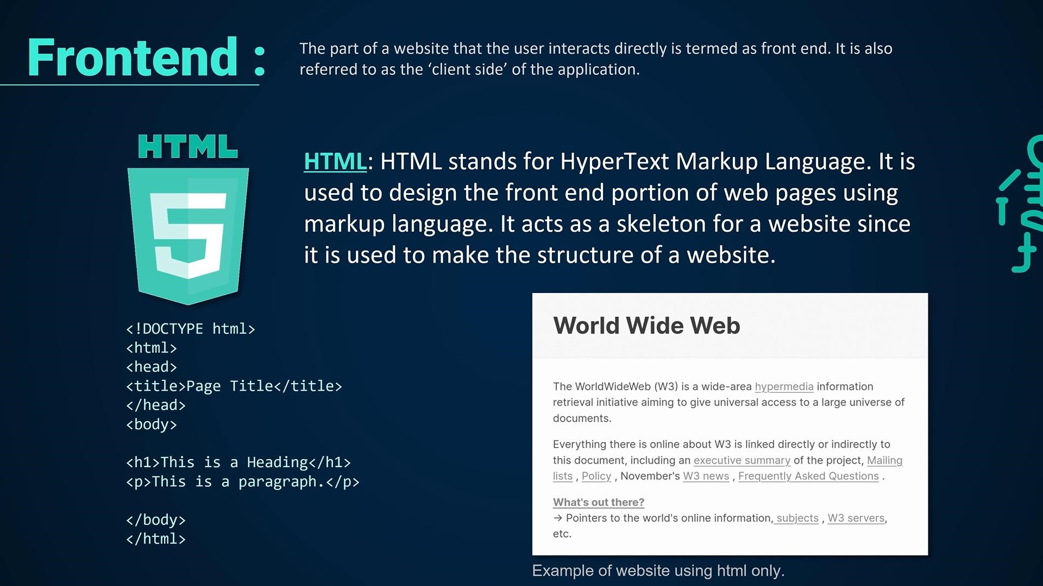

Slide 3
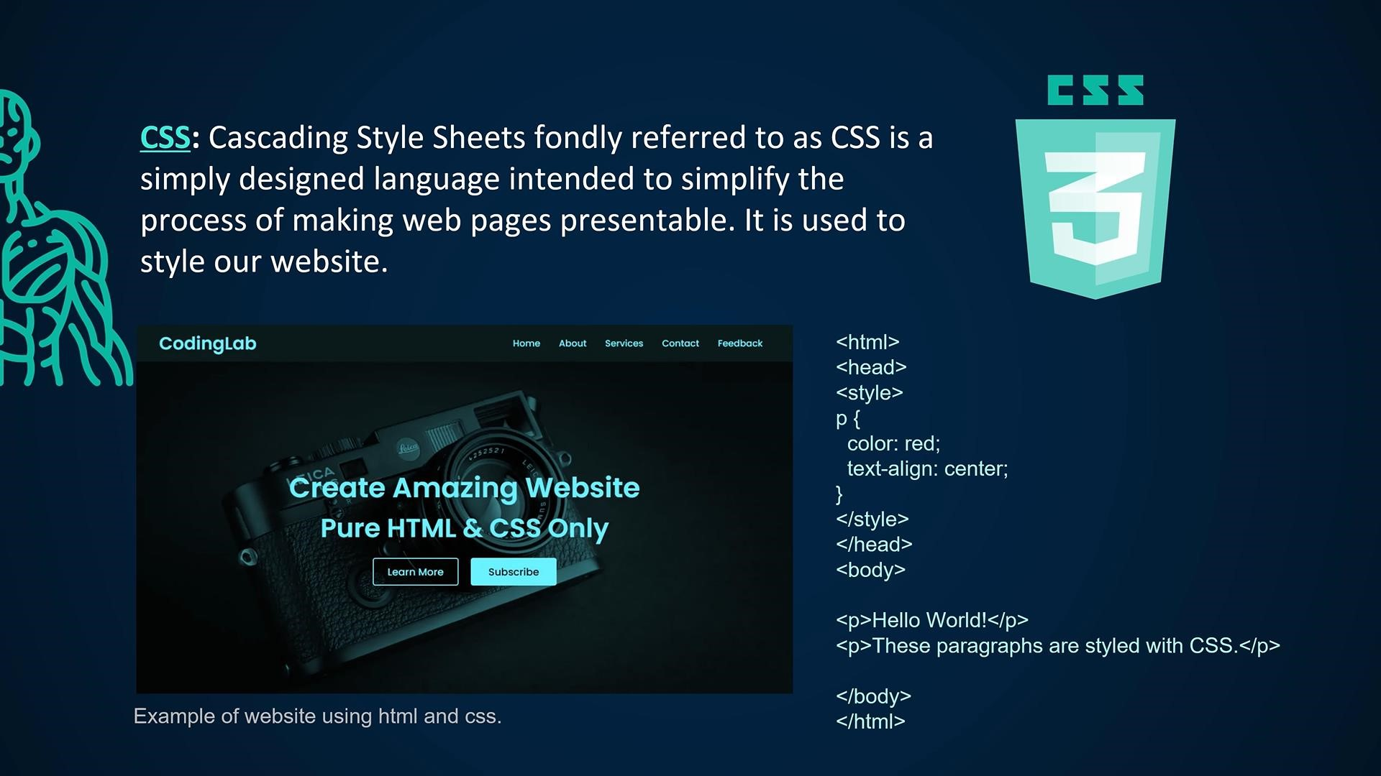

Slide 4
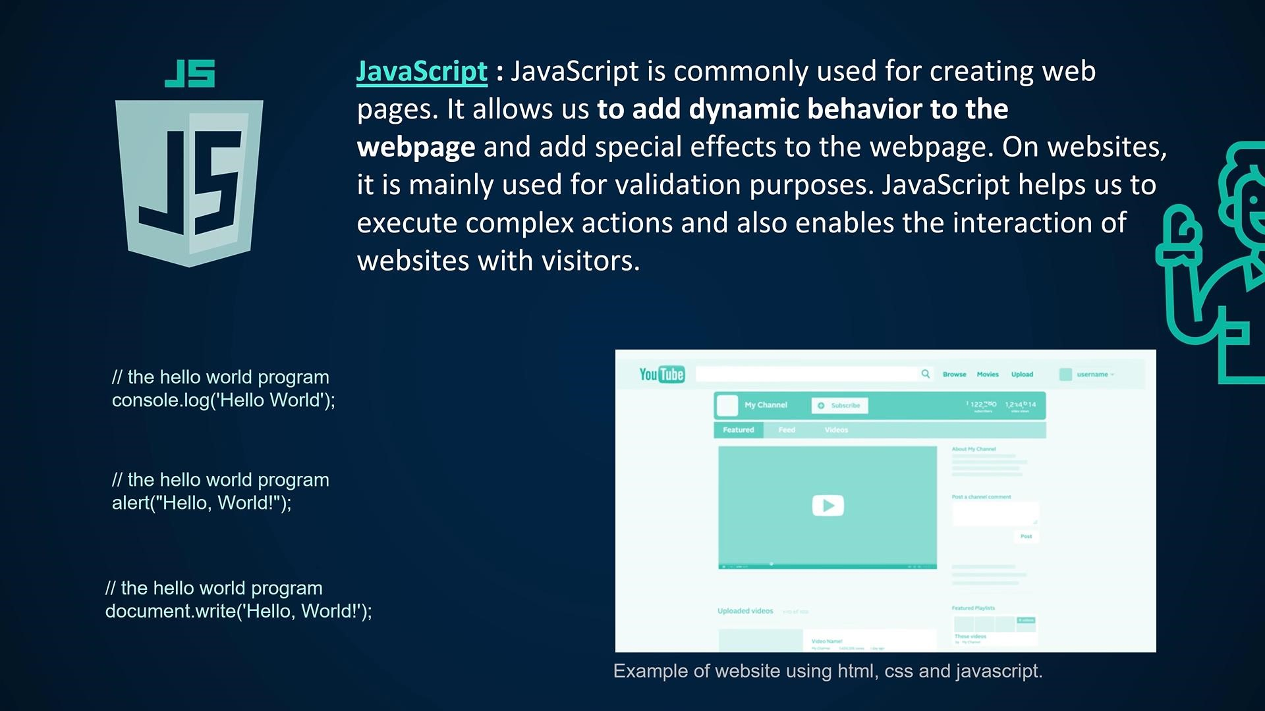

Slide 5
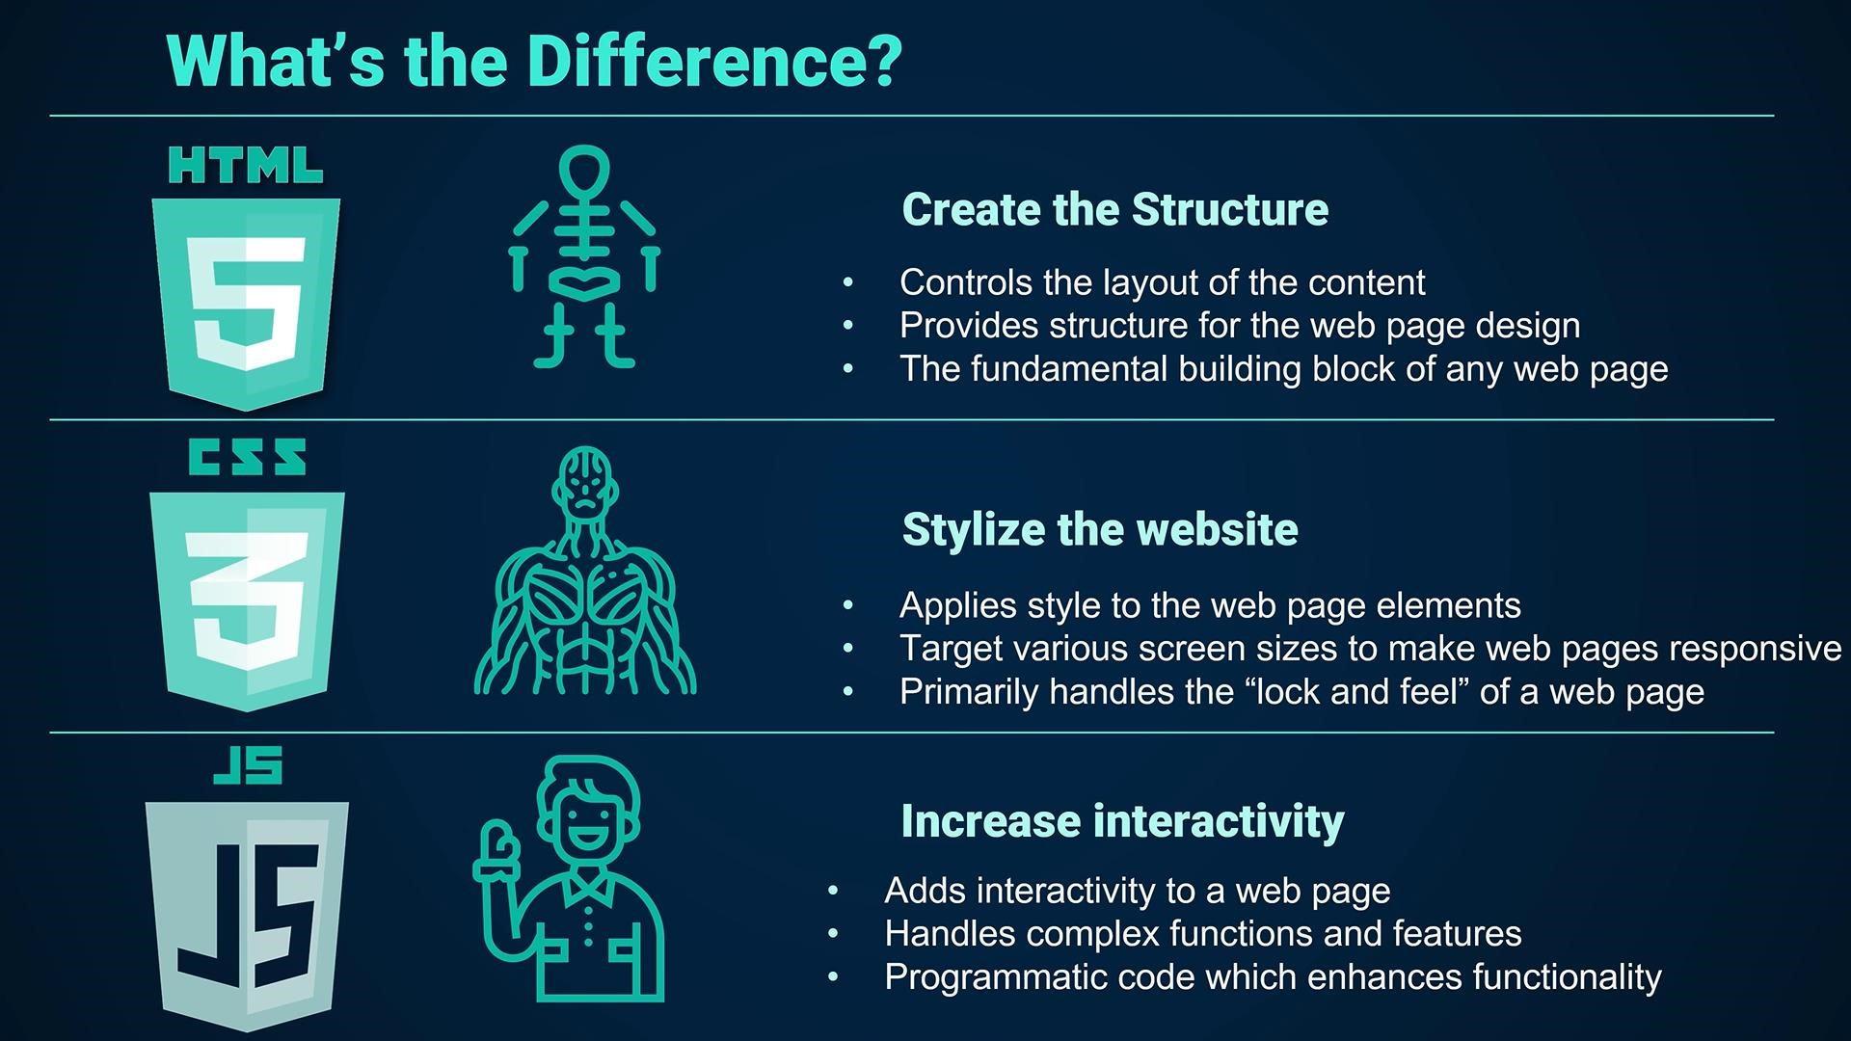

Slide 6
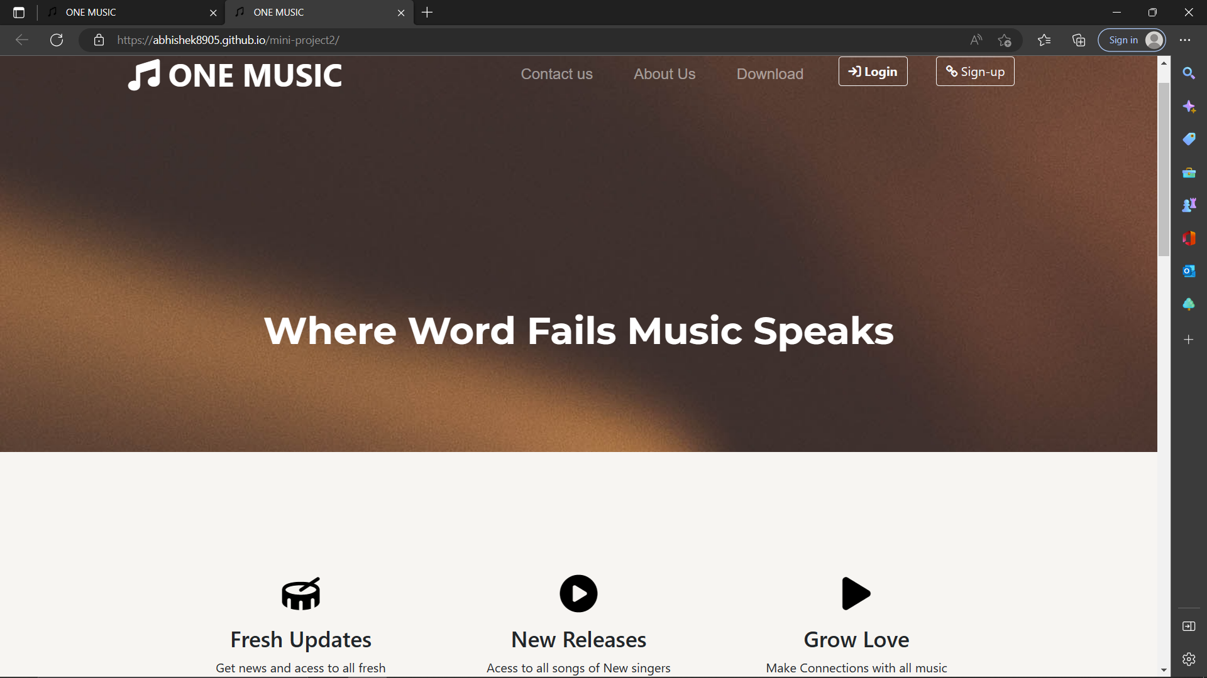

Slide 7
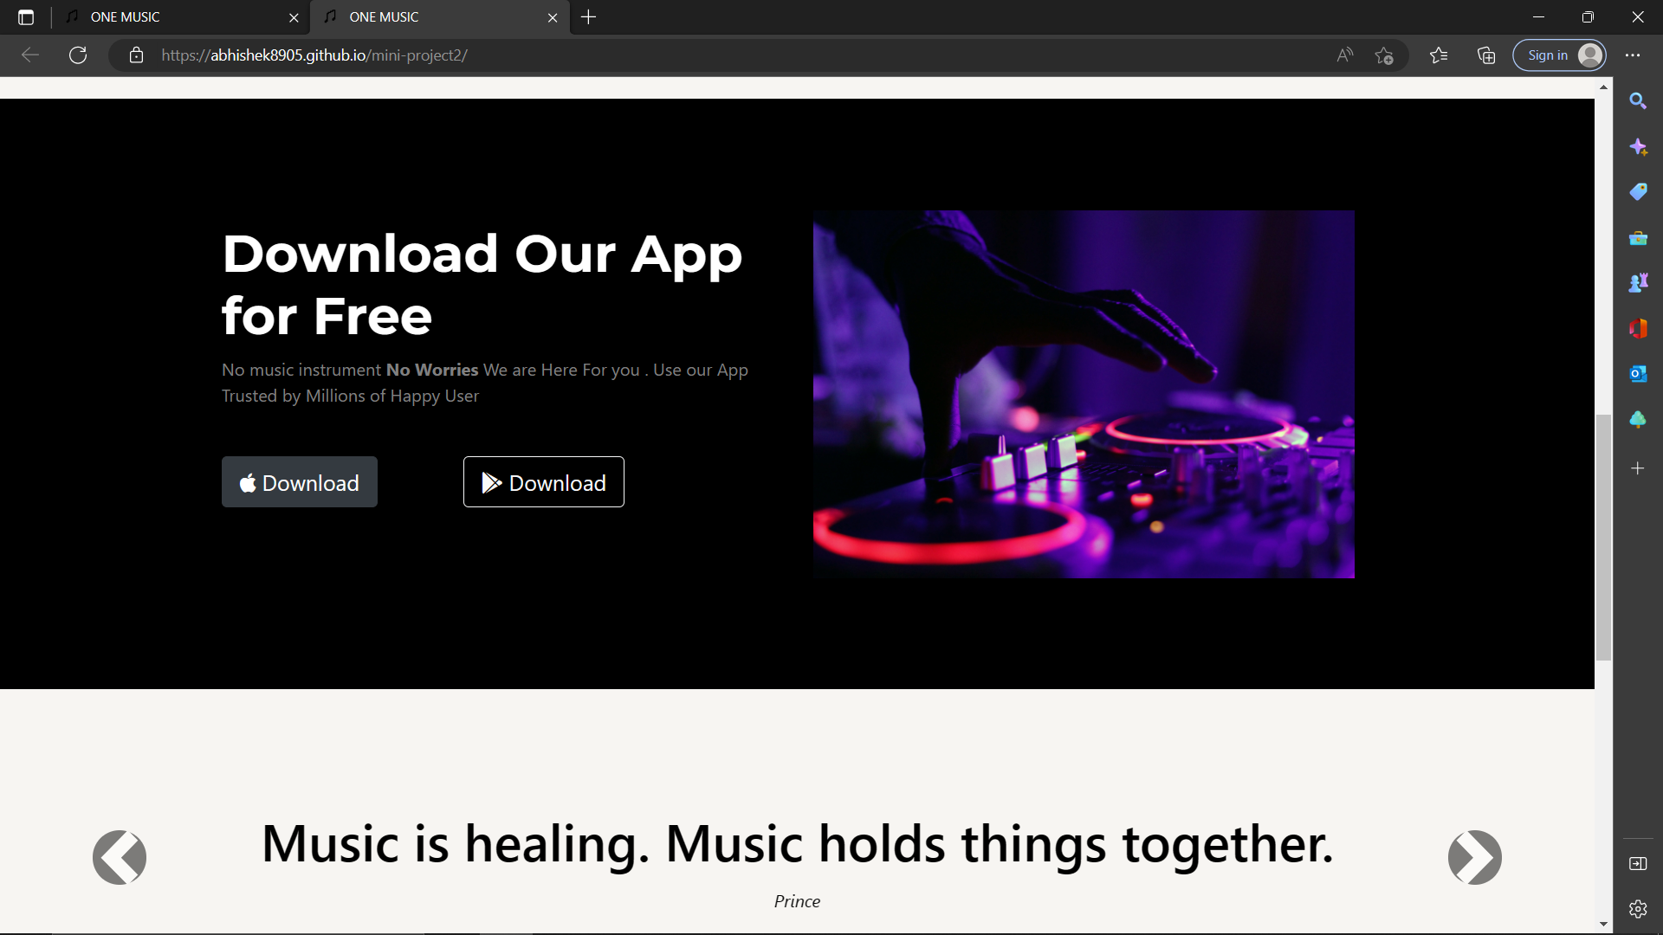

Slide 8
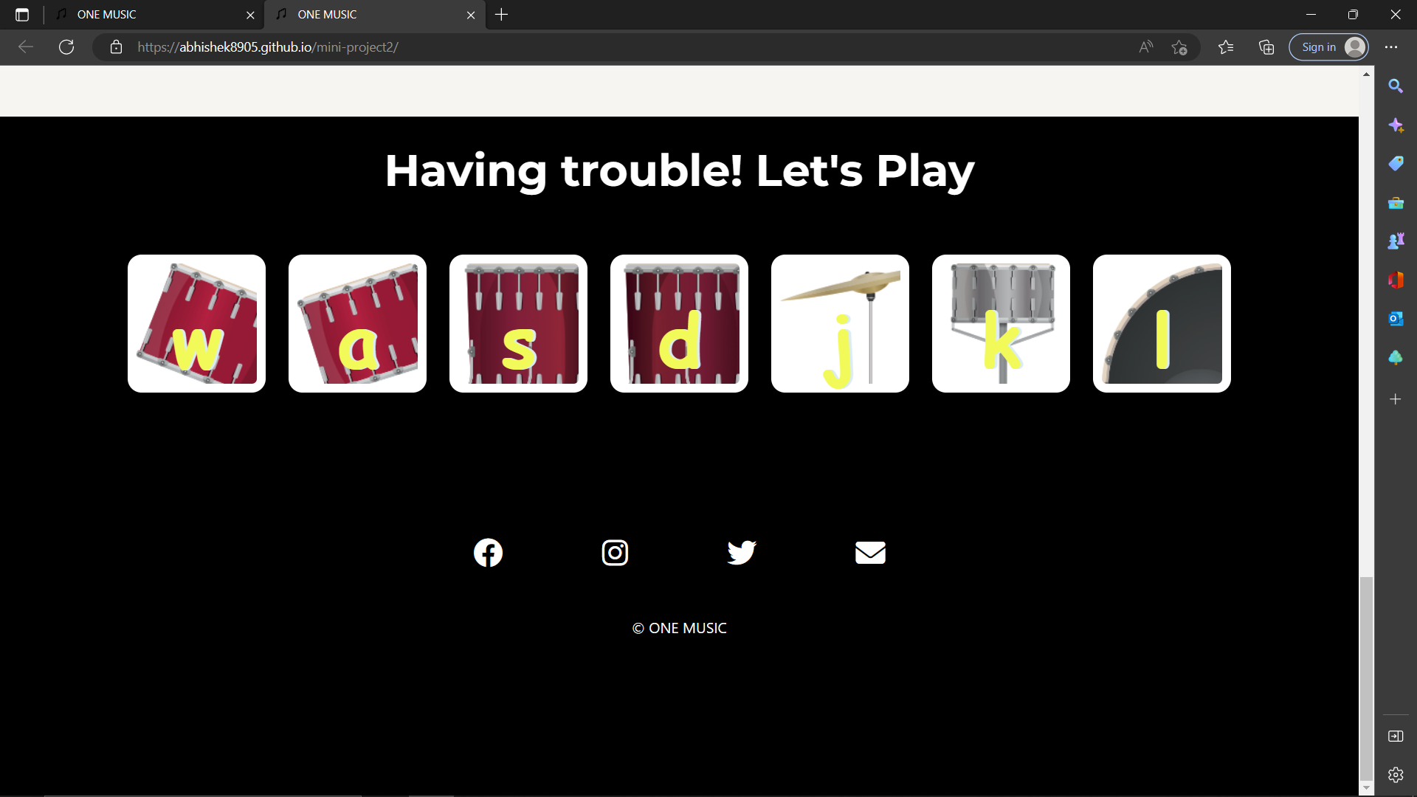
Clicking on the button sound comes

Slide 9
Thank YOU

