Slide 1
Customer Churn Analysis in Telecom Industry
Predicting and Understanding Customer Attrition
Presented by: Chetan Yadav
Date: 17/05/25

Slide 2
Project Overview
Business Problem: High churn rate in telecom services.
Goal: Predict churn and identify key drivers.
Tools: Python, Pandas, Scikit-learn, Matplotlib, Seaborn.

Slide 3
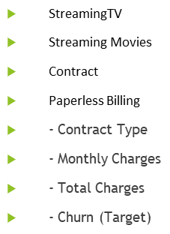
Dataset Description
Source: Telco Customer Churn dataset
Rows: ~7,000 customers
Key Columns:
- Gender
- Senior Citizen
- Partner
- Dependents
- Tenure
- Phone Service
- Multiple Lines
- Online Security
- Online Backup
- Device Protection
- Tech Support

Slide 4
Data Preprocessing
Handled missing values (e.g., cleaned Total Charges).
Encoded categorical variables (Label encoder).
Customer ID removed as it is not required for modelling.
No missing values in the dataset.
Missing values in the Total Charges column were replaced with 0.
Class imbalance identified in the target.

Slide 5
Exploratory Data Analysis (EDA)
Visuals:
- Churn distribution pie chart
- Churn vs. contract type (bar plot)
- Churn vs. tenure and charges (histograms)
Insights:
- Month-to-month customers churn more.
- Short tenure indicates higher churn risk.

Slide 6
Correlation Matrix
Heatmap showing feature correlations.
Insight: Monthly Charges and Tenure are significant.

Slide 7
Model Building
Models Used:
- Decision Tree
- Random Forest
- XG Boost
Evaluation Metrics: Accuracy, Precision, Recall, ROC-AUC

Slide 8
Model Performance Comparison
Training Decision Tree with default parameters Decision Tree cross-validation accuracy: 0.78
Training Random Forest with default parameters Random Forest cross-validation accuracy: 0.84
Training XG Boost with default parameters XG Boost cross-validation accuracy: 0.83

Slide 9
Feature Importance
Top features influencing churn:
- Contract type
- Tenure
- Monthly charges
- Online security
Visual: Feature importance bar chart

Slide 10
Business Insights
Monthly contracts lead to higher churn.
Short tenure and high charges are risk factors.
Upselling long-term contracts and offering security features can reduce churn.

Slide 11
Conclusion
Churn prediction helps guide retention strategies.
Random Forest is the best-performing model.
Predictive analytics can improve decision-making.

