Slide 1
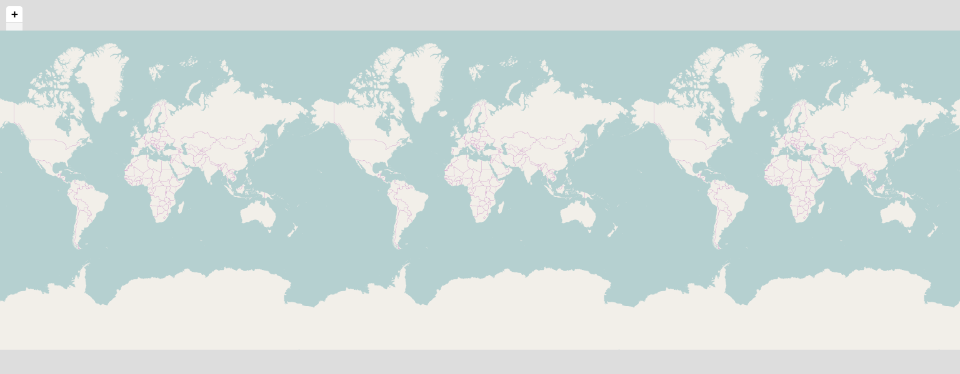
Dategraph
Dategraph #2
Sunburst
Text Data
Plain Bold Italic BoldItalic
Map
Table
TopicMap
List
Animal | Count
Cat | 1
Dog | 1
Mouse | 1
Groupe d'Etude Sur le Congo
Congo Research Group
Congo Research Group
to get
and I
you know
United States
is that
and so
it is
we have
title1
5 months ago
reference
summary
Incident Summary
attack to
Assailants attacked
casualties were reported
No group claimed responsibility
5
if you
group claimed responsibility
Incident Summary
title2
5 months ago
summary
I think
talk about
this is
is that
I think
title3
reference
summary
and I
to do
have to

