Slide 1
FINLATICS DATA SCIENCE EXPERIENCE PROGRAM
PROJECT:GLOBAL YOUTUBE STATISTICS
NAME: CHETAN TEWARI.

Slide 2
PROJECT OVERVIEW:
This project involves analyzing a detailed dataset of top YouTube channels, focusing on key metrics such as subscriber counts, video views, upload frequency, and earnings. By examining these factors, we aim to uncover trends and insights into what makes successful YouTube channels.
Beyond channel-specific data, the project also explores the relationship between YouTube channel metrics and country-level data such as population, urbanization, unemployment rate, and tertiary education enrollment. This helps in understanding the broader socio-economic context of YouTube success
The findings from this analysis will be valuable for aspiring YouTube creators seeking to optimize their content strategies and for data enthusiasts interested in the dynamics of online content creation. The insights can guide strategic decisions and identify potential areas for growth and improvement.
The project aims to identify correlations between different metrics, such as the relationship between subscriber count and video views, or the impact of economic conditions on channel performance. Additionally, it will look at trends over time, such as seasonal variations in video uploads and long-term growth in subscribers.

Slide 3
Key Features:
rank: Position of the YouTube channel based on the number of subscribers
Youtuber: Name of the YouTube channel
subscribers: Number of subscribers to the channel
video views: Total views across all videos on the channel
category: Category or niche of the channel
Title: Title of the YouTube channel
uploads: Total number of videos uploaded on the channel
Country: Country where the YouTube channel originates
channel_type: Type of the YouTube channel
lowest_monthly_earnings: Lowest estimated monthly earnings from the channel
highest_monthly_earnings: Highest estimated monthly earnings from the channel
lowest_yearly_earnings: Lowest estimated yearly earnings from the channel
highest_yearly_earnings: Highest estimated yearly earnings from the channel
Gross tertiary education enrollment (%): Percentage of the population enrolled in tertiary education in the country
Population: Total population of the country
Unemployment rate: Unemployment rate in the country
Urban_population: Percentage of the population living in urban areas.

Slide 4
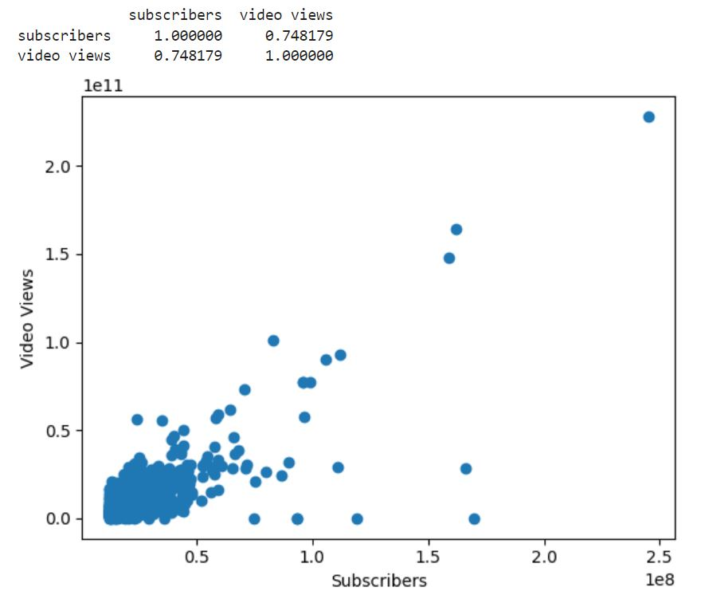
Correlation between Subscribers and video views:
Correlation coefficient between the two variables is 0.748179 as seen in the correlation matrix, which suggests that the two variables exhibit strong correlation between them.
Also as seen in the scatter plot most the data points is situated for lower subscriber base which have relatively lower video views as compared to those with higher subscribers.
Correlation also suggest that the channel with higher subscriber base will have relatively higher number of video views which is also intuitively explainable, indicating channel engagement.

Slide 5
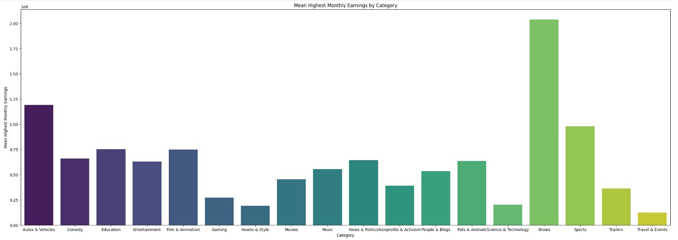
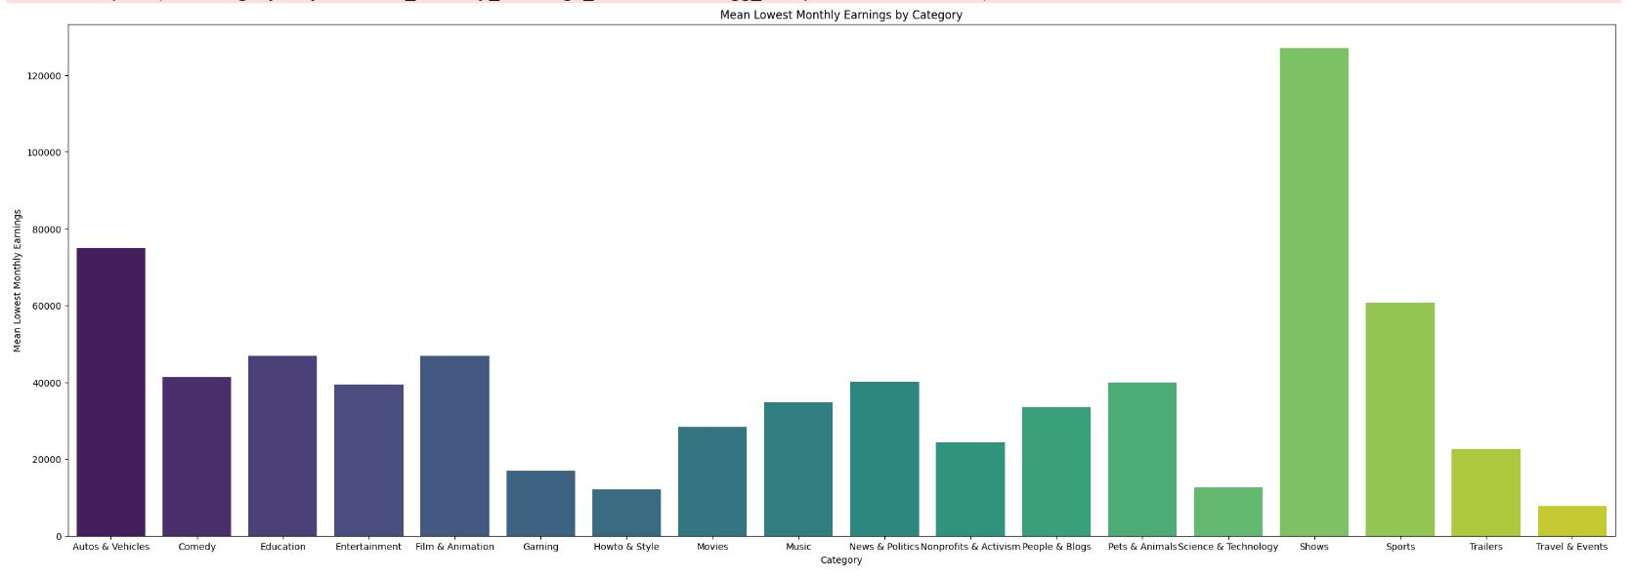
Monthly Earnings Variation Across Categories:
Determine which content categories are the most lucrative.
Analysis reveals that ‘Shows’ category has highest average highest as well as lowest monthly incomes.
Followed by ‘Auto and vehicles’, ‘Sports’, ’Film’ and animation’ and ‘Education’.
Least monthly income comes for ‘Travel and Events’ category which turns out to be least lucrative in terms of monthly income.

Slide 6
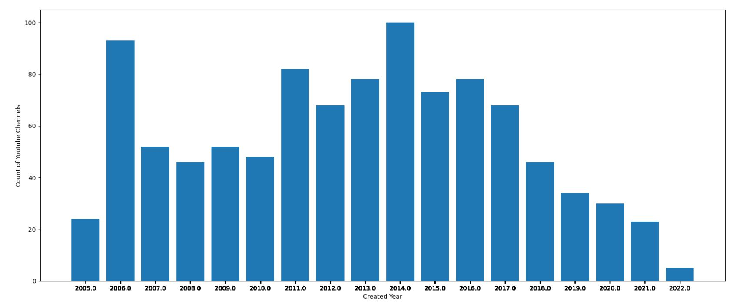
Distribution of Channel Creation Dates:
Observe trends in channel creation over time, possibly reflecting the growth of YouTube as a platform.
The distribution of the creation of the YouTube channel seems to be normally distributed with the count of the channels peaking in 2014.
In the recent years the count of the channels seems to be decreasing which seems to be counter intuitive, given the reach of internet connections to further parts of the world particularly in India.

Slide 7
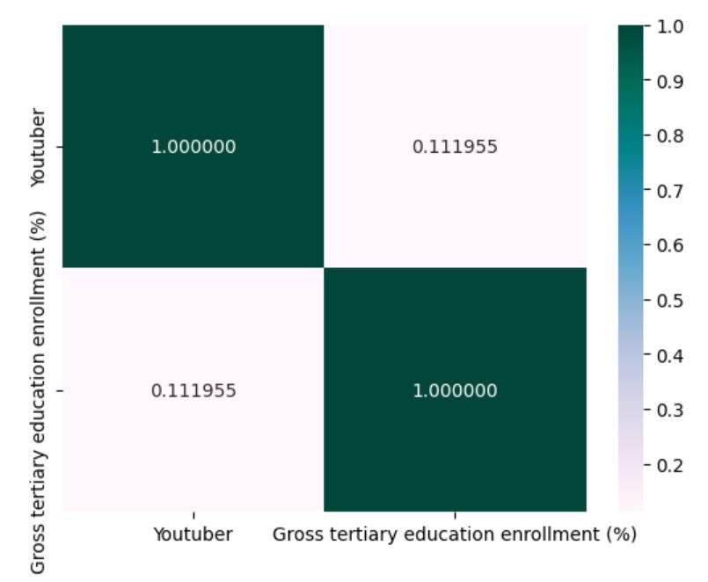
Relationship Between Gross Tertiary Education Enrollment and Number of YouTube Channels:
Explore if higher education levels in a country correlate with the number of YouTube content creators.
Correlation coefficient between the two variables is 0.1119 as seen in the correlation matrix, which suggests that the two variables exhibit weak correlation between them.
This suggests that there are very less chances that a country with very high percentage of enrollment in tertiary education will have higher number of YouTube Channels.

Slide 8
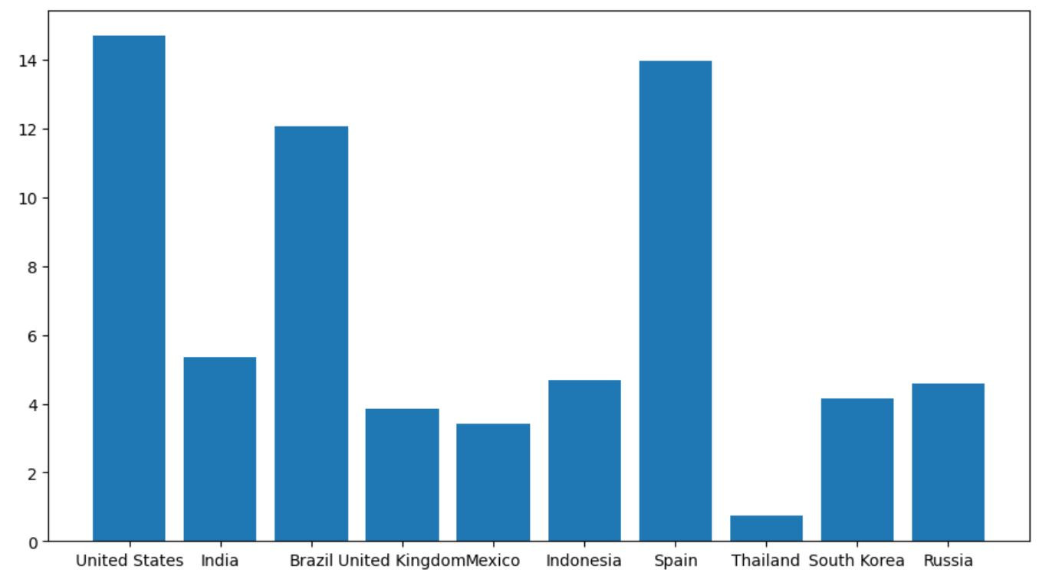
Unemployment Rate Among Top 10 Countries with Most YouTube Channels:
Assess if there's a relationship between the number of YouTube channels and the economic conditions in these countries.
Turns out that there is no direct relationship between the two, as a country with highest number of channels have higher unemployment rate
A country like India with second highest channels have relatively lower unemployment rate compared to a country like Spain with lower channels and higher unemployment rate.

Slide 9
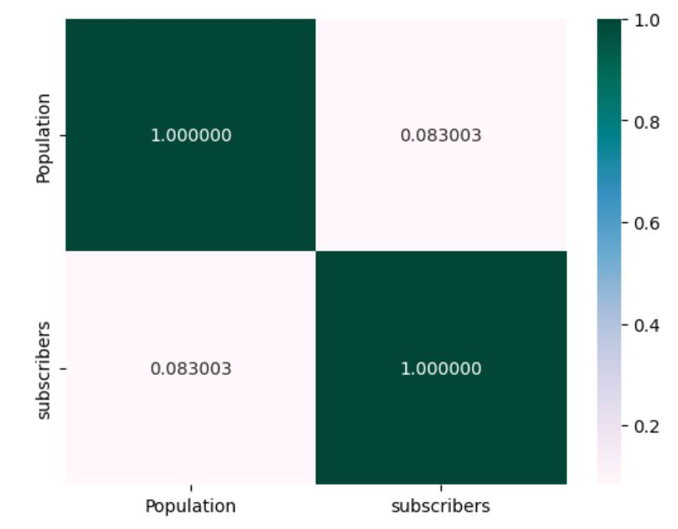
Correlation Between Subscribers and Population of a Country:
Determine if larger populations result in more popular channels.
The correlation between the subscribers and the population is very weak which suggests that it is not necessary that country with most population will have higher number of subscribers to the YouTube channels.
Although again this is very much counter-intuitive but it can be seen that the countries with highest number of subscribers are not the most populous ones as seen in the bar plot in the next page.

Slide 10
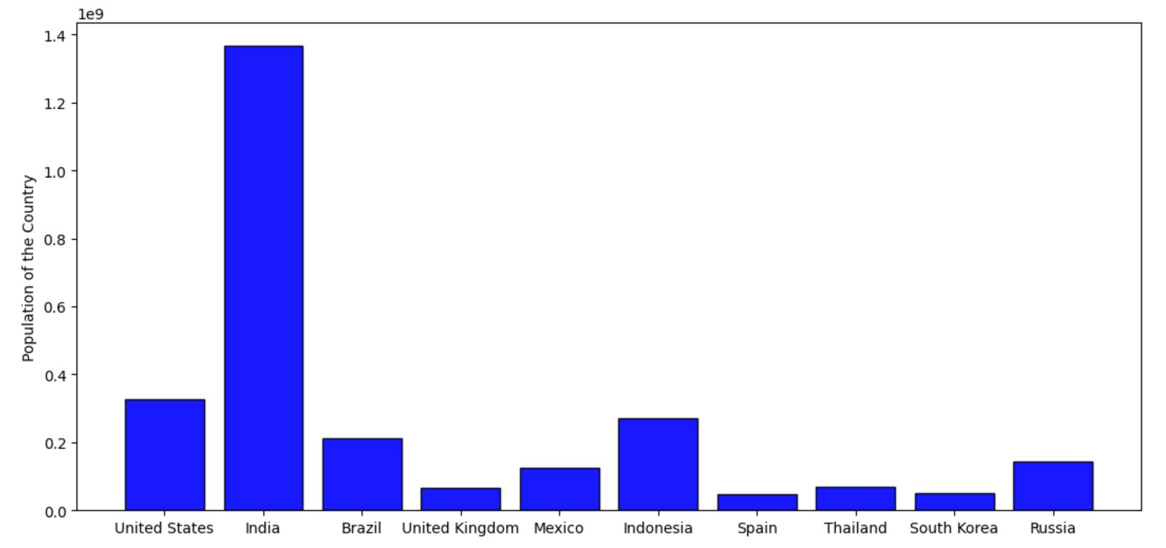
Comparison of Top 10 Countries with Highest Number of YouTube Channels by Population:

Slide 11
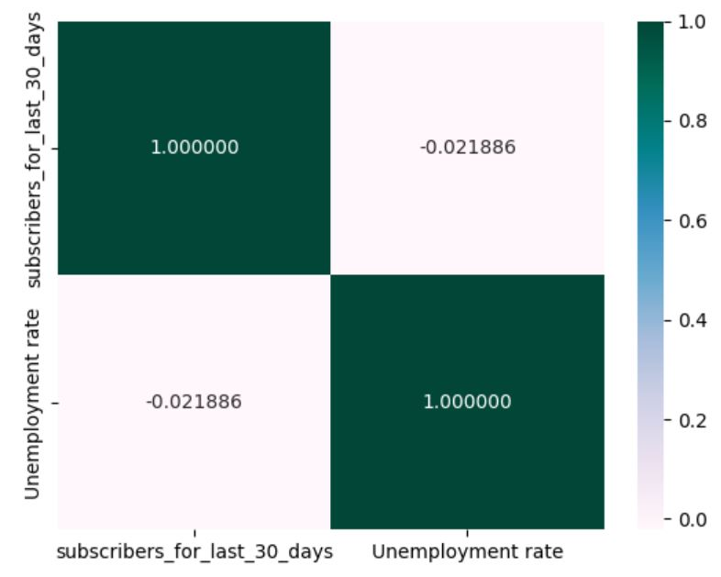
Correlation Between Subscribers Gained in Last 30 Days and Unemployment Rate:
Investigate if economic conditions influence recent subscriber growth.
The correlation coefficient is very small negative value which suggest that economic condition of the country do not directly influence the subscriber gain in the last one month.
Negative value suggest that increase in unemployment rate may slightly decrease the number of subscriber gained.
A small correlation value suggest that two variables are almost independent of each other, i.e. it doesn’t matter if unemployment rate increase or decrease, the subscribers will remain almost the same.

Slide 12
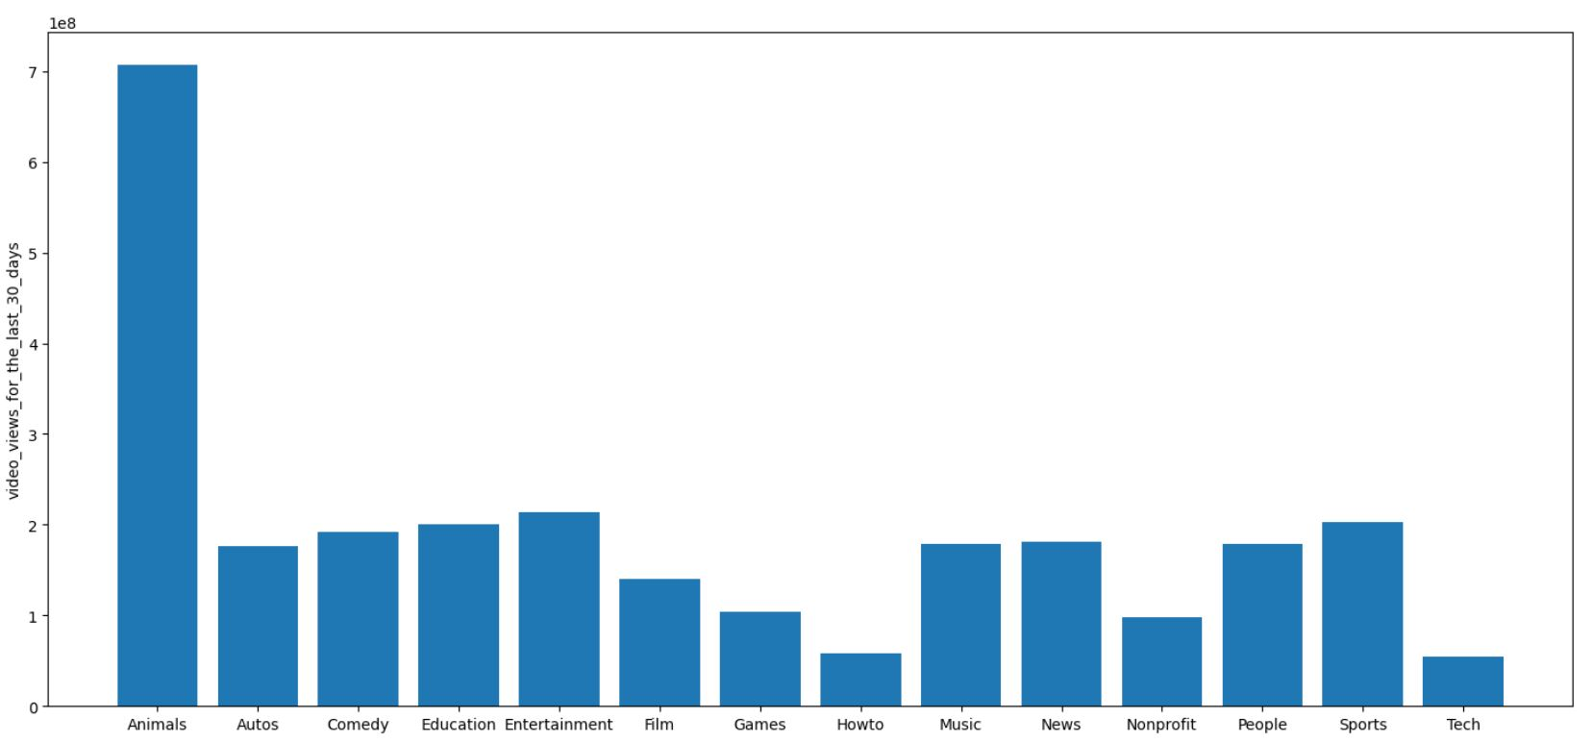
Distribution of Video Views for Last 30 Days Across Channel Types:
Identify which channel types are currently seeing the most viewership.
The analysis suggest that Animal channel type are currently enjoying the most viewership followed by Sports, Comedy, Music, Entertainment etc.
Channel types like Tech, How-to and Nonprofit are a bit low in viewership in past one month.

Slide 13
Conclusion:
The analysis revealed very weak correlations between some variables, such as the number of subscribers gained and the unemployment rate. This indicates that these variables do not have a strong linear relationship, suggesting the need to explore other factors or non-linear models to fully understand their dynamics.
The success of YouTube channels is influenced by a multitude of factors beyond basic metrics like subscriber counts and video views. Elements such as content quality, engagement strategies, country-specific trends, and economic conditions play significant roles and should be considered in a comprehensive analysis.
Different content categories exhibit distinct trends in terms of earnings, subscriber growth, and upload frequency. For instance, certain categories may generate higher earnings on average, while others might see more consistent subscriber growth. Understanding these trends can help aspiring creators tailor their content strategies to align with successful patterns in their chosen categories.
The YouTube ecosystem is complex and multifaceted, with various interrelated factors affecting channel performance. Simple linear relationships often fail to capture the full picture, highlighting the importance of comprehensive and nuanced analyses to derive actionable insights. Future research could benefit from incorporating advanced analytical techniques and more granular data to uncover deeper patterns and trends.

