Slide 1

KarmaSky: Fair Federated Multi-Agent Reinforcement Learning for Shared Drone Delivery Airspace
Theme: SDG 9, Industry, Innovation and Infrastructure

Slide 2
EL Phase-I
Presentation Outline
Introduction
Literature Review
Problem Definition
Objectives
Methodology
Proposed Outcomes
Timeline of the project
Conclusion
References

Slide 3
Introduction
Overview: Delivery drones from several companies will share the same low-altitude city airspace. Each company trains its own AI to avoid conflicts and keeps it private.
Why it matters: In a recent simulation study, the company with weaker drones took 22.4% longer to complete deliveries, and fairness between companies fell to 80.8% (Sharifi et al., 2026).
Manned aircraft: Air ambulances and rescue helicopters also fly low, and drones must always give way to them. Only 6 of 44 recent drone studies even model crewed aircraft (Samu et al., 2026).
SDG 9 link: Fair and safe access to shared airspace, treated as emerging public infrastructure (target 9.1).
Our idea: Companies learn together without sharing secrets; contributing to shared safety earns airspace-priority credits that keep circulating.

Slide 4
Literature Review
Sharifi et al. (2026), arXiv preprint: Two companies' delivery fleets (20 drones) over Dallas in the BlueSky simulator. Independently trained PPO + attention policies reach a safe equilibrium (97.75% success) but favour the stronger fleet (fairness 80.8%). Authors call for fairness-aware conflict management.
Brittain and Wei (2022), IEEE T-ASE: Predicting each intruder's intent lets agents with different objectives cooperate; loss-of-separation events fell from 28 to 4 with five agent types.
Chen et al. (2023), IEEE GLOBECOM Workshops: Federated QMIX for multi-UAV missions; federation speeds up learning, but only among drones of one team.
Rezaee et al. (2024), JAC-ECC: Federated MADDPG for 96 drones in 2D; marginal collision reduction; heterogeneity and security listed as open problems.
Samu et al. (2026), Drones (review of 44 studies): 86% validated only in simulation; none provides formally assured separation from crewed aircraft.

Slide 5
Literature Review (contd.)
Trends in literature: Shift to decentralized multi-agent RL with attention for variable traffic; federated RL for UAVs; fairness between operators emerging as a concern; free riding and manipulation documented in cross-company federated learning.
Theoretical framework: Multi-agent RL (PPO actor-critic); federated learning (FedAvg); cooperative game theory (Shapley value); non-tradable karma credits (CARMA, Elokda et al., 2025); runtime safety shielding (ElSayed-Aly et al., 2021).
Relevance to our project: These studies show multi-company drone RL is feasible and federation works for UAVs, while fairness between competing operators and guaranteed separation from manned aircraft remain unaddressed. This defines our research gap.

Slide 6
Problem Definition
Problem statement: When competing drone operators with unequal fleets share airspace, independently trained deconfliction is safe but unfair. Learning together could help, but it invites free riding, dominance by large operators, and cheating. No framework addresses fairness, incentives, integrity and manned-aircraft safety together.
Context: Existing federated drone work shares learning only within one team. Fairness is measured with raw mission times, which mixes unfair treatment with slower hardware.
Significance: Without a fix, small operators are systematically delayed, weakening fair access to public infrastructure; drones without guaranteed separation cannot safely share airspace with crewed aircraft.

Slide 7
Objectives
Main objective: Design and evaluate a fairness-aware federated multi-agent RL framework in which competing drone operators with unequal fleets learn deconfliction together while keeping their data and decision policies private, and test whether it reduces the hardware-normalized delay gap without reducing safety.
Specific objectives:
  Reproduce the multi-fleet baseline in BlueSky and confirm the unfairness.
  Build partial federation (shared encoder, private policy head) and compare three aggregation rules.
  Design contribution-earned karma credits (Shapley-scored, redistributed, capped) and test whether they reward sharing without letting large operators dominate.
  Add a safety shield for a non-yielding manned helicopter, and defences against score gaming.
Expected contributions: First study of federation between competing drone operators; a hardware-normalized fairness metric; contribution-based karma airspace priority; an open-source multi-operator BlueSky benchmark.

Slide 8
Methodology
Design: Quantitative, simulation-based experiments with a layered comparison: independent training, centralized upper bound, rule-based, federated variants (F1 to F3), and full KarmaSky (K1, K2).
Data collection: Generated in simulation: 2 operators x 10 drones over Frisco, Dallas; strong fleet up to 44.88 m/s vs weak fleet up to 30.12 m/s; solo runs per operator; 3 seeds per setup; 300 evaluation runs.
Data analysis: Safety (success rate, near mid-air collisions, helicopter separation), efficiency (mission time), fairness (Ft and normalized delay gap), credit share, attack gain; Mann-Whitney U tests with Holm correction and effect sizes.
Tools and resources: BlueSky simulator, Python, PyTorch (PPO with attention), custom aggregator and credit ledger, TensorBoard, pandas, SciPy, matplotlib; GPU (about 300 GPU-hours estimated).

Slide 9
Methodology: System Architecture
Loop 1, every 3 s: Each drone observes its neighbours, bids credits at a contested crossing, its network proposes slow, hold or speed up, then credit and safety checks remove options before it acts and is scored.
Loop 2, every run: Each company trains its own drones with PPO from a private experience log.
Loop 3, every 50 runs: Operators share only encoder updates. A referee checks integrity, scores each contribution by Shapley value on a hidden hard-scenario suite, aggregates, and mints credits.
Loop 4, every period: Spent credits are pooled and redistributed with a cap, so priority keeps circulating.
Fixed rules: Manned aircraft always first; the safety shield overrides credits; credits never enter the reward.

Slide 10
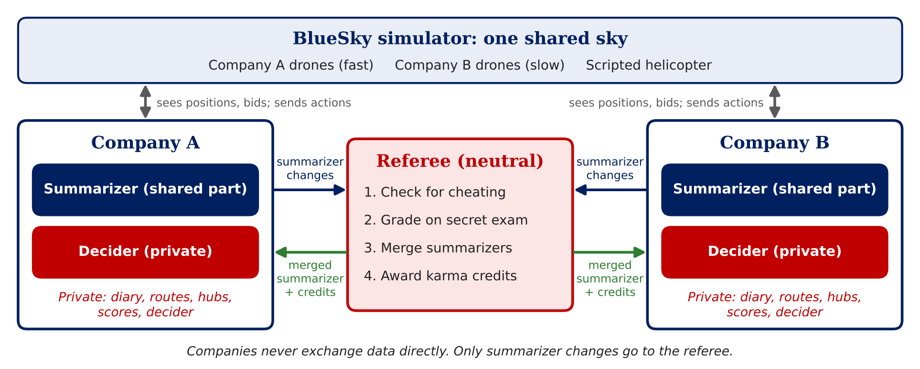
Data Flow Between Companies
Only summarizer changes leave a company; everything else stays private

Slide 11
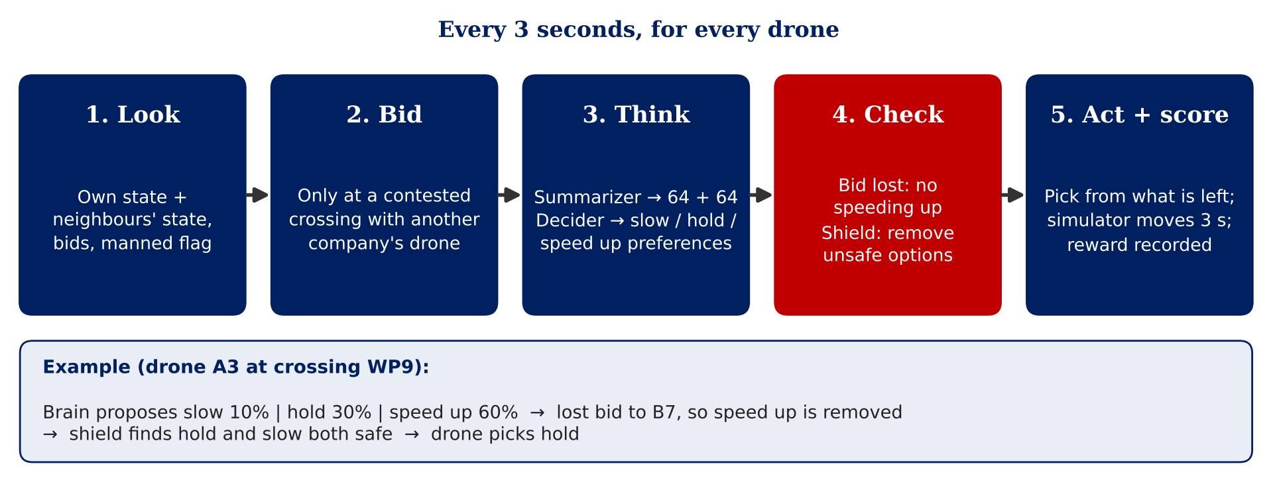
Loop 1: One Drone Decision
The brain proposes; bid and safety checks can only remove options

Slide 12
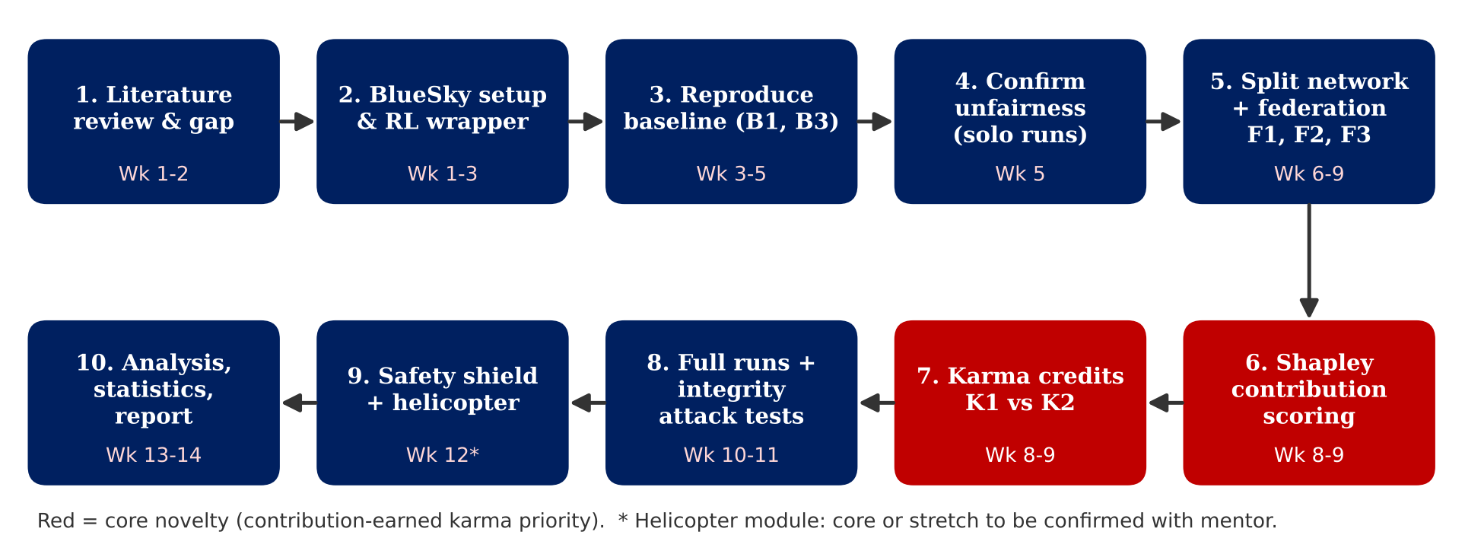
Methodology
Research process (14 weeks)

Slide 13
Proposed Outcomes
Expected results: A working multi-operator BlueSky simulation; the published unfairness reproduced; evidence on whether federation and karma credits shrink the normalized delay gap without safety loss; no helicopter separation violations under the shield's stated assumptions.
Potential impact: Informs how drone traffic management systems could allocate priority fairly between large and small operators; a reusable open-source benchmark for future studies.
Future directions: Learned bidding; more operators and real city layouts such as Bengaluru; wind and communication loss; hardware-in-the-loop tests; privacy attacks on shared updates.

Slide 14
Timeline of the project
Weeks 1-2: Initiation
  Consolidate literature; read the two remaining preprints for overlap
  Set up BlueSky; confirm GPU access
Weeks 3-5: Baseline
  Build the multi-agent wrapper; reproduce Sharifi et al. (B1, B3)
  Solo runs; confirm the unfairness result
Weeks 6-9: Core development
  Split network and federation F1 to F3; normalized-delay metric
  Shapley contribution scoring; karma credits K1 and K2
Weeks 10-12: Experiments
  Full runs with seeds; integrity attacks and defences
  Safety shield and helicopter (if confirmed as core)
Weeks 13-14: Closure
  Analysis, plots and statistics
  Report, presentation and demo video

Slide 15
Conclusion
Summary: Shared drone airspace today is safe but unfair between operators. KarmaSky combines privacy-preserving federation, contribution-earned karma credits and a safety shield.
Final thoughts: Our novelty lies in the setting and the questions (federation between competitors, fair priority), not in new tools; even a negative result on federation alone is informative.
Next steps: Mentor approval of scope; confirm novelty against two recent preprints; build the BlueSky wrapper; reproduce the baseline.

Slide 16
References
Brittain, M., & Wei, P. (2022). Scalable autonomous separation assurance with heterogeneous multi-agent reinforcement learning. IEEE Transactions on Automation Science and Engineering, 19(4), 2837-2848. https://doi.org/10.1109/TASE.2022.3151607
Chen, J., Esrafilian, O., Bayerlein, H., Gesbert, D., & Caccamo, M. (2023). Model-aided federated reinforcement learning for multi-UAV trajectory planning in IoT networks. IEEE GLOBECOM Workshops. arXiv:2306.02029
Elokda, E., Cenedese, C., Zhang, K., Censi, A., Lygeros, J., Frazzoli, E., & Dorfler, F. (2025). CARMA: Fair and efficient bottleneck congestion management via nontradable karma credits. Transportation Science, 59(2), 340-359.
ElSayed-Aly, I., Bharadwaj, S., Amato, C., Ehlers, R., Topcu, U., & Feng, L. (2021). Safe multi-agent reinforcement learning via shielding. Proceedings of AAMAS 2021, 483-491.
Geimer, A., Fiz, B., & State, R. (2025). On the volatility of Shapley-based contribution metrics in federated learning. Proceedings of IJCNN 2025.
Hoekstra, J. M., & Ellerbroek, J. (2016). BlueSky ATC simulator project: An open data and open source approach. Proceedings of ICRAT 2016.
Rezaee, M. R., et al. (2024). Federated multi-agent reinforcement learning for UAV collision avoidance in dense smart city environment. JAC-ECC 2024. https://doi.org/10.1109/JAC-ECC64419.2024.11061244
Samu, J., Yang, C., & Poddar, K. R. (2026). Optimization and tactical deconfliction for drone search-and-rescue in low-altitude airspace: A systematic literature review. Drones, 10(8), 596. https://doi.org/10.3390/drones10080596
Sharifi, I., Kim, H. T., Ahmed, M. H., Ghasemi, M., & Wei, P. (2026). Separation assurance between heterogeneous fleets of small unmanned aerial systems via multi-agent reinforcement learning. arXiv:2605.01041 (preprint).

Slide 17
Expected Outcome by the end of First Year
Planned tangible results for this project:
Conference publication (primary target): IEEE-format paper on fair federated multi-agent RL for multi-operator drone airspace, reporting fairness, safety and incentive results.
Journal publication (if results are strong): Extended version adding the integrity and manned-helicopter experiments.
Open-source release: The multi-operator BlueSky environment, fairness metrics and experiment scripts.
Patent filing: Not planned at this stage; the contribution is algorithmic and experimental.

Slide 18


