Slide 1
PRESENTATION TITLE
Home Loans Data Science Project
27-12-2022

Slide 2
TEXT LAYOUT 1
Agenda
Data Science Lifecycle​
Project Overview​
Data
Analysis
Modeling
Model Evaluation
Recommendations

Slide 3
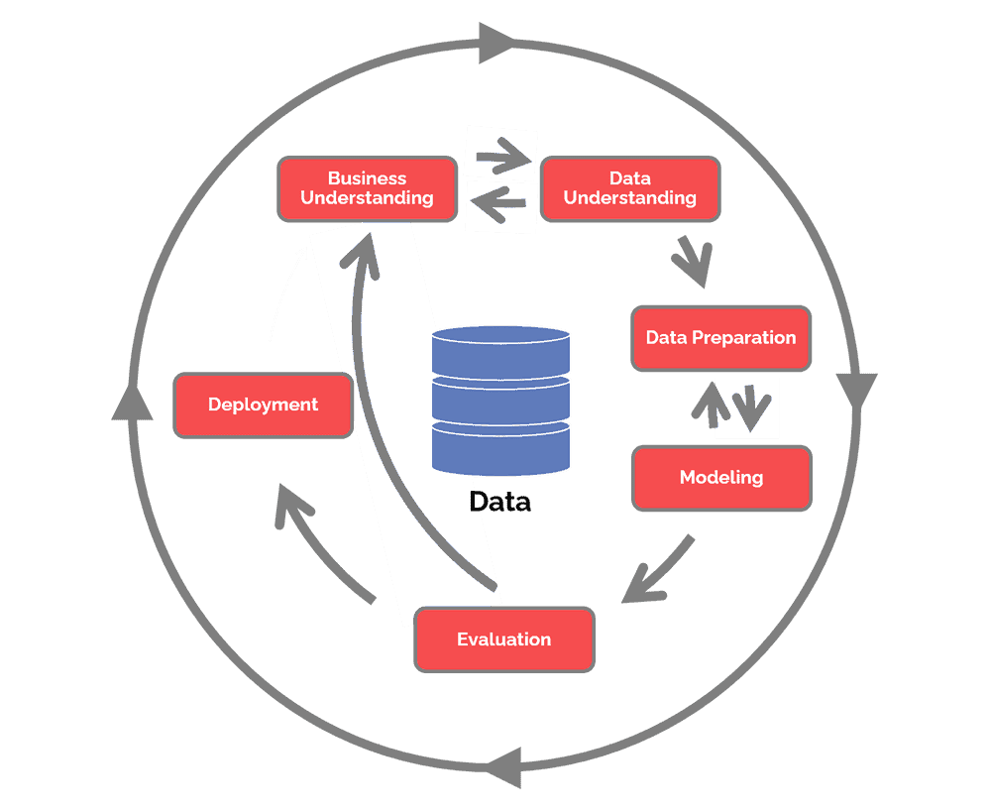
TEXT LAYOUT 1
Data Science Lifecycle
Following steps data science should have to fallow:
Business understanding – What does the business need?
Data understanding – What data do we have / need? Is it clean?
Data preparation – How do we organize the data for modeling?
Modeling – What modeling techniques should we apply?
Evaluation – Which model best meets the business objectives?
Deployment – How do stakeholders access the results?

Slide 4
TEXT LAYOUT 1
Project Overview
Business Problem:
Standard Bank is embracing the digital transformation wave and intends to use new and exciting technologies to give their customers a complete set of services from the convenience of their mobile devices. As Africa’s biggest lender by assets, the bank aims to improve the current process in which potential borrowers apply for a home loan. The current process involves loan officers having to manually process home loan applications. This process takes 2 to 3 days to process upon which the applicant will receive communication on whether or not they have been granted the loan for the requested amount.
Business Objective:
To improve the process Standard Bank wants to make use of machine learning to assess the creditworthiness of an applicant by implementing a model that will predict if the potential borrower will default on his/her loan or not, and do this such that the applicant receives a response immediately after completing their application.

Slide 5
TEXT LAYOUT 1
Project Overview
Hypothesis:
Our main aim is to improve the current process by which potential borrowers apply for a home loan by implementing a machine learning model to assess an applicant’s creditworthiness.

Slide 6
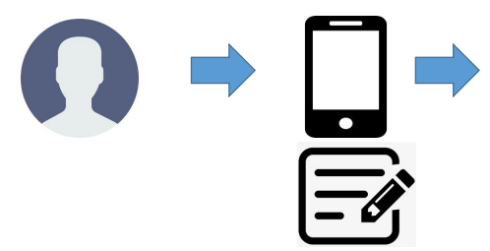

TEXT LAYOUT 1
Process Overview / Solution
Importing Libraries
Importing datasets
Exploratory data analysis
Model building

Slide 7
TEXT LAYOUT 1
Data
Data described all the relevant columns that are required in our analysis such as Loan Amount, Credit History, Property Area etc
Data consist of 13 columns and 614 rows and 8 categorical and 5 numerical columns
LoanAmount,

Slide 8
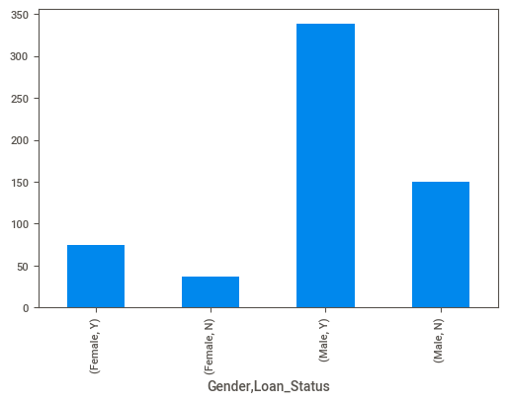
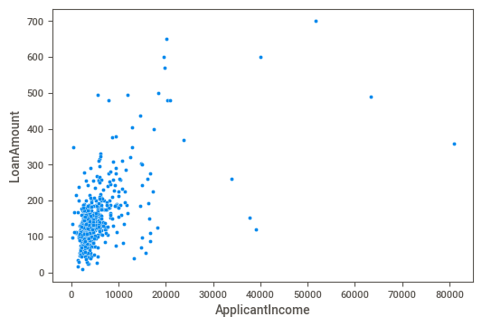
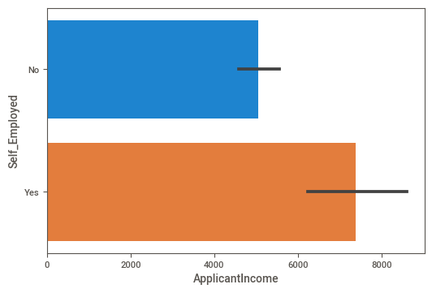
TEXT LAYOUT 1
Analysis
Analytical Findings:
loan amount as applicant income increases
self-employed have more applicant income than non-self-employed
Males getting More numbers of approved loans than female

Slide 9
TEXT LAYOUT 1
Modeling
In these use cases basically, we have to predict customer loan will be approved or not so it’s a classification problem to approach that problem I used two approaches:
1. AutoML and Bespoke ML
2. Traditional approach

Slide 10
TEXT LAYOUT 1
Model Evaluation
For checking the performance of the model I used a confusion matrix and model accuracy
1. AutoML—Accuracy score -78.04% 3. DecisionTreeClassifier--Accuracy score -69.10%
2. Logistic Regression--Accuracy score -78.86% 4. SGDClassifier--Accuracy score -69.91%
 | P | N
T | 18 | 2
F | 25 | 78
 | P | N
T | 22 | 17
F | 21 | 63
 | P | N
T | 18 | 1
F | 25 | 79
 | P | N
T | 22 | 16
F | 21 | 64

Slide 11
TEXT LAYOUT 1
Recommendations
1. Logistic regression shows 78.86% accuracy so we can make a machine-learning model to automate the loan granting process
2. Train the model periodically with new data to increase the model performance.

