Slide 1

Deep Learning–Based Spectrum Sensing under Partial Observations
Submitted by:
Chetan Prakash Dudi Roll No: 2022CSB1074
Manish Anwla Roll No: 2022CSB1090
Under the guidance of:
Dr. Sudeepta Mishra & Anjani Gupta
Department of Computer Science and Engineering Indian Institute of Technology Ropar

Slide 2

Project Overview (Before Mid-Semester)
Motivation:
Wireless spectrum is crowded, like a busy bazaar where everyone wants a stall.
Primary Users (licensed) must be protected from interference.
Secondary Users need reliable spectrum sensing, especially under low SNR and partial visibility.
1
Objective:
Build deep learning models (LSTM, Bi-LSTM, GRU, RNN, Enhanced LSTM) to detect PU activity.
Compare with state-of-the-art Collaborative CNN from IEEE TCCN 2024
2

Slide 3

Problem Statement & Research Gap (Pre-Mid-Sem Work)
Problem:
Efficient spectrum sensing fails when
SNR is very low
Each SU sees only a slice of the spectrum (“partial observations”).
Conventional methods (Energy Detection, Cyclostationary) crumble under noise uncertainty.
Research Gaps Identified:
Partial Observations Issue:
Existing DL models assume full-spectrum input → unrealistic.
Temporal Dependencies Ignored:
PU activity has patterns over time; CNNs can’t capture these well.
Model Complexity vs Robustness:
Collaborative CNNs reduce parameters but still need coordination.
Our Direction:
Explore LSTM-based models to capture long-term temporal behaviour.

Slide 4



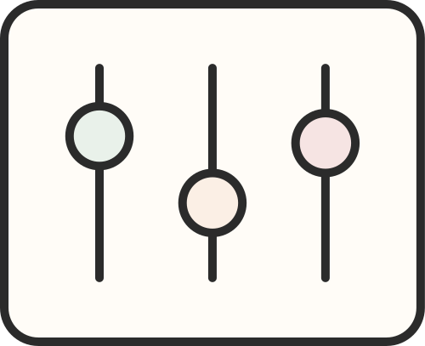




Pre-Mid-Semester Work Summary
Pre-Mid-Semester Work Summary
Data Pipeline Built:
Preprocessing Completed:
Synthetic PSD dataset across SNR = −16, −10, −4 dB.
PSD shape: 64 frequency bins × 20 bands per sample.
Labels: Occupied / Idle for each of 20 bands.
Standardization of PSD values.
Sequence conversion: (20 time steps × 64 features).
Train/test splitting & DataLoader setup.
Model Implementations (PyTorch):
Baseline Evaluation Done:
LSTM, Bi-LSTM, RNN, GRU, Enhanced Gated LSTM
Loss: Binary Cross-Entropy
Optimizer: Adam
Training convergence plots
ROC curves
PD vs SNR

Slide 5
Post Mid-Semester Progress Overview
An I/Q signal is a way to represent a complex signal using two real signals:
I → In-phase component
Q → Quadrature component (90° phase shifted version of I)
Purpose: Generate wideband wireless I/Q datasets using GNU Radio and SDR.
1
Goal: Capture real-world signals under varying channel conditions for IoT and modulation analysis.
2
Mathematically, a complex baseband signal is written as:
x(t)=I(t)+jQ(t)
Where:
I(t) = amplitude of the cosine (real) part
Q(t) = amplitude of the sine (imaginary) part
j=sqrt(−1)​
Devices: ADALM-PLUTO SDR, GNU Radio, Python (PyTorch) integration.
3
Output: Dataset of PSD, SNR, and PU activity logs for each modulation type.
4

Slide 6
NumPy: Used for fast mathematical operations like FFT and signal processing on complex I/Q data.
Torch (PyTorch): Used to save and structure datasets (.pth files) for later ML-based signal analysis.
CSV: Used to log real-time PSD, SNR, and PU activity values in a readable file format.
FFT Library: Converts time-domain signals into frequency-domain (Power Spectral Density) for analysis.
Frequency Range (325 MHz – 3.8 GHz): Defines the tunable radio spectrum that the PlutoSDR can operate in.
Sample Rate (up to 61.44 MSPS): Determines how many signal samples are captured per second, affecting bandwidth and accuracy.
Software and Hardware Stack
Software:
GNU Radio Companion
Python (NumPy, Torch, CSV, FFT libraries)
IIO Drivers for SDR communication
Hardware:
ADALM-PLUTO SDR
Frequency range: 325 MHz – 3.8 GHz
Sample rate: Up to 1.024 MSPS

Slide 7




PU block
Overall System Flow
Primary User (PU): Transmits modulated signal using GNU Radio and Adam Pluto SDR.
Secondary User (SU): Receives signal and logs spectral data.
Data Flow:
Generate binary data by Matlab.
Modulation applied (BPSK/QPSK/FSK/16QAM).
Signal transmitted using PlutoSDR Sink.
SU receives via PlutoSDR Source and runs Python logger.
Air
SU Block
Logger

Slide 8

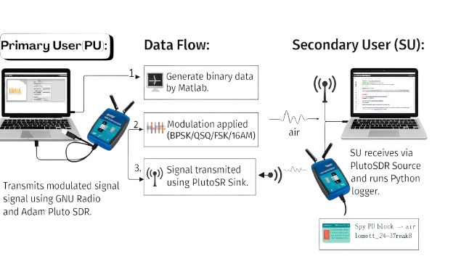
Overall System Flow

Slide 9
Transmitter Flowgraph (PU_tx.grc)
Blocks Used:
File Source → Constellation Modulator → QT Frequency Sink + PlutoSDR Sink
Key Parameters:
LO Frequency: 2.4 GHz
Sample Rate: 1.024 MHz
Buffer Size: 32.768k
Function:
Generates and transmits I/Q data using chosen modulation.

Slide 10
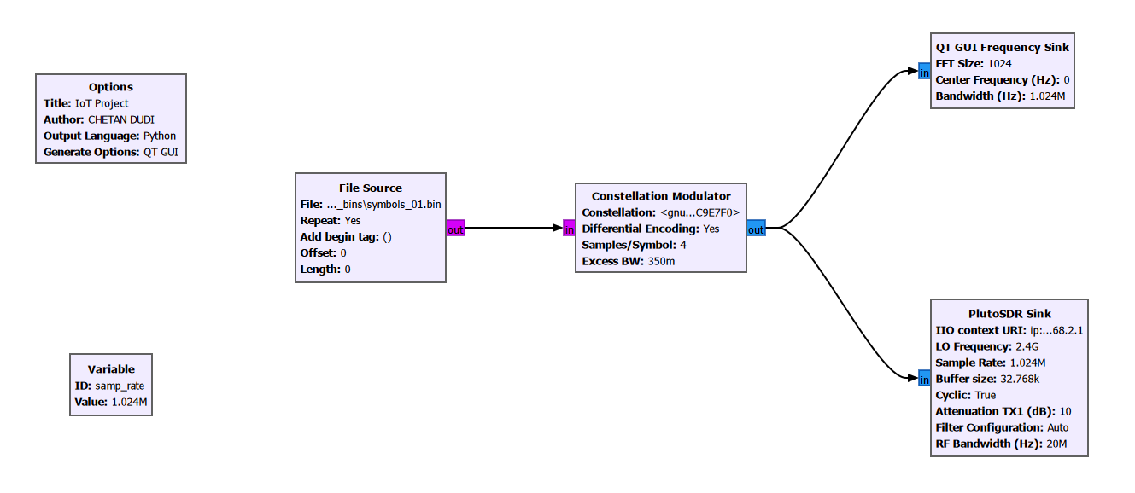
Transmitter Flowgraph (PU_tx.grc)

Slide 11
Receiver Flowgraph (SU_rx.grc)
Blocks Used:
PlutoSDR Source → QT GUI Frequency Sink → File Sink → Custom PSD Logger
Key Parameters:
LO Frequency: 2.4 GHz
Sample Rate: 1.024 MHz
RF Bandwidth: 20 MHz
Function:
Captures PU signals and logs Power Spectral Density.

Slide 12
Receiver Flowgraph (SU_rx.grc)
Custom Python Block (psd_logger)
Reads complex input samples from SDR source.
Computes Power Spectral Density (PSD) in dB.
Calculates SNR using mean PSD and 10th percentile noise floor.
Flags PU presence (if SNR > 5 dB).
Stores results in:
CSV: human-readable log
PTH: tensor dataset
Binned PTH: organized by SNR range (for ML)

Slide 13
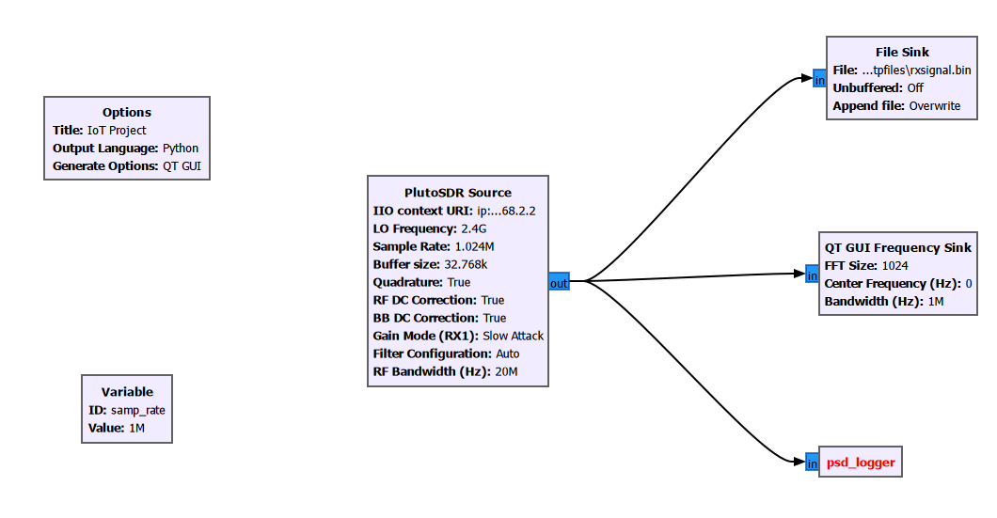
Receiver Flowgraph (SU_rx.grc)

Slide 14
Modulation
Why is Modulation Needed?
What is Modulation?
Without modulation:
Digital signals can’t travel long distances efficiently.
Bandwidth and interference would increase.
Multiple users can’t share the same frequency spectrum.
Hence, modulation helps to:
Transmit data over long distances (radio frequency range).
Allow multiple users to coexist (via different frequency bands).
Improve resistance to noise and interference.
Optimize bandwidth usage depending on channel capacity.
Modulation is the process of varying one or more properties of a carrier signal (like amplitude, frequency, or phase) in accordance with a baseband digital signal (data) that you want to transmit.
In simple terms:
Modulation converts digital data (0s and 1s) into an analog waveform that can be transmitted efficiently over a wireless channel.

Slide 15
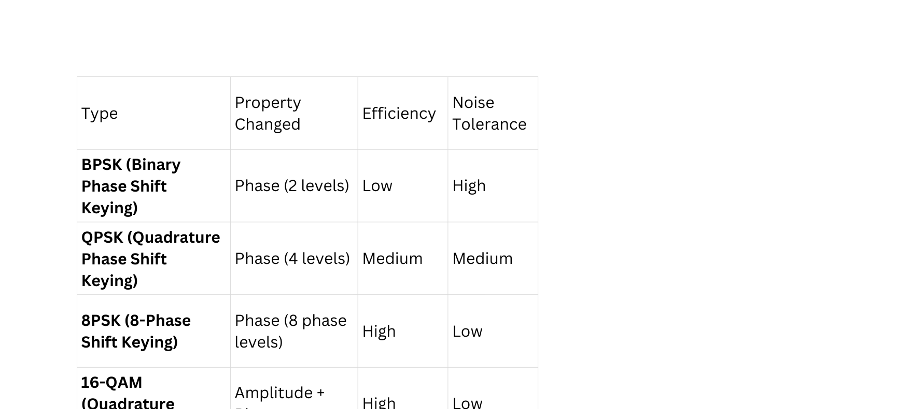
Modulation Techniques Used
Modulation Description Data Rate Robustness
BPSK 1-bit per symbol Low High
QPSK 2-bit phase shift Medium Medium
8PSK Frequency-coded Medium High
16-QAM Amplitude + Phase High Lower
Observation:
Higher-order modulations (QAM) give more throughput but are more noise-sensitive.

Slide 16
Impacts Of Modulation
When you transmitted using GNU Radio:
The PU (Primary User) modulated binary files using BPSK, QPSK, FSK, and 16-QAM.
The SU (Secondary User) received the waveforms and calculated:
PSD → how energy is distributed across frequency
SNR → how clear the signal is over background noise
You then used this data to log and analyze modulation performance under different noise and distance conditions.
So modulation directly impacted:
The shape of the PSD you captured
The SNR values stored in your CSV
The PU detection accuracy (higher-order modulations harder to detect at low SNR)

Slide 17

Dataset & Logging Outputs
CSV Columns: Timestamp | Mean_PSD_dB | SNR_dB | PU_Present
PTH (Torch file) contains:
PSD arrays
Corresponding SNR values
PU activity labels
Used for wireless signal classification & IoT traffic pattern analysis.

Slide 18
1
Input Data
Simulating Single PU-SU to Multiple PUs and SUs
2
System Configuration
Concepts Used:
Channel Gain
Shadowing
Frequency Drift
AWGN
3
4
Algorithm

Slide 19
Simulating Single PU-SU to Multiple PUs and SUs
Input Data (Real PSD Library):
PSDs collected from real SDR hardware (Pluto/RTL-SDR)
Stored inside .pth files per modulation:
BPSK
QPSK
8PSK
16QAM
Each PSD: 192 frequency bins
May include recorded SNR values
Loaded into PSD_LIB for sampling
System Configuration:
PUs = 10
SUs = 10
Channels = 20
Freq bins per channel = 64
One PSD (192 bins) split into:
0–63 → Left leakage
64–127 → Main signal
128–191 → Right leakage
Class count = 210=10242^{10} = 1024210=1024

Slide 20
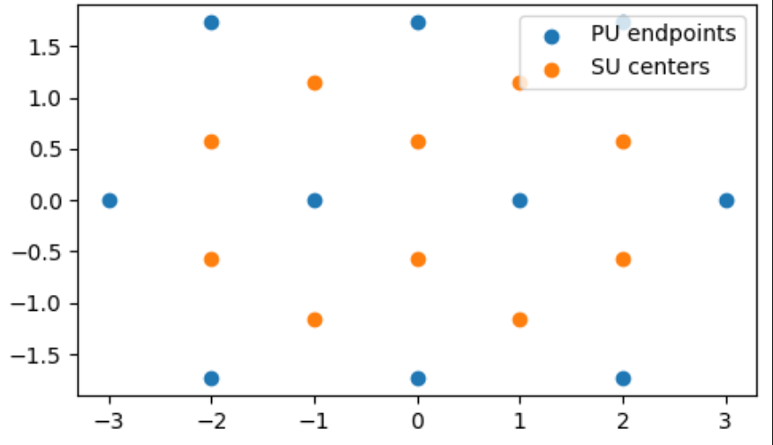
Simulating Single PU-SU to Multiple PUs and SUs

Slide 21
Important Terms(Concepts Used)
Frequency Drift
Why do we use frequency drift?
Real radio signals do NOT stay perfectly centered at their exact carrier frequency because of:
Local oscillator (LO) mismatch
PLL instability
Doppler shift (motion)
Temperature changes
Imperfect filters
Hardware imperfections
Therefore, the received PSD will be slightly shifted left or right.
To simulate this real behavior, we apply a fractional shift to the PSD bins.
Formula:
If PSD = x[n]x[n]x[n] of length N and
drift = Δf (fractional shift in bins):
xshifted[n]=x[n−Δf]x_{\text{shifted}}[n] = x[n - \Delta f]xshifted​[n]=x[n−Δf]

Slide 22
Important Terms(Concepts Used)
Channel Gain(Path-loss Model):
Why do we use channel gain?
Signal strength reduces when traveling from PU → SU due to:
Distance
Obstructions
Atmospheric absorption
Multipath fading
To model this attenuation, we use a log-distance path-loss model.
Base formula:
base_gain=(β⋅(d⋅A)α)−1\text{base\_gain} = \left( \beta \cdot (d \cdot A)^{\alpha} \right)^{-1}base_gain=(β⋅(d⋅A)α)−1
Parameter:
α (alpha): Rate at which signal decays with distance
β (beta): Constant scaling factor based on environment
DIST_AMP: AAmplify the distance

Slide 23
Important Terms(Concepts Used)
Shadowing:
Additive White Gaussian Noise (AWGN):
Why do we use shadowing?
Even at the same distance, signal power fluctuates due to:
Buildings
Trees
Cars
Humans
Temporary blockages
This causes slow variations around the average path-loss.
This is called log-normal shadow fading.
Why do we use AWGN?
Every radio receiver experiences thermal noise:
ADC noise
RF front-end noise
Mixer noise
Amplifier noise
Environmental EM noise
To simulate this, AWGN is added.
But the amount of noise must match the desired SNR.
Pnoise​=Psignal/SNRlinear​​

Slide 24
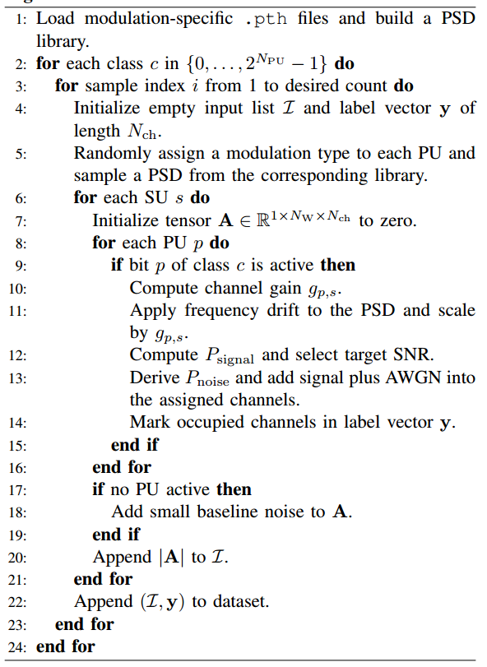
Algorithm

Slide 25
Conclusion
Implemented PU–SU communication using SDRs.
Logged spectral features and generated datasets.
Built foundation for AI-based modulation detection.

Slide 26

A
Radio GNU Download Link
B
Pluto SDR Driver Link
Resource
Page
C
Results
D
SU_rx.grc
E
PU_tx.grc
F
PSD logger Block Code
G
GitHub Repo

Slide 27
Thank you!

