Slide 1
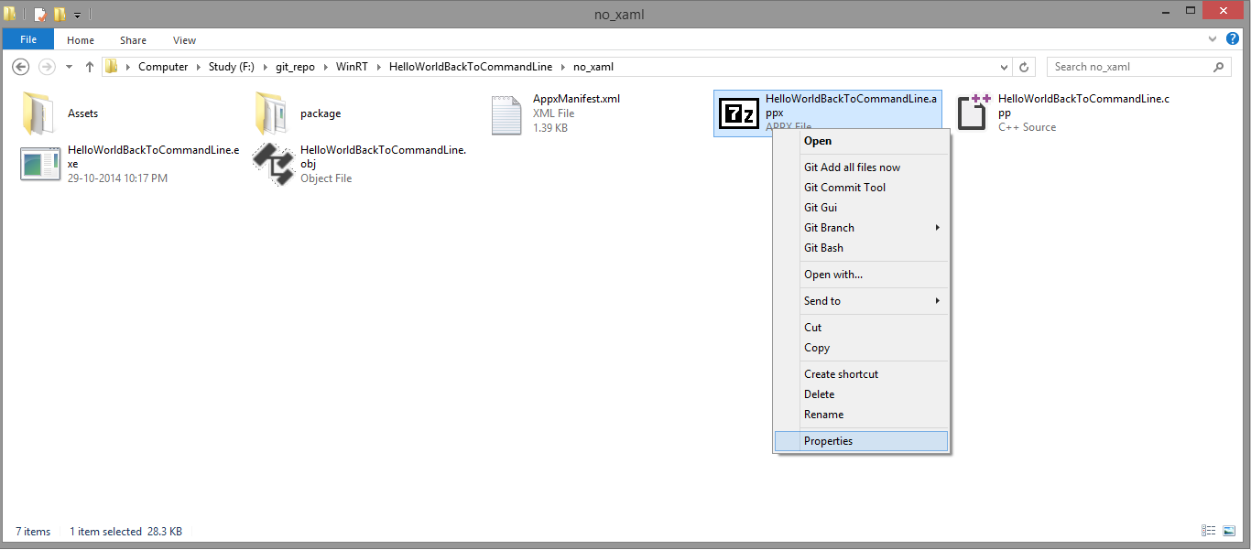
1] Appx package
2] Right click and select “Properties”

Slide 2
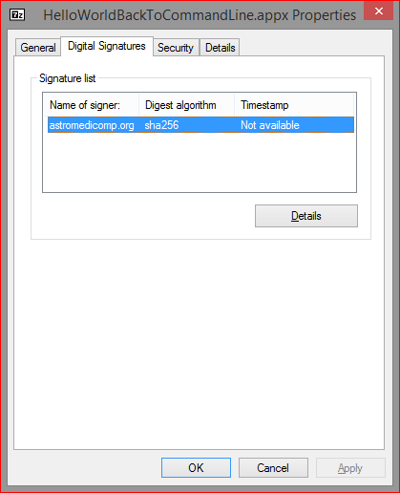
3] Go to "Digital Signature" tab
4] Select your certificate and click on "Details"

Slide 3
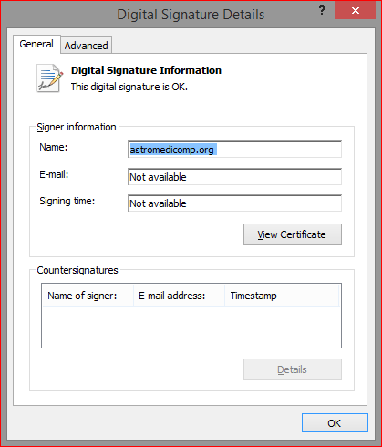
5] Select "View Certificate"

Slide 4
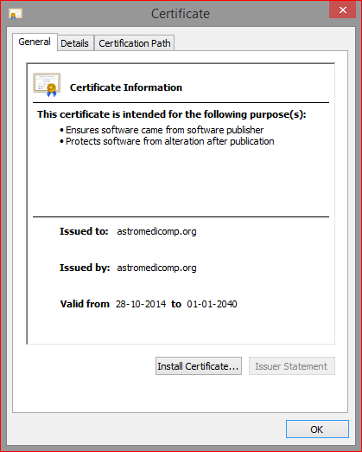
6] Select "Install Certificate"

Slide 5
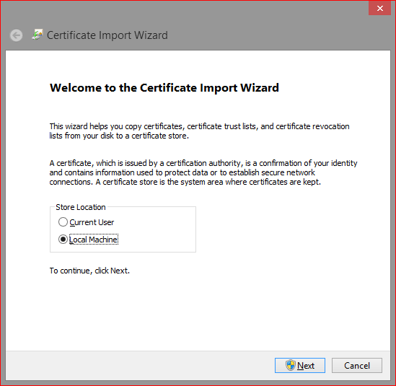
7] Select "Local Machine" and click "Next"

Slide 6
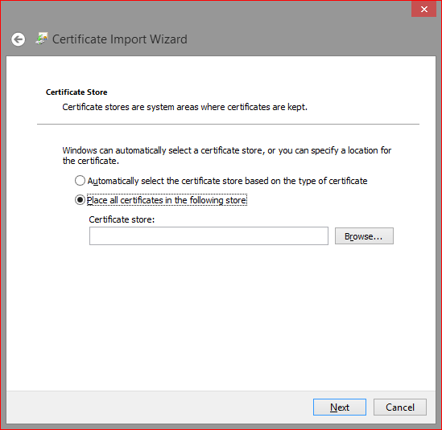
8] Select "Place all certificate in the following store“ and select "Browse"

Slide 7
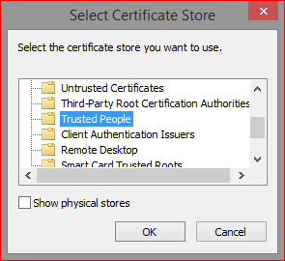
9] Select "Trusted People" and click "Ok"

Slide 8
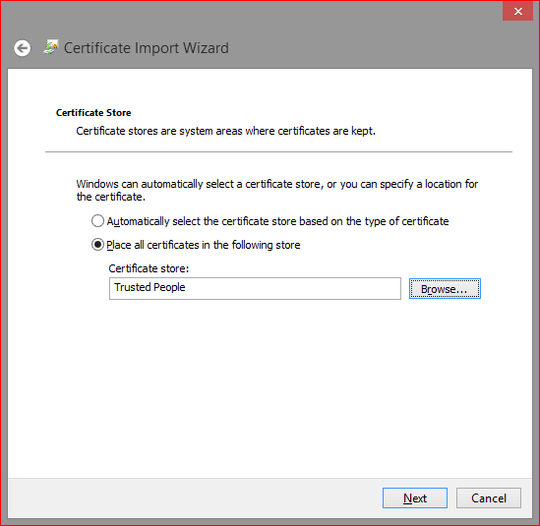
Selected options
10] Select "Next"

Slide 9
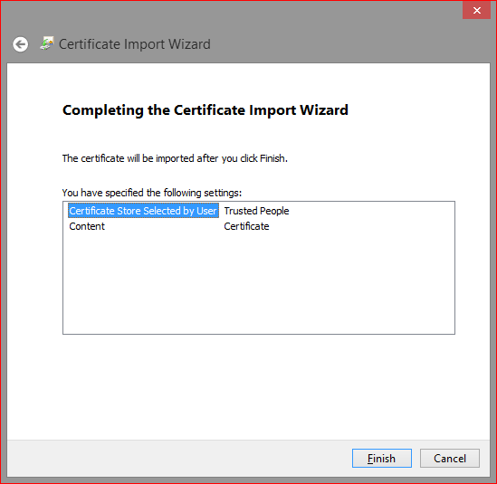
11] Select “Finish"

Slide 10
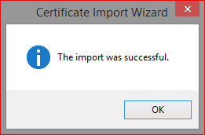
12] Secures

Slide 11
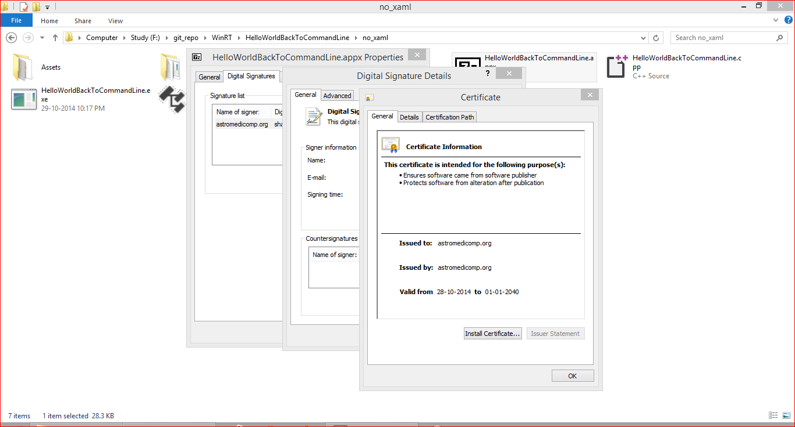
Properties Pages

