Slide 1
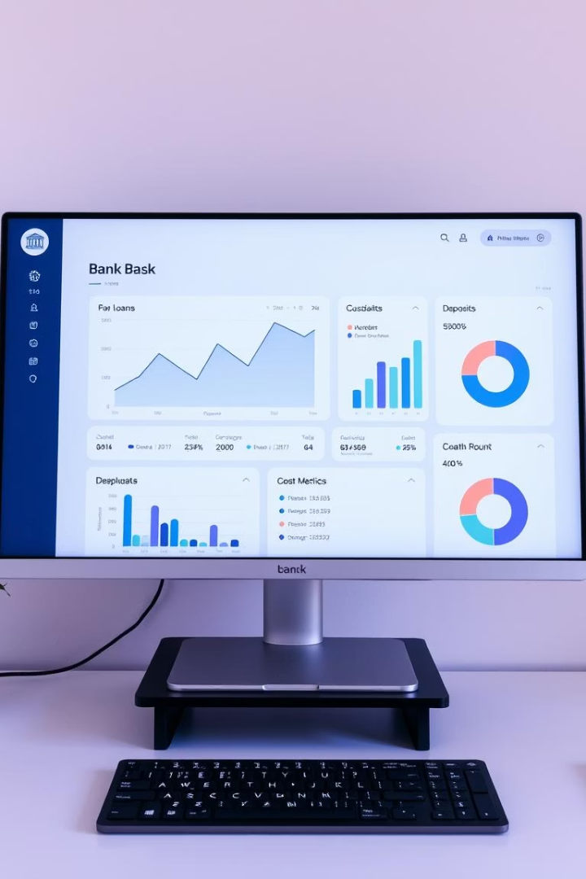
Bank Loan Dashboard Analysis: Key Insights
An analytical review of the bank’s loan portfolio reveals key performance indicators and risk factors.
by CHETAN GOWDA

Slide 2

Portfolio Overview and Key Metrics
Loan Portfolio Size
Interest and Risk
Total collection at 814.90M; funded loan amount 733M across 65.54K loans.
Average interest rate is 12.03%, delinquency rate 10.8%, default rate 1.6%.
Collection Challenges
1,020 defaulted loans and 7,106 delinquent clients highlight recovery issues.

Slide 3




Loan Distribution by Religion
Hindu Applicants
Muslim Applicants
1
2
Hold 75% of total loan amount, reflecting majority borrower segment.
Account for 11%, indicating moderate participation in loan uptake.
Christian Applicants
Sikh Applicants
Minor share at 1%, representing minimal loan distribution.
Receive 13% of loans, showing significant share within the portfolio.
4
3

Slide 4
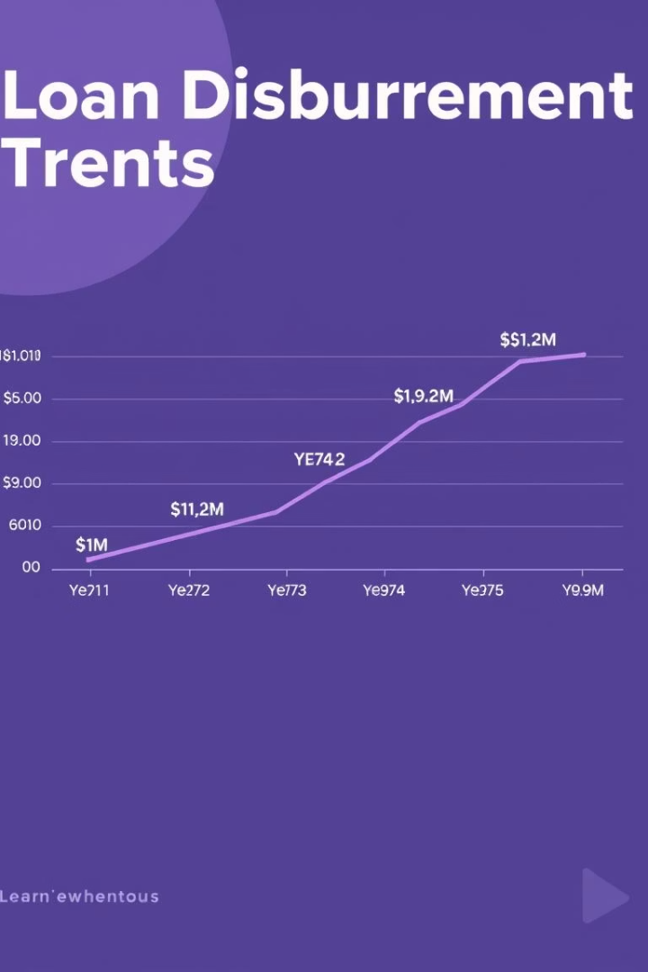
Loan Disbursement Trends Over Time
1
FY 2017
Disbursement was 4.17%, marking the start of growth phase.
2
FY 2019
Peak at 56.87%, signifying strong market expansion.
3
FY 2020
Declined sharply to 8.51%, reflecting market slowdown and uncertainty.

Slide 5
Age Group and Borrowing Patterns
26–45 Years
18–25 & 56–63 Years
Dominates loan disbursement, representing prime working-age borrowing.
Lower loan amounts indicate reduced borrowing in younger and older groups.

Slide 6

Loan Grade Composition and Risk Layering
Grade B
Grade C
Grades D to G
Largest share at 29.99%, reflecting moderate-risk borrower focus.
20% of portfolio, supporting risk diversification strategy.
Progressively smaller shares, limiting high-risk exposure (lowest is 1.43%).

Slide 7
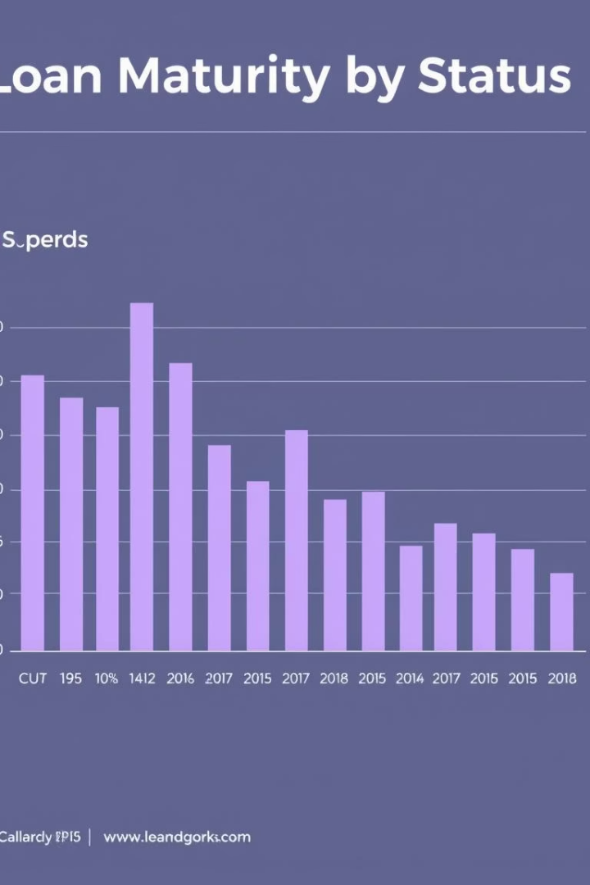


Loan Status and Maturity Insights
Active Loans
63% of loans are active with 36-month tenure dominant among outstanding.
Delinquent & Defaulted
Together constitute 12%, signaling manageable credit risk levels.

Slide 8
Verification Status and Product Focus
Verification Gaps
Product Group Distribution
16,921 loans marked unverified; 25,818 unknown, posing data risk.
Home loans dominate at ₹278.26 Cr; Services follow at ₹155.53 Cr.

