Slide 1
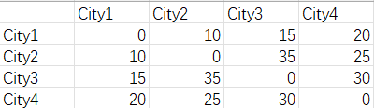
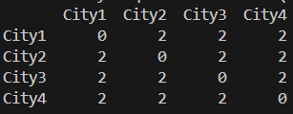
TSP TO RELIABLE NETWORK
Input for reliable network: distance matrix Dij, requirement matrix Rij,
Budget b’
Input for TSP: distance matrix Dij, budget b
Transformation
Budget = 90
Time complexity: O(N^2)
Budget = 90

