Slide 1
Spain Airbnb data warehouse
Tracey Jabbour, Chethan Singh, jose perez Gonzalez
October 14, 2020

Slide 2
Business overview

Slide 3


Introduction
Airbnb has quickly become one of the most popular vacation rental platforms worldwide. You can find lodging arrangements from Airbnb, ranging from single rooms to entire houses, in nearly every country. Consumers also have the option to choose how many bedrooms they would like, and which amenities to include, such as Wi-Fi, air conditioning, heating, etc. This flexibility creates a more attractive platform for travelers than a hotel.

Slide 4

Introduction cont.
This data warehouse includes Airbnb information specifically for Madrid, Spain
The warehouse contains information such as:
Host
Location
Amenities
Availability
Price
Reviews

Slide 5
Business overview
Why build a data warehouse for this Airbnb data?
Objective
Purpose
To improve the organization by:
Storing historical information on Airbnb activity
Analyse trends to better predict future Airbnb activity
Create a common, one-stop-shop for Airbnb data in Madrid, Spain
To answer business questions such as:
Which Airbnb hosts are the most profitable, based on neighborhood location?
What type of housing is most demanded or desired in Madrid?
Which month is the peak of occupancy per listing in Madrid?
What is the average occupancy rate for a given Host?
What is the impact of amenities on the revenues?
What is the impact of various review scores (cleanliness, check-in score, location, value, etc.) and rating scores for each housing type?
“DWs are central repositories of integrated data from one or more disparate sources. They store current and historical data in one single place that are used for creating analytical reports for workers throughout the enterprise.”

Slide 6
Dimensional modeling process

Slide 7
Dimensional modeling process
1. What is the business process we are trying to model?
2. What is the grain of the business process?
The business process TPI will model the Spain Airbnb housing sales
The grain of this business process is the price of the Airbnb unit by listing by day, up to 7 consecutive days on a listing
3. What are the dimensions that apply to each fact table row?
4. What are the facts?
The dimensions that apply are:
Amenities
Date
Host
List
Location
Property Type
Reviews
The facts that are applied are:
Number of days of stay
Total Price
Cleaning Fee
Security Deposit

Slide 8
Dimensional model

Slide 9
Dimensional model – placeholder for full model

Slide 10
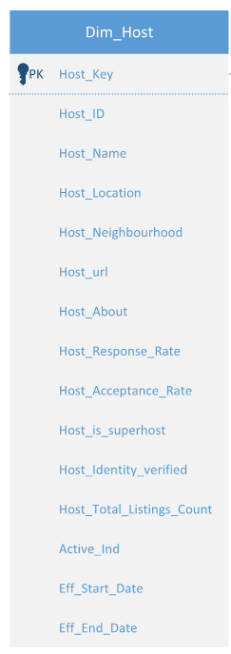
Dimensional model - host
Why was the host dimension chosen to be included in the data warehouse?
To be able to determine which host is most profitable, if a host has multiple listings & if a super host has better listing confirmations (i.e. their listings get booked faster than non-super hosts)
SCD Type 2 Fields
Key Attributes
Host Name, Host Location, Host Neighborhood, Host Response & Host acceptance rate

Slide 11
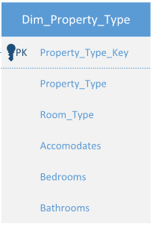
Dimensional model – property type
Why was the Property Type dimension chosen to be included in the data warehouse?
To be able to determine the type of properties we can compare when doing analysis on most profitable hosts. For example, a property type that has 3 bedrooms should be compared to differently than one that has 10 bedrooms, likely for a much larger party of occupants.
Key Attributes
Property Type (Apartment, House, Loft, etc.)
Type of Room (Private room, Entire home/apt)
How many individuals this property accommodates
How many bedrooms & bathrooms are available in this property
Note – this dimension table is a one- time load with all possible combination of the fields loaded, and the mappings based on primary keys of this table. This table will act as a junk dimensions table.

Slide 12
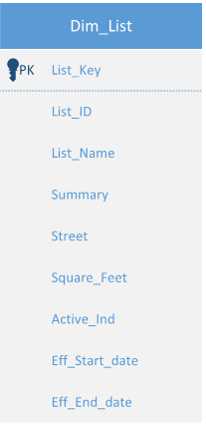
Dimensional model - List
Why was the List dimension chosen to be included in the data warehouse?
To be able to understand how large the listings are in the area, and help determine which listings are most profitable by size and what area they are in. For example, a smaller listings will not be as expensive as a larger listing, so the two should not be compared together in terms of profitability.
SCD Type 2 Fields
Key Attributes
Name of the listing
Listing Summary (an advertising mechanism to attract customers)
Listing Street
Square Feet of listing

Slide 13
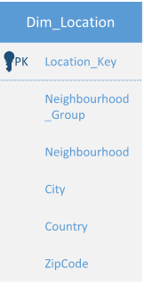
Dimensional model – location
Why was the Location dimension chosen to be included in the data warehouse?
To be able to determine the location of properties that we are comparing price to; the City and State will be key attributes in this dimension to split locations for each listing.
Key Attributes
Neighborhood
Neighborhood Groupings (summary view of neighborhood)
City
State
ZipCode
Note – this dimension table is a one- time load with all possible combination of the fields loaded, and the mappings based on primary keys of this table. This table will act as a junk dimensions table.

Slide 14
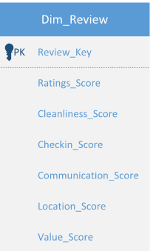
Dimensional model – review
Why was the Review dimension chosen to be included in the data warehouse?
An important factor when an individual searches for lodging is what previous ratings have been for the host. The review dimension will allow us to compare host ratings and determine if hosts with higher ratings had more bookings, resulting in a higher profit.
Key Attributes
Overall rating
Rating on cleanliness
Rating on check-in efficiency
Rating on communication by host
Rating on location
Rating on value of property
Note – this dimension table is a one- time load with all possible combination of the fields loaded, and the mappings based on primary keys of this table. The fields will act as rapidly changing dimensions.

Slide 15
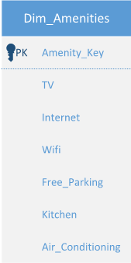
Dimensional model – amenities
Why was the Amenities dimension chosen to be included in the data warehouse?
The amenities dimension will allow users to query what features come with the listing by each host. In a busy city like Madrid, free parking available with the listing may be a key request by customers. With this dimension, we can query if hosts that have these amenities turn a larger profit than hosts who do not include these amenities.
Key Attributes
TV
Internet
Wifi
Free Parking on the premises of the listing
Kitchen
Air Conditioning

Slide 16
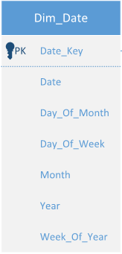
Dimensional model – date
Why was the Date dimension chosen to be included in the data warehouse?
As with any data warehouse, a date dimension in key for implementation. This date dimension here will allow users to query information such as a surge of listings or in what period of the year listings become more available.
Key Attributes
Date
Day of the Month
Day of the Week
Month
Year
Week of the Year
Note – this dimension table is a one- time load from January 1, 2018 to December 31, 2020

Slide 17
Data source
Overview
Data source link - https://www.kaggle.com/rusiano/madrid-airbnb-data
The input data source consisted of two (2) extracts:
listings_detailed.csv – where the main information was stored
Calendar.csv – calendar information, availability & price per date
Data Load
Load Summary:
Data was transferred to a .txt file
Data was loaded via SSIS, Microsoft Visual Studio

Slide 18
Etl overview

Slide 19
ETL Overview – Dimension tables
Note: All Dimension Tables have identity column as primary key for automated primary key increments necessary for new inserts
Table Name | Load Strategy
Dim_Host | This table maintains SCD2 dimensions of a host, hence a data is first loaded to a staging table from source file(listings_details.csv) through SSIS workload, identify the dimensional changes in and make updates/insert as per SCD2 rules in SQL server.
Dim_List | This table maintains SCD2 dimensions of a listing, hence a data is first loaded to a staging table from source file(listings_details.csv) through SSIS workload, identify the dimensional changes in and make updates/insert as per SCD2 rules in SQL server.
Dim_Date | This date dimension requires onetime load of all dates for years 2019 and 2020 along with date attributes are loaded though SSIS workload. This table can be scaled as required for future years.
Dim_Property_Type | This junk dimension requires onetime historical load of all property type attributes are loaded from source file listings_details.csv through SSIS workload. For all future loads, source data can be checked for new property type attributes and data inserted accordingly.
Dim_Location | This junk dimension requires onetime historical load of all location attributes are loaded from source file listings_details.csv through SSIS workload. For all future loads, source data can be checked for new location attributes and data inserted accordingly.
Dim_Amenities | This junk dimension requires onetime load of all combination of amenities was loaded using SQL Server query.
Dim_Review | This rapidly changing dimension from source is converted to ranges and a onetime load of all combination of review ratings scores ranging from 0-5 was loaded using SQL Server query.

Slide 20
ETL Overview – Fact tables
After all the dimensional tables are loaded and checked for data quality, fact tables are loaded using the strategy described below.
Table Name | Load Strategy
Fact_Bookings | Step 1: Since calendar.csv is having data at daily bookings level for each listings, this data is first rolled to each bookings level with assumption that single booking has continuous days of occupancy for maximum of 7 days. This is done in SQL server using a intermediate table in the process. This table has all bookings attributes such as occupancy days, total price per booking, cleaning fee, security deposit. Step 2: This intermediate table from step 1 is joined with listings_details,csv data present in another intermediate table loaded using SSIS. This is to get all listing details, host details, property type attributes, amenities, reviews, location Step 3: Join the data in step 2 with all dimensional tables to lookup surrogate keys – Host_Key, List_Key, Date_Key, Property_Type_Key, Amenities_Key, Location_Key and Review_Key necessary for fact table load
Fact_Calendar | This factless table is at daily bookings level, so the calendar.csv source data can be directly used to load this fact table. In the process, Host_key, ListKey and Date_key is looked up from corresponding dimension table for loading this factless table.

Slide 21
Business reports

Slide 22
Lessons learned

Slide 23
Q&A

