Slide 1
Nexpay
A unified fintech dashboard for fiat and crypto,
built with production-grade security.
Hackathon 2026

Slide 2
The Problem
Money management today is fragmented across separate apps for fiat and crypto, with weak authentication and no real access control.
Fragmented
Assets
Weak
Authentication
No Access
Control

Slide 3
The Solution
Nexpay unifies fiat and crypto wallets behind a secure, role-based platform.
Unified Wallets
Secure Auth (OAuth+JWT)
Role-Based Access Control
Full Audit Trail

Slide 4
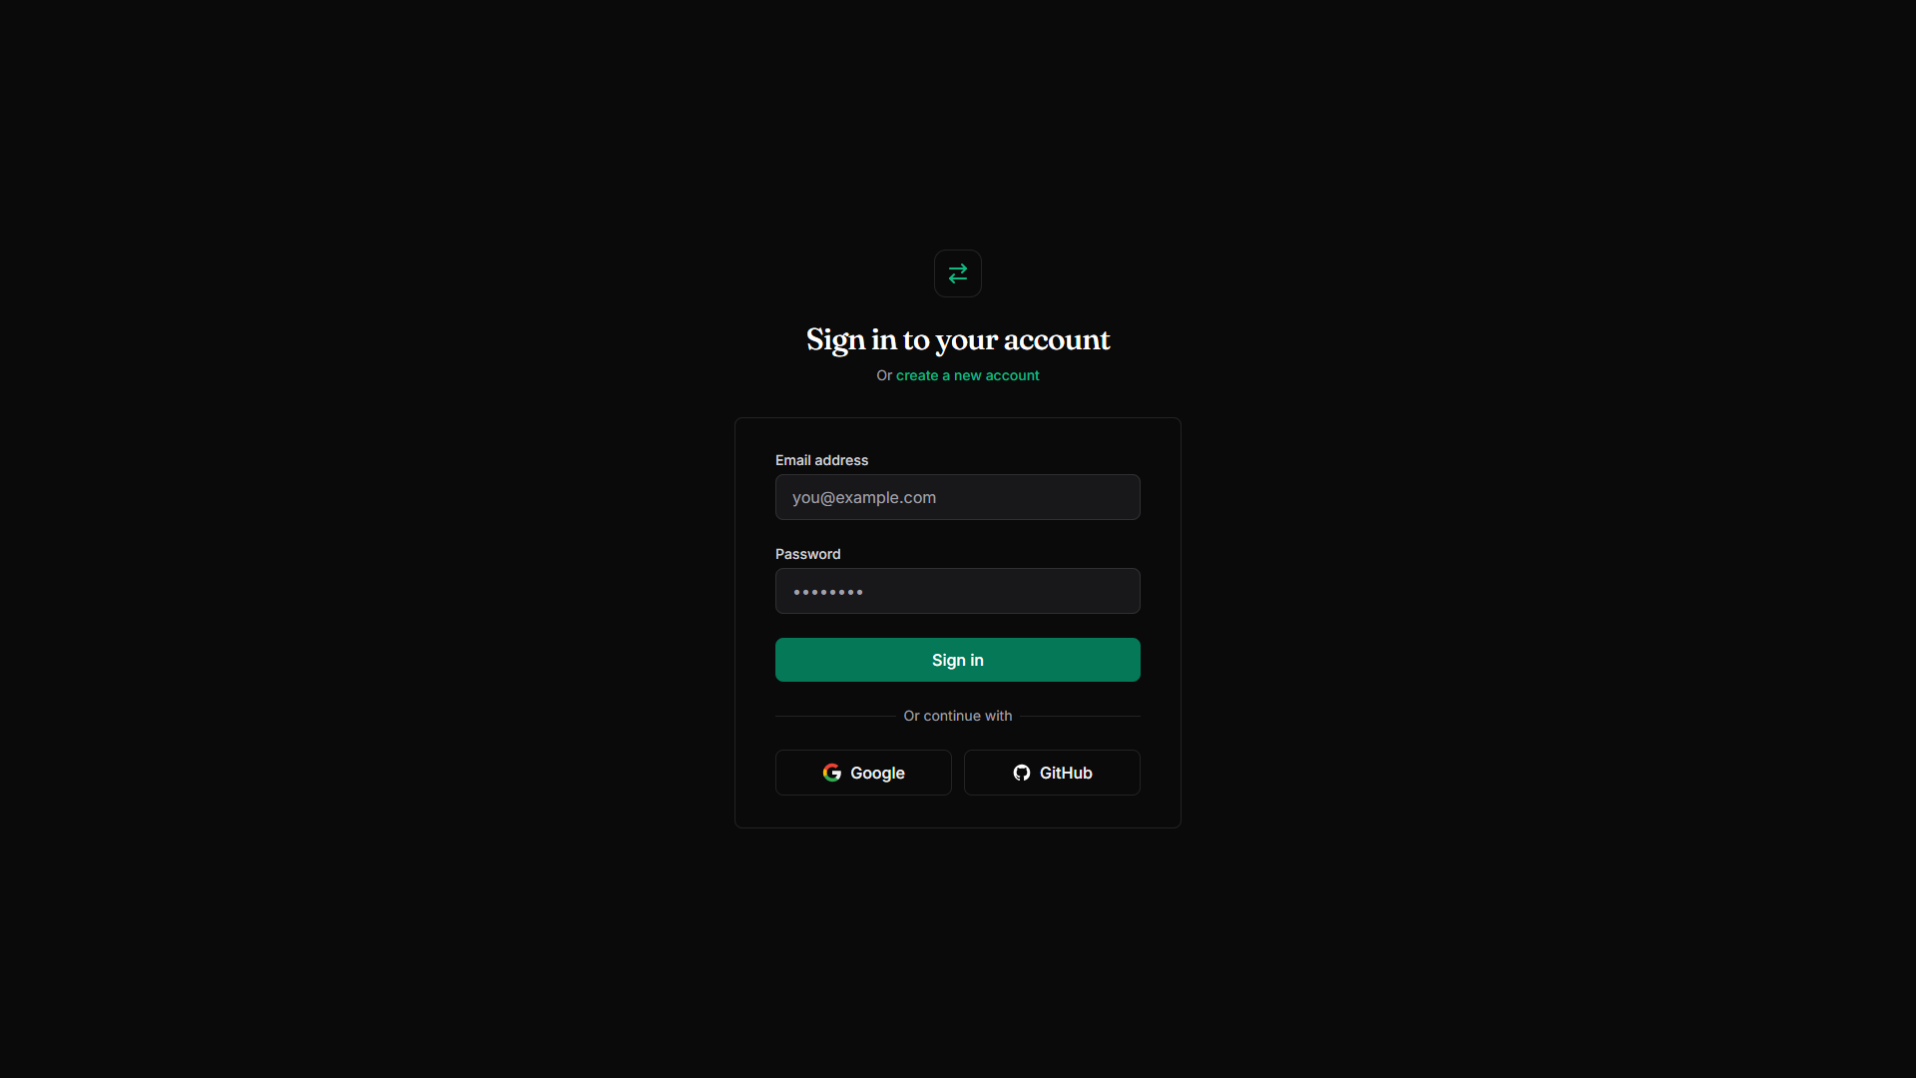
Unified Dashboard

Slide 5
Enterprise Access Control
Three roles, three distinct experiences — User, Admin, Auditor

Slide 6
Production-Grade Security
Google / GitHub
OAuth 2.0
JWT Access +
Refresh Tokens
Bcrypt Hashing
Rate Limiting

Slide 7
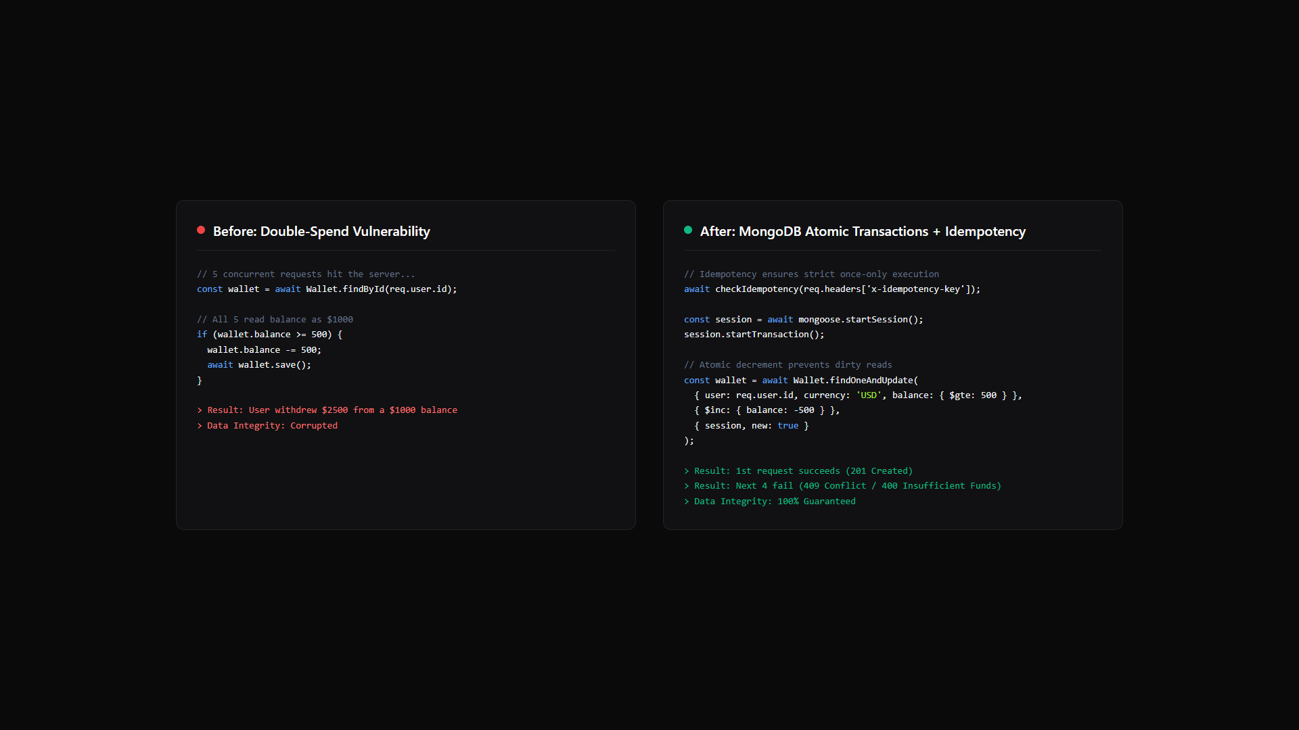
We found and fixed a real double-spend bug.
Concurrent transfer requests could double-spend. Fixed with MongoDB atomic transactions + idempotency keys.

Slide 8
Competitive Analysis
Feature | Real-World Apps | Nexpay
Asset Types | Separate Fiat/Crypto Apps | Unified Dashboard
Access Control | Single Role | Strict RBAC (Admin, Auditor)
Authentication | Password Only | JWT + OAuth 2.0
Transaction Safety | Race Conditions Ignored | Atomic Transactions + Idempotency

Slide 9
Tech Stack
Frontend:
React, TailwindCSS, Vite, Vercel
Backend:
Node.js, Express, MongoDB, Mongoose, Render
Security:
JWT, Passport.js, OAuth 2.0, Bcrypt

Slide 10

Try it live.
https://nexpay-fintech-dashboard.vercel.app

Slide 11
What's Next
• Two-Factor Authentication (2FA)
• Live Crypto Pricing Feeds (WebSockets)
• Automated CI/CD Test Suite

Slide 12
Nexpay
Thank You
https://github.com/ChetanMhaske/nexpay-fintech-dashboard
https://nexpay-fintech-dashboard.vercel.app

