Slide 1
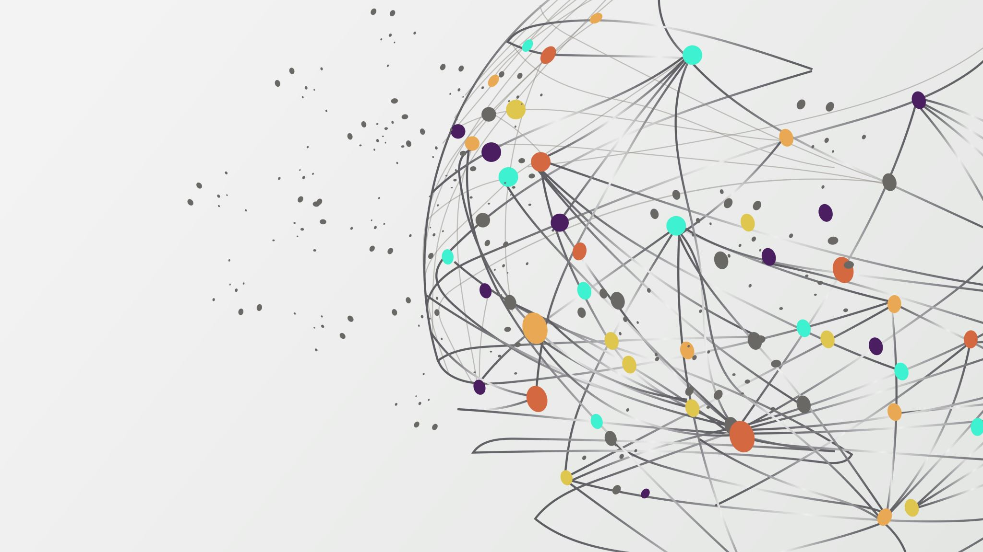
CSBC2000
Week 3 | Class 1
Blockchain Use Case Modelling I

Slide 2
Last "Week"
InfoSec, CyberSec, cryptography
Private, public, consortium blockchains
How blockchains maintain security
Hashing
Advanced encryption

Slide 3
This "Week"
Use cases
Learning the class of problems solved by blockchain
Converting business requirements to technical requirements
Engineering blockchain systems

Slide 4
This Class
Understanding blockchain from a business perspective
Understanding the current solutions that could be disrupted by blockchain
Analyzing traditional transactional systems and their pros/cons
Analyzing some existing blockchain systems and their pros/cons

Slide 5
Traditional Systems
Use databases to store state
Centralized content distribution
Centralized data management
Trust is required

Slide 6
Some tech business fundamentals
2 kinds of businesses: B2B and B2C
B2B: business-to-business
B2C: business-to-consumer
Businesses build products or services
- Products deliver some software to solve a problem
- Services deliver customized solutions to aid business IP
SaaS: Software-as-a-service; "software licensing and delivery model in which software is licensed on a subscription basis and is centrally hosted"
Some economics ahead

Slide 7
B2B
From a business to another business
Use cases: accounting (Quickbooks), sales (Salesforce), analytics (Google SEO), etc
Business logic consists of coding business functions
Used by employees to increase total factor productivity

Slide 8
B2C
Business-to-Consumer
From a business directly to an internet consumer
Used to facilitate everyday interactions between internet users
Use cases: code collaboration (Github), social networks (LinkedIn), email (Gmail), etc

Slide 9
Apps
Serve as means of delivery of business requirements as technical requirements
Perform business functions and reduce the cost of everyday business operations
Are delivered to customers based on requirements
Code for business requirements is typically referred to as business logic

Slide 10
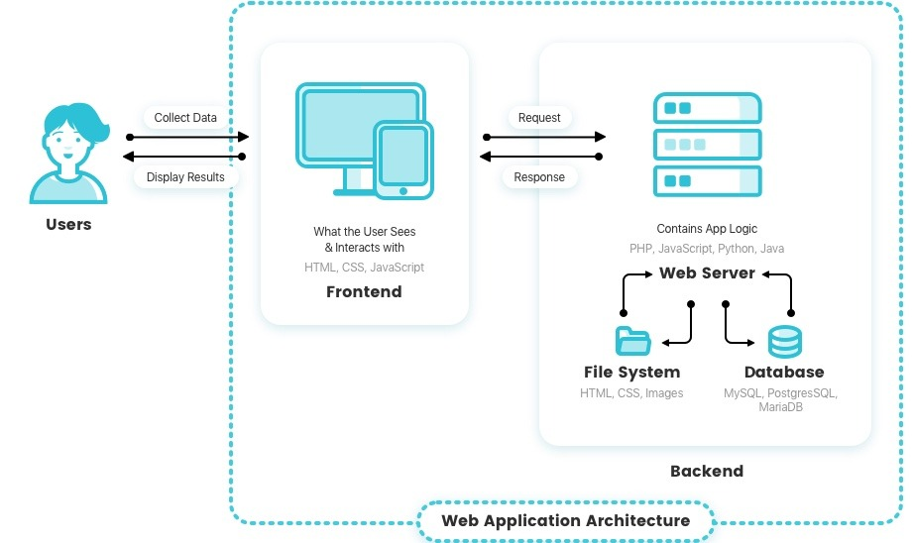
Server-Client Architecture

Slide 11
Server-Client Architecture
Users make requests from their browser to a dedicated machine that serves them – server
The server performs data management
- Figures out what data – or state – to read/write and performs the transaction
- Maintains InfoSec
- Configured by devs

Slide 12
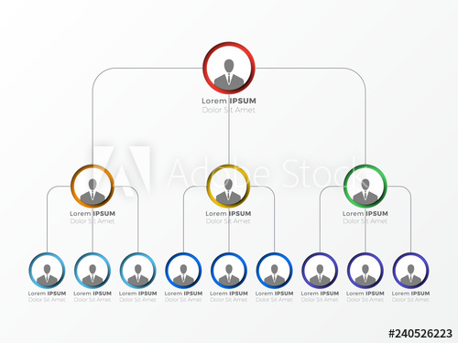
Server-Client Architecture: Pros
Centralized data control
Centralized security administration
Hierarchical decision-making overhead
Fast data clearing (TPS)

Slide 13
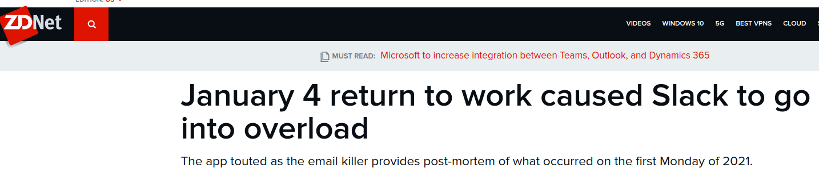
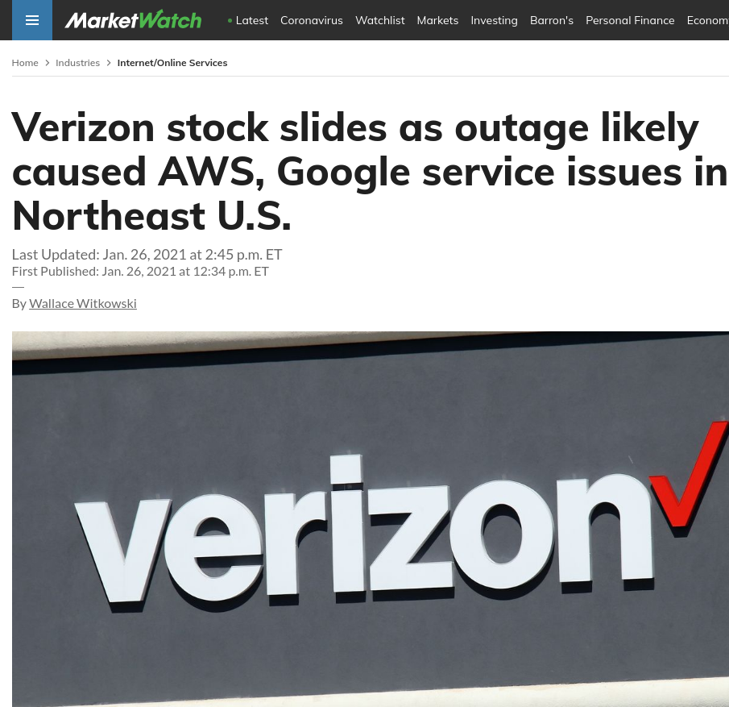
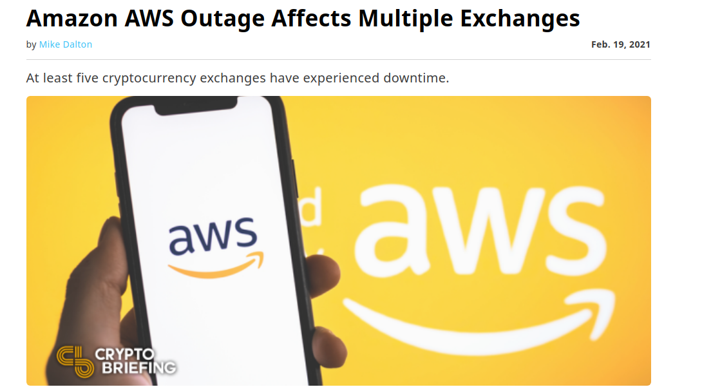
Server-Client Architecture: Cons
Centralized trust
Downtime
Security: single point of failure
Higher cost of verification

Slide 14
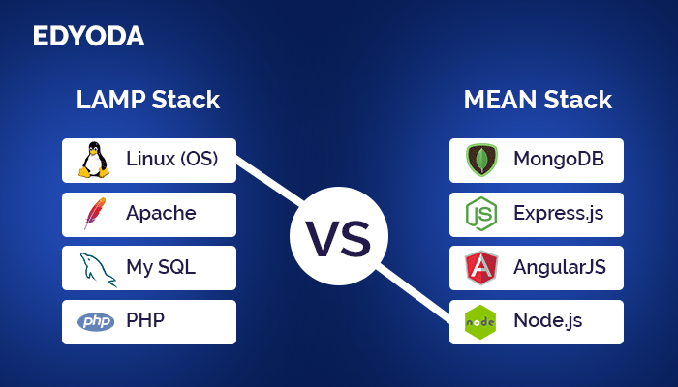
Enterprise SaaS

Slide 15
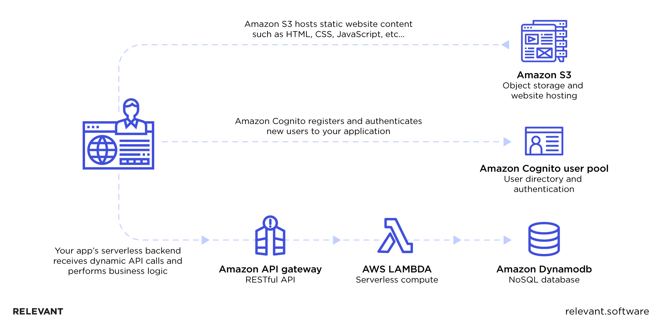
SaaS in 2021: Serverless

Slide 16
So when do I use Blockchain?
Is data controlled by only one party/entity in the network?
Can we secure all endpoints using just a database?
Does the system require security against tampering or alteration?
Is there a lack of trust in the network?
Is there a need for tracking using provenance?

Slide 17
Parties
If you have just one stakeholder, there is no need for a blockchain
Blockchain is designed for interoperability and multi-party coordination
If data persistence is important, can use a distributed database (which most enterprise DBs are anyway)
- Blockchain is a team sport

Slide 18
Disintermediation
Disintermediation is the term used to prevent intermediaries in any business process flow
Several businesses rely on middlemen that don't really have to be there
- E.g. Uber
Centralized database-based systems might be an easier fit to avoid distributed transaction processing.

Slide 19
Trust
Various stakeholders can operate with full freedom without requiring any trust
Centralized systems are vulnerable to a lot of malicious activities
Multi-party coordination offered by a centralized entity leads to increased risk
- If Google becomes evil...

Slide 20
Trust
Centralized trust can be abused by
- Tampering of existing data (e.g. SolarWinds)
- Withholding information (e.g. coverups)
- Reporting inconsistent transactions (e.g. "cooking the books")
- Providing unauthorized access to data for certain users (e.g. Cambridge Analytica)

Slide 21
Trust Problem
There are several parties that need to work with each other
They cannot trust each other
They need a platform to collaborate on work
They all need to trust the platform to allow for secure coordination
Blockchains solves this in different ways

Slide 22
Secure Ledger
All the parties need a single source of truth
A malicious party can claim that their source is true
Worse, they can collude with the platform maintainer to favor their position
Blockchain solves this by providing a permanent, immutable record of all transactions
The record is always set straight!
Malicious party would immediately and easily be disproved by history of txs

Slide 23
Virtual Machine Interdependency
Parties that don't trust each other need to work with each other
If the scope of work is not defined, there is no ground truth
Think Statement-of-Work for contractors
A blockchain VM solves this by exactly defining the scope of interactions that parties have with each other
This is reflected in Solidity code for Eth
Parties will not be allowed to change the single source of truth in ways undefined by the Smart Contract
i.e. All state transitions are fully specified

Slide 24
Token Aligning Incentive
Some Economics:
- First-Price Auction – Digital buying model where if your bid wins, you pay exactly what you bid. This maximizes revenue potential for the seller
- Second-Price Auction – Digital buying model where if your bid wins, you pay $0.01 above the second highest bid in the auction. In this type of auction, it is in your best interest to bid the highest amount you are willing to pay, knowing that often you will end up paying less than that amount

Slide 25
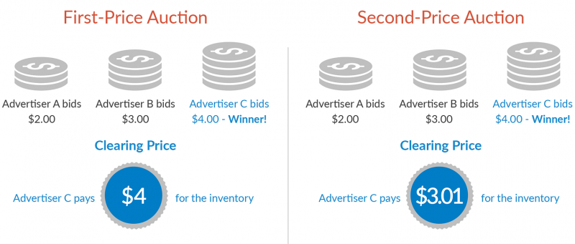
Token Aligning Incentives
Notes:
https://goodwaygroup.com/blog/first-price-vs-second-price-auction

Slide 26
Market Mechanism
We want all parties to behave in a good way to allow for multi-party coordination
Recall Byzantine Generals problem
Stakeholders have obligations that they need to meet
Market mechanisms are put in place to ensure that stakeholders perform toward maintaining these obligations

Slide 27
Blockchain Marketplace Mechanisms
Tokens issued/staked based on performance
Utility token e.g. Filecoin – make sure users provide storage space by giving them tokens
Staking e.g. PoS
Staking e.g. Escrow

Slide 28
Blockchain Marketplace Mechanisms
Multi-User confirmation of performance
Currency = History of transactions e.g. Bitcoin
Bug bounty programs

Slide 29
This Class
Third party confirmation of performance
Proof-of-Modelling e.g. DataX

Slide 30
Others!

Slide 31
Questions/Comments?

Slide 32
Let's make a use case!

