Slide 1

CSBC2000
Week 3 | Class 2
Blockchain Use Case Modelling II

Slide 2
Last Class
When to/not to use blockchain
Trust problem
Modelling a trust problem as a blockchain use case
Understanding market mechanisms

Slide 3
This Class
More use case modelling
When to use pub/priv/consortium ledger
Modelling from a technical perspective

Slide 4
Reminder
Secure Ledger: single source of truth
Virtual Machine Interdependency: Smart contract logic that defines the extent of what actors can do. Anything unsaid is undefined behavior
Tokens Aligning Incentives: using staking/value to enforce good behavior and/or punish bad behavior

Slide 5
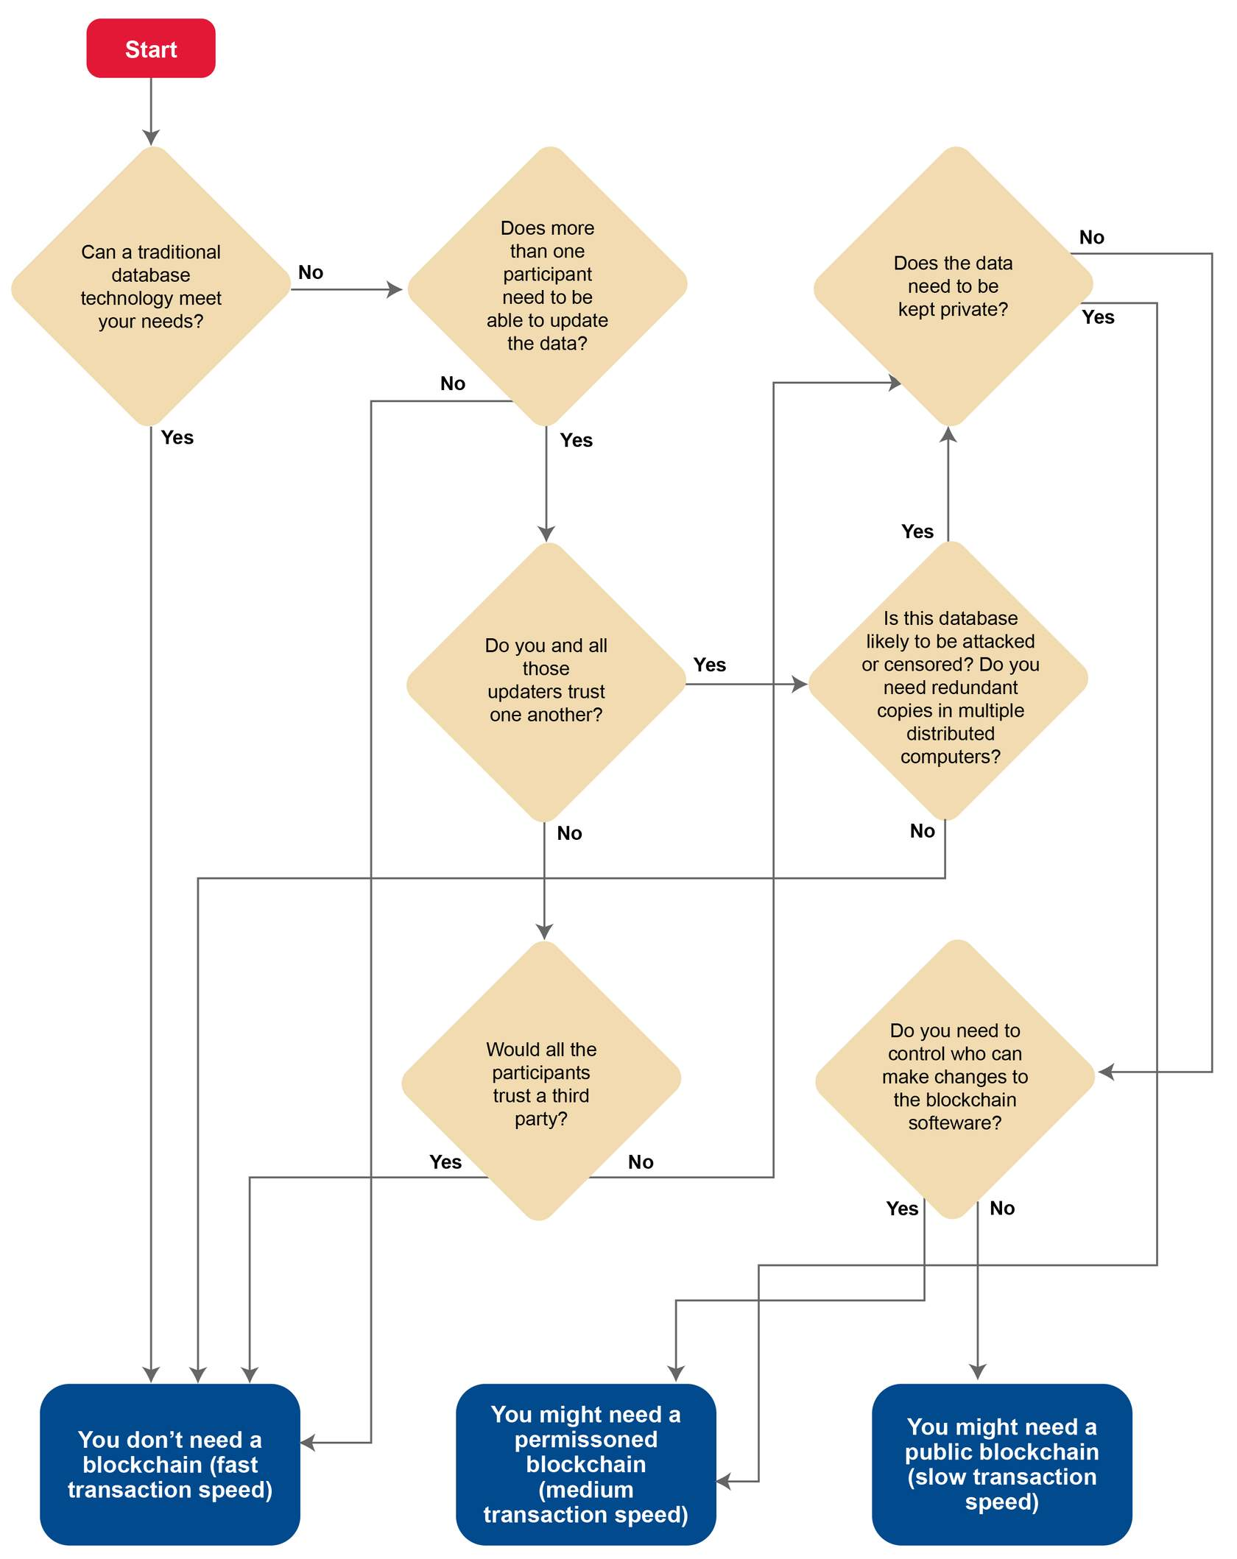
Choosing between Public, Private, Consortium

Slide 6
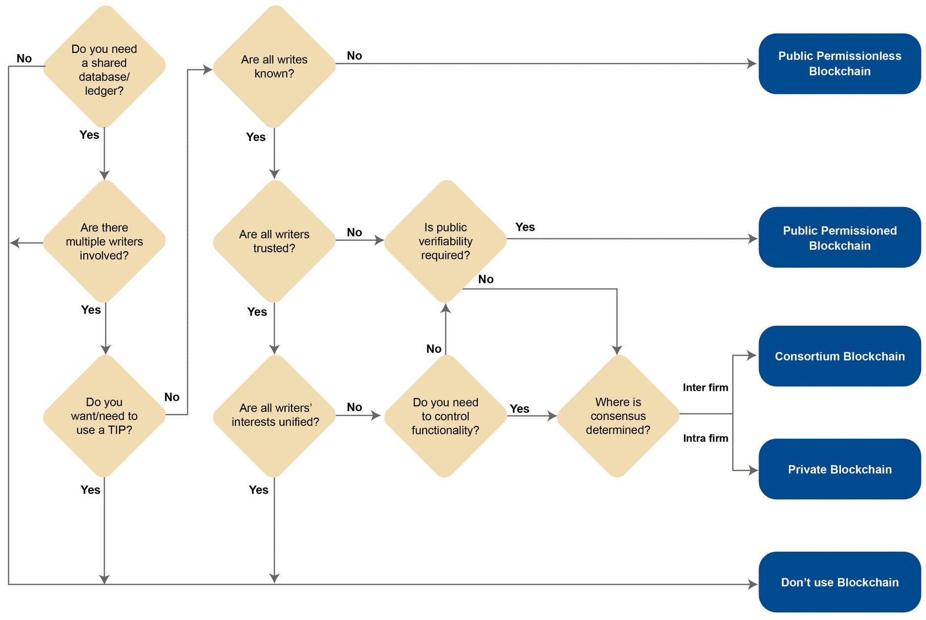
Choosing between Public, Private, Consortium

Slide 7
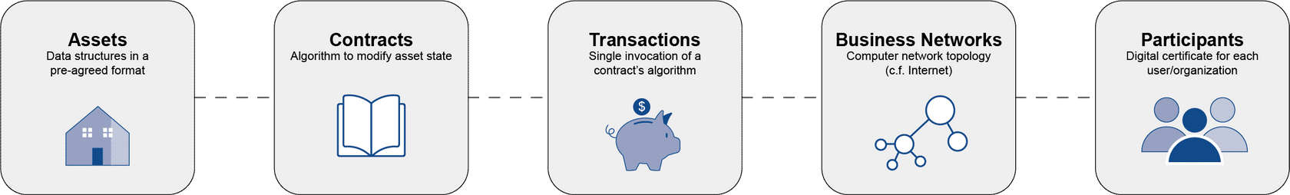
Modelling
Modelling is the mapping of business concepts into technical concepts
Models don't need to be complete (in fact are mathematically proven to not be so)
Consist of the following

Slide 8
Assets
Assets are anything of value that is being transacted in the blockchain application
Assets are typically scarce
Depends how you model
One possible model: once created, cannot be destroyed but only moved
E.g. NFTs
Asset is the name of the data structure, attributes are its properties

Slide 9
Assets
const cars = [ { color: 'blue', make: 'Toyota', model: 'Prius', owner: 'Tomoko', } ]

Slide 10
Contract
- Contracts are algorithms to modify an asset state.
- They are composed of several functions that fulfill biz requirements
async changeCarOwner(ctx, carNumber, newOwner) { const carAsBytes = await ctx.stub.getState(carNumber); // get the car from chaincode state If (!carAsBytes || carAsBytes.length === 0) { throw new Error(`${carNumber} does not exist`); } const car = JSON.parse(carAsBytes.toString()); car.owner = newOwner; await ctx.stub.putState(carNumber, Buffer.from(JSON.stringify(car))); }

Slide 11
Transactions
Single invocations of smart contracts
In other words, a transaction is an instantiation of a smart contract function intended to modify state by specific quantities (the function args)
Goes in the block body

Slide 12
Participants
Users who will invoke smart contract functions to create transactions
Have a unique identity represented by their address
Will authorize transactions using PKI

Slide 13
How to make a technical model: Asset
Asset is always the starting point
Blockchain solves the problem of trust for parties working together
Parties can be sure that other parties won't act maliciously toward assets
After identifying the asset, attributes can be identified
Escrow use case has other attributes than just the house
The attributes of the asset will determine the functionality of your transactions
Same principle as OOP

Slide 14
How to make a technical model: Tx
Once you have your asset and its attributes defined, you can define the actions that you want your participants to take
Again, just like OOP
Have your view functions and your modification functions
Your business requirements will heavily dictate this part
This is where you must make sure to have the smart contract security covered

Slide 15
How to make a technical model: Business Net
In private blockchain, organizations in the business network map to peers or nodes in a technical network
Every peer or node in the blockchain network contains a copy of the ledger
No restriction on the number of nodes an organization can host (since tx consensus is endorsement based)
Smaller organizations or individuals may delegate the responsibility of hosting peers to another larger organization in the network
E.g. Pharma company labs

Slide 16
How to make a technical model: Users
If your use case is public, users you want to participate should be able to invoke the right smart contract functions, e.g. ride share
- Can also think of it as the right role you want them to play
In private blockchains, this is baked in by design as you are operating based on the existing hierarchy of an organization
Consortium blockchains need to have the governing member roles defined, which is external (to the blockchain) and can be changed by voting

Slide 17
Questions/Comments?

Slide 18
Let's code!

