Slide 1
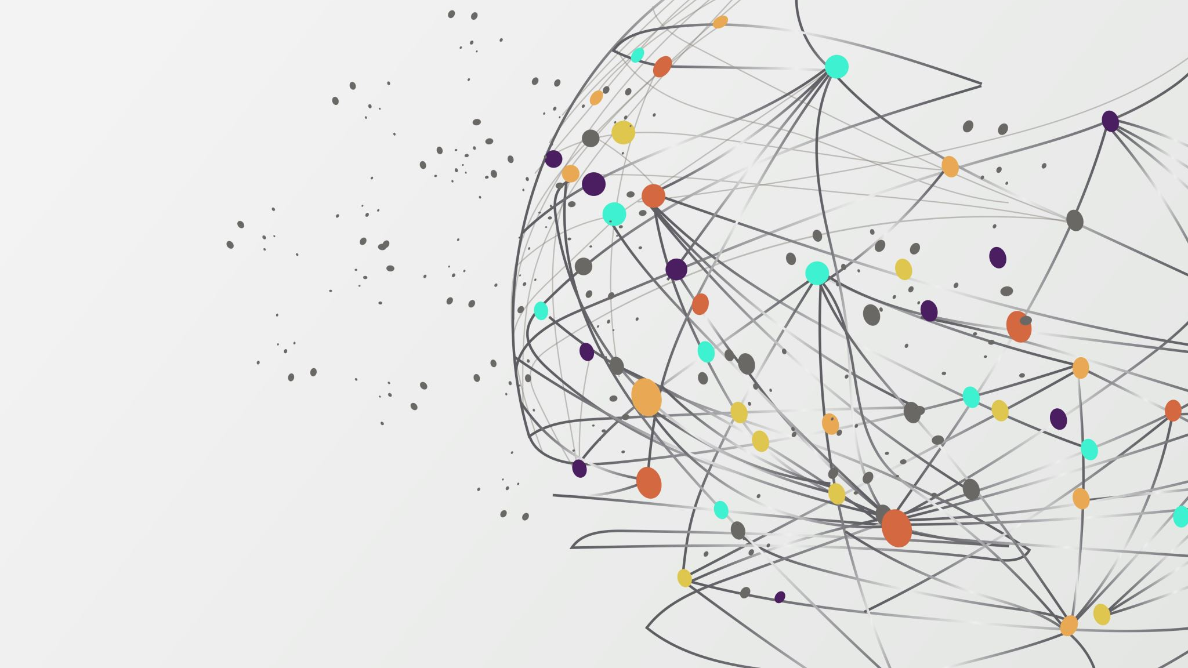
CSBC2000
Week 3 | Class 3
Cryptoeconomics

Slide 2
Last Class
Covered technical requirement generation for a blockchain use case
Assets, functions, participants
When to use public/private/consortium

Slide 3
This Class
Cryptoeconomics
Some cryptoeconomic market mechanisms
Cost of verification
Cost of networking
Maybe code assets into Solidity

Slide 4
Cryptoeconomics
Cryptocurrency+economics
Cryptoeconomics is an area of computer science that attempts to solve participant coordination problems in digital ecosystems through cryptography and economic incentives
Provides a way to coordinate the behavior of network participants by combining cryptography with economics
Mechanism that provides a way to align participants’ incentives without the need for trusted third parties: disintermediation

Slide 5
Cryptoeconomics
Recall Byzantine Generals Problem
In distributed systems, it is critical for the different actors to reach agreements
Before Bitcoin, the assumption was since some of the actors might be unreliable, agreements can never be made, and the network cannot function as intended
Bitcoin solves this by disintermediation (currency = history of transactions)
Most crypto networks have been incorporating economic incentives that encourage network participants to behave in certain ways

Slide 6
Cryptoeconomics: Crypto
PKI guarantees attack-resistant access control of one’s token
Hashing functions allow nodes to verify transactions that are done over the network
Both hashing functions and public-private key cryptography are required for PoW to reward miners for adding truthful transaction blocks to the ledger
Cryptoeconomic mechanisms can provide a security equilibrium such that a distributed system is safe against attacks

Slide 7
Cryptoeconomics: Assumptions
Security depends on the strength of assumptions about how people react to economic incentives
How people react to incentives is a field of study in economics
Cryptoeconomics has a lot in common with mechanism design, a field of economics related to game theory
Game theory analyzes strategic interactions (games); it tries to understand the best strategies for each player, and the likely outcome if both players follow those strategies according to the players’ utilities
Mechanism design defines desirable outcomes and works backwards to create a game that incentivizes players toward that desired outcome
Interdisciplinary, but predominantly developed in the computer science

Slide 8
Cryptoeconomics of Bitcoin Mining
Goal of Bitcoin is to create a value transfer network that accurately verifies transfers of value, is immutable, censorship-resistant
Achieved by mining
Miners who successfully validate a block of transactions are rewarded in bitcoin
Compare this to torrent networks
Does anybody really seed?
Why should I seed after I get my content? Nobody in the torrent network knows who I am

Slide 9
Cryptoeconomics of Bitcoin Mining
Without the hardness of its cryptographic protocol, there would be no secure unit of account with which to reward miners
Without the miners, there would be no confidence in the validity of the transaction history of the distributed ledger, unless if it was verified by a trusted third party, which would negate one of the main advantages of Bitcoin
Based on cryptoeconomic assumptions, the symbiotic relationship between miners and the Bitcoin network provides confidence

Slide 10
PoS
The point of requiring miners to buy hardware and spend electricity is to impose a cost on miners
Want to raise the cumulative cost of attempting a 51 percent attack sufficiently high that it becomes too expensive
The idea behind proof-of-stake systems is to use deposits of cryptocurrency to create the same disincentive, rather than real-world investments like hardware and electricity
In order to mine in a proof-of-stake system, you must commit a certain amount of ether into a smart contract “bond”
This raises the cost of a 51 percent attack – an attacker would have to commit a very large amount of ether to successfully attack the network, which they would then lose forever

Slide 11
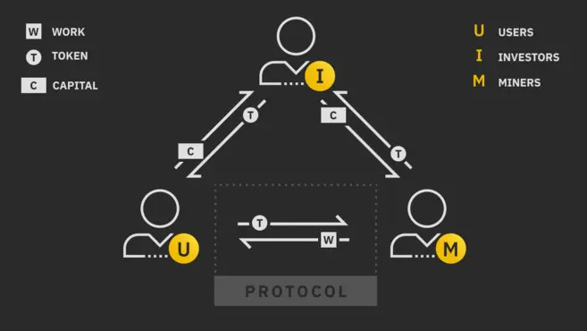
Three-sided Crypto Market

Slide 12
Three-sided Crypto Market
Miner - "works" for the user, gets tokens from the user; provides tokens to the investor, receives liquidity from the investor
Investor – provides liquidity, receives token; can be short-term or long-term
User: Receives work from miner, gives token to miner
All the participants in such an economy depend on each other to reach their economic goals

Slide 13
Cryptoeconomics examples: Stablecoin
1 Dai = $1
Maker keeps Dai at $1 using a system of collateral and price feeds. This collateral is carefully managed by the MKR token holders
MKR holders act as a buyer of last resort
Global settlement provides a final layer of safety

Slide 14
Cryptoeconomics examples: Stablecoin
Dai is a token like BTC or ETH
However, it has no volatility (relative to USD)
Compare to USDT: hold USD in bank accounts and issue tokens on a blockchain that are ‘backed’ by these dollars
- If those bank accounts are frozen or if the accountants defrauded token holders, the stablecoin now becomes an IOU on whatever’s left when they eventually get the bank accounts back
- Thus, you have to rely on a middleman, no disintermediation

Slide 15
Cryptoeconomics examples: Stablecoin
Dai is a stablecoin that lives completely on the blockchain chain with its stability unmediated by the legal system or trusted counterparties
Stablecoins are what allow us to fully realize the promise of blockchain technology
- If not, the volatility makes crypto infeasible for daily use
- Consumer loans for example, simply cannot be denominated in a currency which fluctuates 10–20% in a day, like bitcoin and ether

Slide 16
Cryptoeconomics examples: Stablecoin
Dai is backed by collateral
If you're an ETH holder and want to create DAI, you will send your ETH to a "Collateralized Debt Position" (CDP)
CDP is a smart contract
You give the Maker CDP smart contract your ether and it lets you take out a loan in Dai
- If the value of your ether goes below a certain threshold, you either have to pay back the smart contract as you would a bank or it will auction off your ether to the highest bidder

Slide 17
Cryptoeconomics examples: Stablecoin
CDPs are simply where the collateral (ether) in the Maker system is held.
Once your ether is in the CDP smart contract, you can create Dai
The amount of Dai you can create is relative to how much ether you have put into the CDP
This ratio is fixed but can be changed over time. Known as collateralization ratio

Slide 18
Cryptoeconomics examples: Stablecoin
Say ETH is worth $100, and collateralization ratio is 150% (150 DAI = 1 ETH)
1 ETH would yield me 66 DAI (100/150)
In the Maker system, you don’t lose your ether, but you also no longer control it
The ether that you sent to the CDP is stuck there until you pay back the 66 Dai (this destroys the Dai)

Slide 19
Cryptoeconomics examples: Stablecoin
If ETH-USD appreciates, collateralization increases, and DAI becomes stronger
Maker has mechanisms that incentivize users to create more Dai if the price of Dai should trade above one dollar
If ETH goes down, value of ether held as collateral is worth less than the amount of Dai it’s supposed to be backing
Maker combats this by liquidating CDPs and auctioning off the ether inside before the value of the ether is less than the amount of Dai it is backing
- n.b. this is where the MKR hack happened
The CDP is “liquidated” and the ether inside the CDP is auctioned off for Dai until there is enough Dai to pay back what was extracted from the CDP

Slide 20
Cryptoeconomics examples: Stablecoin
In case there's a "Black-Swan" event, like a flash crash, price of ether crashes well below the one-to-one collateralization ratio in a time frame too short for the system to handle
MKR is another token on the ethereum blockchain (like the rest of the Maker ecosystem) that has governance rights over the Maker smart contracts
For instance, the number used in the above examples (the collateralization rate of CDPs) is set by a vote of MKR holders
In return for regulating the system, MKR holders are rewarded with fees
Should the collateral in the system not be enough to cover the amount of Dai in existence, MKR is created and sold onto the open market in order to raise the additional collateral
This provides a strong incentive for MKR holders to responsibly regulate the parameters at which CDPs can create Dai, as it will ultimately be their money on the line should the system fail, not holders of Dai

Slide 21
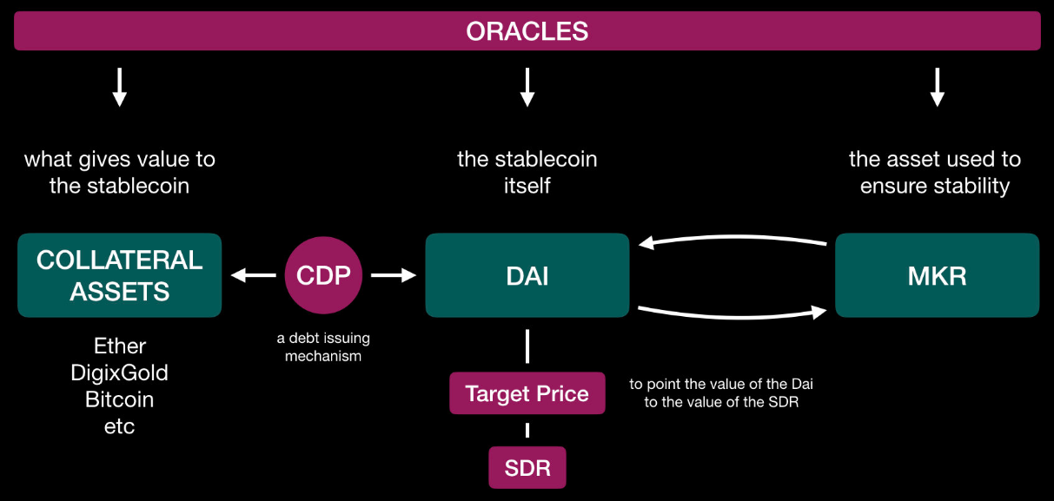
Cryptoeconomics examples: Stablecoin

Slide 22
Cost of Verification: Current context
For an exchange to be executed, key attributes of a transaction need to be verified by the parties involved
When an exchange takes place in person the buyer can usually directly assess the quality of the goods, and the seller can verify the authenticity of the cash
When a transaction is performed online instead, one or more financial intermediaries broker it by verifying that the buyer has sufficient funds
Intermediaries add value to marketplaces by reducing information asymmetry and the risk of moral hazard through third-party verification

Slide 23
Cost of Verification: Current context
In exchange for their services, intermediaries typically charge a fee. This is one of the costs buyers and sellers incur when they cannot efficiently verify all the relevant transactioattributes by themselves
Additional costs may stem from the intermediary having access to transaction data (a privacy risk), and being able to select which transactions to execute (a censorship risk)
- E.g. banks not allowing you to trade crypto

Slide 24
Cost of Verification: Current context
As a large share of economic and social activity is digitized, keeping data secure has become more problematic and information leakage more prevalent
- Equifax
- Credit card data breach
- Cambridge Analytica

Slide 25
Cost of Verification: Blockchain
Blockchain can prevent information leakage by allowing market participants to verify transaction attributes and enforce contracts without exposing the underlying information to a third-party
This allows an agent to verify that some piece of information is true (e.g. good credit standing), without full access to all background information (e.g. past transaction records): i.e., the technology allows for the verification of transaction attributes in a privacy-preserving way

Slide 26
Cost of Verification: Blockchain
Blockchain thus allows for costless verification
However, the link between “on-chain” activities recorded on a blockchain and “off-chain” events introduces major challenges which cannot be overcome without complementary innovations
- e.g. Oracles
Information about identity (KYC) is often used to reduce fraud and build robust digital reputation systems, but being able to link an online action and digital record on a blockchain to an offline individual or entity is as expensive with blockchain as it would be with more traditional solutions

Slide 27
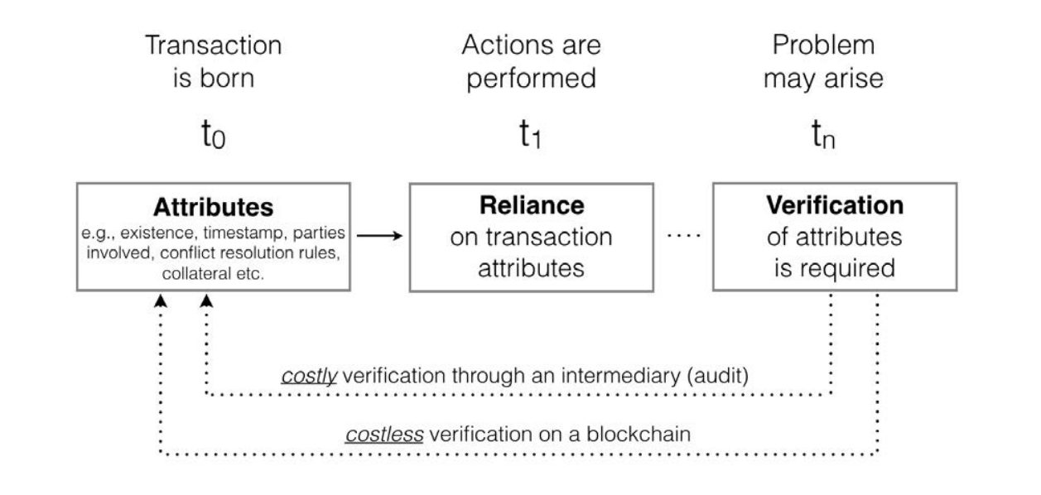
Cost of Verification: Comparison

Slide 28
Cost of Verification: Comparison
Trust in the intermediary is replaced with trust in the underlying code and consensus rules
These rules define how a distributed network reaches agreement, at regular intervals, about the true state of the shared data it needs to maintain to operate a well-functioning marketplace
In more complex applications, the shared data can also cover the rules and data required to perform a specific operation: Smart Contract
Trusted, independent oracles can also be incorporated to ensure that can respond to market conditions and new information
e.g. to implement a weather derivative, a smart contract can aggregate information across multiple weather sources to assess if a payout has to be made

Slide 29
Cost of Verification: Comparison
A native cryptocurrency can be used to facilitate low cost transactions of digital resources such as computation (Ethereum), data storage (Filecoin), bandwidth or electricity, as in all these cases verifying the exchange of a resource is not too expensive
However, when entries on a shared ledger are digital representations of offline identities, products, services and related transactions, costless verification is difficult to achieve

Slide 30
Cost of Verification: IoT+Blockchain
The way forward (more in next class) is IoT
They can be used to record real-world information (e.g. through sensors, GPS devices) and substitute labor intensive verification with inexpensive hardware
Overall, when it comes to strictly on-chain matters, verification goes from being costly, scarce and prone to abuse, to being cheap and reliable.

Slide 31
Cost of Networking
There are several costs incurred while running an economic network
B2B, B2C, social networks, government networks
E.g. Setting up a supply chain, adding new members, verifying provenance...
All this is made easier by having access to a verifiable, immutable, secure shared state

Slide 32
Cost of Networking
The ability to verify state at a lower cost because of the reduction in the cost of verification allows a blockchain protocol to reach consensus about the history and proposed evolution of a digital asset
Also allows us to define rules for state transitions that are particularly valuable from a network perspective
In the same way that Twitter, because of the 140 character limitation, enabled new forms of communication, the ability to implement costless verification at the level of a single piece of information has the potential to change how information markets, digital property rights and micropayments are designed

Slide 33
Cost of Networking
In other words, this new format emerged from the reduced cost of verification
For example, blockchain can be used to incentivize behavior that builds network effects (both in terms of users and applications), ensures the network has sufficient resources available to meet demand, guarantees its security, encourages savings or spending behavior, etc
Taken together, these incentives lower the cost of networking, i.e. the cost of bootstrapping, operating and scaling an economic network

Slide 34
Cost of Networking: Private vs Public
When a blockchain is permissioned, the entities developing it retain control over which participants can update and verify state
Transitions are not fully defined by code and self-contained within the system, but rather can be influenced by external parties through fiat
As a result, the network will operate under constraints similar to those of traditional digital platforms, and participants will have to trust the platform architect and core constituents through formal and relational contracts, past reputation, etc

Slide 35
Cost of Networking: Private vs Public
A permissionless blockchain protocol, instead, allows a network of economic agents to agree, at regular intervals, on the true state of a set of shared data
No assignment of rights to trusted entities
The flexibility in terms of what such shared data represents across settings (e.g. currency, intellectual property, financial assets, contracts, etc.) makes it a general purpose technology (GPT)
GPTs typically take a long time to diffuse through the economy, but also lead to total factor productivity gains across multiple industries
e.g. steam engine, electricity, and the internet

Slide 36
Cost of Networking
Overall, relative to blockchain implementations that only take advantage of the reduction in the cost of verification (permissioned), those that also benefit from the reduction in the cost of networking (permissionless ones) are different on at least four dimensions:
1. Less likely to leave market power in the hands of their founders or early participants. This limits the ability of any party to unilaterally censor transactions or exclude participants from the network, and removes single points of failure, as the network does not depend on the availability of one or a few key players to operate

Slide 37
Cost of Networking
2. Less reliant on off-chain governance, relational contracts and laws to support their operations
By design, to take advantage of the lower cost of networking they need to embed as much as possible of the incentives and governance rules required for their operations on-chain
Of course, permissionless networks still need off-chain governance and coordination between their key stakeholders to execute a hard fork, imple-ment controversial changes, or respond to an attack, but relative to more closed networks that rely on trusted intermediaries they leave less discretion to any single party and end up codifying more of their rules into their codebases.

Slide 38
Cost of Networking
3. They involve a lower privacy risk, as no single entity (or group of entities) has preferential access to or visibility over the information generated by the network
In traditional platforms, the privacy risk is particularly salient in markets where consumers pay for services by allowing intermediaries to access and monetize their data
increasingly relevant because of the role such data can play in the training of AI algorithm

Slide 39
Cost of Networking
4. Blockchain implementations that take advantage of the lower cost of networking inevitably induce architectural changes in how firms create and capture value within markets
Architectural innovations, by destroying the usefulness of the assets and accumulated knowledge of incumbents, open opportunities for entrants to reshape the dimensions firms compete on, and experiment with new business models
This is known as Creative Destruction (Joseph Schumpeter)
E.g. the technology offers new ways to reward contributors, allocate rents in a marketplace, and build applications on top of shared data while preserving the privacy of the underlying information

Slide 40
Questions/Comments?

Slide 41
Let's code!

