Slide 1

Exploring Deep Learning Architectures for Fake News Detection : Comparative Performance of LSTM, BiLSTM, CNN - BiLSTM and BERT.

Slide 2
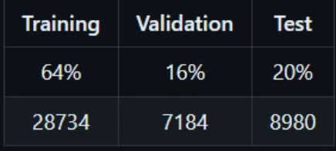
Dataset Used:
Link: https://www.uvic.ca/engineering/ece/isot/datasets/fake-news/index.php
We employ the ISOT Fake News dataset, which was first made available by the University of Victoria's ISOT Research Lab in Canada.
This dataset is a collection of thousands of articles, both true and false, that were classified as untrustworthy by Politifact.com and from many reputable news websites.

Slide 3
Long Short-Term Memory (LSTM) Model
1
Purpose
LSTMs address the vanishing gradient problem found in traditional RNNs.
2
Structure
An LSTM network consists of a series of LSTM cells, each equipped with gates (input, output, and forget gates) that control information flow into and out of the cell.
3
Advantage
LSTMs are insensitive to gap length, making them suitable for capturing long-term dependencies in sequences

Slide 4
Bidirectional Long Short-Term Memory (LSTM) Model
1
Purpose
BiLSTMs are designed to enhance the understanding of sequential data by considering both past and future context.
The primary purpose of BiLSTMs is to capture richer context information, especially when the meaning of a word or token depends on its surrounding context.
2
Structure
Forward and Backward layer operate independently and produce probability vectors as outputs.
The final output is a combination of the probabilities from both the forward and backward LSTMs.
3
Advantage
Contextual Understanding
Richer Information
Improved Performance

Slide 5
Convolutional Neural Network (CNN) - BiLSTM Model
1
Purpose
The CNN-BiLSTM hybrid model aims to leverage the strengths of both CNNs and BiLSTMs. It is commonly used in sequence-based tasks, such as named entity recognition, sentiment analysis, and time series prediction.
2
Structure
The output of the CNN component (character-level features) and the BiLSTM component (word-level features) are combined.
This fusion allows the model to benefit from both local and global context information.
3
Advantage
More informative features
Higher prediction accuracy
Nonlinear Temporal Signal Processing

Slide 6
Bidirectional Encoder Representations from Transformers (BERT) Model
1
Purpose
BERT utilizes multi-head attention to capture contextual relationships in text. BERT is pre-trained on a large corpus of text, enabling robust feature extraction.
2
Structure
Pre-training: During this phase, the model learns from a large corpus of text data. It captures contextual information bidirectionally by considering both preceding and subsequent words.
Fine-tuning: After pre-training, BERT can be fine-tuned for specific downstream tasks by training on task-specific data.
3
Advantage
BERT’s bidirectional nature allows it to understand context by analyzing word relationships in sentences from both directions. This contextual understanding makes it highly effective for various NLP tasks

Slide 7
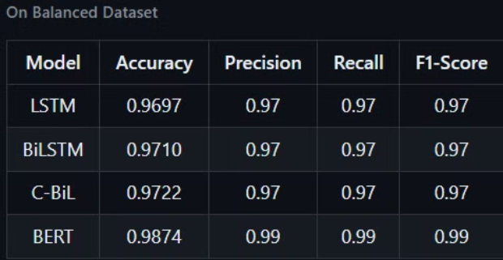
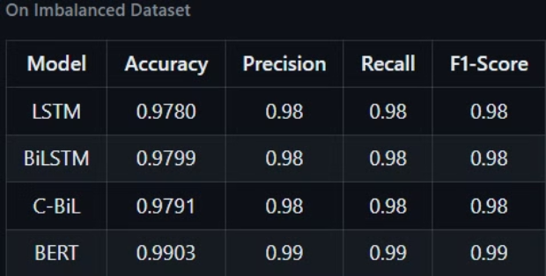
Comparative Analysis of Model Performance
On Balanced Dataset
On Imbalanced Dataset

Slide 8
Challenges and Limitations
1
Data Scarcity
2
Evolving Fake News
3
Ethical Concerns
Limited availability of high-quality labeled data for model training.
Potential for misuse of these models to suppress free speech and opinions.
Fake news tactics constantly evolve, challenging the models to adapt.

Slide 9



Conclusion and Future Directions
Hybrid Approaches
Combining multiple architectures to leverage their unique strengths.
Continual Learning
Enabling the models to adapt and evolve with the changing fake news landscape.
Explainability
Enhancing the interpretability of model decisions to address ethical concerns.

