Slide 1
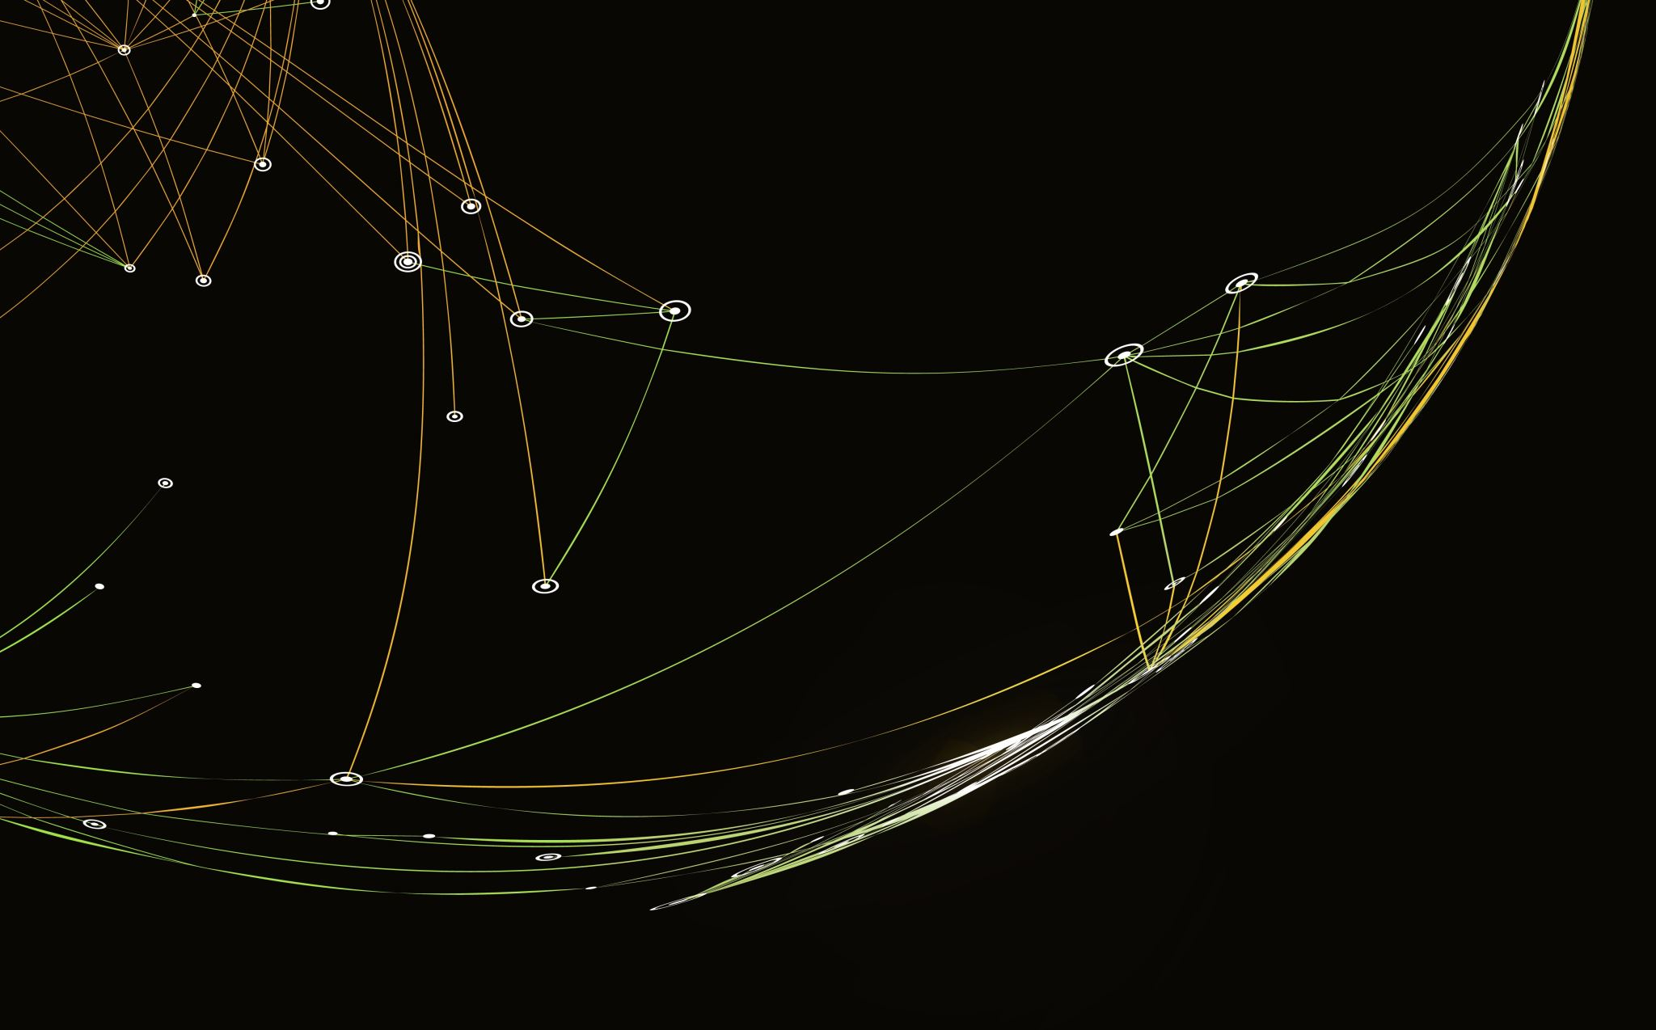
CaptionCraft: Scientific figures Image Captioning Tool
Team Members:
ANKITA MANJAREKAR (00818984)
CHETANA NANNAPANENI (00825122)

Slide 2
Project Objectives
Develop an Image Caption Generator for scientific plots and figures
Utilize the SCICAP dataset for training purposes.
Implement preprocessing techniques to clean captions.
Extract image features using the pre-trained model to tokenize captions for model input.
Develop a model integrating Dense, Embedding, self-attention mechanisms and vision transformers to generate captions.
Assess the model's performance using BLEU-4 metric to achieve a benchmark score of 0.5

Slide 3
Dataset
SCICAP
This remains a major dataset contains scientific figures and their corresponding captions.
It provides a valuable resource for training and evaluating image captioning models in this domain.
The dataset contains over 2 Million scientific figures and plots. We are using a random sample of 201 images for our project.
It contains different figures and captions from research papers in eight categories: Computer Science, Economics, Electrical Engineering and Systems Science, Mathematics, Physics, Quantitative Biology, Quantitative Finance, and Statistics
The caption is in a JSON file corresponding to a particular image.
The link to the dataset is as follows Scicap_dataset

Slide 4
Data Pre processing
Clean captions by removing punctuation, single characters, and numeric values.
Convert the figures into images, ensuring uniform dimensions and formats.
Tokenize captions by using techniques like word tokenization
Employ the pre-trained VGG16 and ResNet50 model to extract features from images.

Slide 5
Model Training
Model Architecture:
Vision Transformer for image feature extraction.
Text embedding and self-attention mechanism.
Pre-trained Models:
Utilization of ViT, GPT-2, and SWIN Transformer models

Slide 6
Demo

Slide 7
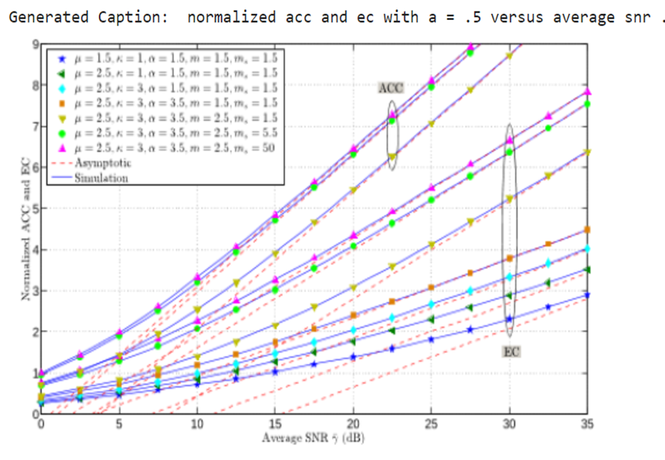
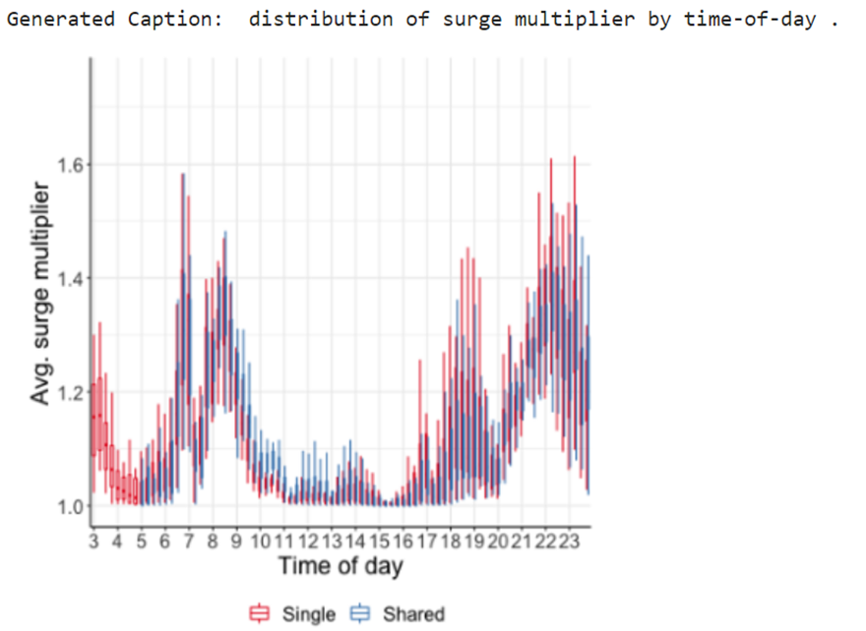
Evaluation and Output
The evaluation metric used for this project is BLEU - 4 Score
The Evaluation Metric we were able to achieve is 0.411

Slide 8
Challenges
Fine tuning large models such as Vision Transformers on a huge dataset of 18GB would require a much higher performance hardware like GPUs and TPUs.
More extensive experimentation is required to select the optimal hyperparameters required to give the best results, which was difficult with limited resources and time

Slide 9
Conclusion
Achieved a BLEU score of 0.411, indicating a high level of captioning accuracy.
Successful integration of Vision Transformer and GPT-2 models contributed to model performance.
Our findings underscore the potential for further advancements in image captioning.
Future work will focus on exploring enhancements in model architecture and fine-tuning strategies to push performance boundaries.

Slide 10
Thank You

