Slide 1
Supermarket Management System
By
Chetan Ingle (cmi8525)
Viswanath Nagarajan (vn2065)

Slide 2
Introduction
The Supermarket Management System (SMS) is a simple, easy to use database management system that allows a supermarket to run their business through the internet
There are 2 main types of users:
Customers : That can place orders online
Admins: That can get the store insights about the inventory and most selling products and can also access information about the employees working at the store
The Supermarket Management System (SMS) is a simple, easy to use database management system that allows a supermarket to run their business through the internet
There are 2 main types of users:
Customers : That can place orders online
Admins: That can get the store insights about the inventory and most selling products and can also access information about the employees working at the store
Data Gathering:
For this application, we have created our own realistic data by referring to products listed on Amazon. The data we created contains 90 products, 7 departments, 23 subdepartments, 21 employees, 7 suppliers and few users and the orders placed by them.

Slide 3
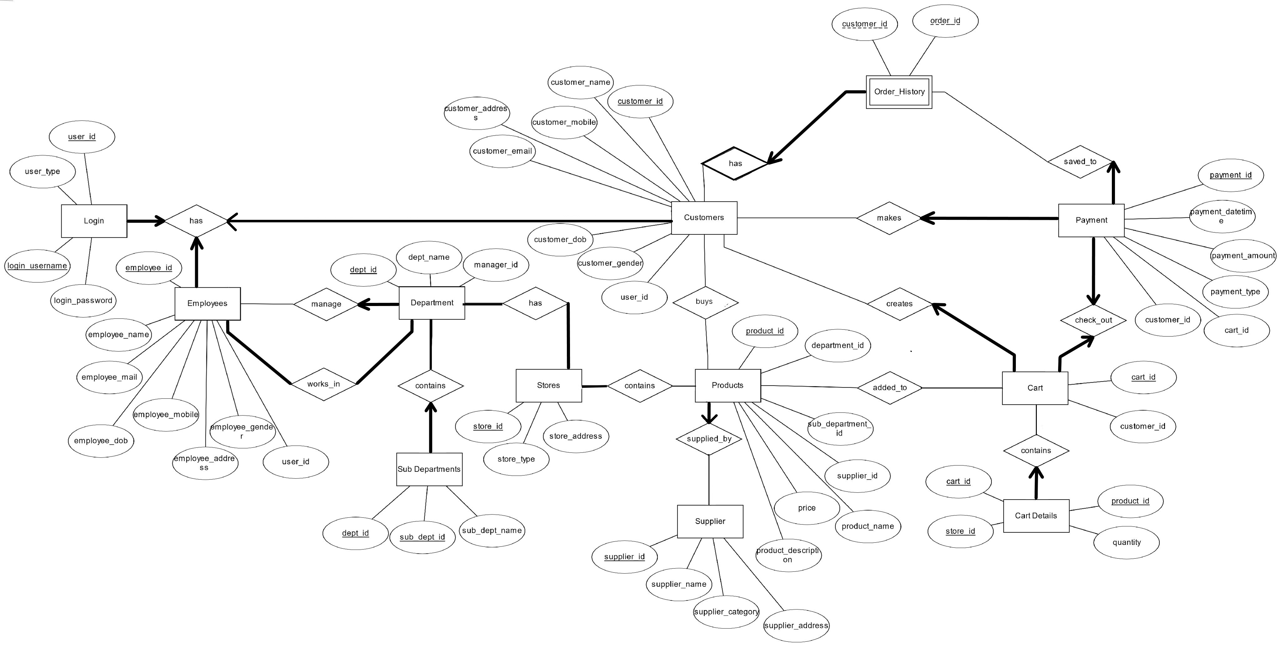
ER Diagram

Slide 4
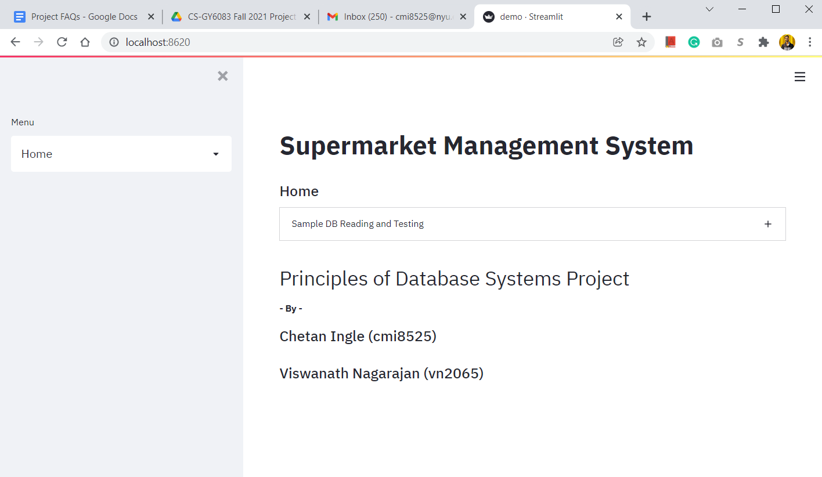
App Screenshots - Home

Slide 5
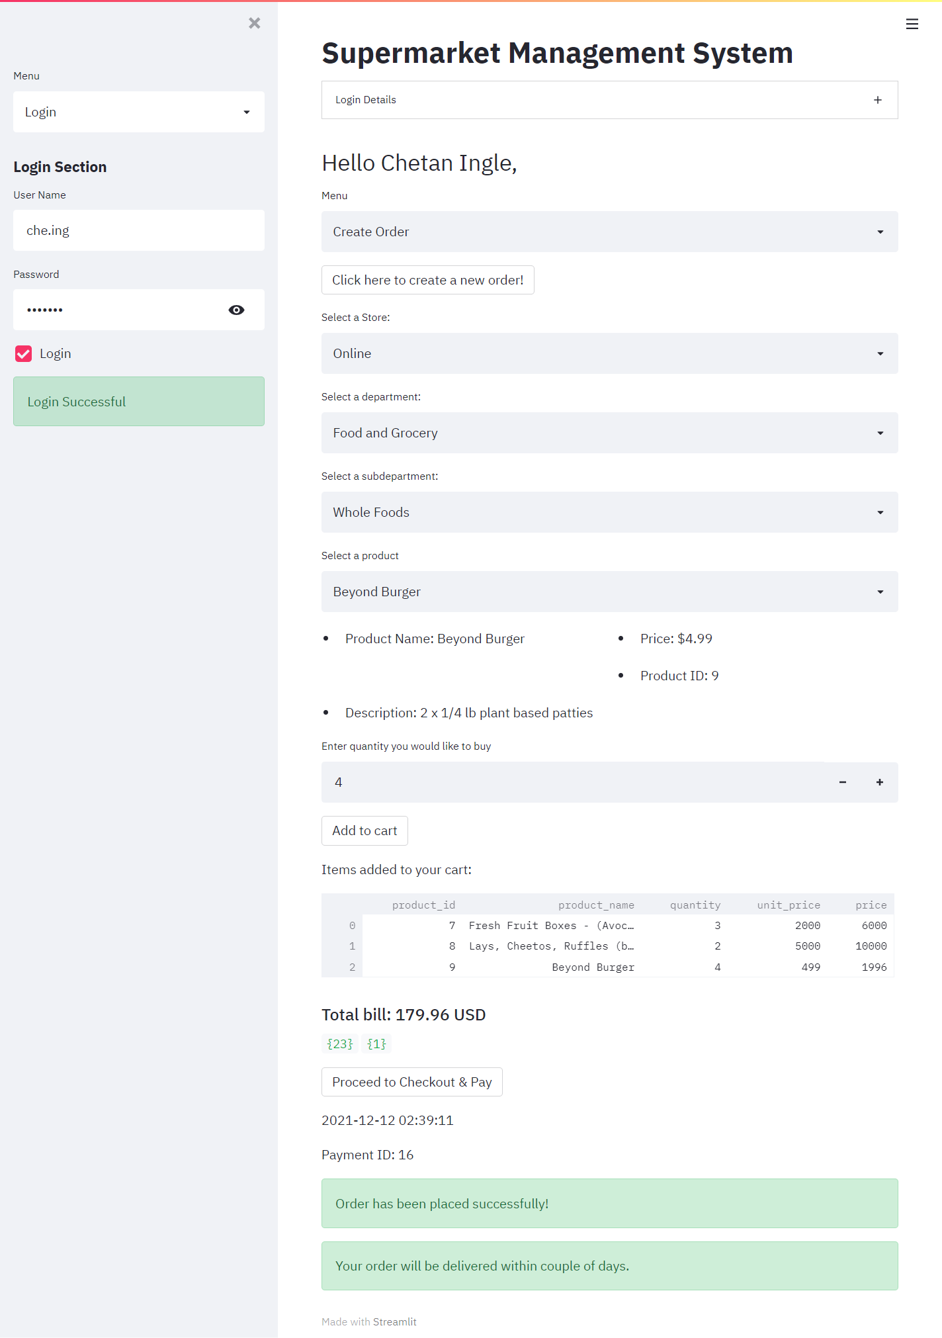
App Screenshots:
1. Customer – Create Order
Make sure to click this button to create a new order
Select D.dept_name
from store_departments SD, manage_departments D
where SD.store_id = { store_id } and D.dept_id = SD.dept_id
order by D.dept_name
Select S.sub_dept_name
from subdepartments S, manage_departments M
where M.dept_id = S.dept_id and M.dept_name = {departmentChoice}
order by S.sub_dept_name;
Select product_name
from products_suppliedby P, store_products SP
where SP.product_id = P.product_id
and SP.store_id = {store_id}
and P.department_id = {department_id}
and P.sub_department_id = {subdepartment_id}
Select product_id, product_name, price, product_description
from products_suppliedby
where product_name = {productsChoice}

Slide 6
App Screenshots:
1. Customer – Create Order
Insert into cart_details(cart_id, store_id, product_id, quantity)
Values ({ cart_id }, { store_id }, { productId }, { qty });
Select CD.product_id, P.product_name, CD.quantity,
P.price as Unit_Price,P.price*CD.quantity as price
from cart_details CD, products_suppliedby P, cart C
where CD.product_id = P.product_id
and CD.store_id = '{store_id}'
and C.cart_id = CD.cart_id
and C.customer_id = '{customer_id}'
and C.cart_id = '{cart_id}'
Insert into Cart_check_out_Payment (payment_datetime, payment_amount, payment_type, cart_id, customer_id)
values ('{date_time}', {total_bill}, 'card', {cart_id}, {customer_id} );

Slide 7
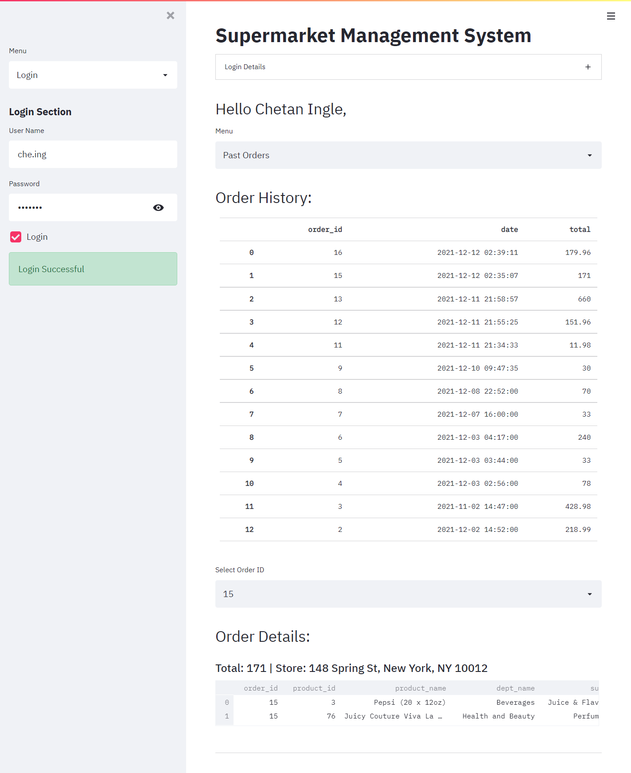
2. Customer – Order History
Past Orders
Select O.order_id as Order_ID, P.payment_datetime as date,
P.payment_amount as Total
from Order_History O, cart_check_out_payment P
where O.order_id = P.payment_id
and P.customer_id = {customer_id}
order by O.order_id desc
select St.store_address, O.order_id, C.payment_amount, CD.product_id,
P.product_name, D.dept_name, S.sub_dept_name, CD.quantity,
P.price as unit_price, P.price*CD.quantity as price
from Order_History O, cart_check_out_payment C, cart_details CD,
products_suppliedby P, manage_departments D, subdepartments S, Stores St
where C.payment_id = O.order_id
and O.order_id = {order_id}
and C.cart_id = CD.cart_id
and CD.product_id = P.product_id
and D.dept_id = P.department_id
and P.sub_department_id = S.sub_dept_id
and S.dept_id = D.dept_id
and CD.store_id = St.store_id

Slide 8
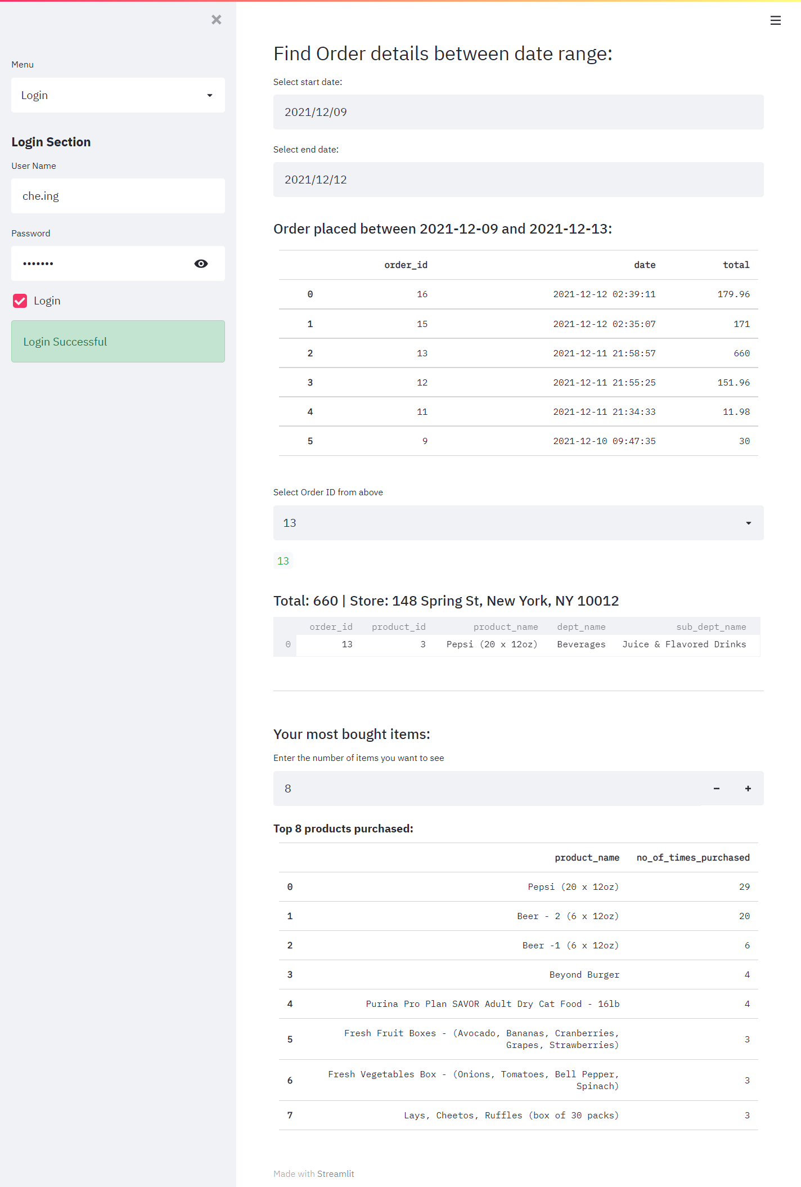
2. Customer – Order History
Past Orders between dates
Most bought items
Select O.order_id as Order_ID, P.payment_datetime as date,
P.payment_amount as Total
from Order_History O, cart_check_out_payment P
where O.order_id = P.payment_id
and P.customer_id = {customer_id}
and P.payment_datetime >= '{start}'
and P.payment_datetime < '{end}'
order by O.order_id desc
Select PS.product_name, SUM(CD.quantity) AS No_of_times_purchased
from order_history O, cart_check_out_payment P, cart_details CD, Products_suppliedby PS
where O.customer_id = {customer_id}
and O.order_id = P.payment_id
and P.cart_id = CD.cart_id
and CD.product_id = PS.product_id
group by PS.product_name
order by SUM(CD.quantity) desc
limit {number};

Slide 9
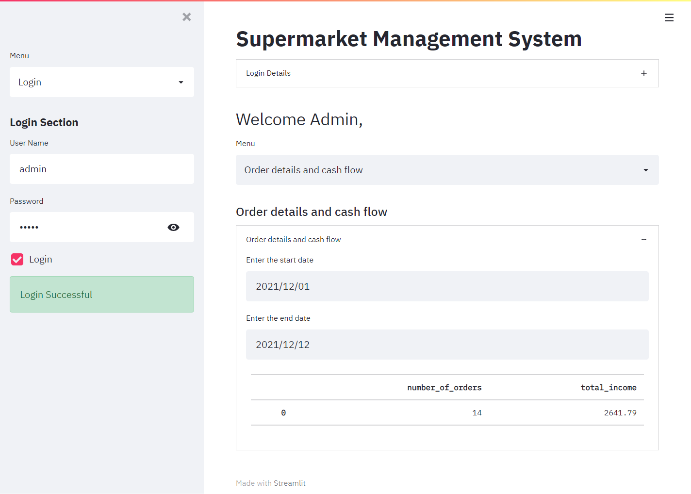
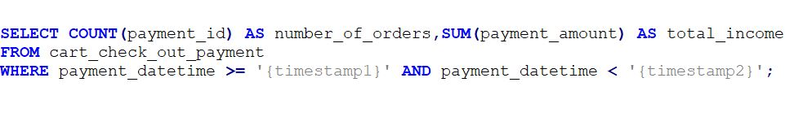
App Screen shots - Admin

Slide 10
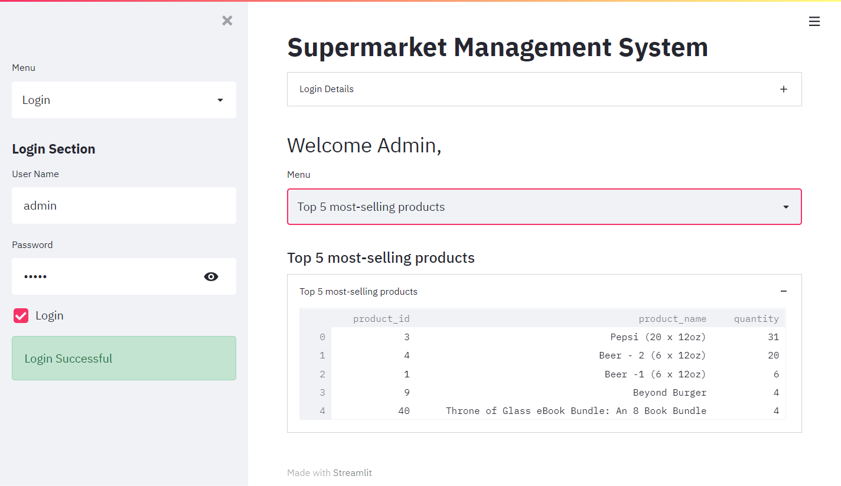
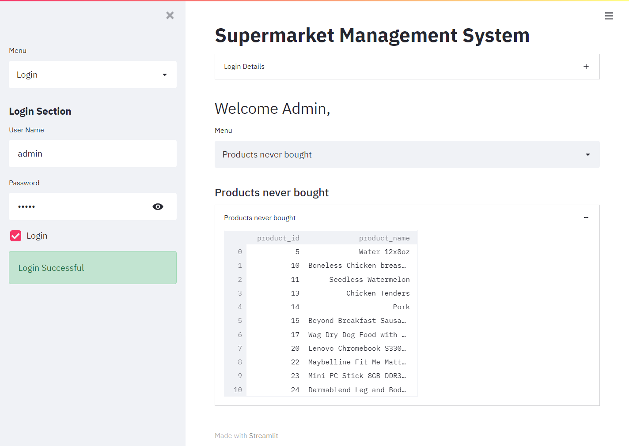
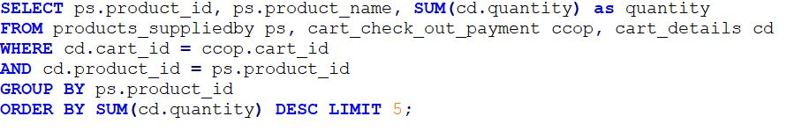
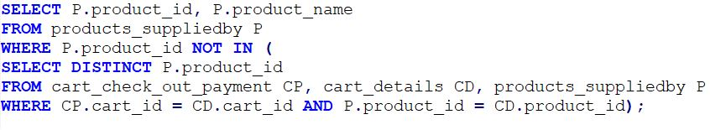
App Screen shots - Admin

Slide 11
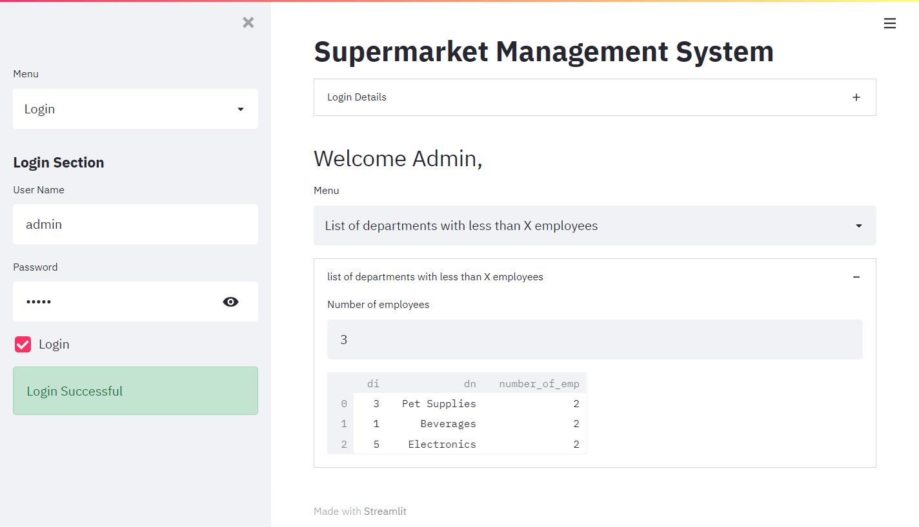
App Screen shots - Admin

Slide 12
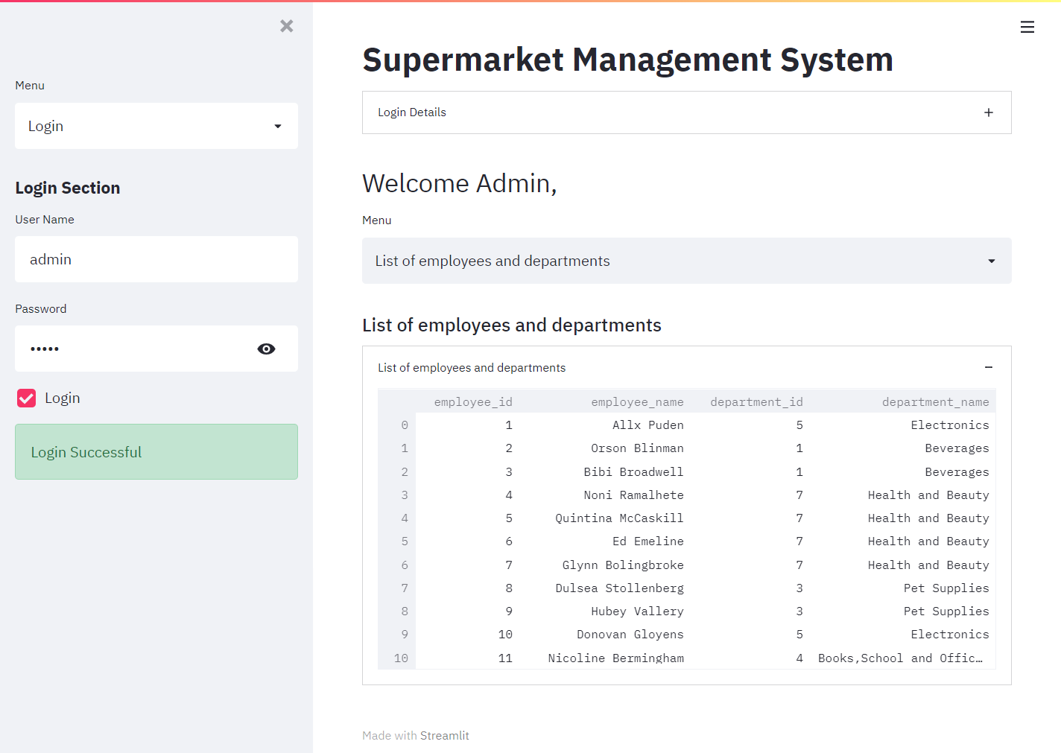
App Screen shots - Admin

Slide 13
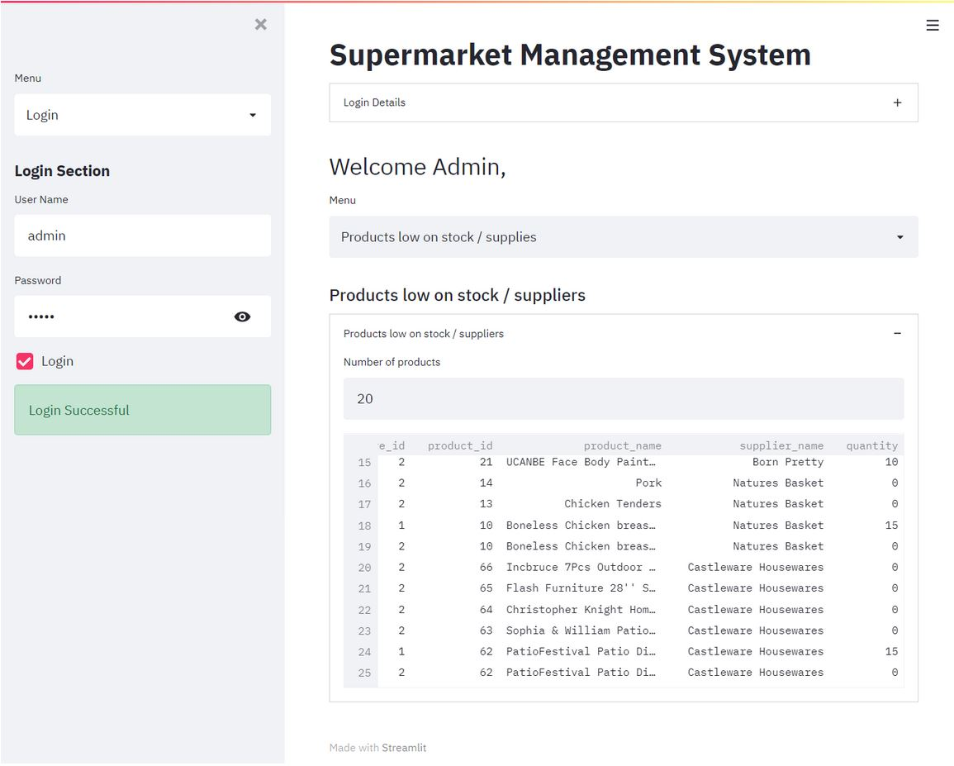
App Screen shots - Admin

Slide 14
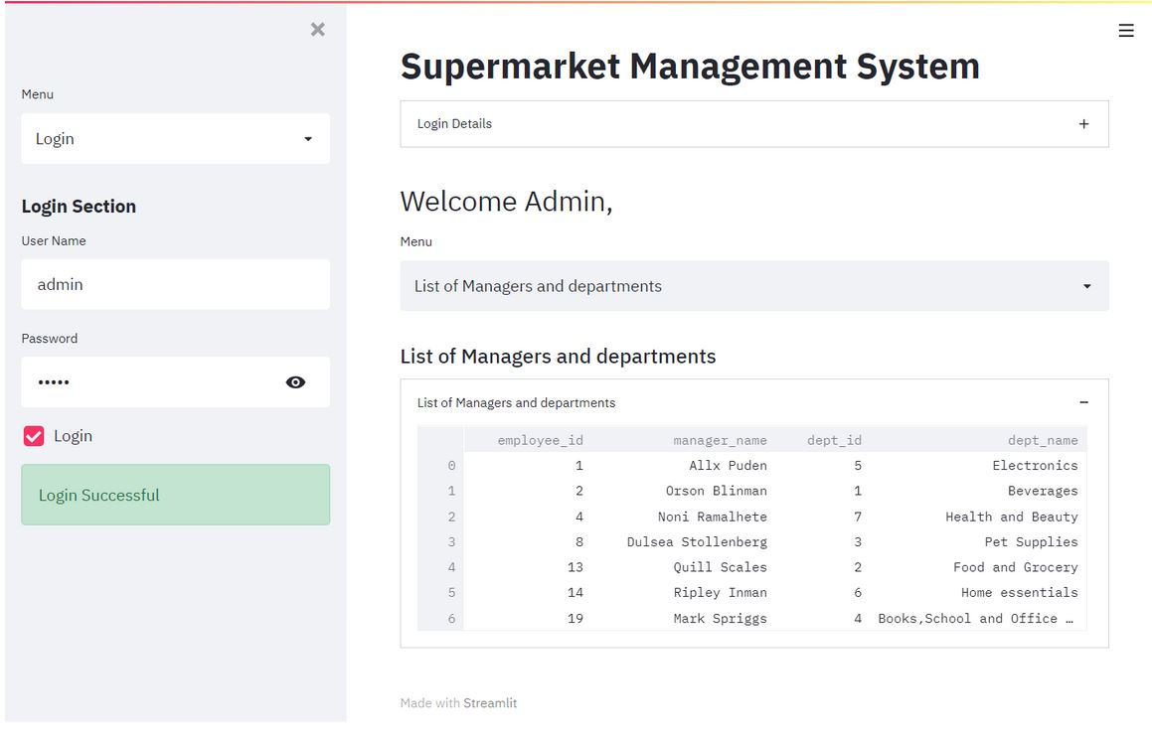
App Screen shots - Admin

