Slide 1
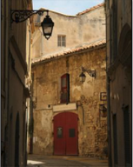
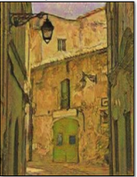

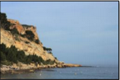
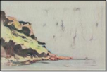
CycleGANs
Unpaired Image-to-Image Translation using
Cycle Consistent Adversarial Networks
Aditya Sreedhar
Prerna Mahajan
Chetan Jagadeesh Sahil Joshi

Slide 2




Introduction
Background
Architecture
Table of Contents
Loss Function
Model
Results & Conclusion

Slide 3
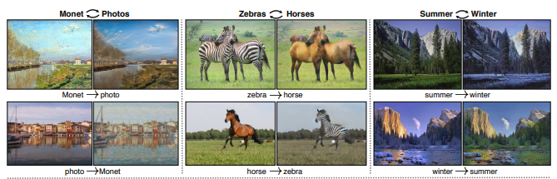
Introduction
CycleGANs learn to translate the style of one set of images to another style, in the absence of paired training examples
Can be used in converting an image from one representation to another in variety of setting, i.e grayscale to color, image to semantic labels, edgemap to photographs
CycleGAN exploits the advantage of two GANs and package them together inside of one meta GAN module.

Slide 4
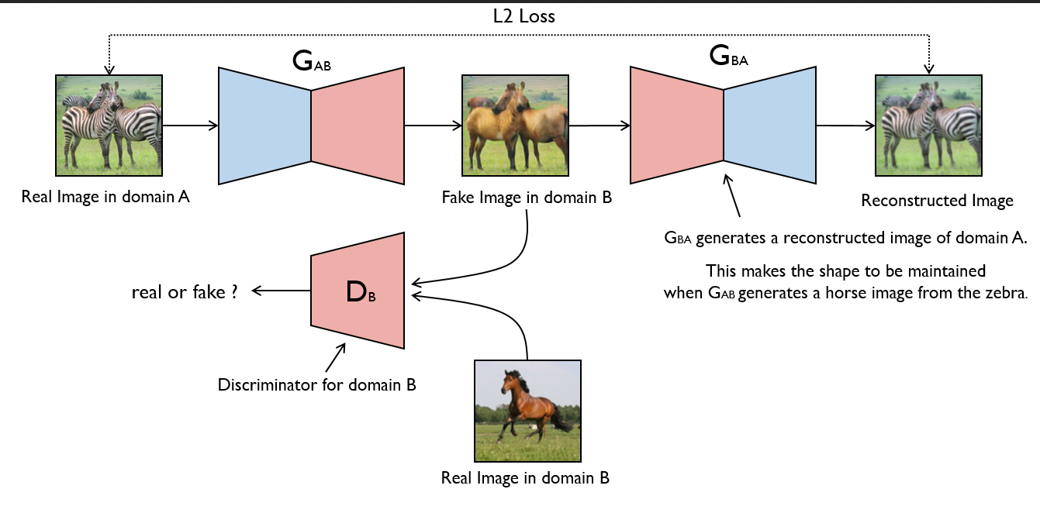
Background
CycleGAN aims to develop algorithm that translate between domains without i/p and o/p examples
It exploits supervision at the level of sets instead of at the level of examples G : X->Y and F : Y->X, where G and F should be inverses of each other
It combines this loss and adversarial loss on domains X and Y and yields the objective for unpaired image-to -image translation

Slide 5
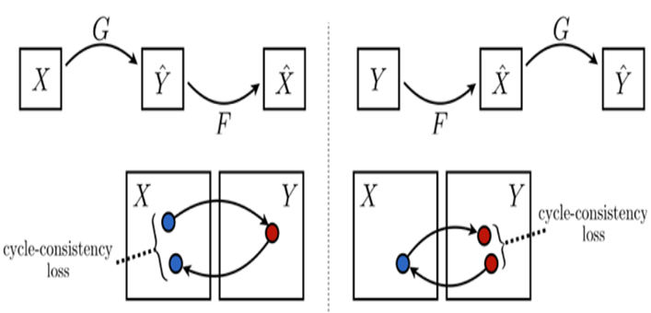

Background
The CycleGAN architecture is different from other GANs :
Generators: It contains 2 mapping functions (G and F) that act
as generators. The generator mapping functions are as follows:
where X is the input image distribution and Y is the desired output distribution .
Discriminators : The corresponding Discriminators (Dx and Dy): :
Dx : distinguish G(X)(Generated Output) from Y (real Output )
Dy : distinguish F(Y)(Generated Inverse Output) from X (Input distribution)

Slide 6
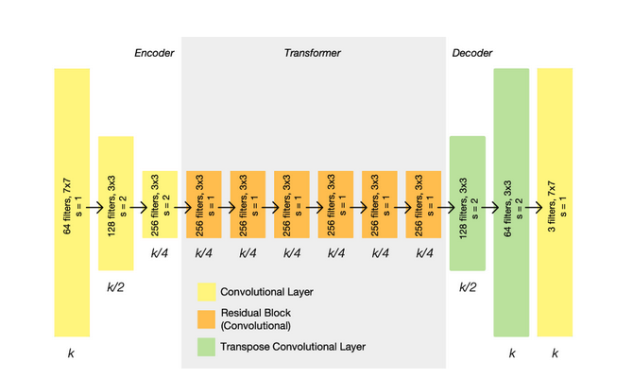
Architecture
Generator:
Each CycleGAN generator has three sections:
Encoder
Transformer
Decoder
The input image is passed into the encoder.
The encoder extracts features from the input image by using Convolutions and compressed the representation of image but increase the number of channels.
The encoder consists of 3 convolution that reduces the representation by 1/4 th of actual image size.
Consider an image of size (256, 256, 3) which we input into the encoder,
the output of encoder will be (64, 64, 512).
Then the output of encoder after activation function is applied is passed into the transformer. The transformer contains 6 or 9 residual blocks based on the size of input. The output of transformer is then passed into the decoder which uses 2 -deconvolution block of fraction strides to increase the size of representation to original size.

Slide 7
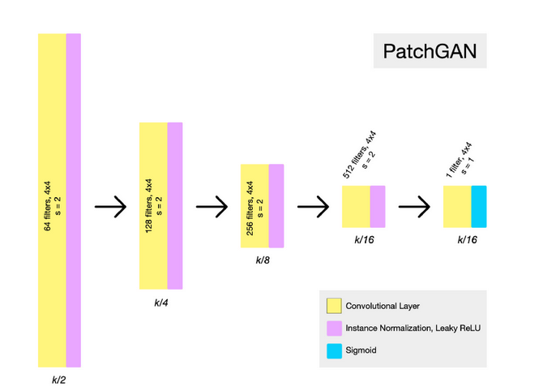
Architecture
Discriminator:
In CycleGAN,the discriminator used is PatchGAN.
PatchGAN is a type of discriminator for GANs which only penalizes structure at the scale of local image patches. The PatchGAN discriminator tries to classify if each patch in an image is real or fake.
The PatchGAN maps from 256×256 to an NxN (here 30×30) array of outputs X, where each X_{ij} signifies whether the patch ij in the image is real or fake.

Slide 8



Loss Function
Adversarial Loss: We apply adversarial loss to both our mappings of generators and discriminators. This adversary loss is written as :
Cycle Consistency Loss : The adversarial mapping in CycleGAN should be cycle-consistent. The loss function proposed in Cycle GAN measures the error rate of inverse mapping G(x) -> F(G(x)). The behavior induced by this loss function cause closely matching the real input (x) and F(G(x))
Identity Loss : The identity mapping loss acts as an effective stabilizer at early stage of training. Without Identity Loss, the generator G and F are free to change the tint of input images when there is no need to.
Total Loss : The total loss of the GAN model calculated during training is:
Adversarial Loss (Ukiyo) + Adversarial Loss (Real) + λ*Cycle Consistency Loss + 0.5*λ*Identity Loss
where λ controls the relative importance of the two objectives.

Slide 9
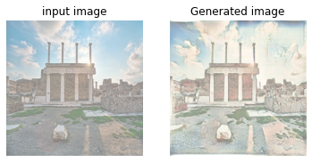
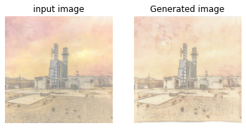
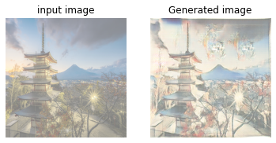
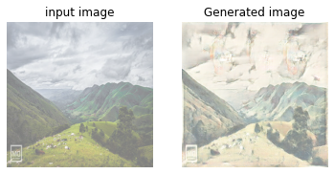
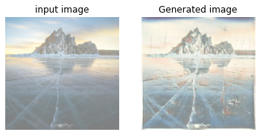
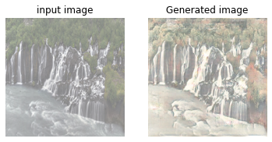
Results
After training, the Ukiyo-Generator of the CycleGAN model translates real photos to ukiyo -e art

Slide 10
Conclusion
CycleGAN learns to mimic the style of an entire collection of artworks, rather than transferring the style of a single selected piece of art. It can generate different styles such as : Van Gogh, Cezanne, Monet, and Ukiyo-e
Some other applications of CycleGAN include transforming objects from one ImageNet class to another such as: Zebra to Horses and vice-versa, Apples to Oranges and vice versa, etc
CycleGANs are useful in performing color or texture transformation, however they do not give good results on geometrical transformation

Slide 11
References
Unpaired Image-to-Image Translation using Cycle-Consistent Adversarial Networks
https://www.geeksforgeeks.org/cycle-generative-adversarial-network-cyclegan-2/
https://paperswithcode.com/method/patchgan
https://www.cs.cmu.edu/~junyanz/projects/CycleGAN/CycleGAN.pdf

Slide 12


