Slide 1
CRYPTOGRAPHY
Submitted By:-
Madhav Harjai(CO19340)
Satyam Wats(CO19356)
Mandeep Choudhary(CO19370)

Slide 2
Cryptography
Cryptography is technique of securing information and communications through use of codes so that only those person for whom the information is intended can understand it and process it
It is the process where an ordinary plain text is converted to cipher text which is the text made such that intended receiver of the text can only decode it and hence this process is known as encryption. The process of conversion of cipher text to plain text this is known as decryption.

Slide 3
Features of Cryptography
Confidentiality: Information can only be accessed by the person for whom it is intended and no other person except him can access it.
Integrity: Information cannot be modified in storage or transition between sender and intended receiver without any addition to information being detected.
Non-repudiation:The creator/sender of information cannot deny his intention to send information at later stage.
Authentication:The identities of sender and receiver are confirmed. As well as destination/origin of information is confirmed.

Slide 4
Types Of Cryptography:
In general there are three types Of cryptography:
Symmetric Key Cryptography: It is an encryption system where the sender and receiver of message use a single common key to encrypt and decrypt messages.
Hash Functions: There is no usage of any key in this algorithm. A hash value with fixed length is calculated as per the plain text which makes it impossible for contents of plain text to be recovered.
Asymmetric Key Cryptography: Under this system a pair of keys is used to encrypt and decrypt information. A public key is used for encryption and a private key is used for decryption.

Slide 5
Symmetric Key Cryptography
In this technique,
Both sender and receiver uses a common key to encrypt and decrypt the message.
Before starting the communication, sender and receiver shares the secret key.
This secret key is shared through some external means.
At sender side, sender encrypts the message using his copy of the key.
The cipher text is then sent to the receiver over the communication channel.
At receiver side, receiver decrypts the cipher text using his copy of the key.
After decryption, the message converts back into readable format.

Slide 6
Diffie Hellman Algorithm
The first party picks two prime numbers, g and p and tells them to the second party.
The second party then picks a secret number (let’s call it a), and then it computes gª mod p and sends the result back to the first party; let’s call the result A. Keep in mind that the secret number is not sent to anyone, only the result is.
Then the first party does the same; it selects a secret number b and calculates the result B similar to the
step 2. Then, this result is sent to the second party.
The second party takes the received number B and calculates Bª mod p
The first party takes the received number A and calculates A^{b} mod p
Result of above two steps is same.

Slide 7
EXAMPLE
Step 1: Alice and Bob get public numbers P = 23, G = 9
Step 2: Alice selected a private key a = 4 and Bob selected a private key b = 3
Step 3: Alice and Bob compute public values Alice: x =(9^4 mod 23) = (6561 mod 23) = 6 Bob: y = (9^3 mod 23) = (729 mod 23) = 16
Step 4: Alice and Bob exchange public numbers
Step 5: Alice receives public key y =16 and Bob receives public key x = 6
Step 6: Alice and Bob compute symmetric keys
Alice: ka = y^a mod p = 65536 mod 23 = 9
Bob: kb = x^b mod p = 216 mod 23 = 9
Step 7: 9 is the shared secret.

Slide 8
Asymmetric Encryption

Slide 9
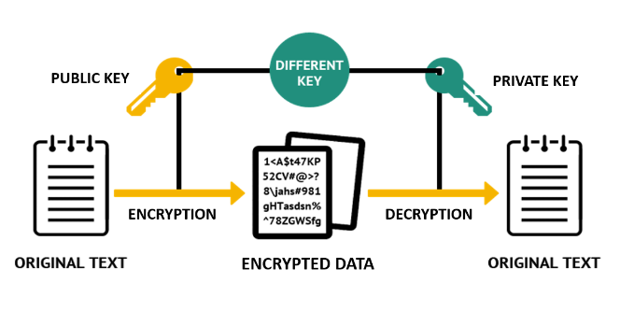
What is Asymmetric Encryption

Slide 10
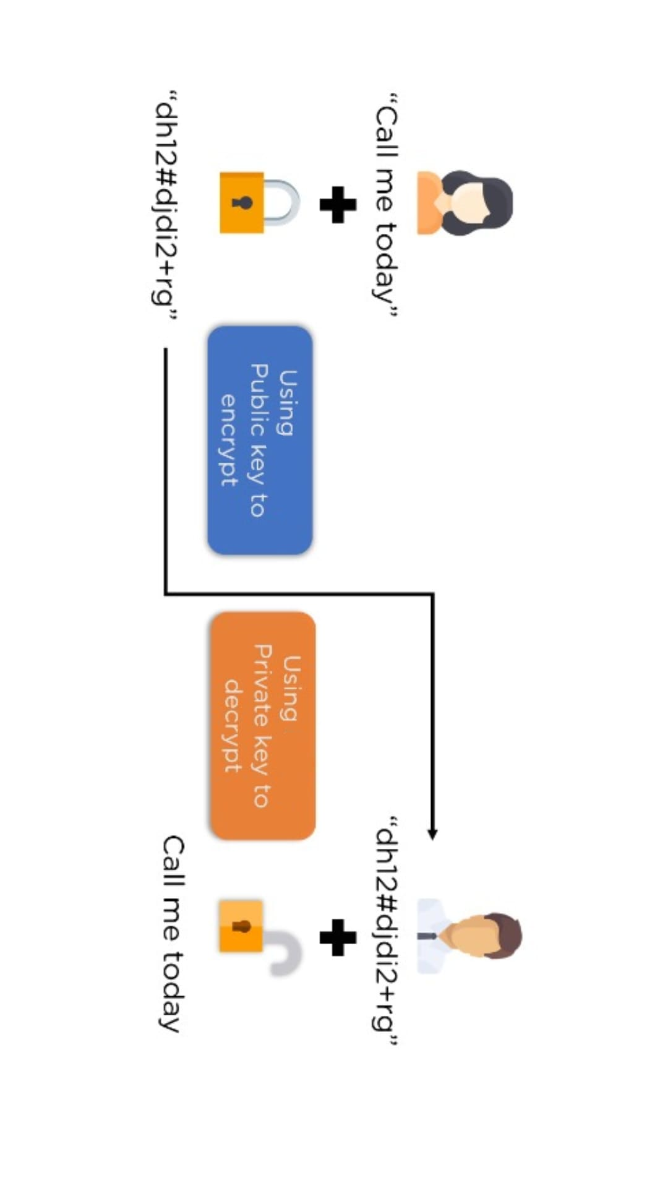
For example:

Slide 11
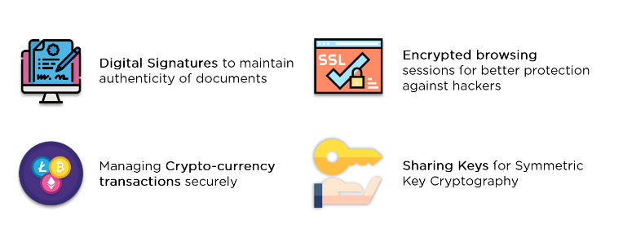
Applications

Slide 12
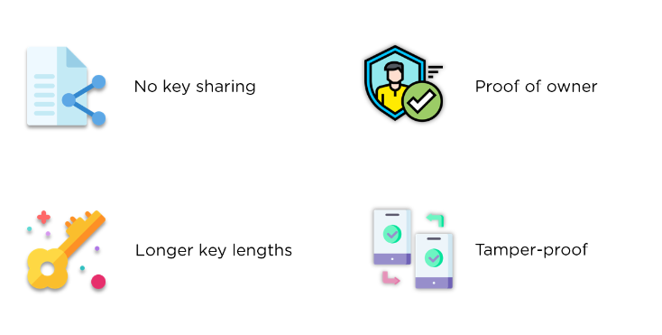
Advantages of Asymmetric Encryption

Slide 13
Hashing

Slide 14
Introduction
Hashing is the process of transforming any given key or a string of characters into another value. This is usually represented by a shorter, fixed-length value or key that represents and makes it easier to find or employ the original string.
The most popular use for hashing is the implementation of hash tables. A hash table stores key and value pairs in a list that is accessible through its index. Because key and value pairs are unlimited, the hash function will map the keys to the table size. A hash value then becomes the index for a specific element.

Slide 15
Use of hashing
1. Data Retrieval: Hashing uses functions or algorithms to map object data to a representative integer value. A hash can then be used to narrow down searches when locating these items on that object data map.
For example, in hash tables, developers store data -- perhaps a customer record -- in the form of key and value pairs. The key helps identify the data and operates as an input to the hashing function, while the hash code or the integer is then mapped to a fixed size.

Slide 16
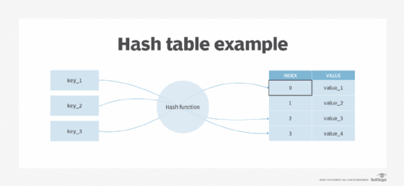

Slide 17
2. Digital signatures
In addition to enabling rapid data retrieval, hashing helps encrypt and decrypt digital signatures used to authenticate message senders and receivers. In this scenario, a hash function transforms the digital signature before both the hashed value (known as a message digest) and the signature are sent in separate transmissions to the receiver.
Upon receipt, the same hash function derives the message digest from the signature, which is then compared with the transmitted message digest to ensure both are the same. In a one-way hashing operation, the hash function indexes the original value or key and enables access to data associated with a specific value or key that is retrieved.

Slide 18
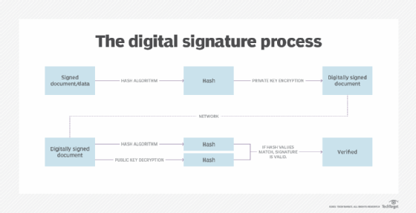

Slide 19
MD5
MD5 is a cryptographic hash function algorithm that takes the message as input of any length and changes it into a fixed-length message of 16 bytes. MD5 algorithm stands for the message-digest algorithm. MD5 was developed as an improvement of MD4, with advanced security purposes. The output of MD5 (Digest size) is always 128 bits. MD5 was developed in 1999.
This is even used for password encryption in databases like MySQL.

Slide 20
SHA
Algorithms in the SHA family are considered slightly more secure. The first versions were developed by the United States government, but other programmers have built on the original frameworks and made later variations more harder to break. In general, the bigger the number after the letters "SHA," the more recent the release and the more complex the program.
For example, SHA-3 includes sources of randomness in the code, which makes it much more difficult to crack than those that came before. It became a standard hashing algorithm in 2015 for that reason.

