Slide 1
Artificial Intelligence with Python
By : Chetankumar Sirokha Python Trainer at Logipool Infotech

Slide 2
What we will learn in this session
Introduction to Artificial Intelligence
Need and Evolution of AI
Types of AI
Applications of AI Across Industries
Advantages and Disadvantages of AI
Tools and Programming Languages in AI
Future Trends in AI
Job Opportunities and Skills in AI

Slide 3
Introduction to Artificial Intelligence
Artificial Intelligence (AI) is the field of computer science that aims to create machines that can mimic human intelligence like learning, reasoning, problem-solving, understanding language, and perception.
“AI is the simulation of human intelligence processes by machines, especially computer systems.”
Branches of AI
Machine Learning (ML) – Learning from data
Deep Learning – Neural networks for complex tasks
Natural Language Processing (NLP) – Understanding human language
Computer Vision – Interpreting images and videos
Robotics – AI-powered machines that perform task

Slide 4
Need and Evolution of AI
Why Do We Need AI? (Need for AI)
As technology evolves, we need systems that can think, learn, and make decisions like humans. Here's why AI is essential:
1. Handling Big Data
2. Automating Repetitive Tasks
3. Better Accuracy & Speed
4. 24/7 Availability
5. Intelligent Decision-Making
The need for AI arises from the desire to make machines think and act like humans.

Slide 5
Types of AI
Types of AI Based on Capabilities:
Narrow AI (Weak AI):
Definition: AI that is designed and trained for one specific task.
Examples: Siri, Alexa,Google Maps,Face Recognition,Chatbots
Limitations: Cannot perform beyond its programming.
General AI (Strong AI):
Definition: AI that has the ability to understand, learn, and apply intelligence like a human across a wide range of tasks.
Examples: Still theoretical – no existing example.
Goal: Make machines truly intelligent, capable of reasoning and problem-solving like humans.
Super AI:
Definition: Hypothetical AI that surpasses human intelligence in all aspects—creativity, wisdom, problem-solving, emotional intelligence.
Examples: Only exists in theory (e.g., AI in sci-fi movies like Her, Ex Machina, etc.)
Risks: May pose existential risks if not properly controlled.

Slide 6
Types of AI Based on Functionalities:
Reactive Machines:
Definition: Basic AI systems that can only react to current input.
Examples: IBM’s Deep Blue (chess-playing computer)
Limitation: No memory or learning ability.
Limited Memory:
Definition: Can use past experiences to make decisions.
Examples: Self-driving cars (store past traffic data to improve performance)
Features: Learn from historical data and make improved predictions.
Theory of Mind (Conceptual):
Definition: AI that can understand emotions, beliefs, intentions, and interactions like humans.
Current Status: Still in research phase.
Goal: Improve human-AI interaction.
Self-Aware AI (Futuristic):
Definition: AI with its own consciousness, self-awareness, and feelings.
Examples: Does not exist yet.
Ethical concerns: Raises debates on rights and risks.

Slide 7
Applications of AI Across Industries
Industry | Key Applications | Examples
Healthcare | Diagnosis, Surgery, Chatbots | IBM Watson, Ada
Banking | Fraud Detection, Credit Scoring | HDFC EVA, AI credit engines
Manufacturing | Predictive Maintenance, Robotics | Bosch AI
Retail | Recommendations, Chatbots | Amazon, Flipkart
Transportation | Self-driving, Route Planning | Tesla, Uber AI
Education | Personalized Learning, Grading | Byju’s, Khan Academy
Entertainment | Recommendations, Content Generation | Netflix, Spotify
Security | Facial Recognition, Surveillance | Airport AI systems
Agriculture | Crop Monitoring, Soil Analysis | AI drones, John Deere
Government | Smart Cities, Public Assistance | Digital India initiatives

Slide 8
Advantages and Disadvantages of AI
Advantages of AI
Accuracy and Efficiency: AI systems can perform tasks faster and more accurately than humans, especially in repetitive or complex calculations (e.g., diagnosing diseases from scans).
24/7 Availability: Unlike humans, AI doesn't get tired. It can work continuously without breaks , increasing productivity.
Handles Repetitive Tasks: AI automates mundane, repetitive tasks like data entry, reducing human error and freeing people for creative work.
Data Analysis and Decision Making: AI can process large volumes of data quickly and identify hidden patterns for predictive analytics (e.g., weather forecasts, stock trends).
No Emotional Bias: AI makes logical decisions without being affected by emotions, fatigue, or stress.
Risk Reduction: AI can work in dangerous environments (e.g., deep sea, space, disaster zones, bomb disposal), reducing risk to human life.
Smart Assistance: AI powers virtual assistants (e.g., Siri, Alexa, ChatGPT) that help with tasks like scheduling, answering queries, and more.

Slide 9
Disadvantages of AI
High Cost: Developing and maintaining AI systems is expensive due to the need for high computing power, skilled labor, and large data sets.
Job Displacement: AI can replace human jobs , especially in repetitive or routine roles, leading to unemployment in some sectors.
Lack of Creativity: AI can mimic creativity but lacks original human imagination or emotional intelligence.
Dependence on Data: AI heavily relies on quality and quantity of data . Poor data leads to poor decisions (garbage in, garbage out).
No Human Judgment: AI lacks moral values and common sense . It may fail in situations needing human empathy or ethics .
Privacy and Security Risks: AI systems can be hacked or misused . They may also lead to data breaches or biased surveillance.
Bias in Algorithms: If trained on biased data, AI will produce biased results , leading to unfair or unethical outcomes (e.g., in hiring or policing).

Slide 10
Tools and Programming Languages in AI
Category | Name | Use Case / Feature
AI Frameworks | TensorFlow | Deep learning by Google
 | PyTorch | Flexible neural network framework (Meta)
 | Keras | Simplified API for neural networks (runs on TensorFlow)
 | Scikit-learn | Classical machine learning (SVM, decision trees, etc.)
NLP Tools | NLTK, spaCy | Natural Language Processing (text analysis)
Computer Vision Tools | OpenCV | Image and video processing
Experiment Tracking | MLflow, Weights & Biases | Track ML experiments, models, and results
Development Platforms | Jupyter Notebook | Interactive coding and visualization environment
 | Google Colab | Free cloud-based notebook with GPU/TPU
Programming Languages | Python | Most widely used for AI – easy and powerful
 | R | Statistical computing and graphics
 | Java | Scalable enterprise-level AI systems
 | C++ | High-performance AI (robotics, gaming)
 | Julia | High-speed numerical computing
 | JavaScript | Web-based AI apps using TensorFlow.js
 | Prolog | Logic programming and expert systems
 | LISP | Early AI, used for symbolic reasoning

Slide 11
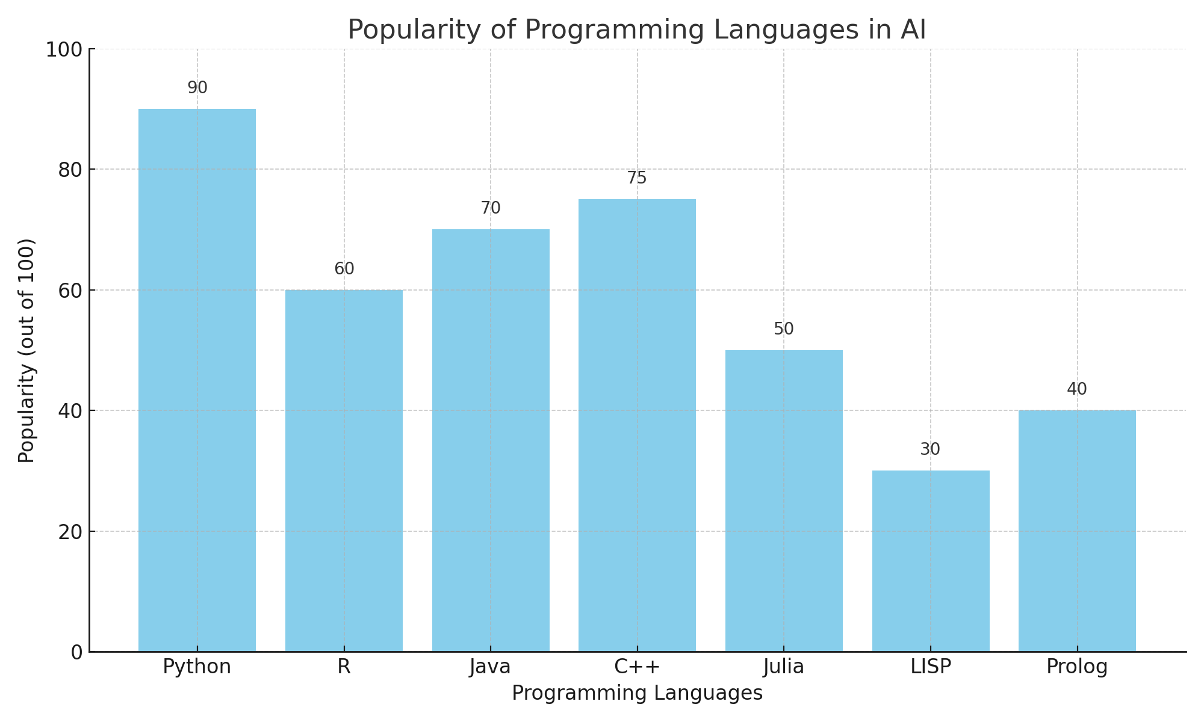

Slide 12
Future Trends in AI
Trend | Description | Real-World Impact
1. Generative AI | AI that can create content—text, images, code, videos | ChatGPT, DALL·E, Sora
2. Explainable AI (XAI) | AI systems that can explain their decision-making process | Improves trust in AI (e.g., healthcare AI)
3. AI + IoT (AIoT) | Integrating AI with IoT for smarter automation | Smart homes, factories
4. Edge AI | Running AI algorithms on edge devices (local, not cloud) | Real-time AI in phones, drones
5. AI in Cybersecurity | Predicts, detects, and prevents cyber threats in real time | AI-powered threat detection tools
6. AI in Healthcare Expansion | Personalized treatment, drug discovery, robotic surgeries | AI-assisted diagnostics
7. Autonomous Vehicles | AI controlling self-driving cars, drones, delivery bots | Tesla Autopilot, Waymo
8. Emotion AI (Affective Computing) | AI that recognizes and responds to human emotions | Customer service, virtual therapy
9. Federated Learning | Training AI on decentralized data (privacy-focused) | Banking, healthcare AI apps
10. AI Governance & Ethics | Growing focus on regulating AI for fairness, safety, and transparency | Global AI laws, ethical frameworks

Slide 13
Job Opportunities and Skills in AI
Job Role | Description | Tools/Technologies
AI/ML Engineer | Builds and deploys AI models and ML algorithms | Python, TensorFlow, PyTorch
Data Scientist | Analyzes and interprets complex data for decision-making | Pandas, Scikit-learn, SQL
Data Analyst | Interprets data trends and visualizes insights | Excel, Tableau, Power BI
NLP Engineer | Specializes in processing human language | NLTK, spaCy, HuggingFace
Computer Vision Engineer | Works with image/video data using AI | OpenCV, YOLO, MediaPipe
Robotics Engineer | Designs AI-driven robots for real-world tasks | ROS, C++, Python
AI Research Scientist | Conducts advanced research on AI theories and models | PyTorch, JAX, scientific papers
AI Product Manager | Plans and manages AI-based product lifecycle | AI basics, Agile, Communication
Business Intelligence Analyst | Turns AI/ML insights into business strategies | SQL, Power BI, ML basics
AI Ethics Specialist | Ensures responsible and fair AI usage | Ethics, Legal frameworks

Slide 14
What we will learn in this session
NumPy, Pandas and Scikit-learn Libraries
Introduction to Machine Learning
Types of ML : Supervised, unsupervised and reinforcement learning
Hands-on (basic): Predict marks based on study hours

Slide 15
NumPy, Pandas and Scikit-learn Libraries
NumPy is a Python library used for numerical computing. It provides a high-performance multi-dimensional array object and tools for working with arrays.
Enables fast mathematical operations on large datasets
Functions for linear algebra, statistics
E.g.
import numpy as np
arr = np.array([1, 2, 3, 4])
print(arr * 2)
# Output: [2 4 6 8]

Slide 16
Pandas is a Python library for data manipulation and analysis. It provides powerful data structures like DataFrame and Series.
Makes data cleaning, transformation, and analysis easy
Works seamlessly with CSV, Excel, SQL, and JSON data
Functions for filtering, grouping, merging, and reshaping data
E.g.
import pandas as pd
data = {'Name': ['Alice', 'Bob'], 'Age': [25, 30]}
df = pd.DataFrame(data)
print(df)
#Output
Name Age
0 Alice 25
1 Bob 30

Slide 17
sklearn, short for Scikit-learn, is a powerful and easy-to-use machine learning library in Python. It provides simple tools to build, train, and evaluate machine learning models.
Covers most ML tasks: classification, regression, clustering, dimensionality reduction, model selection, etc.
What can we do with sklearn
Task | Example Algorithms
Classification | LogisticRegression, SVC, KNeighborsClassifier
Regression | LinearRegression, Ridge, Lasso
Clustering | KMeans, DBSCAN
Model Selection | train_test_split, GridSearchCV
Dimensionality Reduction | PCA, TruncatedSVD
Preprocessing | StandardScaler, LabelEncoder

Slide 18
Popular Modules in sklearn
Module | Purpose
sklearn.linear_model | Regression models
sklearn.tree | Decision trees
sklearn.ensemble | Random forests, boosting
sklearn.neighbors | KNN and neighbors
sklearn.naive_bayes | Probabilistic classifiers
sklearn.svm | Support Vector Machines
sklearn.cluster | Clustering like KMeans
sklearn.decomposition | PCA and dimensionality reduction
sklearn.preprocessing | Feature scaling, encoding
sklearn.model_selection | Cross-validation, grid search
sklearn.metrics | Accuracy, precision, recall

Slide 19
Introduction to Machine Learning
Machine Learning is a field of computer science that gives computers the ability to learn from data and improve performance over time without being explicitly programmed.
Instead of writing rules to tell the computer what to do, you feed it data, and it figures out patterns or relationships by itself.
Traditional Programming vs Machine Learning
Traditional Programming | Machine Learning
You give rules + data → get answers | You give data + answers → get rules
Fixed logic, hard-coded | Learns patterns from data
Example: If-else, loops | Example: Linear Regression, Neural Networks

Slide 20
Machine Learning Workflow
Collect Data : Real-world or simulated data
Prepare the Data : Cleaning, formatting, feature engineering
Split Data : Train set and test set
Choose Model : Select algorithm
Train Model : Fit the model to training data
Evaluate Model : Accuracy, precision, recall, F1 score, etc.
Tune Hyperparameters : Improve performance
Deploy Model : Use it in production (e.g., web app, mobile app)

Slide 21
Types of ML : Supervised, unsupervised and reinforcement learning
Supervised Learning is a type of machine learning where the model is trained using labeled data that means the input data already has the correct output (answer).
The model learns from the data and then predicts outcomes for new, unseen data.
How It Works:
Input: Features (X) — e.g., height, weight
Output: Labels (Y) — e.g., “Fit” or “Unfit”
The algorithm learns a mapping f(X) → Y
Once trained, it can predict Y for new X

Slide 22
Types of Supervised Learning
Type | Description | Common Algorithms | Example
Regression | Predicts continuous values | Linear Regression, Decision Tree Regression | Predict house prices based on size
Classification | Predicts discrete labels/categories | Logistic Regression, KNN, SVM, Random Forest | Email spam detection (spam or not)
Regression is a supervised learning technique used to predict continuous numerical values based on input data.
It answers questions like: “How much?”, “How many?”, or “What is the value?”
E.g.
Predicting the price of a house based on:
Size (sq ft)
Location
Number of rooms

Slide 23
Classification is a type of supervised learning used to predict categories or labels from input data.
It answers questions like: "Is it spam or not?", "Will the customer churn?".
E.g.
Predict whether a student will pass or fail based on:
Study hours
Attendance
Previous scores

Slide 24
Unsupervised Learning is a type of machine learning where the model learns patterns from data without labeled outputs.
In simple terms: The machine is given input data without knowing the answers, and it tries to group or understand the structure of the data on its own.
Algorithm tries to find hidden patterns, similarities, or groupings
Examples of Unsupervised Learning:
Task | Description | Example Algorithm
Clustering | Group similar items together | KMeans, DBSCAN, AgglomerativeClustering
Dimensionality Reduction | Reduce number of features while keeping important data | PCA (Principal Component Analysis)
Association Rule Learning | Discover relationships in data | Apriori, Eclat (used in market basket analysis)

Slide 25
Clustering is an unsupervised learning technique where the algorithm groups similar data points together without predefined labels.
In simple words: Clustering is like organizing similar items into boxes — without knowing the labels ahead of time.
Imagine you have a bunch of mixed fruits but no labels. A clustering algorithm will:
Group bananas together
Group apples together
Group oranges together → without knowing what they are called!

Slide 26
Common Clustering Algorithms:
Dimensionality Reduction is the process of reducing the number of input features (dimensions) in a dataset while preserving as much important information (patterns, variance) as possible.
Dimensionality Reduction helps by:
Removing redundant or irrelevant features
Making data easier to process, visualize, and train
Algorithm | Description
K-Means | Divides data into k clusters based on distance
Hierarchical Clustering | Builds a tree of clusters (dendrogram)
DBSCAN | Groups based on density (great for uneven clusters)
Mean Shift | Uses data density to find clusters

Slide 27
Common Techniques:
Method | Purpose | Description
PCA (Principal Component Analysis) | Most popular | Projects data to lower dimensions using maximum variance
t-SNE (t-distributed Stochastic Neighbor Embedding) | Visualization | Converts high-dimensional data into 2D or 3D
LDA (Linear Discriminant Analysis) | Supervised | Reduces dimensions while keeping class separability
Autoencoders (Deep Learning) | Neural nets | Learn compressed data representation

Slide 28
Association Rule Learning is a rule-based unsupervised learning method used to discover interesting relationships (associations) between variables in large datasets especially in market basket analysis.
IF-THEN relation
Real-Life Example: Market Basket Analysis
Imagine a supermarket database shows:
If a customer buys Bread & Butter, they often also buy Milk.
This can be expressed as an association rule:
{Bread, Butter} → {Milk}
This means Bread and Butter lead to Milk.

Slide 29
Key Metrics in Association Rule Learning
Metric | Meaning
Support | How often the rule occurs in the dataset
Confidence | How often the rule has been found to be true
Lift | How much more likely the RHS is given the LHS compared to random chance

Slide 30
Reinforcement Learning is a type of machine learning where an agent learns to take actions in an environment in order to maximize rewards.
An Agent interacts with an Environment by taking Actions, and the environment gives back a Reward and a new State.
The agent's goal is to learn a strategy (called a policy) that maximizes its total reward over time.
Reinforcement Learning Cycle: Agent → Takes Action → Environment → Returns Reward & New State → Agent

Slide 31
Real life examples:​
Example | Description
Playing Games | AI agents learn to play Chess, Go, or Atari games (e.g. AlphaGo, Deep Q Learning)
Robotics | Robot learns to walk or pick objects through trial and error
Self-Driving Cars | Car learns to drive by taking correct turns, braking, avoiding collisions
Ad Recommendations | Showing right ads to users by learning what they click
Finance | Making stock trading decisions based on rewards (profits/losses)

Slide 32
Hands-on (basic): Predict marks based on study hours
from sklearn.linear_model import LinearRegression
import numpy as np
# Hours studied and corresponding marks
x = np.array([[1], [2], [3], [4], [5]])
y = np.array([25, 30, 35, 40, 45])
model = LinearRegression()
model.fit(x, y)
# Predict for 6 hours
print("Predicted marks for 6 hours:", model.predict([[6.5]])[0])

Slide 33
What we will learn in this session
What is Dataset and its types
Supervised Learning
Regression : Linear Regression, Multiple linear regression
Classification : Logistic Regression, KNN, SVM, Naïve Bayes classifier

Slide 34
What is Dataset and its type
A dataset is a collection of data usually structured in rows and columns, or in some organized format that is used for analysis or training machine learning models.
Types of datasets:
Structured Dataset : Data is organized in rows and columns(e.g. CSV, Excel)
Unstructured Dataset : Data is not organized in a predefined manner (e.g. text, Image, videos)
Semi-Structured Dataset : Data is partially organized (XML,JSON)

Slide 35
Regression : Linear Regression and Multiple Linear Regression
Linear Regression : It is a supervised learning algorithm used to predict continuous output based on the input.
It tries to draw a straight line (best fit) through the data points to get the relationship between input (X) and output (Y).
How it works, It uses mathematical straight line formula : y = mx + c
Here,
y → Predicted value
x → Input value
m → Slope (gradient)
c → Intercept (jab x = 0)

Slide 36
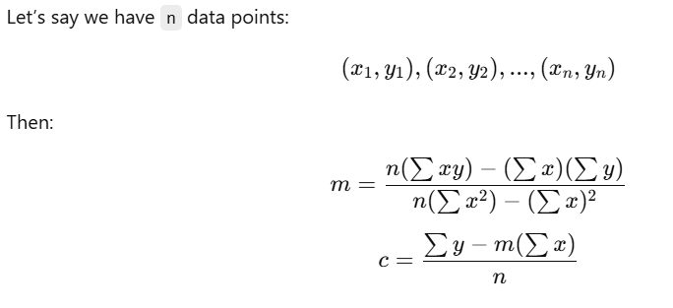
Mathematically, How m and c are calculated
Term | Meaning (in regression)
Slope (m) | When x increases by 1, how much y increases or decreases.(It shows the rate of change between x and y.)
Intercept (c) | When x is 0, what is the value of y. (It tells us the starting point of y on the graph.)

Slide 37
Problem:
Predict marks based on hours studied.
The relationship looks linear. We want to predict marks if someone studies for 5 hours.
How it works:
The model finds the best line that minimizes the error between actual and predicted marks.
It uses least squares method to calculate the slope (m) and intercept (c)
Next will see coding examples...........
Hours Studied (X) | Marks Scored (Y)
1 | 20
2 | 40
3 | 60
4 | 80

Slide 38

Multiple Linear Regression:
Multiple Linear Regression (MLR) is a machine learning algorithm used to predict a value (Y) using more than one feature (input variable).
Mathematical formula:
Where,
y: Dependent variable (Target)
x1, x2, x3...: Independent variables (Features)
m1, m2, m3...: Coefficients (Slopes)
c: Intercept
Next will see coding problem......

Slide 39
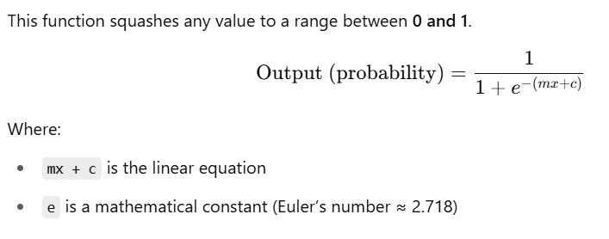
Classification : Logistic Regression, KNN, SVM, Naïve Bayes classifier
Logistic Regression is a supervised machine learning algorithm used for classification problems, especially binary classification (where output is 0 or 1, Yes or No, True or False).
logistic regression uses a special function: Sigmoid Function

Slide 40
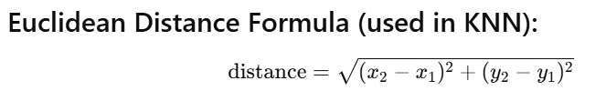
KNN (K-Nearest Neighbors) is a supervised machine learning algorithm, It makes predictions based on similarity — meaning it looks at its “neighbors” to decide what a new data point should be classified as.
How KNN Works (Step-by-step):
Choose K → Number of neighbors to consider (e.g. K=3 or K=5)
Calculate distance between the new point and all existing points (commonly use Euclidean distance)
Find K nearest neighbors → Pick the K closest data points
Voting → Check which class (label) is most common among those K neighbors
Assign that class to the new data point

Slide 41
SVM(Support Vector Machine) tries to find the best decision boundary (called hyperplane) that separates different classes in the dataset with the maximum margin (maximum distance between the nearest points of different classes).
The points that are closest to the hyperplane are called support vectors, and they are critical in defining the position and orientation of the hyperplane.
Think of it as drawing a line that splits two groups (cats vs. dogs) such that the line is as far away as possible from both sides.

Slide 42
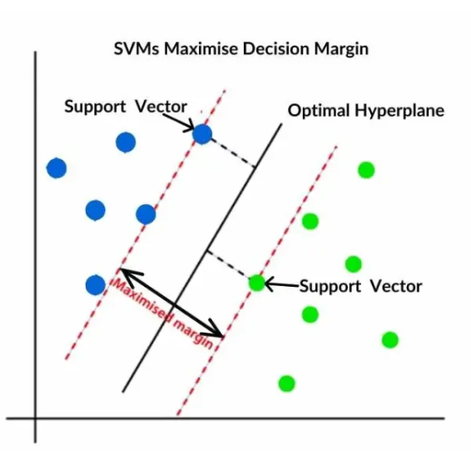

Slide 43
Naïve Bayes is a supervised machine learning algorithm used for classification tasks. It is based on Bayes' Theorem and assumes that features are independent of each other which is a naïve assumption.
It calculates the probability that a data point belongs to a certain class, and chooses the class with the highest probability.
Types of Naïve Bayes
Type | Suitable For
Gaussian Naïve Bayes | Continuous data (assumes normal distribution)
Multinomial NB | Text classification (e.g., word counts)
Bernoulli NB | Binary/boolean features (e.g., 0/1 data)

Slide 44
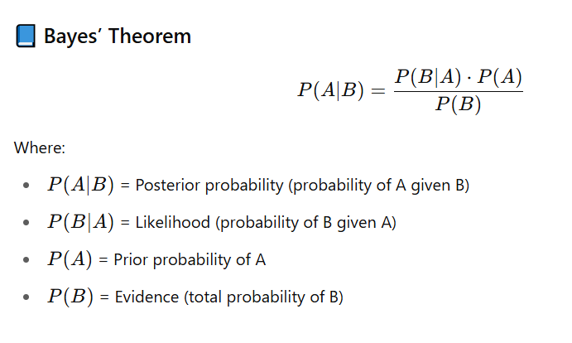

Slide 45
What we will learn today
Unsupervised Learning
Clustering
K-Mean clustering
Association Rule Learning
Apriori Algorithm

Slide 46
Clustering is an unsupervised machine learning technique used to group similar data points together without using labels.
Imagine you walk into a room full of people and want to group them by:
Their language
Their outfits
Their behavior
Even if you don’t know their names or backgrounds, you can naturally form groups (clusters) of similar people. That’s exactly what clustering does with data!
It finds patterns or structures in your data and groups similar points into clusters.

Slide 47
K-Means is an unsupervised learning algorithm used to partition data into K distinct groups (clusters) based on feature similarity.
How K-Means Works (Step-by-Step):
Choose K (number of clusters).
Randomly initialize K centroids (cluster centers).
Assign each data point to the nearest centroid (based on Euclidean distance).
Recalculate centroids as the mean of all points in each cluster.
Repeat steps 3 and 4 until:
Centroids don't change (converge), or
Max iterations reached.

Slide 48
Association Rule Learning is a machine learning technique used to find interesting relationships (patterns or associations) among a set of items in large datasets.
Common Use Case: Market Basket Analysis
“People who buy bread and butter also tend to buy milk.”
Key Terminology:
Term | Meaning
Support | How frequently an itemset appears in the dataset
Confidence | How often the rule is true (i.e., if X happens, how likely is Y)
Lift | How much more likely Y is when X happens, compared to random chance

