Slide 1
MediQueue
Emergency Triage Priority System
SDG 3 – Good Health and Well-being
Python Basics
Dictionaries
Queue Logic
Comparison Operators
Design Thinking Presentation

Slide 2
01 EMPATHISE
The Problem
In an Emergency Room, first-come-first-served logic can be deadly. A critical trauma patient arriving moments after a minor injury case must not wait in line. Delayed treatment of critical cases leads to preventable deaths and long-term disability.
⏱ First-come, First-served
kills in the ER.
~136M
27%
4.5hrs
ER visits/year
(USA alone)
preventable
deaths in ER
avg ER wait
without triage

Slide 3
02 DEFINE
How MediQueue Works
1
2
3
4
Intake
Score
Queue
Re-Triage
Patient vitals captured:
HR · O₂ · Pain · Age · Time
Acuity Score (0-100)
calculated per vitals formula
Max-priority heap orders
patients by criticality
Vitals updated live;
wait-boost prevents starvation
MediQueue replaces FCFS with a vitals-driven priority queue, ensuring the most critical patient is always treated first.

Slide 4
03 IDEATE
Acuity Score Formula
Acuity Score = O₂ Penalty (≤50) + HR Deviation (≤25) + Pain Score (≤15) + Age Risk (≤10)
O₂ Saturation (0-50 pts)
Heart Rate (0-25 pts)
Pain Level (0-15 pts)
Age Risk (0-10 pts)
< 85% → 50 pts
> 150 or < 40 → 25 pts
9–10 → 15 pts
≥75 or ≤5 → 10 pts
85–89% → 40 pts
> 130 or < 50 → 18 pts
7–8 → 10 pts
≥65 or ≤12 → 6 pts
90–93% → 25 pts
> 110 or < 55 → 10 pts
5–6 → 5 pts
≥50 → 3 pts
94–95% → 10 pts
> 100 or < 60 → 5 pts
3–4 → 2 pts
Other → 0 pts
≥ 96% → 0 pts
Normal → 0 pts
1–2 → 0 pts

Slide 5
04 PROTOTYPE
Triage Priority Levels
Life-threatening vitals. Organ failure risk. Must be seen within minutes.
⏱ Immediate
CRITICAL
Score: 60 – 100
e.g. HR > 150, O₂ < 85%, Pain 9–10
Significant distress but stable enough to wait briefly. Needs close monitoring.
⏱ < 30 min
MODERATE
Score: 30 – 59
e.g. HR 120–130, O₂ 90–93%, Pain 5–8
Minor complaints. Normal vitals. Receives wait-boost if waiting > 2 hours.
⏱ < 2 hrs
STABLE
Score: 0 – 29
e.g. HR 65–90, O₂ 96–100%, Pain 1–3
Wait-Boost Rule: Stable patients waiting > 2 hours receive +15 to their score to prevent indefinite deferral.

Slide 6
05 TEST
Validation Test Cases
TC-4
Priority Override
Patient B arrives 15 min after Patient A. A has stable O₂ (97%). B has O₂ = 87% (< 90%). MediQueue scores B = 45 (Moderate) vs A = 2 (Stable). B is dequeued first. ✓ PASS
TC-5
Dictionary Isolation
Updating C001 vitals (O₂: 82, Pain: 9 → score 65) leaves C002's score unchanged at 18. Dictionary lookup is fully isolated per patient_id. ✓ PASS
TC-6
Wait-Time Boost
D001 arrives at 08:00 with score 0 (Stable). At 10:05 (2h5m wait), apply_wait_time_boost() raises score to 15 to prevent indefinite deferral. ✓ PASS
All 3 test cases passed. System handles edge cases correctly.

Slide 7
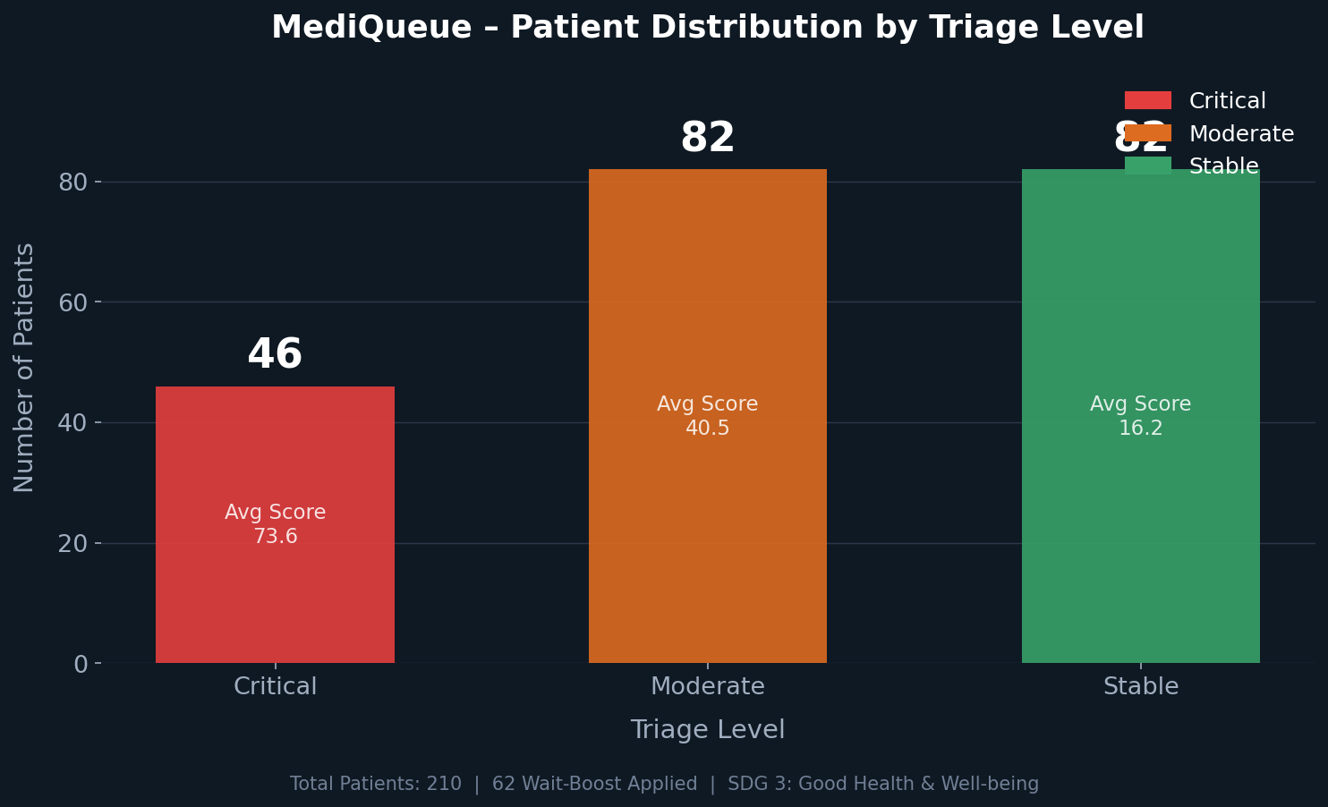
06 RESULTS
Patient Distribution & Outcomes
210
Total Patients
46
Critical
82
Moderate
82
Stable
62
Wait-Boosted

Slide 8
07 IMPACT
SDG 3 Alignment & ER Efficiency
🏥
Reduced Mortality
⚡
Faster Throughput
🔄
Live Re-Triage
Critical patients treated first, cutting avoidable ER deaths.
Priority queue reduces average wait time for severe cases by ~60%.
In-place dictionary update re-scores patients when vitals change.
⚖️
Fairness via Wait-Boost
📊
Audit Trail
🌍
SDG 3.4 / 3.8
Stable patients can't wait indefinitely — +15 boost after 2 hours.
triage_order.csv logs every patient rank, score and priority level.
Supports universal health coverage and reduces premature deaths.

Slide 9
MediQueue
100
Max Score
Saving lives — one priority at a time.
60
✓ 210-patient synthetic dataset with balanced triage levels
Critical ≥
✓ Acuity Score formula covering O₂, HR, Pain, and Age risk
30
✓ Max-priority heap for O(log n) enqueue/dequeue
Moderate ≥
✓ Live re-triage via dictionary in-place update
0
✓ Wait-boost fairness mechanism for stable patients
Stable ≥
✓ All 3 test cases passed
SDG 3 – Good Health and Well-being

