Slide 1

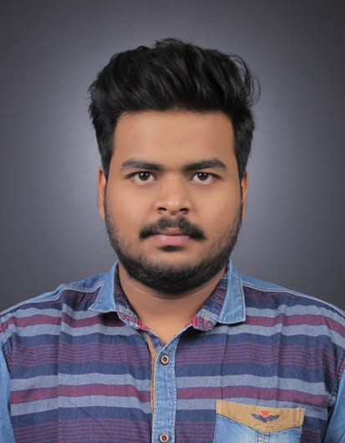


Chetan Anand Prasad
Education and certificates
Bachelor Of Engineering : 2016-2020
Analyst/Software Engineer
Base Location: MUMBAI
Email ID:
chetan.anand-prasad@capgemini.com
Skills
Mobile No: +917057440536
Grade: A4
EMP ID- 46205865
Java | Basics, OOPS, Exception Handling, Collections & Generics, Java 8 Features
Spring Framework | Spring MVC. Spring JDBC, , Spring Boot
React | Components, Hooks, Virtual DOM, Routing, Form, React Redux & Validation
RDBMS | MySQL
UI Technology | HTML 5, CSS, JavaScript
Tools | Git ,GitHub, Postman, Eclipse, Visual Studio code
Add On Skills | Communication , Team management , Problem solving, Leadership.
Strengths
Full Stack Developer
Good Knowledge of java programming
Good with Spring Framework.
Good in developing web pages using HTML, CSS.
Currently learning on iTransform: Full Stack With React, Spring Boot MS & MongoDB
Full Stack developer with React and Full Stack Java Developer
Hands on experience in developing web pages
using HTML5, CSS3, REACT. Good understanding of Document Object Model (DOM) and DOM Functions.
Proficient in creating Single page Web Application in
REACT with routing.
Achievement
MULTIPLEX TICKET BOOKING :
Case study of Multiplex Ticket Booking System along with Spring Boot, HTML5, CSS and React used as User Interface.
Four layered architecture which includes a Presentation Layer, Business Layer, Persistence Layer and Database Layer. Exception Layer handled the exceptions.
Check out my work on GitHub
Presentation Title | Author | Date © Capgemini 2017. All rights reserved | 1

