Slide 1
Review 2 Presentation
XAI-Driven Cost Digital Twin for Procurement Intelligence
Objective: validate the pipeline, should-cost template endpoint, and evaluation direction
30
90
demo parts
clean ERP rows
Core claim: ERP price says what was paid; the Cost Digital Twin and ML fair-price model estimate what should be paid and explain why.
Review 2 | XAI-Driven DTP
01

Slide 2
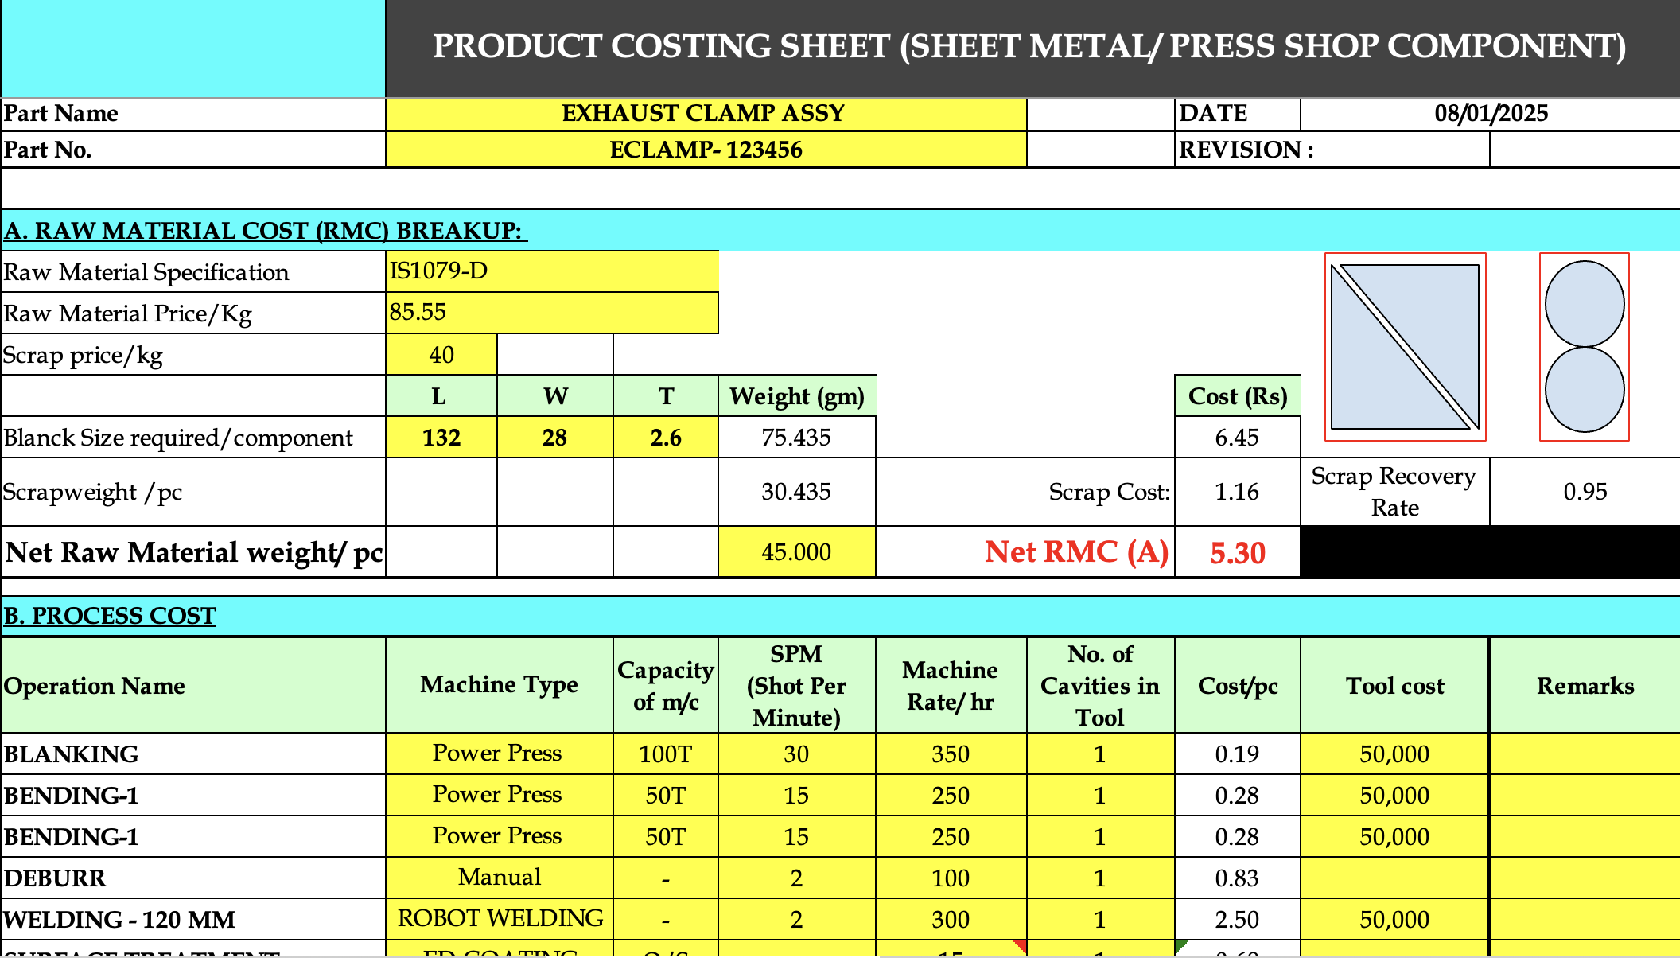
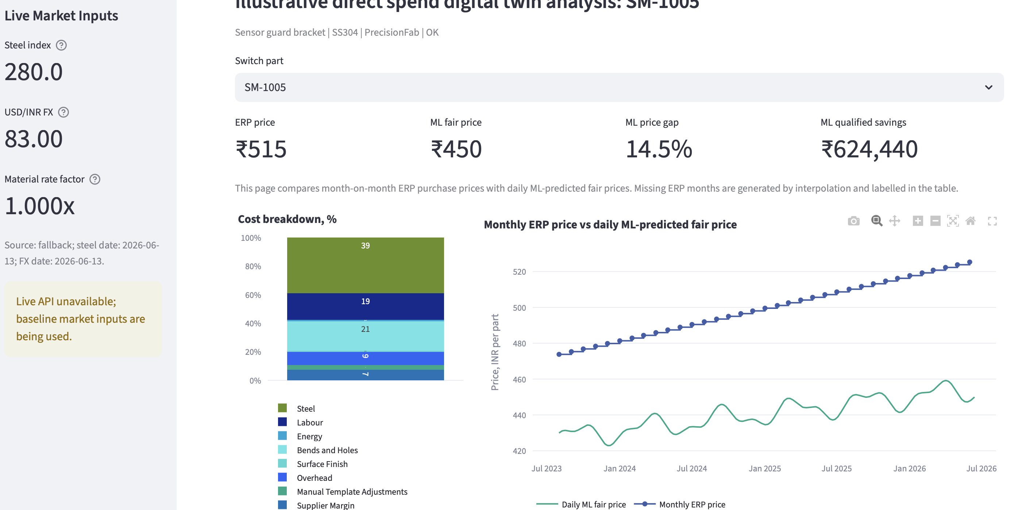
Review 2 | XAI-Driven DTP
Problem Statement
Current procurement pain
Aim
• ERP data stores historical purchase price, but not whether the price is fair.
• Commodity rate movement, FX changes, supplier behavior, and missing engineering context distort direct comparison.
• Negotiation teams need traceable evidence, not only a predicted number.
• Build an explainable AI-driven Cost Digital Twin that converts procurement and technical inputs into fair-price intelligence.
• Use engineering should-cost as the anchor and ML fair price as the decision-support layer.
Review 2 | XAI-Driven DTP
02

Slide 3
Review 2 | XAI-Driven DTP
Literature Review
Explainable AI for a No-Teardown Vehicle Component Cost Estimation
Pipeline used:
1. Collect large-scale vehicle attribute and price data.
2. Clean, integrate, transform, and engineer vehicle features.
3. Cluster vehicles into comparable market groups.
4. Train a vehicle price prediction model.
5. Validate model performance using residual and prediction-error analysis.
6. Use Shapley-value reasoning to allocate price contribution to features/components.
Algorithms/methods used:
- CatBoost gradient-boosted decision trees.
- Hierarchical clustering for vehicle grouping.
- t-SNE for cluster visualization.
- Shapley values / SHAP-style feature attribution.
- Cross-validation and residual analysis.
This paper presents a top-down, data-driven component cost estimation approach using machine learning and Shapley-value reasoning. Instead of relying only on physical teardown or bottom-up component costing, the paper estimates how vehicle features contribute to total vehicle price. It uses explainability to allocate price contribution across components and features.
Relevance to project: This supports SHAP-style cost-driver explanation. It is relevant because your system also needs to explain why a predicted fair price is higher or lower.
Review line: This paper supports the use of Shapley/SHAP explanations to convert black-box price prediction into understandable cost-driver contribution.
Review 2 | XAI-Driven DTP
07

Slide 4
Review 2 | XAI-Driven DTP
Literature Review
Estimation for Large Scale Production of Sheet Metal Parts Using ANN
This paper develops a quotation-costing method for sheet-metal parts using CAD-derived product features and Artificial Neural Networks. It focuses on reducing the time and cost of preparing quotations, especially where detailed tool-layout planning is expensive. The paper uses features such as material, sheet thickness, contours, bends, holes, batch size, and tool-related parameters to estimate progressive-die and manufacturing costs.
Relevance to project: This is highly aligned with your drawing/OCR-to-cost direction. It supports the idea that engineering drawing features can become model inputs for automated cost prediction.
Review line: This paper justifies using drawing-derived cost drivers and ML models for sheet-metal fair-price or should-cost estimation.
Pipeline used:
1. Take customer inquiry and CAD model as input.
2. Extract geometric and technical features from the CAD model.
3. Build a product model containing sheet-metal cost drivers.
4. Convert features into technology-specific base units such as machining time, profile length, bends, holes, and batch size.
5. Estimate tool and manufacturing costs.
6. Generate quotation cost using cost sheets and enterprise cost data.
Algorithms/methods used:
- Feature-based quotation costing.
- CAD feature recognition.
- Analytical geometric analysis.
- Semantic networks.
- Artificial Neural Networks for progressive-die tool-cost estimation.
- Quickprop/FlexNet ANN training approach.
- Job-order costing and workcenter costing.
Review 2 | XAI-Driven DTP
07

Slide 5
Review 2 | XAI-Driven DTP
Literature Review
Machine Learning-Based Manufacturing Cost Prediction from 2D Engineering Drawings via Geometric Features
Pipeline used:
1. Collect 2D DWG engineering drawings and historical cost/price records.
2. Extract geometric and statistical descriptors from drawings.
3. Build drawing-level feature vectors.
4. Train gradient-boosted machine-learning models.
5. Evaluate prediction accuracy across automotive part groups.
6. Use SHAP to explain which drawing features drive cost.
7. Position the approach as a deployable CAD-to-cost and ERP-integrated decision-support pipeline.
Algorithms/methods used:
- XGBoost.
- CatBoost.
- LightGBM.
- Gradient-boosted decision trees.
- SHAP explainability.
- Geometric and statistical feature extraction from 2D drawings.
- MAPE-based model evaluation.
This recent paper proposes an ML framework for estimating manufacturing cost directly from 2D engineering drawings. It extracts around 200 geometric and statistical descriptors from 13,684 DWG drawings across 24 automotive part groups. Gradient-boosted models such as XGBoost, CatBoost, and LightGBM achieve about 10 percent MAPE, and SHAP is used to identify important geometric cost drivers.
Relevance to project: This is one of the strongest recent supports for your next phase. It directly supports drawing-to-cost automation, geometric feature extraction, explainable prediction, and ERP-integrated cost decision support.
Review line: This paper supports my next step of replacing synthetic engineering fields with OCR/CAD-derived drawing features for automated should-cost template generation.
Review 2 | XAI-Driven DTP
07

Slide 6
Review 2 | XAI-Driven DTP
Literature Review
Cost Estimation Approach of a Digital Twin Implementation in Industry
Pipeline used:
1. Identify digital twin application areas.
2. Derive digital twin requirements.
3. Map requirements to required IT infrastructure.
4. Identify cost types for implementation and operation.
5. Assess company digitalization level using checklists.
6. Calculate implementation cost using parameters and maturity factors.
7. Validate the approach using an industry use case.
Algorithms/methods used:
- Total Cost of Ownership approach.
- Requirement analysis.
- Checklist-based digital maturity scoring.
- Parameterized cost calculation.
- Cost-type classification.
- Excel-based estimation tool.
This paper proposes a methodology for estimating the cost of implementing a digital twin in an industrial setting. It considers the company's current digitalization level, required IT infrastructure, hardware, software, implementation effort, running costs, indirect costs, and digital twin application area. The approach is implemented as an Excel-based tool and validated through an industry use case.
Relevance to project: This supports the digital-twin framing and shows that digital twin systems can be studied through structured cost factors and implementation logic.
Review line: This paper supports the framing of system as a cost-oriented digital twin that combines data, models, and decision support.
Review 2 | XAI-Driven DTP
07

Slide 7
Review 2 | XAI-Driven DTP
Literature Review
XAI for Manufacturing Cost Estimation and Machining Feature Visualization
Pipeline used:
1. Collect 3D CAD models, material data, volume data, and cost/price data.
2. Convert CAD models into mesh, voxel, or point-cloud representations.
3. Normalize cost and volume data and encode material data.
4. Train deep-learning models for manufacturing cost prediction.
5. Select the best-performing 3D model.
6. Use visualization to explain which machining features increase cost.
Algorithms/methods used:
- 3D Convolutional Neural Network.
- PointNet and VoxNet baselines.
- 3D Grad-CAM for explainability.
- Min-max normalization and log normalization.
- One-hot encoding for material.
- Adam optimizer.
- MSE, MAE, and MSLE loss functions.
This paper proposes a manufacturing cost prediction process using 3D CAD models and explainable AI. It uses deep learning to predict CNC machining cost and applies 3D Grad-CAM to visualize which machining features increase cost. The key contribution is not only cost prediction, but also explaining the geometric features responsible for the prediction.
Relevance to project: This supports your XAI requirement. It helps justify why your model should explain cost drivers such as weight, thickness, bends, holes, material, and surface finish.
Review line: This paper supports using explainable AI so that cost predictions are not black-box outputs but are connected to visible manufacturing features.
Review 2 | XAI-Driven DTP
07

Slide 8
Review 2 | XAI-Driven DTP
Literature Review
Transparency in AI Decision Making: A Survey of Explainable AI Methods and Applications
Pipeline used:
1. Define the black-box problem in AI decision-making.
2. Categorize explainable AI methods.
3. Compare XAI methods by interpretability, complexity, and domain applicability.
4. Review real-world applications in healthcare, finance, criminal justice, and human-computer interaction.
5. Identify future challenges such as accuracy-interpretability tradeoff and ethical AI.
Algorithms/methods used:
- LIME.
- SHAP.
- Layer-wise Relevance Propagation.
- Attention mechanisms.
- Counterfactual explanations.
- Interpretable models such as decision trees, linear models, and rule-based systems.
- Feature-importance and surrogate-model explanations.
This survey explains why AI systems need transparency, trust, accountability, and fairness. It discusses XAI methods such as LIME, SHAP, interpretable machine-learning models, attention mechanisms, layer-wise relevance propagation, and counterfactual explanations. It also highlights the tradeoff between accuracy and interpretability.
Relevance to project: This gives general XAI theoretical support. Since procurement users need to trust model outputs before using them for supplier negotiation, explainability is a necessary part of the system.
Review line: This paper supports the decision to include explainability in the procurement dashboard and not present only a predicted number.
Review 2 | XAI-Driven DTP
07

Slide 9
Review 2 | XAI-Driven DTP
Literature Review
Costing Support and Cost Control in Manufacturing
This thesis proposes a cost-estimation and cost-control architecture for manufacturing, with application in the sheet-metal domain. It defines modules such as cost models, cost determination, cost reports, risk analysis, data analysis, and data tuning. The work emphasizes that cost information should be integrated into engineering and product-development decisions, not treated only as post-production accounting data.
Relevance to project: This supports the Cost Digital Twin foundation. It justifies using structured engineering cost drivers such as material, geometry, process effort, overhead, and cost feedback loops for should-cost estimation.
Review line: This paper supports the need for a structured cost model that can generate explainable cost information during procurement and engineering decision-making.
Pipeline used:
1. Review manufacturing cost-control needs.
2. Build a generic cost-estimation architecture around manufacturing information.
3. Define cost models and cost structures.
4. Use cost-determination and reporting modules.
5. Demonstrate the prototype in the sheet-metal domain.
Algorithms/methods used:
- Generative cost estimation.
- Variant-based cost estimation.
- Direct costing.
- Activity-based costing.
- Cost structures and cost-control feedback loops.
- Risk analysis, data analysis, and data tuning modules.
Review 2 | XAI-Driven DTP
07

Slide 10
Review 2 | XAI-Driven DTP
Research Gap
Sharp gap statement
Project contribution
• Existing work supports cost estimation, document extraction, and explainable ML separately.
• There is limited end-to-end support for converting procurement/technical inputs into a traceable should-cost template with explainable fair-price intelligence.
• A domain-specific pipeline that connects data cleaning, cost modeling, ML prediction, explanation, and review-ready output.
Review 2 | XAI-Driven DTP
09

Slide 11
Review 2 | XAI-Driven DTP
Proposed Pipeline
Input
->
Clean
->
Cost Twin
->
Template
->
ML/XAI
->
Decision
Flow
Key principle
• Raw ERP / technical inputs -> cleaning and normalization -> engineering cost drivers -> should-cost template population -> ML fair-price prediction -> explainability and anomaly detection -> dashboard/output.
• Raw ERP price is noisy evidence, not direct ground truth. The cost model anchors the ML layer so it does not simply learn historical inefficiency.
Review 2 | XAI-Driven DTP
10

Slide 12
Review 2 | XAI-Driven DTP
System Architecture
Data
Engineering
Cost
AI
Decision
ERP cleaning anonymization currency normalization
material, weight thickness, bends holes, finish, volume
should-cost manual template commercial margin
fair price confidence SHAP/anomaly/cluster
dashboard Excel output procurement review
Layers
• Data layer: ERP cleaning, anonymization, currency normalization. • Engineering layer: material, weight, thickness, bends, holes, finish, volume. • Cost layer: material + conversion + commercial adjustments + margin. • AI layer: fair-price model, confidence, SHAP/fallback explanation, anomaly and cluster outputs. • Decision layer: Streamlit dashboard and generated cost-template outputs.
Review 2 | XAI-Driven DTP
11

Slide 13
Review 2 | XAI-Driven DTP
Code Implementation Snapshot
Walkthrough order
• app.py: Dashboard orchestration and review-facing tabs. • dtp/erp_pipeline.py: ERP cleaning and validation. • dtp/market_data.py: Steel index and FX data/fallbacks. • dtp/cost_model.py: Traditional Cost Digital Twin should-cost formula. • dtp/ml_models.py:
Define ML input features : Use part and market features like material grade, thickness, dimensions, weight, bends, holes, finish, supplier region, annual volume, commodity index, and FX rate.
Train pricing models : Linear Regression as baseline, Random Forest as non-linear model, XGBoost, or Gradient Boosting fallback.
Calculate savings and gaps. : Compare ERP price with AI fair price and calculates:
Detect anomalies : Isolation Forest to flag unusual part-price patterns.
Cluster similar parts : K-Means to group similar parts for benchmarking.
Explain predictions : SHAP if available. If SHAP is not available, it falls back to tree feature importance.
Review 2 | XAI-Driven DTP
13

Slide 14
Review 3 | XAI-Driven DTP
Results: Generated Outputs
Review 3 demo metrics
Strongest honest claim
- Parts evaluated: 120 - Prediction-ready parts: 120/120 - ERP transactions: 480 - Savings-eligible parts: 49 - Qualified savings: INR 29.57 lakh - Isolation Forest anomalies: 51/120 - K-Means clusters: 3 - XAI explanation coverage: 100.0%
• The Review 3 pipeline now demonstrates expanded data, drawing-spec extraction, and procurement-grade XAI: fair vs ERP price, vendor, price driver, negotiation, savings, and BATNA; real drawing/OCR validation remains the next phase.
Review 3 | XAI-Driven DTP
15

Slide 15
Review 2 | XAI-Driven DTP
Next Steps
Validation first
Implementation next
• Evaluate on more RFQ/technical documents. • Compare outputs against expert-filled templates. • Record field-level accuracy, completeness, and cost variance.
• Add OCR/CAD extraction, ERP-drawing join, confidence model, deployment polish, and scripted demo path.
Review 2 | XAI-Driven DTP
18

