Slide 1
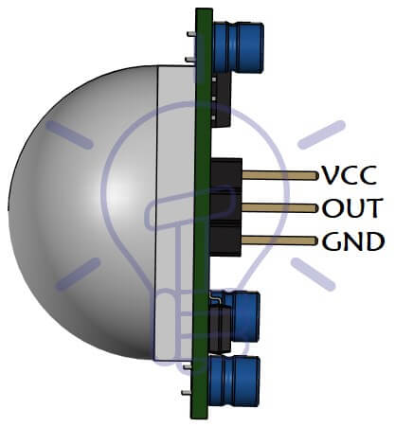

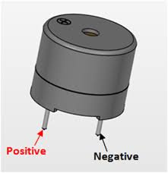

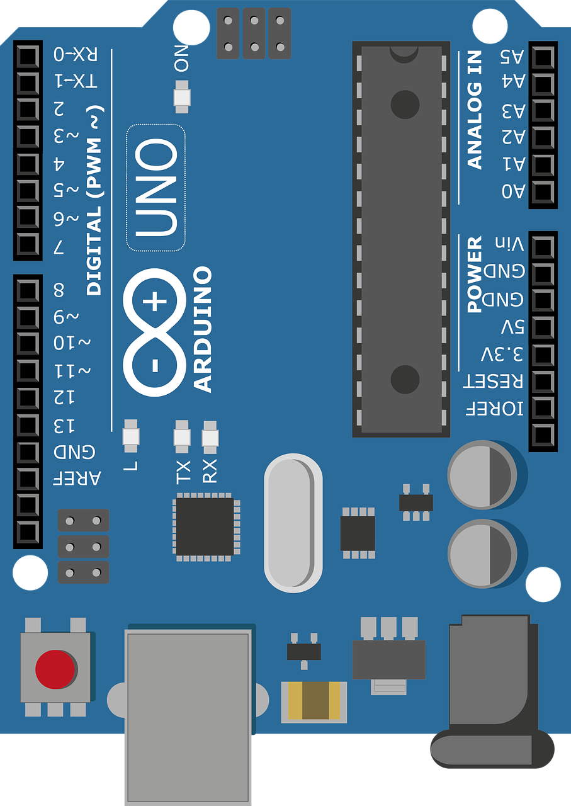
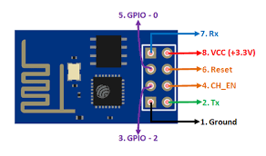
PIR sensor
Give input to Arduino
LED indicates, piezo detected something
6
4
3
GND
If out = HIGH, then Arduino Reads From PIR
Otherwise not
VCC
Buzzer(Output)
Buzz indicate-motion detected by PIR
1
Piezo-electric sensor
5
2
Direction of Understanding
7
Result
Sends email to Admin
Wi-Fi module sends data of PIR o/p to Thing speak cloud
Sends data to IFTTT
Email Service
IFTTT
Thing speak
10
9
8

Slide 2

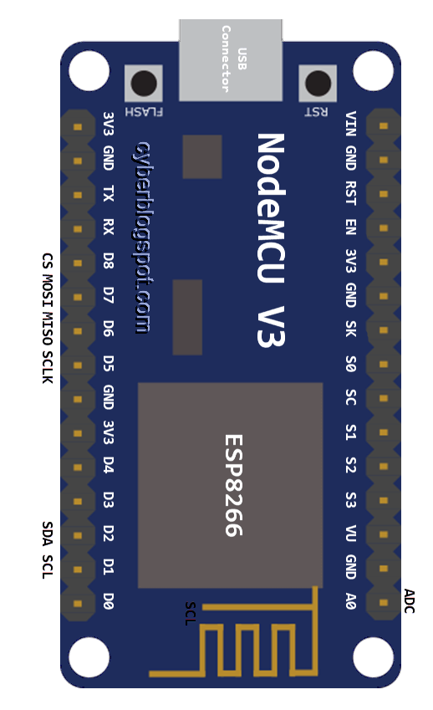
LED indicates, Motion detected by PIR
If o/p of PIR is HIGH, then piezo activates for detection, Otherwise deactivated
Sensor detects motion
1
4
PIR sensor
6
Piezo-electric sensor
3
Buzzer(Output)
Buzz indicate, piezo detected something.
2
5
Direction of Understanding
7
Result
Sends email to Admin
Wi-Fi module sends data of Piezo o/p to Thing speak cloud
Sends data to IFTTT
Email Service
IFTTT
Thing speak
10
9
8

Slide 3
PIR sensor
Give input to Arduino
LED indicates, piezo detected something
6
4
3
GND
If out = HIGH, then Arduino Reads From PIR
Otherwise not
VCC
Buzzer(Output)
Buzz indicate-motion detected by PIR
1
Piezo-electric sensor
5
2
Direction of Understanding
Result
Sends email to Admin
Wi-Fi module sends data of PIR o/p to Thing speak cloud
Sends data to IFTTT
Email Service
IFTTT
Thing speak
9
8
7

