Slide 1
Operations Analytics and Investigating Metric Spike
Using Microsoft SQL Server Management Studio

Slide 2
Description :-
This Project aims to understand and explain the sudden changes in key metrics, such as dip in daily user engagement or a drop in engagement backed by the data driven insights. We will be analyzing different data sets to derive meaningful insights from the data to answer questions posed by different departments within the company and support operational efficiency.

Slide 3
Approach to the Project
In this project, we will take a structured and analytical approach to solving business problems by leveraging SQL for data extraction, transformation, and analysis. The analysis is divided into 2 case studies : Case Study 1: Job Data Analysis
Jobs Reviewed Over Time
Throughput Analysis
Language Share Analysis
Duplicate Rows Detection
Additionally, the report includes actionable recommendations designed to enhance user engagement and support overall business growth.
Case Study 2: Investigating Metric Spike
Weekly User Engagement
User Growth Analysis
Weekly Retention Analysis
Weekly Engagement Per Device
Email Engagement Analysis

Slide 4
Tech-Stack used
Microsoft SQL Server Management Studio (SSMS 20.2.1) was utilized as the primary tool for this project, enabling efficient data import, transformation, and analysis. Its support for advanced analytics, in-memory processing, and robust security features made it ideal for handling complex datasets and queries involved in the Instagram user analytics project.
The intuitive and user-friendly interface of SSMS significantly enhanced productivity, allowing seamless execution of large queries and visualization of results. Additionally the smart features like IntelliSense and built-in code snippets, enhanced coding efficiency and reduced development time.
I tried using MySQL Workbench as well but since I installed it earlier on my system and removed it later on, so while attempting this project I was not able to use my root password, hence I left with no option then using MS SQL Server.

Slide 5
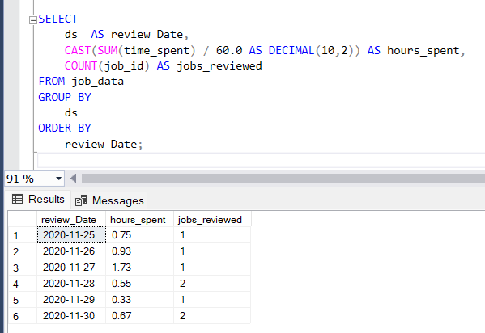
(A) Jobs Reviewed Over Time: The team wants to calculate the number of jobs reviewed per hour for each day in November 2020. The following query returns the total number of hours spent and aggregated job reviewed grouped by day.
These are the number of jobs reviewed and hours spent on each day.

Slide 6
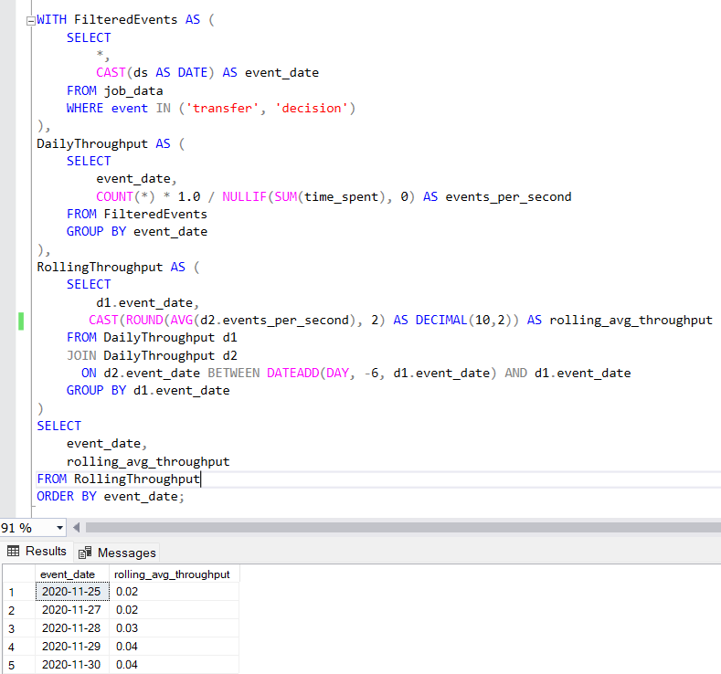
(B) Throughput Analysis: It measures the number of job actions occurring per second, giving insight for team efficiency. This is the 7 days average rolling throughput rate.

Slide 7
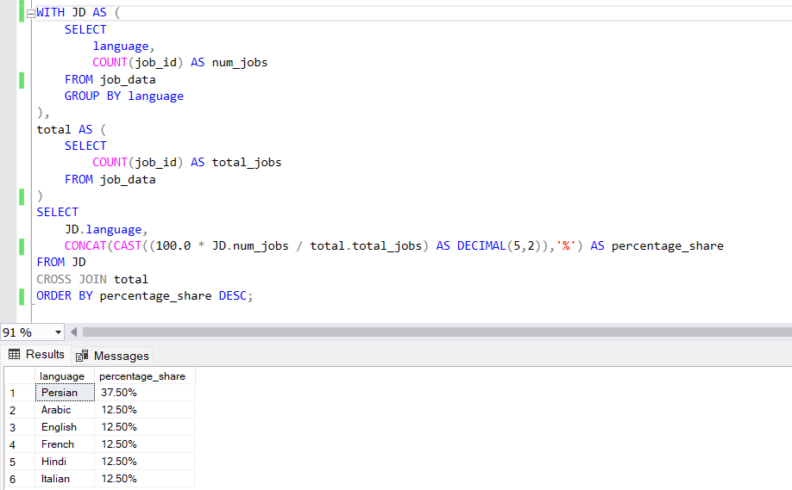
(C) Language Share Analysis: We want to see the percentage share of each language in the last 30 days.
Persian is the highest used language to view the content, holding 37.5% share highest among all.

Slide 8
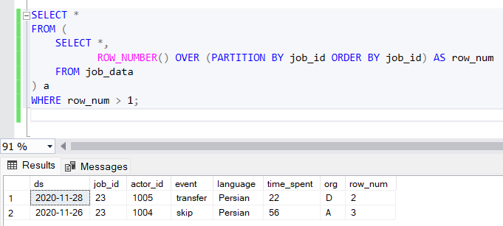
(D) Duplicate Records: We want to identify the duplicate records from our dataset, to ensure data integrity.
We only have 2 duplicate records in our dataset.

Slide 9
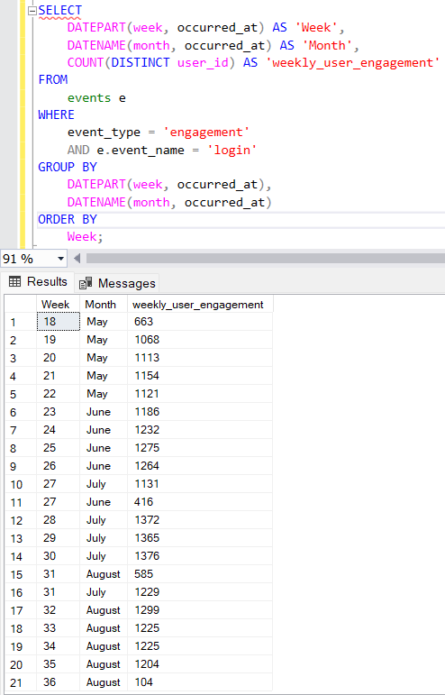
Case Study 2 : Investigating Metric Spike
(A) Weekly User Engagement: The team wants to measure the activeness of users on a weekly basis. This query returns the number of users engaged every week.
Count of unique active users each week.

Slide 10
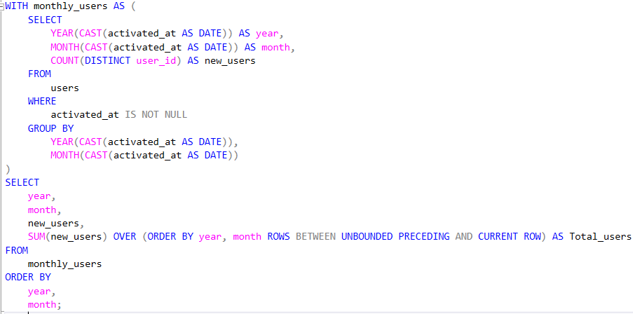
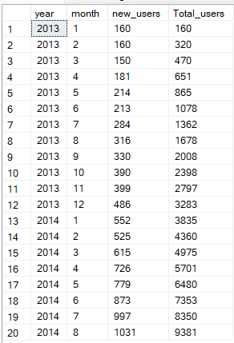
(B) User Growth Analysis: We want to analyze the growth of users over time for a product. The below mentioned query returns the newly registered users and the total number of users over time.
Query :-
Output :-

Slide 11
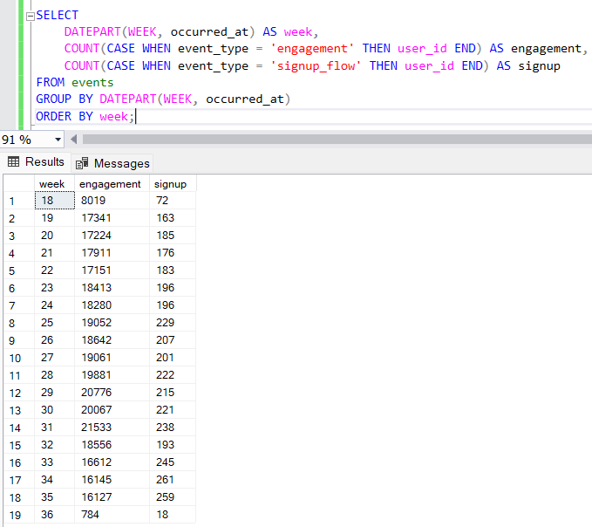
(C) Weekly Retention Analysis: Analyze the retention of users on a weekly basis after signing up for a product.
Total number of users engaged and signed up for a product

Slide 12
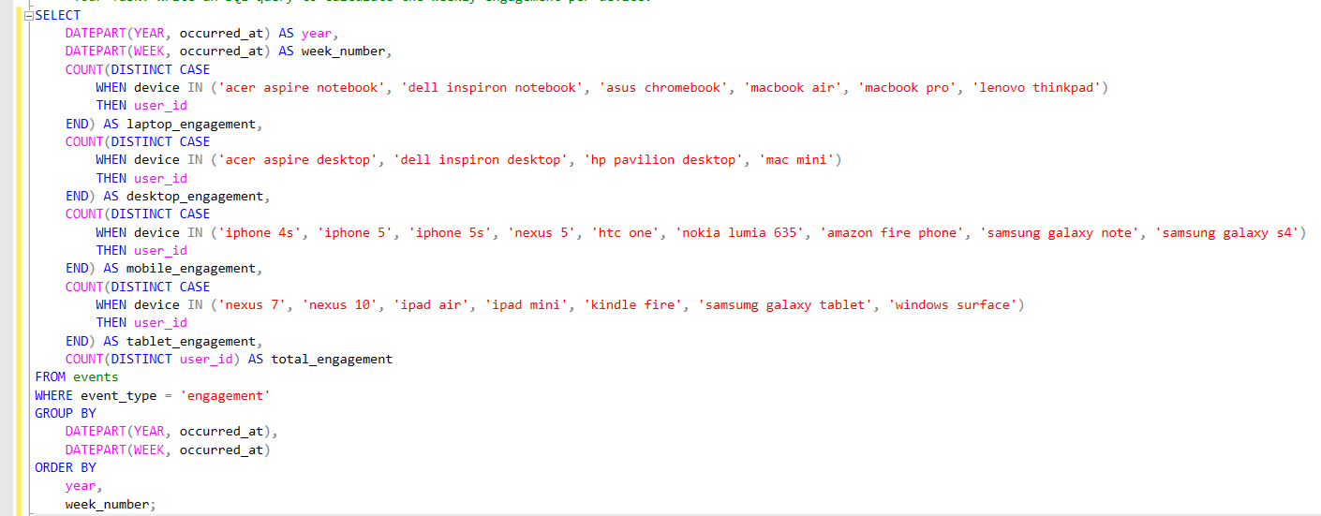
(D) Weekly Engagement Per Device: The team want to measure the activeness of users for each device per week. We have classified all the devices into 4 major categories

Slide 13
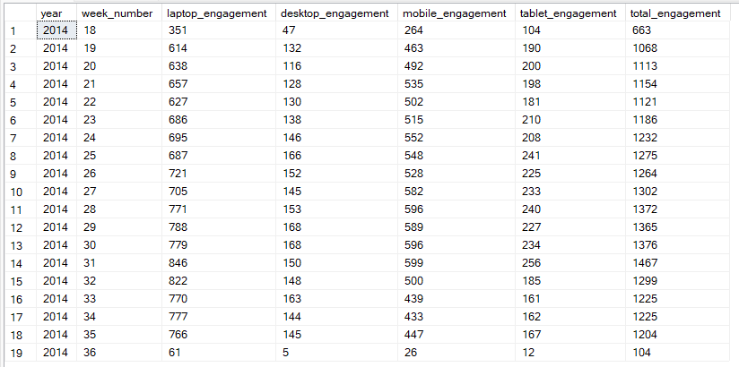
Result : We have classified all the devices into 4 major categories.
Laptop_engagement – All the laptops will fall under this category.
Desktop_engagement – All the desktops are included in this.
Mobile_enagement – All mobile devices are under this name.
Tablet_enagement – All the tablets will fall under this category.
Total _enagagement – This is the total number of engagement happened, combining all the categories.

Slide 14
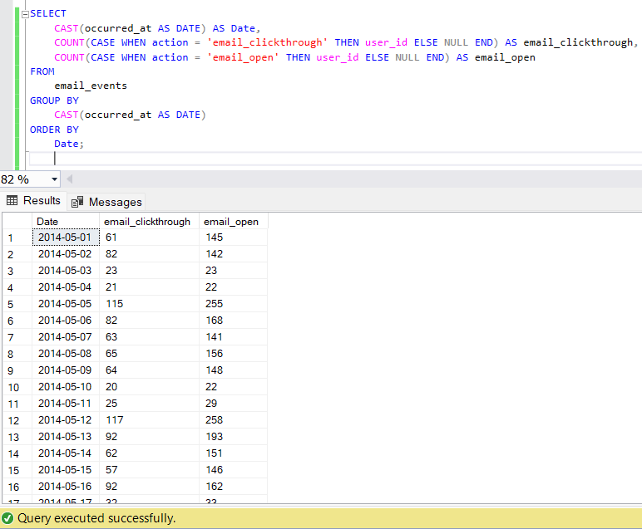
(E) Email Engagement Analysis: We want to measure the open and click-through email behavior among the users.

Slide 15
Key Findings from Case Study 1
Daily Job reviews Vs 7 Day rolling average: The throughput analysis reveals that while daily job review efficiency fluctuated, the 7-day rolling throughput remained relatively stable, indicating consistent team performance over time. This combination helps identify both short-term inefficiencies and long-term trends, enabling more informed decisions on resource allocation and process improvements.
Language preferences: Persian leads with a 37.5% share in job content usage over the last 30 days, indicating a significant user preference or audience concentration in Persian-speaking regions.
Date Integrity: The dataset contains only 2 duplicate job entries, indicating strong data integrity with minimal redundancy.

Slide 16
Key Findings from Case Study 2
Engagement weekly: Weekly user engagement showed a consistent upward trend from Week 18 to Week 30, peaking at 1,376 users. A sudden dip in Week 27 and in Week 36 indicate possible anomalies or seasonal effects.
Users growth over time: User acquisition has grown steadily since launch, with a clear upward trend in monthly signups. This suggests increasing product-market fit or effective marketing over time.
Engagement-to-signup: User engagement grew consistently the whole year with a strong Engagement-to-signup ratio, suggesting high retention
Engagement across devices: Laptop engagement is strong and stable, staying above 600 in most of the weeks, Total engagement increased steadily from week 18 (663) to week 34 (peaking at 1476 in week 34), before dropping sharply in week 36.
The email open rate is consistently higher than the click-through rate, which is expected—but also highlights room for improving email content or CTA effectiveness

Slide 17
Thank You

