Slide 1
CSS - Training

Slide 2
CSS Property - Background
Backgrounds - CSS background properties are used to add background effects for elements.
background-color
Background Image
Background-repeat
Background Shorthand
div { background-color: lightblue; }
div {background-image: url("bgWallppr.jpg"); }
body { background-image: url("img_tree.png"); background-repeat: no-repeat;
Background-size:100px 200px;
Background-size:cover; }
div {background: #ffffff url("img_tree.png") no-repeat;}

Slide 3
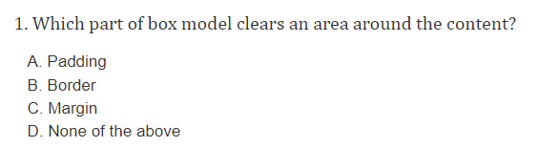
Question

Slide 4
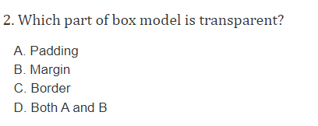
Question

Slide 5
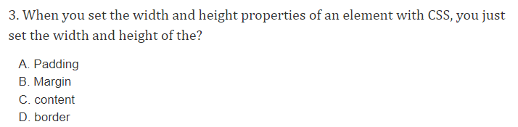
Question

Slide 6
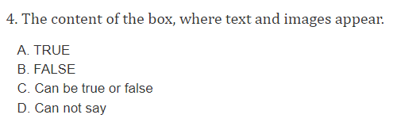
Question

Slide 7
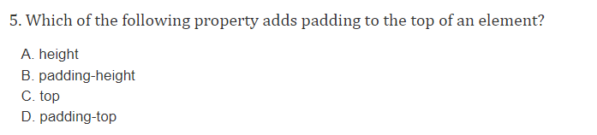
Question

Slide 8
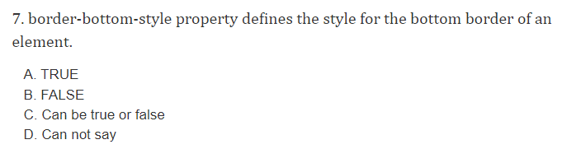
Question

Slide 9
CSS Property - Fonts
Fonts
font-family
font-style
font-weight
font-size
p {font-family: "Times New Roman", Times, serif; }
p {font-style: italic;}
p {font-weight: bold;}
p {font-size: 14px;}

Slide 10
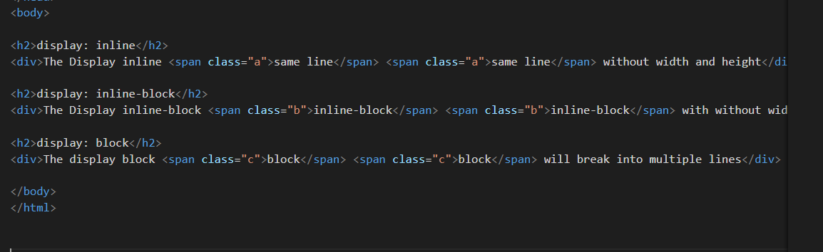
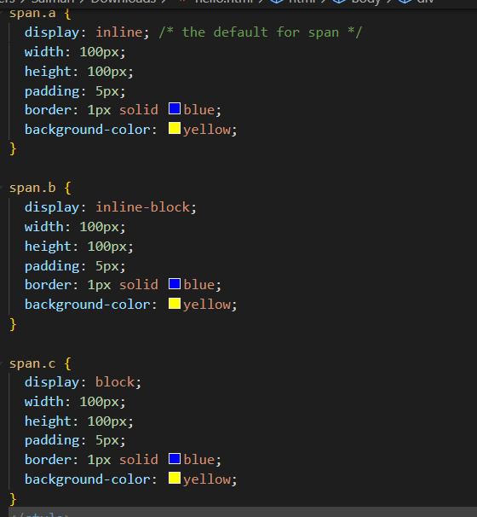
Display:inline,display:inline-block,display:block

Slide 11
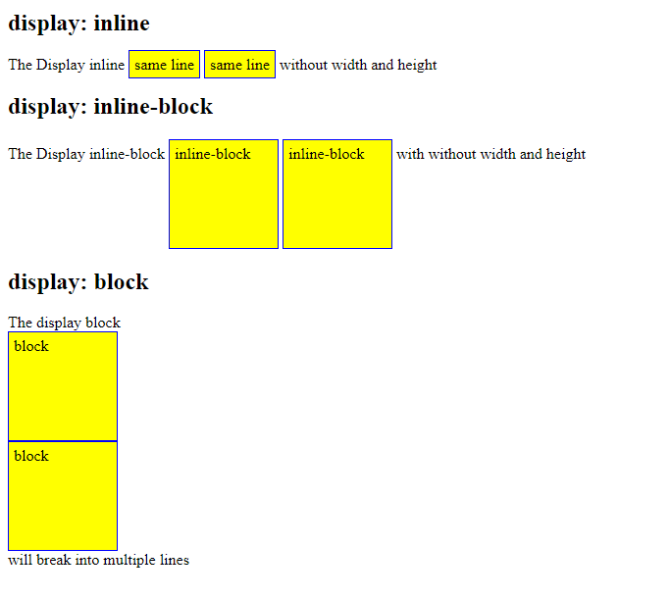
Display:inline,display:inline-block,display:block

Slide 12
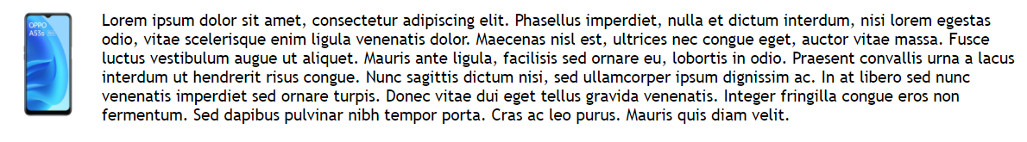
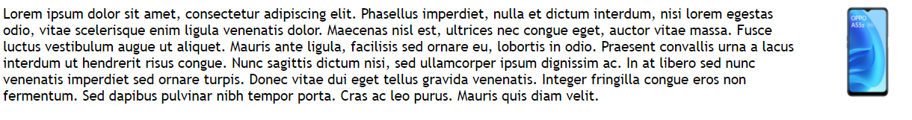
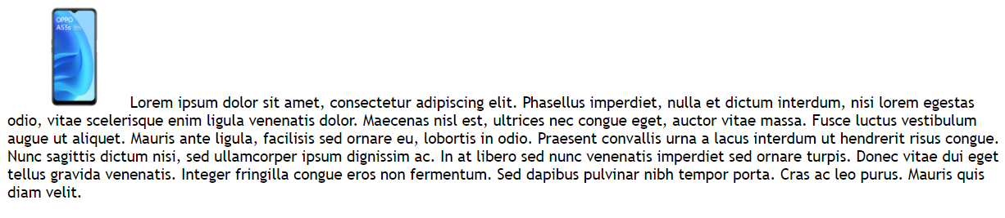
CSS Property - Float
Float - The CSS float property specifies how an element should float.
float: left
float: right
float: none
img {
float: left;
}
img { float: right; }
img { float: none; }

Slide 13

CSS – Navigation using List
Horizontal Navigation bar
ul {
list-style-type: none;
margin: 0;
padding: 0;
background-color: #E7E9EB;
}
li {
float: left;
}
li a {
display: block;
color: black;
text-align: center;
padding: 14px 16px;
text-decoration: none;
}
li a:hover {
background-color: #04AA6D;
}
.active {
background-color: #04AA6D;
}
<ul> <li><a class="active" href=“home.html">Home</a></li> <li><a href=“news.html">News</a></li> <li><a href="contact.html">Contact</a></li> <li><a href="about.html">About</a></li> </ul>

