Slide 1
HTML-CSS – Mini-project

Slide 2
Header Menu

Slide 3

Main Section

Slide 4
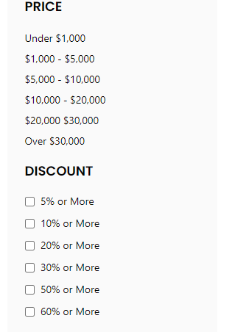
SideMenu

Slide 5
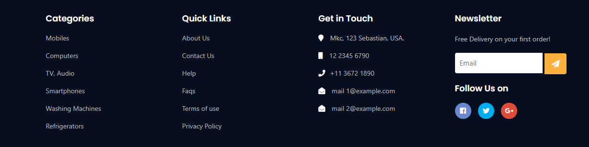
Footer

