Slide 1
CSS - Training

Slide 2
Agenda
CSS Introduction
CSS Syntax understanding
CSS Selectors
Different Ways of Applying CSS in HTML
CSS Properties – Deep Dive
Building Various Navigation List
Styling HTML Forms

Slide 3
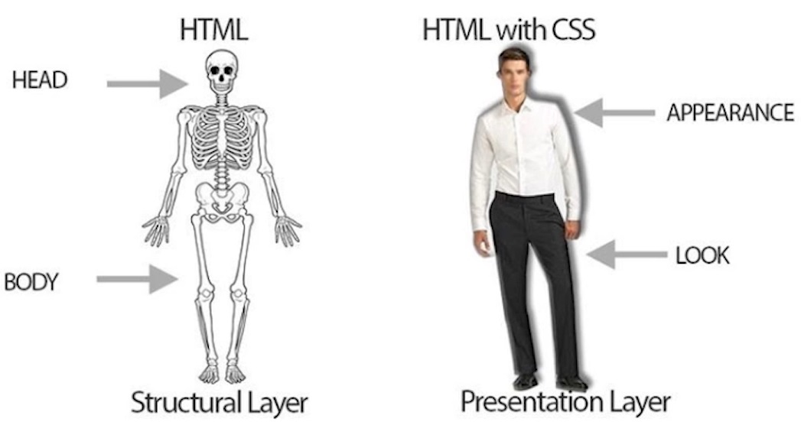
What is CSS?
CSS stands for Cascading Style Sheets.
It is used to style HTML documents to make it good looking.
Turn ordinary black & white page into colorful one.
Can make webpage as a Responsive one.

Slide 4
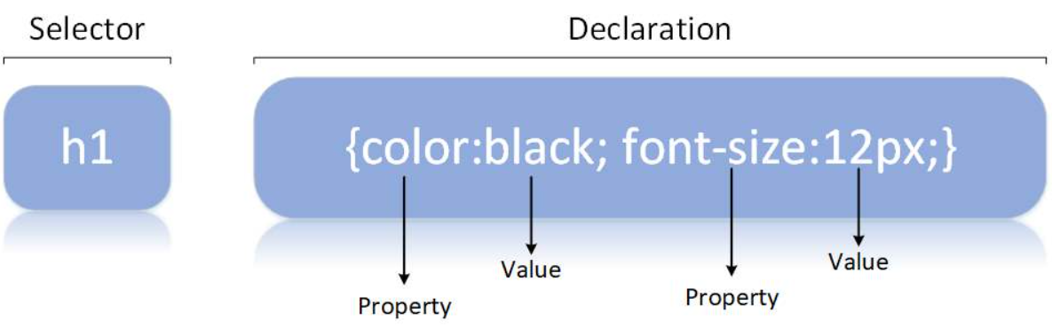
CSS Syntax
A CSS rule consists of a selector and a declaration block.
The selector points to the HTML element you want to style.
The declaration block contains one or more declarations separated by semicolons.

Slide 5
Different Ways of Adding CSS
There are three ways of inserting a style sheet:
External CSS (in the head section)
Internal CSS (in the head section)
Inline CSS (inside an HTML element)
External CSS :
With an external style sheet, you can change the look of an entire website by changing just one file
<!DOCTYPE html> <html> <head> <link rel="stylesheet" href="mystyle.css"> </head> <body> </body> </html>

Slide 6
Different Ways of Adding CSS
Intenal CSS :
An internal style sheet may be used if one single HTML page has a unique style.
The internal style is defined inside the <style> element, inside the head section.
<html> <head> <style> body { background-color: linen; } h1 { color: maroon; margin-left: 40px; } </style> </head> <body> <h1>This is a heading</h1> <p>This is a paragraph.</p> </body> </html>

Slide 7
Different Ways of Adding CSS
Inline CSS :
An inline style may be used to apply a unique style for a single element, to use inline styles, add the style attribute to the relevant element.
<!DOCTYPE html> <html> <body> <h1 style="color:blue;text-align:center;">This is a heading</h1> <p style="color:red;">This is a paragraph.</p> </body> </html>

Slide 8
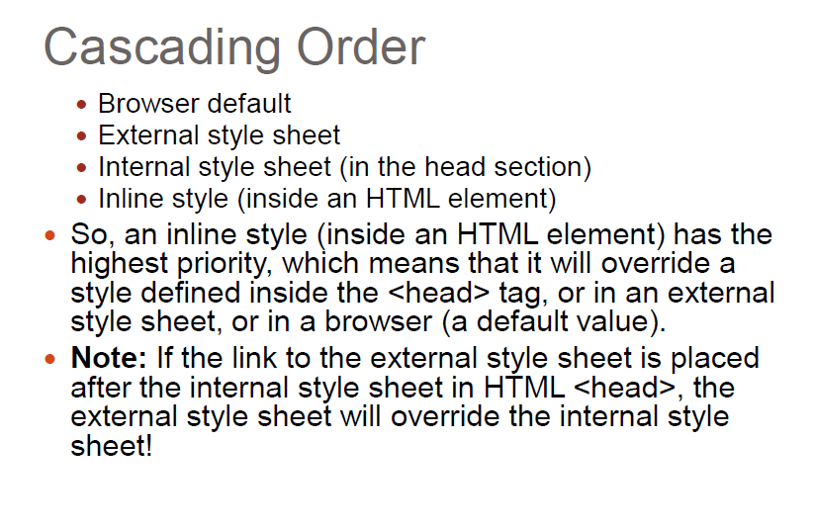
CSS Order

Slide 9
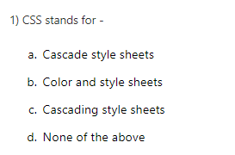
Question

Slide 10
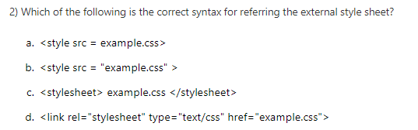
Question

Slide 11
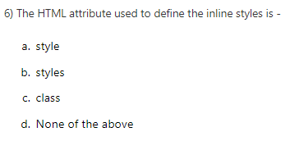
Question

Slide 12
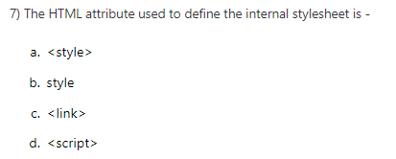
Question

Slide 13
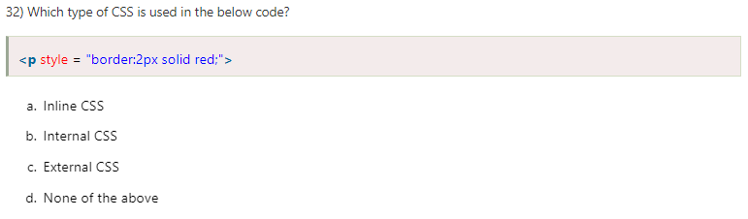
Question

Slide 14
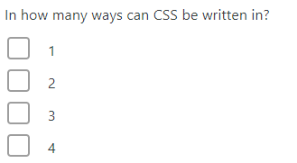
Question

Slide 15
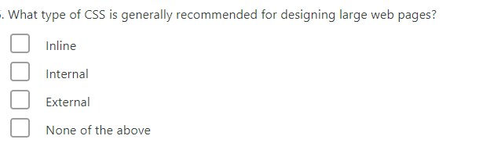
Question

Slide 16
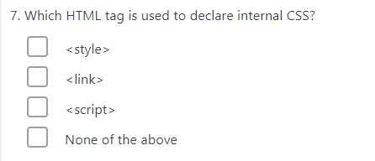
Question

Slide 17
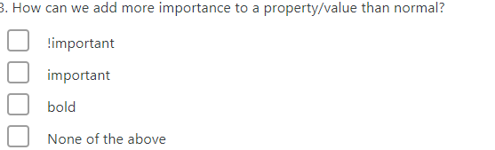
Question

Slide 18
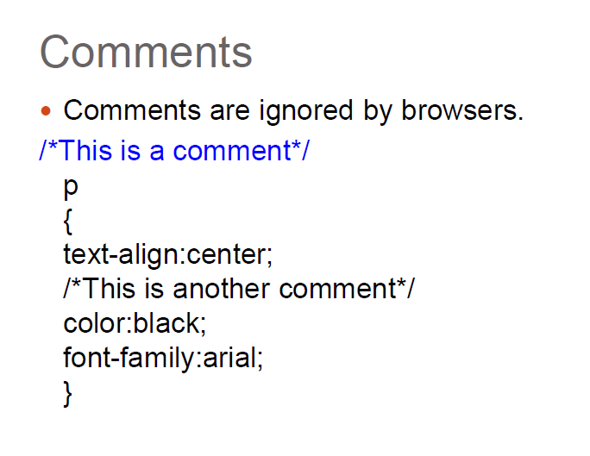
CSS Comment

