Slide 1
Introduction to REGULAR EXPRESSION
SALMAN AHMED G

Slide 2
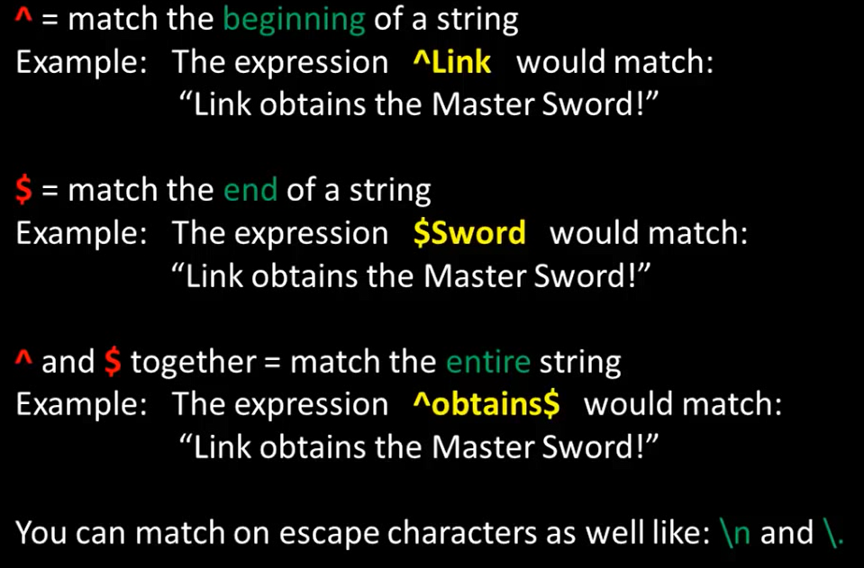
BASIC MATCH

Slide 3
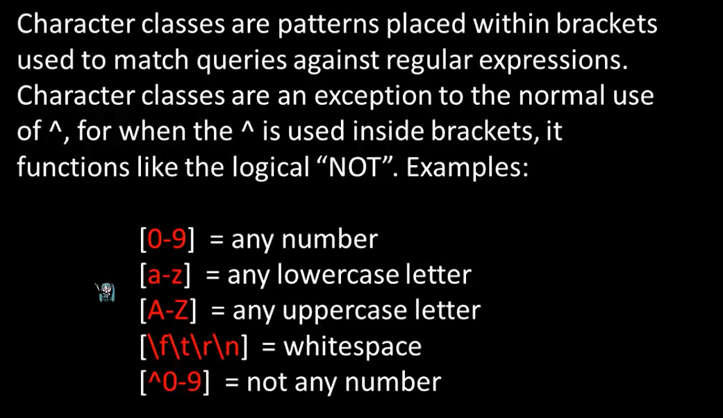
CHARACTER CLASS

Slide 4
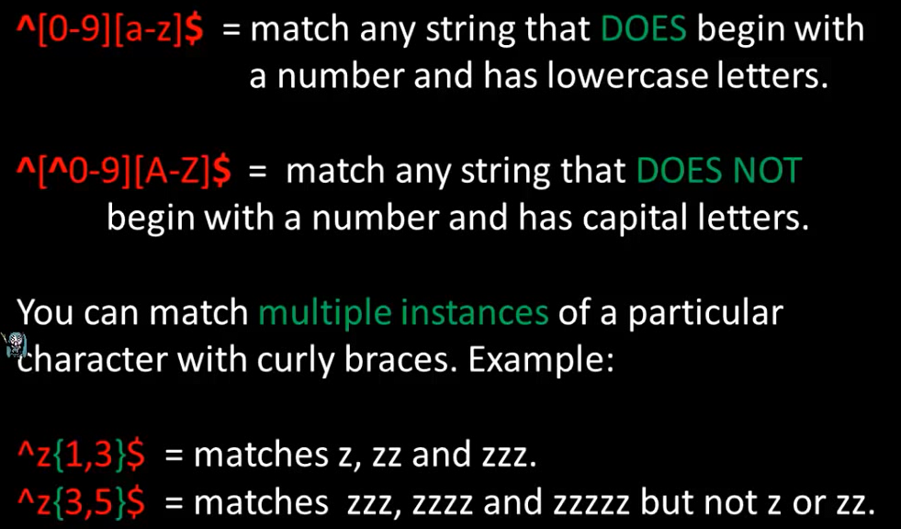
CHARACTER CLASS

Slide 5
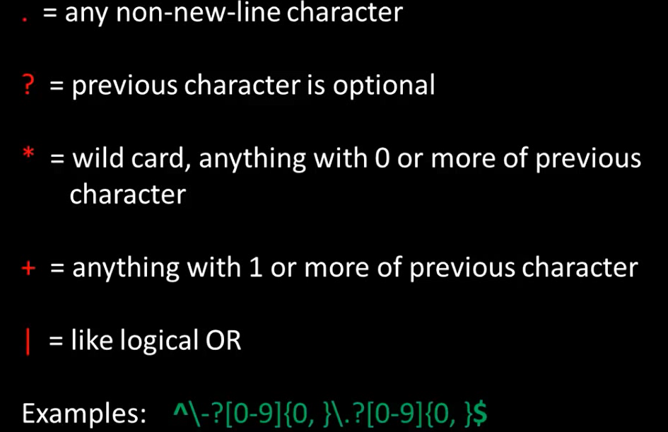
SPECIAL PATTERN CHARACTERS

Slide 6
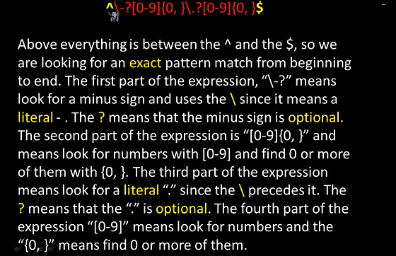
EXAMPLE:

Slide 7
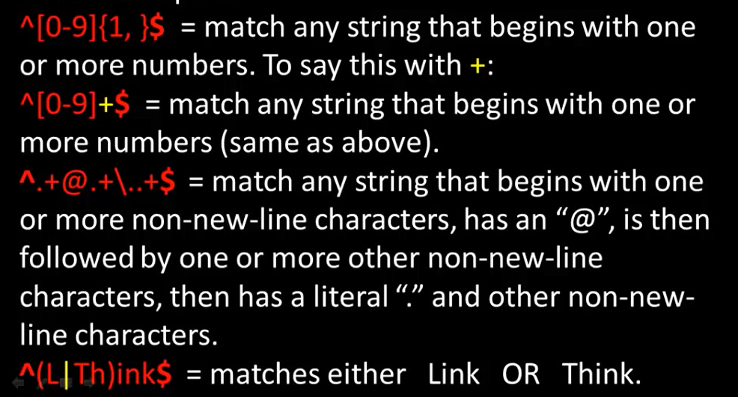
EXAMPLE

Slide 8
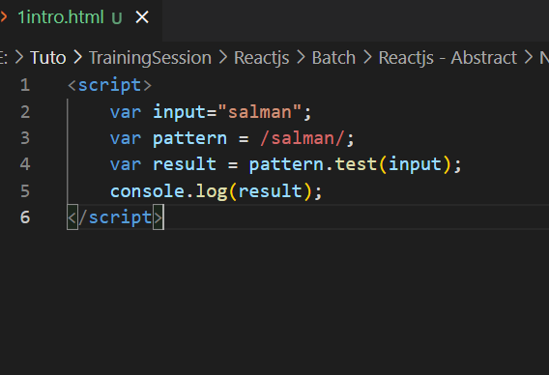
Js code example

Slide 9

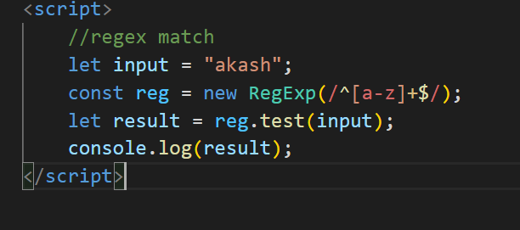

Slide 10
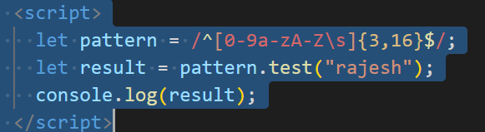
firstName and LastName validation

Slide 11
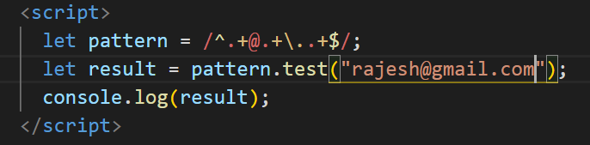
Email validation

Slide 12
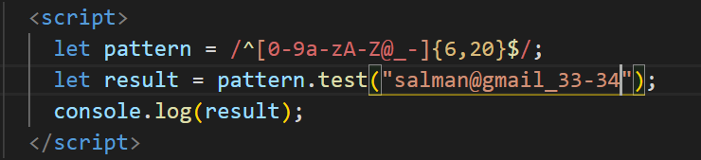
Password validation

Slide 13
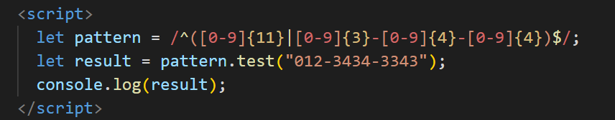
Phone number validation

Slide 14
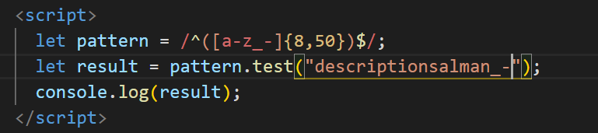
Description

