Slide 1
Event Listener

Slide 2
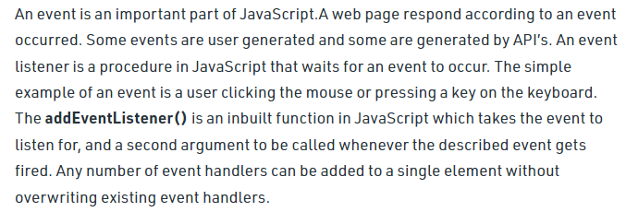
Event

Slide 3

Event

Slide 4
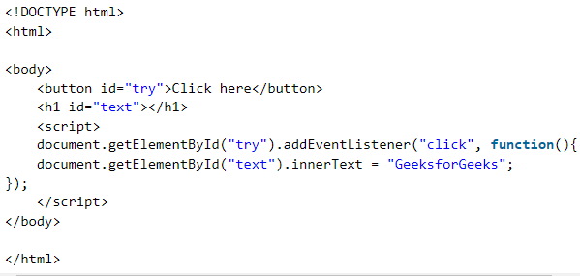
Event

Slide 5
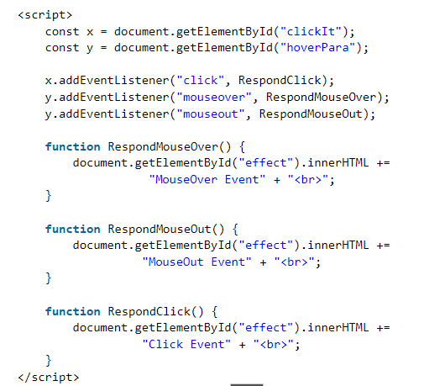
Event

Slide 6

Event

