Slide 1


HTML 5 - Training

Slide 2

Agenda
Web Introduction
Client-side Technologies overview
Application Architecture
HTML Introduction
HTML Elements deep dive
HTML Input Elements
HTML Element Specific Attributes
HTML Forms & its Attributes
www.credosystemz.com © Copyright 2021 | credosystemz | All Rights Reserved

Slide 3
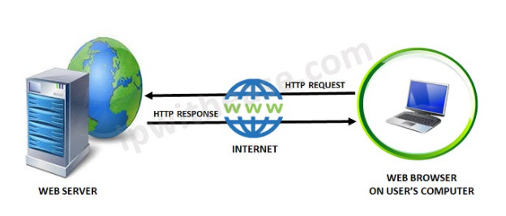
What is Web?
The Web is the common name for the World Wide Web (WWW)
The Web is just one of the ways that information is shared over the Internet.
The Web consisting of the pages that can be accessed by a Web browser such as Internet Explorer, Google Chrome, Mozilla Firefox
Web pages are formatted in a language called HTML.
The Web uses HTTP protocol to transmit data and share information.
www.credosystemz.com © Copyright 2021 | credosystemz | All Rights Reserved

Slide 4
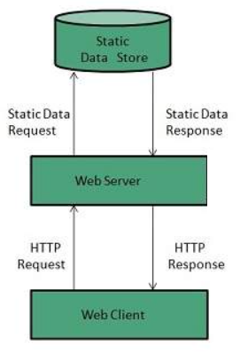
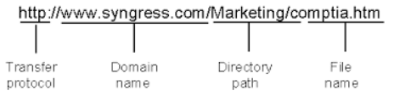
What is Web Server?
Web server is a computer where the web content is stored
Web server is used to host the web sites
When client sends request for a web page, the web server search for the requested page if requested page is found then it will send it to client with an HTTP response.
www.credosystemz.com © Copyright 2021 | credosystemz | All Rights Reserved

Slide 5
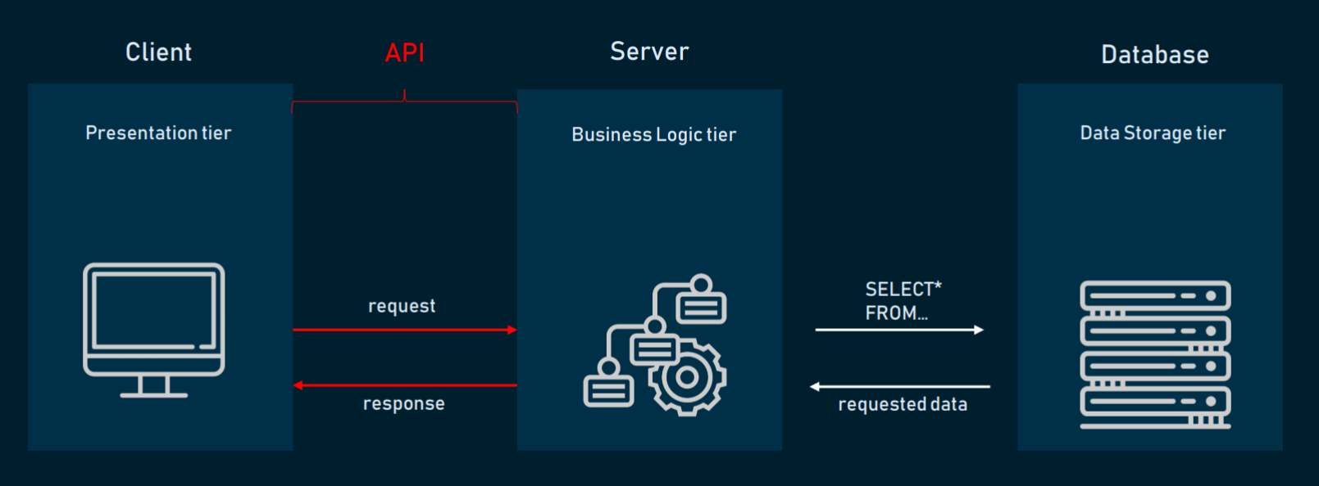
Application Architecture
HTML, CSS, JavaScript, Angular
www.credosystemz.com © Copyright 2021 | credosystemz | All Rights Reserved

Slide 6
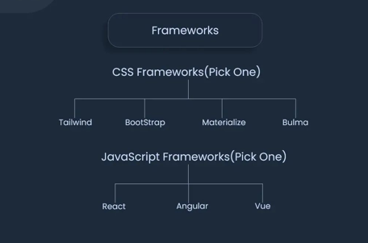
FRONTEND FRAMEWORKS

Slide 7
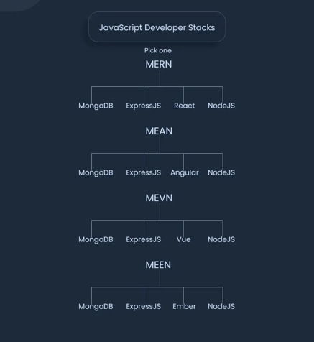
JAVASCRIPT FRAMEWORKS

Slide 8
What is HTML?
HTML (HyperText Markup Language) is the most basic building block of the Web.
HTML describes the structure of a Web page.
HTML consists of a series of elements.
HTML elements tell the browser how to display the content.
HTML elements are represented by tags.
HTML tags label pieces of content such as "heading", "paragraph", "table", and so on.
Browsers do not display the HTML tags, but use them to render the content of the page
www.credosystemz.com © Copyright 2021 | credosystemz | All Rights Reserved

Slide 9
What is Hypertext & Markup?
Hypertext is a text which references to other text.
Hypertext means machine readable text and Markup means to structure it in a specific format.
So, HTML is called hypertext markup language because it is a language that allows users to organize, improve the appearance of, and link text with data on the internet.
www.credosystemz.com © Copyright 2021 | credosystemz | All Rights Reserved

Slide 10
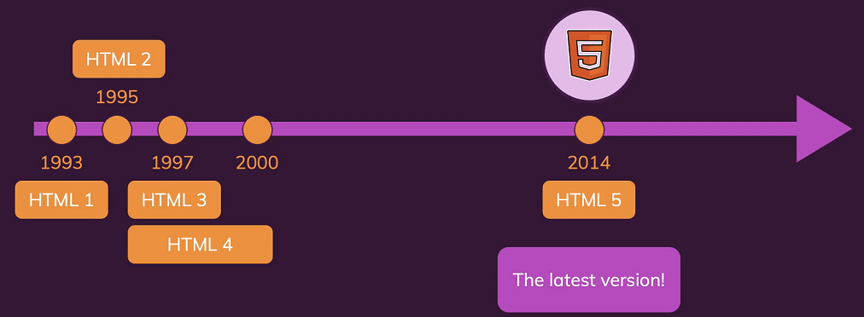
History of HTML
www.credosystemz.com © Copyright 2021 | credosystemz | All Rights Reserved

Slide 11
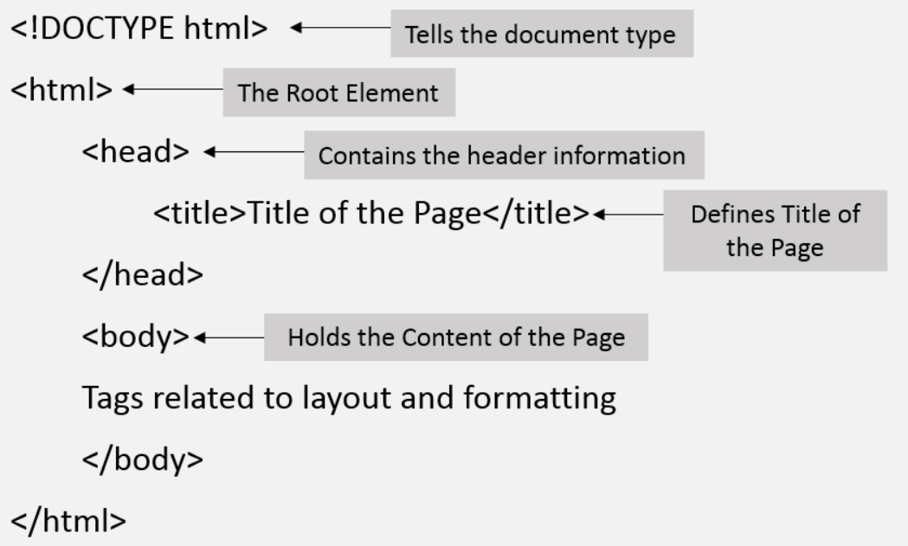
Structure of HTML
www.credosystemz.com © Copyright 2021 | credosystemz | All Rights Reserved

Slide 12
HTML – Head Tag Containers
The Head Element
Title tag
Style tag
Link tag
Script tag
Meta tag
www.credosystemz.com © Copyright 2021 | credosystemz | All Rights Reserved

Slide 13
Structure of HTML continue..
The Head Element
The <head> element is a container for metadata and is placed between the <html> tag and the <body> tag.
HTML metadata is data about the HTML document.
Metadata typically define the document title, character set, styles, scripts, and other meta information.
The <title> Element
The <title> element defines the title of the document.
Defines a title in the browser toolbar
Provides a title for the page when it is added to favorites
Displays a title for the page in search engine-results
www.credosystemz.com © Copyright 2021 | credosystemz | All Rights Reserved

Slide 14
HTML Body Tags
Heading Tags - <h1>, <h2>, <h3>, <h4>, <h5>, <h6> tags.
Paragraph Tag - <p> tag.
Horizontal ruler - <hr> tag.
Anchor(Link) Tag - <a> (anchor) tag.
List Tag - <ul> (unordered list), <ol> (ordered list) and <li> (list element) tags.
Image Tag - <img> tag
Divider, denoted using the <div> tag
Text span, denoted using the <span> tag
www.credosystemz.com © Copyright 2021 | credosystemz | All Rights Reserved

Slide 15
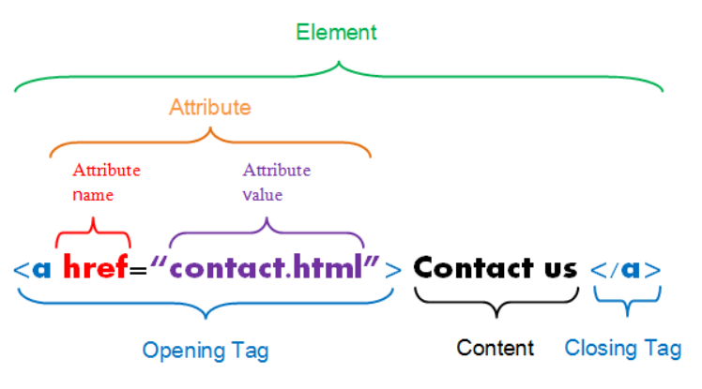
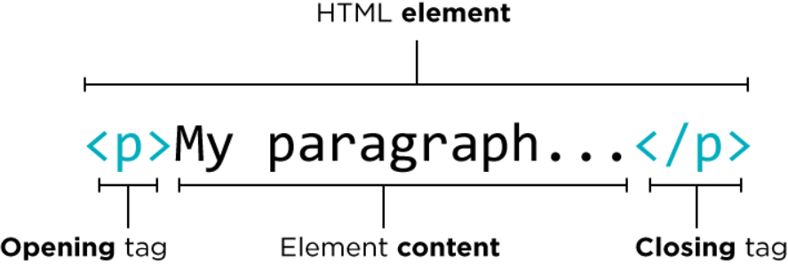
HTML Element, Tag & Attribute
www.credosystemz.com © Copyright 2021 | credosystemz | All Rights Reserved

Slide 16
HTML Elements
HTML Headings
HTML headings are defined with the <h1> to <h6> tags.
<h1> defines the most important heading. <h6> defines the least important heading.
HTML Paragraphs
HTML paragraphs are defined with the <p> tag.
<h1>This is heading 1</h1> <h2>This is heading 2</h2> <h3>This is heading 3</h3>
15hrs
<p>This is a paragraph.</p>
<p>This is another paragraph.</p>
www.credosystemz.com © Copyright 2021 | credosystemz | All Rights Reserved

Slide 17

HTML Elements continue..
HTML Links
Use the <a> element to define a link
Use the href attribute to define the link address
Use the target attribute to define where to open the linked document
Use the <img> element (inside <a>) to use an image as a link
HTML Images
Use the HTML <img> element to define an image.
Use the HTML src attribute to define the URL of the image.
Use the HTML alt attribute to define an alternate text for an image, if it cannot be displayed.
Use the HTML width and height attributes to define the size of the image
15hrs
<a href="https://www.credosystemz.com">This is a link</a>
<img src="credologo.jpg" alt="credosystemz.com" width="104" height="142">
www.credosystemz.com © Copyright 2021 | credosystemz | All Rights Reserved

