Slide 1


HTML 5 - Training

Slide 2

HTML Elements continue..
HTML Links
Use the <a> element to define a link
Use the href attribute to define the link address
Use the target attribute to define where to open the linked document
Use the <img> element (inside <a>) to use an image as a link
HTML Images
Use the HTML <img> element to define an image.
Use the HTML src attribute to define the URL of the image.
Use the HTML alt attribute to define an alternate text for an image, if it cannot be displayed.
Use the HTML width and height attributes to define the size of the image
15hrs
<a href="https://www.credosystemz.com">This is a link</a>
<img src="credologo.jpg" alt="credosystemz.com" width="104" height="142">
www.credosystemz.com © Copyright 2021 | credosystemz | All Rights Reserved

Slide 3

HTML Elements continue..
HTML Lists
HTML lists are defined with the <ul> (unordered/bullet list) or the <ol> (ordered/numbered list) tag, followed by <li> tags (list items):
<ul> <li>Coffee</li> <li>Tea</li> <li>Milk</li> </ul>
<ol> <li>Coffee</li> <li>Tea</li> <li>Milk</li> </ol>
www.credosystemz.com © Copyright 2021 | credosystemz | All Rights Reserved

Slide 4
Main Categories of Elements and Attributes
The main categories of elements are mentioned below:
Block level elements :
<div>, <p>, <h1> to <h6>, <form>, <table> etc.,
Inline elements :
<img>, <a>, <span>, <input> etc.,
Attributes:
Attributes are something which give the additional information of the element.
Ex. name, width, height, alt, title, href, id, class, etc.,
www.credosystemz.com © Copyright 2021 | credosystemz | All Rights Reserved

Slide 5
HTML Block and Inline Elements
Every HTML element has a default display value, depending on what type of element it is.
There are two display values: block and inline.
Block-level Elements:
A block-level element always begins a new line on a web page.
It extends the full width of the available horizontal space of its parent element.
A block level element has a top and a bottom margin, whereas an inline element does not.
Eg: <div></div>
www.credosystemz.com © Copyright 2021 | credosystemz | All Rights Reserved

Slide 6
HTML Block and Inline Elements continue..
Inline Elements
An inline element does not start on a new line.
An inline element only takes up as much width as necessary.
Eg: <span></span>
Note: An inline element cannot contain a block-level element!
www.credosystemz.com © Copyright 2021 | credosystemz | All Rights Reserved

Slide 7
Empty HTML Elements
HTML elements with no content are called empty elements.
Line Break Tag
<br> is an empty element without a closing tag (the <br> tag defines a line break).
<p>This is a <br /> paragraph with a line break.</p>
Horizontal Lines
Horizontal lines are used to visually break-up sections of a document.
<p>This is paragraph one and should be on top</p>
<hr />
<p>This is paragraph two and should be at bottom</p>
www.credosystemz.com © Copyright 2021 | credosystemz | All Rights Reserved

Slide 8
Formatting Elements
HTML <b> Tag
The <b> tag specifies bold text without any extra importance.
<p>This is normal text - <b>and this is bold text</b>.</p>
HTML <i> Tag
The content of the <i> tag is usually displayed in italic.
The <i> tag can be used to indicate a technical term, a phrase from another language, a thought, etc.
<p>He named his car <i>The lightning</i>, because it was very fast.</p>
www.credosystemz.com © Copyright 2021 | credosystemz | All Rights Reserved

Slide 9
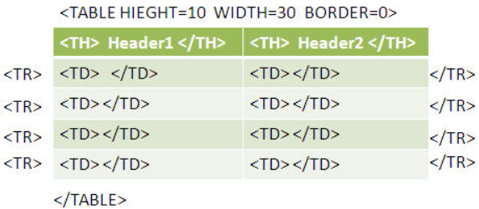
HTML Elements continue..
HTML <table> Tag
An HTML table consists of the <table> element and one or more <tr>, <th>, and <td> elements.
The <tr> element defines a table row, the <th> element defines a table header, and the <td> element defines a table cell.
<table> <tr> <th>Month</th> <th>Savings</th> </tr> <tr> <td>January</td> <td>$100</td> </tr> </table>
www.credosystemz.com © Copyright 2021 | credosystemz | All Rights Reserved

