Slide 1

FORECASTING STUDENT
ACADEMIC PERFORMANCE:
A FORMAL APPROACH
UTILIZING LINEAR
REGRESSION MODEL

Slide 2

INTRODUCTION
Welcome to the presentation
on Forecasting Student
Academic Performance using
Linear Regression Model.
This formal approach aims to
analyze the relationship
between independent
variables and academic
performance.

Slide 3
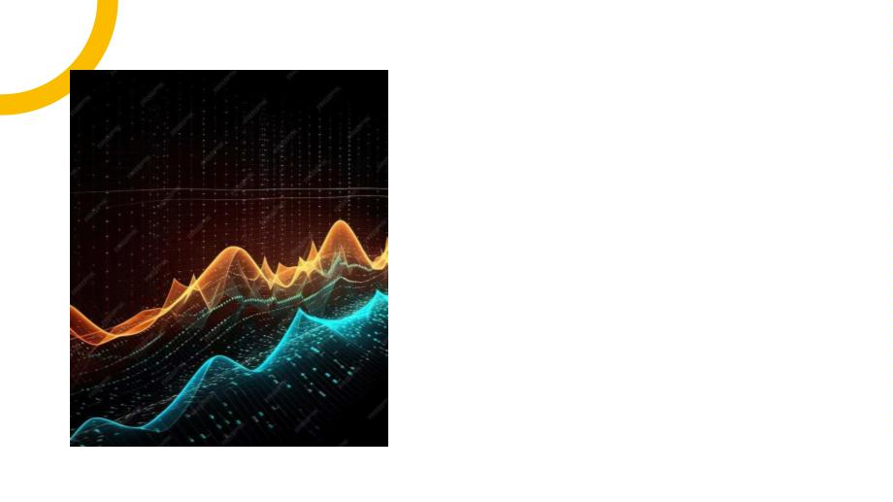
UNDERSTANDING LINEAR
REGRESSION
In this section, we will delve
into the concept of Linear
Regression and its
signiﬁcance in predictive
modeling. The focus will be
on the relationship between
variables and forecasting
accuracy.

Slide 4

DATA COLLECTION AND
PREPROCESSING
This slide will cover the crucial
steps of data collection and
preprocessing. Emphasis will
be on data integrity and
cleaning techniques to
ensure accurate model
training.

Slide 5

FEATURE SELECTION AND
ENGINEERING
Here, we will discuss the process
of feature selection and
engineering to identify the
most inﬂuential variables. The
goal is to optimize the model's
predictive power.

Slide 6

Model Training and Evaluation
This section will focus on the
training and evaluation of the
Linear Regression model. We
will explore model performance
metrics and validation
techniques.

Slide 7

INTERPRETING MODEL
RESULTS
In this slide, we will interpret the
coefﬁcients and signiﬁcance of
variables in the model. The goal
is to gain insights into the
factors inﬂuencing student
academic performance.

Slide 8
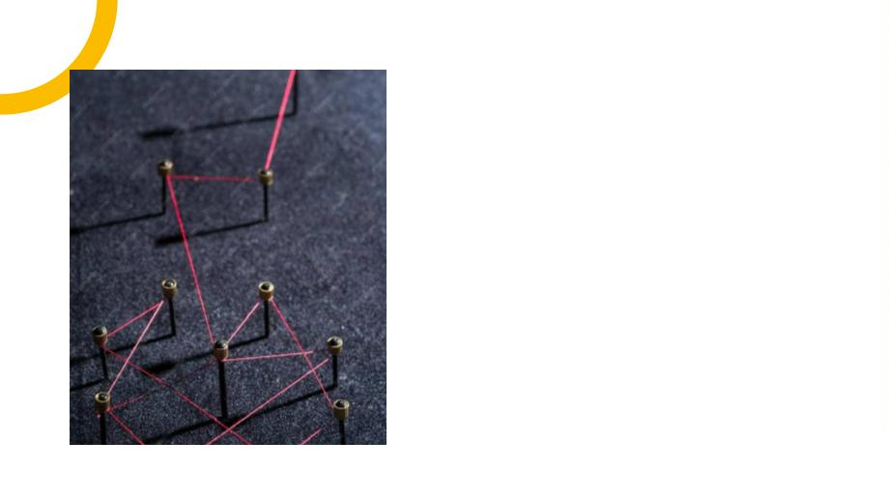
CHALLENGES AND
LIMITATIONS
This section will address the
challenges and limitations of
using Linear Regression for
academic performance
forecasting. We will highlight
the importance of caution in
interpretation.

Slide 9

FUTURE RESEARCH AND
APPLICATIONS
Here, we will explore potential
future research directions
and practical applications of
the formal approach. The
focus will be on advancing
predictive models for
academic institutions.

Slide 10

IMPLICATIONS FOR
ACADEMIC INSTITUTIONS
This slide will discuss the
implications of the formal
approach on academic
institutions. We will
emphasize the potential for
improving student support
and resource allocation.

Slide 11

CONCLUSION
In conclusion, the formal approach utilizing Linear
Regression Model offers valuable insights into
forecasting student academic performance. The
potential for data-driven decision-making in
education is substantial.

